Slide 1
Describing audiovisual materials
AV materials pose unique descriptive challenges, especially when they comprise a small component of mixed collections that may also include books, paper-based records, artwork or museum objects. In many cases, AV materials are minimally cataloged using the descriptive standards and systems already in place for the collections that predominate—or simply not cataloged at all. (We can all probably bring to mind at least one finding aid that includes an entry like “Box 31: Miscellaneous film and video material.”)
How can we do better?

Slide 2
Working within existing systems
Some of the key descriptive challenges common for AV materials have analogies in other kinds of collections that can help accommodate them in descriptive frameworks designed for those material. For example…
Part/whole relationships → Multi-volume sets of books; multi-page letters; triptychs or pendant paintings
Multiple versions → Editions and translations; adaptations of a novel for screen and stage
Pre-print elements → Authors’ drafts and notes; sketches and models for finished artworks or building projects
Derivatives and multiple copies → Editioned artworks; negatives and prints in photographic collections; anthologies and collected writings

Slide 3
AV cataloging* & metadata guides
These resources offer a sort of AV cataloging evolutionary history:
Archival Moving Image Materials: A cataloging manual (AMIM)
http://www.loc.gov/catdir/cpso/amimcovr.html
Originally published in 1984, updated 1999; based on AACR2
AMIA Compendium of Moving Image Cataloging Practice (published in 2001 by SAA; now out of print)
Demonstrates variations in descriptive practice across many collections
FIAF Cataloguing Rules & Moving Image Cataloguing Manual (2016)
http://www.fiafnet.org/pages/E-Resources/Cataloguing-Manual.html
Significant revision of the 1991 FIAF Cataloguing Rules for Film Archives
*It doesn’t matter whether you spell it catalogue or catalog. Just be consistent!

Slide 4
“The object in hand” vs. “the work”
Bibliographic description originally focused on “describing the object in hand”—classically, a physical copy of a book that was part of a library collection. AACR2 and AMIM rules were based on this framework. As library collections increasingly grew to incorporate electronic materials and other, trickier forms of information resources, that paradigm shifted. In 1998 the International Federation of Library Associations (IFLA) published Functional Requirements for Bibliographic Records (FRBR). This approach to description sought to contextualize information resources and enable searchers to follow links between creators, works, and objects…rather than just identify and locate a particular volume.
https://www.ifla.org/publications/functional-requirements-for-bibliographic-records

Slide 5
The FRBR framework: Entities to items
FRBR establishes three groups of entities, which are non-hierarchical:
Group 1: Products of intellectual or artistic endeavor
Group 2: People or corporate bodies that create those products
Group 3: Subjects of artistic or intellectual products
Group 1 entities have a further set of hierarchical subdivisions:
Work: A distinct intellectual or artistic creation (ex: Star Wars (1977))
Expression: The realization of that work (ex: original theatrical version)
Manifestation: Physical embodiment of the expression (ex: a release print)
Item: A single exemplar of the manifestation (ex: a 35mm Tech IB copy)

Slide 6
Resource Description & Access (RDA)
In 2010, the American Library Association, Canadian Federation of Library Associations, and CILIP: Chartered Institute of Library and Information Professionals jointly published the RDA standard. RDA continues to be overseen and maintained by an inter-agency steering committee.
RDA was created to succeed the AACR2 rules as the international standard for library cataloging. It incorporates aspects of FRBR and EN15907, which is the metadata schema for cinematographic works ratified by the European Standards Committee (CEN) in 2010. Resources developed to support RDA adoption by collections worldwide include the RDA Toolkit and detailed mapping to widely used existing standards, such as MARC 21.
https://www.oclc.org/en/rda/about.html, https://www.rdatoolkit.org/

Slide 7
Broadcasting-specific metadata schema
In addition to the work done by the library and film archive communities to develop new descriptive standards based on FRBR core concepts and the Resource Description Framework (RDF), broadcasting communities in the US and Europe have developed two additional metadata schema specifically for use in settings where media assets are managed for production and circulation.
EBUCore: “framework for descriptive and technical metadata for use in service orientated architectures and audiovisual ontologies”
https://tech.ebu.ch/MetadataEbuCore
PBCore: “a cataloging standard for the description of audiovisual content, a data sharing tool, and much more”
https://pbcore.org/

Slide 8
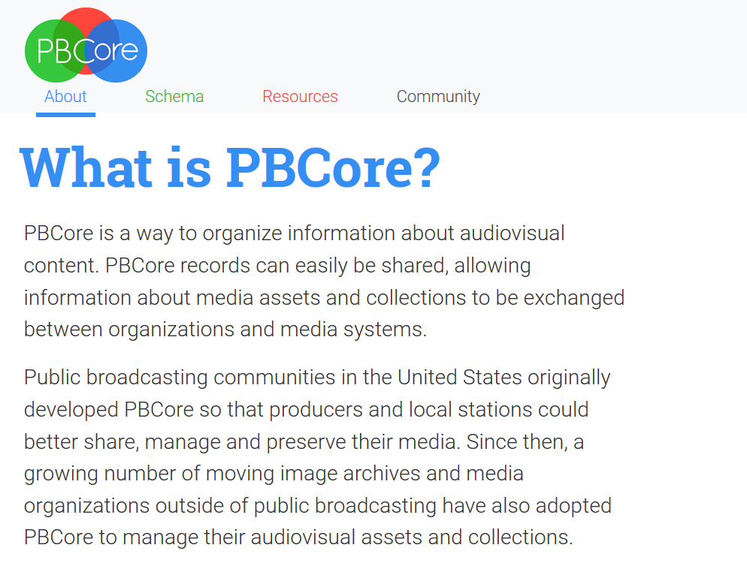
https://pbcore.org/what-is-pbcore

Slide 9
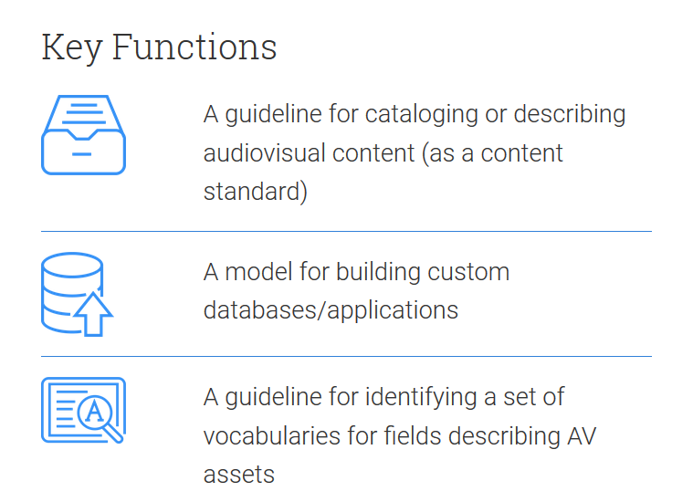
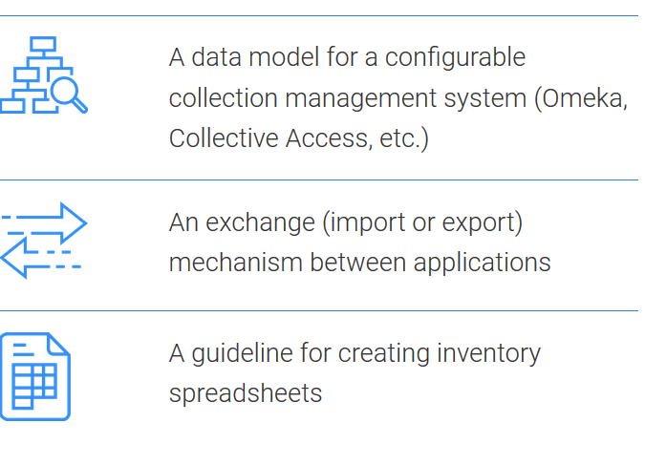
https://pbcore.org/what-is-pbcore

Slide 10
*
*
*
*
These functions make PBCore especially handy for collections where AV assets are part of mixed collections, and may have been historically neglected or under-described!
https://pbcore.org/what-is-pbcore

Slide 11
*
*
*
*
These functions make it easy to integrate PBCore cataloging data for AV holdings into existing descriptive practices at your institution (PBCore is designed to “play well with others”)
https://pbcore.org/what-is-pbcore

Slide 12
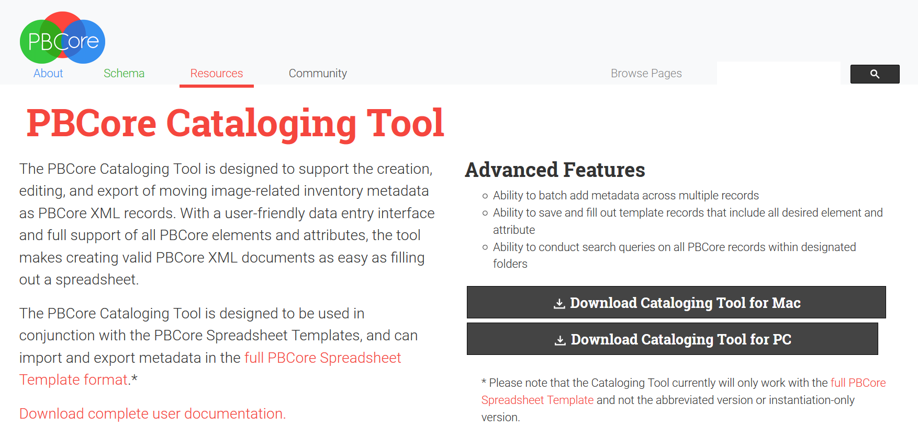
Exploring PBCore resources
Sample records
Cataloging Tool
Inventory spreadsheets
PBCore XML Validator
https://pbcore.org/cataloging-tool

Slide 13
Hands-on: Applying PBCore
Select an AV asset (or collection of assets!) from the box
Create a shared Google Sheet file using one of the spreadsheet templates and collaboratively inventory the assets you have selected
Use the PBCore Cataloging Tool to create item-level records for each of your assets
If your selection contains multiple assets, create and link multiple records!
Consider: How much metadata is enough for each item? Which fields might you collectively decide to use for minimal cataloging of this “collection”? If you recruited and trained volunteers for an AV inventory day, which fields would you want/need them to complete?

