Slide 1



APLIKASI PENGAJUAN USULAN PELATIHAN DAN LPJ
(SIPELITA)
Sistem Informasi Pelaporan Latihan Kegiatan
By: TEAM PBL TRPL-111

Slide 2







Role of Team
215211
Banu failasuf, S.Tr
Poject Manager
4342411068
Andi Hardiansya Permana
Backend Developer
4342411062
Muhammad Nabil Aditya Putera
Leader Team, Analyst, Fullstack Developer
4342411065
Imel Valentina Parapat
Backend Developer
4342411063
Aulia Cahya Lamira
Fronted Developer
4342411064
Yetro Zifora Elkana Sitohang
Quality Assurance
4342411062
Ivander Justine Savero
Fronted Developer

Slide 3
Member Sharing and Contribution
Muhammad Nabil Aditya Putera
Aulia Cahya Lamira
Ivander Justine Savero
Motivate to team, analyze software requirements, vision and scope
working on application wireframe
Working on ui ux design
Andi Hardiansya Permana
Imel Valentina Parapat
Yetro Zifora Elkana Sitohang
working on use case diagram and use case scenarios
working on er diagram and data requirements
perform project documentation

Slide 4
General description of the software
Description
SIPELITA stands for Activity Training Reporting Information System. This application simplifies the process for employees to submit training activity proposals and reports, while also making it easier for supervisors to receive, process, and assign statuses to the submitted proposals and reports.
Purpose
The purpose of this training proposal and LPJ submission application is to facilitate the submission of training activity proposals and LPJ, as well as to prevent human error.
Scope
The system is able to monitor information related to training proposal submissions and LPJ (accountability report) reporting.
The system makes it easy for employees to create and submit training proposals and LPJ reporting.
The system provides direct notification to employees regarding the status of training proposal submissions and LPJ reporting submitted.
The system provides direct notification to supervisors for each training proposal submission and LPJ reporting made by employees.

Slide 5
functional Requirements.
Nomor | Fungsional Requirements
F001 | login User
F002 | Supervisor can Manage employee accounts, Create, Edit, Delete
F003 | Employees can submit training activity proposals.
F004 | The supervisor validates the training submitted by the employee.
F005 | Employees view the status of training proposal submissions.
F006 | Employees can make LPJ reports.
F007 | The supervisor validates the LPJ reporting submitted by the employee.
F008 | Employees view the status of LPJ reporting.
F009 | Supervisors and Employees can review LPJ submissions and reporting.

Slide 6
Non-functional Requirements.
KRITERIA | PARAMETER
Availability | The system must be able to run 24 hours a day to respond immediately.
Security | The application applies encryption to LPJ submission data and user identity, to prevent data leakage, and adds a captcha code to protect the website from spam, as well as limiting passwords to a minimum of 6 characters.
Responsive | Apps must be responsive across devices (desktop, tablet, mobile) and provide a fast and efficient user experience.
Announcement | Every time there is a new submission and report, the system should send an automatic notification via the application to the relevant supervisor to ensure they are immediately aware of any submissions that need to be followed up.
Ergonomics | The application is easy to use by application users.
Language | Using Indonesia language.

Slide 7
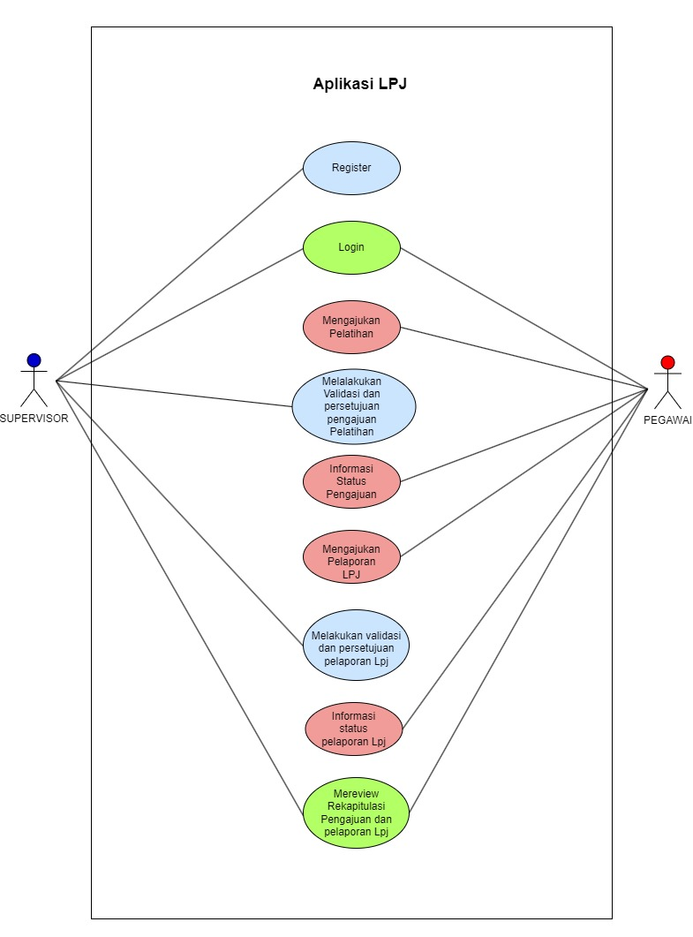
UseCase Diagram.
1. Register: The process of registering a new user to create an account in the system. supervisor will enter data (such as NIP, Username, Email, Password). After successful registration, Employees can access the Application
2. Login: The login process is carried out by registered employees to access the system by entering their Username and Password.
3. Submitting of training Proposal: Employees submit of training proposal submissions, submission forms containing Institutions / Institutions, Study Programs, Departments, Participant Names, Places/Addresses, Activity dates, Activity Completion Date, Source of Funds (Virtual Account), Competencies, Targets to be Achieved After the LPJ is submitted, the system will save it for validation by the Supervisor
4. Validating and Approving of training proposal Submissions: The Validation and Approval Process for training proposal Submissions involves the Supervisor to examine and validate the training proposal submitted by the Employee.
5. Training Submission Status Information: The Training Submission Status Information process can be viewed by employees from the training submissions they make. Employees can monitor whether the application is being processed, approved, or rejected.

Slide 8
UseCase Diagram.
6. Submitting LPJ Reporting: The process of submitting LPJ reporting,employees can fill out the reporting form and upload physical evidence. The submission of the LPJ goes through the validation or approval process that has been carried out by the Supervisor in the Submission of the LPJ.
7. Validating and Approving LPJ: The LPJ Submission Validation and Approval Process involves the Supervisor to check and validate the LPJ submitted by the Employee.
8. LPJ Reporting Status Information: The LPJ Reporting Status Information process can be seen by employees from the reporting they do. Employees can monitor whether applications are being processed, approved, or rejected
9. Review the Recapitulation of Submission and Reporting of LPJ: The process of reviewing the Recapitulation of Submission and Reporting of LPJ is carried out by Supervisors and Employees to see a summary or recapitulation of all submission and reporting of LPJ.

Slide 9
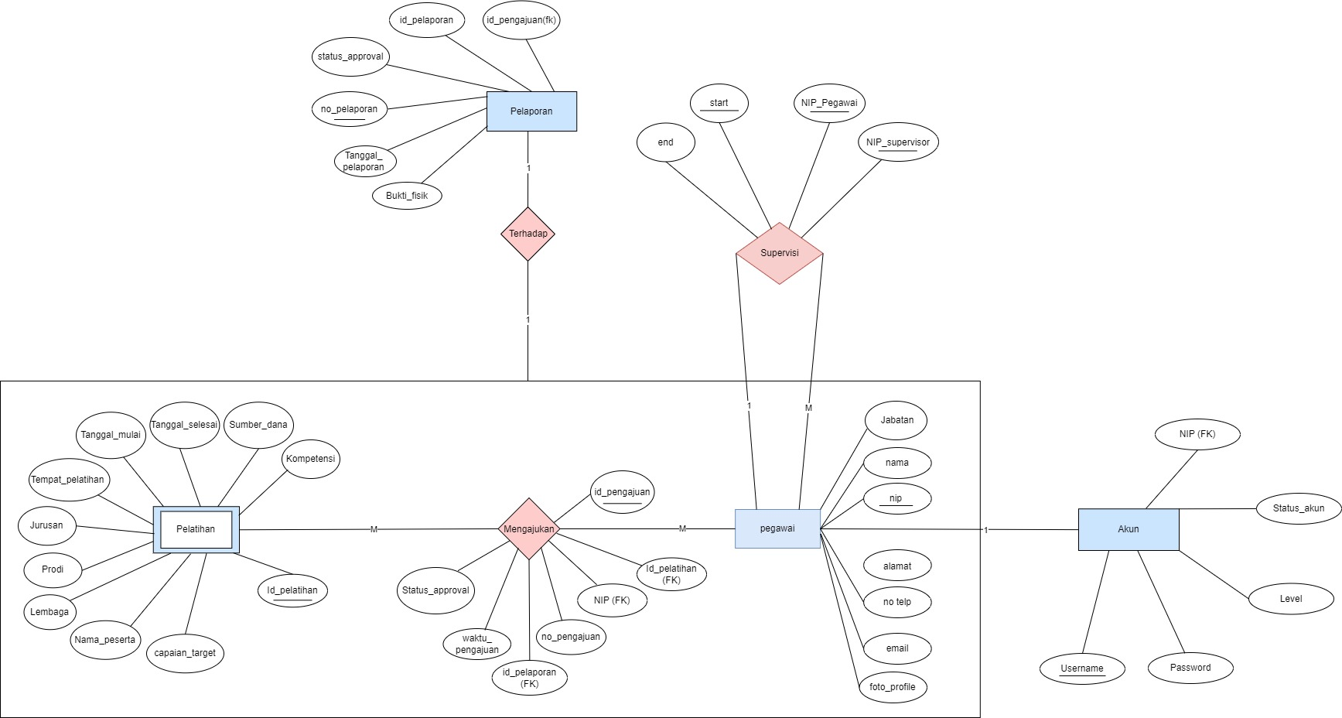
ER Diagram.

Slide 10
Structure Table.
Table Name | : | t_akun
Primary Key | : | Username
Foreign Key | : | NIP
Table Structure | : |  | Name | Type | Long | Description
 |  |  | Username | Varchar | 50 | Employee Username
 |  |  | NIP | integer | 11 | NIP Number is the Official Identity of Employees
 |  |  | Email | varchar | 20 | Official Employee Email
 |  |  | Password | varchar | 20 | Password

Slide 11
Structure Table.
Table Name | : | t_pegawai
Primary Key | : | NIP_pegawai
Foreign Key | : | None
Table Structure | : |  | Name | Type | Long | Description
 |  |  | NIP | integer | 11 | NIP Number is the Official Identity of Employees
 |  |  | Name | varchar | 20 | Employee Username
 |  |  | Position | varchar | 10 | Employee Positions in Companies
 |  |  | Address | Text |  | Officer's Address
 |  |  | No_telp | integer | 12 | From telp pegawai
 |  |  | Email | varchar | 20 | Official Employee Email
 |  |  | Foto_Profile | Blob |  | Employee Profile Photos

Slide 12
Structure Table.
Table name | : | t_supervisi
Primary Key | : | NIP_supervisor, NIP_pegawai, Start
Foreign Key | : | None
Structure Table | : |  | Name | Type | Long | Description
 |  |  | NIP_supervisor | integer | 11 | NIP Number is the Supervisor's Official Identity
 |  |  | NIP_pegawai | integer | 11 | NIP Number is the Official Identity of Employees
 |  |  | start | date |  | Start is the first date of work
 |  |  | end | date |  | End forgets the working end date

Slide 13
Structure Table.
Table name | : | t_Pengajuan
Primary Key | : | id_Pengajuan
Foreign Key | : | NIP, id_pelatihan, no_pelaporan
Structure Table | : |  | Name | Type | Long | Description
 |  |  | id_pengajuan | int | 100 | The submission ID is the primary key on the submission table
 |  |  | no_pengajuan | int | 100 | The submission number is the number of a submission submitted
 |  |  | waktu_pengajuan | datetime |  | Submission time
 |  |  | NIP | int | 11 | NIP Number is the Official Identity of Employees
 |  |  | id_pelatihan | int | 100 | The activity ID is a foreign key taken from the activity table
 |  |  | no_pelaporan | int | 100 | The reporting number is a foreign key taken from the reporting table
 |  |  | status_approval | Bolean |  | Approval status is the status of the submission and report submitted, whether rejected or accepted

Slide 14
Structure Table.
Name Table | : | t_pelatihan
Primary Key | : | id_pelatihan
Foreign Key | : | None
Structure Table | : |  | Name | Tipe | Panjang | Description
 |  |  | id_pelatihan | int | 100 | id_pelatihan is the primary key of the activity table
 |  |  | jenis_pelatihan | varchar | 20 | Types of training that employees will propose
 |  |  | lembaga | varchar | 20 | institutions that conduct training
 |  |  | prodi | varchar | 20 | Division Programs
 |  |  | jurusan | varchar | 20 | Department
 |  |  | tempat_pelatihan | text |  | Where the activity is carried out
 |  |  | tanggal_mulai | date |  | Activity start date
 |  |  | tanggal_selesai | date |  | Activity Completion Date
 |  |  | sumber_dana | text |  | Source of funds / virtual account
 |  |  | nama_peserta | varchar | 20 | Participants who participated in the activity
 |  |  | kompetensi | varchar | 20 | Expertise Competencies
 |  |  | capaian_target | text |  | Description of targets to be achieved

Slide 15
Structure Table.
Name Table | : | t_Pelaporan
Primary Key | : | Id_pelaporan
Foreign Key | : | id_pengajuan id_pelatihan
Structure Table | : |  | Name | Type | Long | Description
 |  |  | NIP | int | 11 | NIP Number is the Official Identity of Employees
 |  |  | Bukti_Fisik | Blob |  | Letters/evidence attached to the Reporting
 |  |  | Tanggal_Pelaporan | date |  | Date the Employee submits the Report
 |  |  | Id_pelaporan | int | 100 | The reporting ID is the primary key of the reporting table
 |  |  | status_approval | Bolean |  | Approval status is the status of the submission and report submitted, whether rejected or accepted
 |  |  | Id_pengajuan | int | 100 | The submission id is the foregn key taken from the submission table

Slide 16
Obstacle Faced
Constraints
Solutions
1. we had difficulty understanding the communication between our team and the project manager, and differences of opinion
1. for the solution we can schedule guidance with the project manager, and communicate more often with the project manager,
2. the constraints on the team, most of this team are beginners who do not understand about making applications,
2. we also study in groups so that we can share knowledge
3. limited project completion time
3. set work priorities

Slide 17
THANK YOU! FOR YOUR ATTENTION
By: TEAM PBL TRPL-111

