Slide 1

A System for Citizen-Centric Human Resource Management in Smart Cities
Team AGILE
21 May 2024
ISSE
Ritsumeikan University
Jesse Charles Grabowski
Andifallih Noor Malela
Satvik Reddy Konda
Hikaru Tokuyama
Yamabe Hiroyuki
Lin Jie
Kathirvel Murugan Sushaant
1

Slide 2
Table of Contents
Introduction
Literature Review
Project Specifics
Similar Products
Requirements Elicitation
Functional Requirements
Conclusion
2

Slide 3
Introduction
Traditional governance is inadequate for modern human capital management
Smart cities use agile governance techniques to engage citizenry and manage the workforce
The proposed system matches users' skills with jobs and predicts future trends while encouraging users to upskill
4

Slide 4

Literature Review & Problem Statement
Problem Statement -:
Lukasz Arendt (2015)
Individual education significant at the micro and macro level
Cities focus on a top-down approach taking significant time
Embracing technological shifts takes time through traditional governance
Guenduez et al. (2024)
"If we want to become a smart city, we need to ensure that we have the right skills"
Smart city development depends on availability which requires mobilizing human resources
Mergel et al. (2020)
Agile governance practices allow cities and to "respond in an efficient way"
"Agile Emphasizes Responsible Individual Discretion over Bureaucratic Procedures"
"Agile Privileges Adaptive Structures over Hierarchal"
4

Slide 5
Project Specifics
Project Vision -:
Agile cities with dynamic workforce systems
Empower individuals for skill acquisition and job transition
Respond to evolving career demands and city needs
Objectives -:
Engage citizenry by allowing them to explore available opportunities
Provide a data-driven approach to human resource management in smart cities
Encourage reskilling and upskilling
5

Slide 6


Similar Applications
Eightfold AI
Human resource management system using deep-learning AI
Traditional HRM Systems
Offers features to the private sector
Follows top-down approach
6

Slide 7
Requirements Elicitation (1) Technical Literature Review
RFC 2119 – Anti-bikeshedding
SOC 2018 – Job Classification System
WCAG 2.2 - Usability Guidelines
7

Slide 8
Requirements Elicitation (2) Expert Interviews
Professor Mate – Domain Expert / Smart City Manager
Professor Uwe – Domain Expert / Smart City Manager
Alireza – Technical Expert
8

Slide 9
Requirements Elicitation (3) Survey
Conducted a Friends and Family Survey - 29 respondents
70% attempted a career change at some point
40% attempted a job change due to anticipated demand
30% failed to successfully transition careers
30% were uncertain about their career direction
50% utilized online learning material to help transition
60% utilized certification courses or exams to help transition
9

Slide 10
Functional Requirements (1)
System will use Standard Occupational Classification (SOC) as foundation in handling occupation titles.
SOC Codes
Standardized codes used to classify jobs into occupational categories.
Groups similar job duties and skills into detailed occupations.
Used for data processing purposes.
10
Notes:
I explain:
- What is SOC standard that we will use as the footing of the how the system handles occupation.
Notes:
Standardized codes used by U.S. Bureau of Labor Statistics to classify workers and jobs into occupational categorie
Occupations are classified based on work performed and, in some cases, on the skills, education and/or training needed to perform the work.
For the purpose of collecting, calculating, analyzing, or disseminating data.

Slide 11
Functional Requirements (2) – Format: MM-mbbd
13-0000 Business and Financial Operations Occupations
13-2000 Financial Specialists
13-2010 Accountants and Auditors
13-2011 Accountants
13-2052 Personal Financial Advisors
13-1000 Business Operations Specialists
13-1032 Insurance Appraisers
Major group (MM)
Minor group (m)
13-2050 Financial Analysts and Advisors
13-1030 Claims Adjusters, Appraisers, Examiners, and Investigators
Broad identifier (bb)
Detailed identifier (d)
11
Notes:
I explain how the codes work just briefly
“Here is how the code work, 6 digits, each digits refer to a section that categorize them most bottom is the lowest level detail occupation”

Slide 12
Functional Requirements (3)
Actors / User Classes
Citizen -:
User from citizenry. Uses system for assistance in career.
Smart City Manager -:
User from city government municipality. Uses system for human resource management related tasks.
Administrator -:
System administrator that maintains system.
12
Notes:
ACTORS THAT WILL INTERACT WITH SYSTEM DIRECTLY CITIZENS
use the system to view job opportunities, acquire educational materials, and gain insights into their skillsets and job market trends to transition into new employment opportunities.
MANAGERS
use the system to analyze and manage the workforce within the city, predict labor trends, assess workforce skills, and plan for future urban development needs.
ADMIN
managing, maintaining, and overseeing the system’s technical aspects. This role includes administrating accounts for city managers, maintaining system, troubleshooting issues, and supporting users.

Slide 13
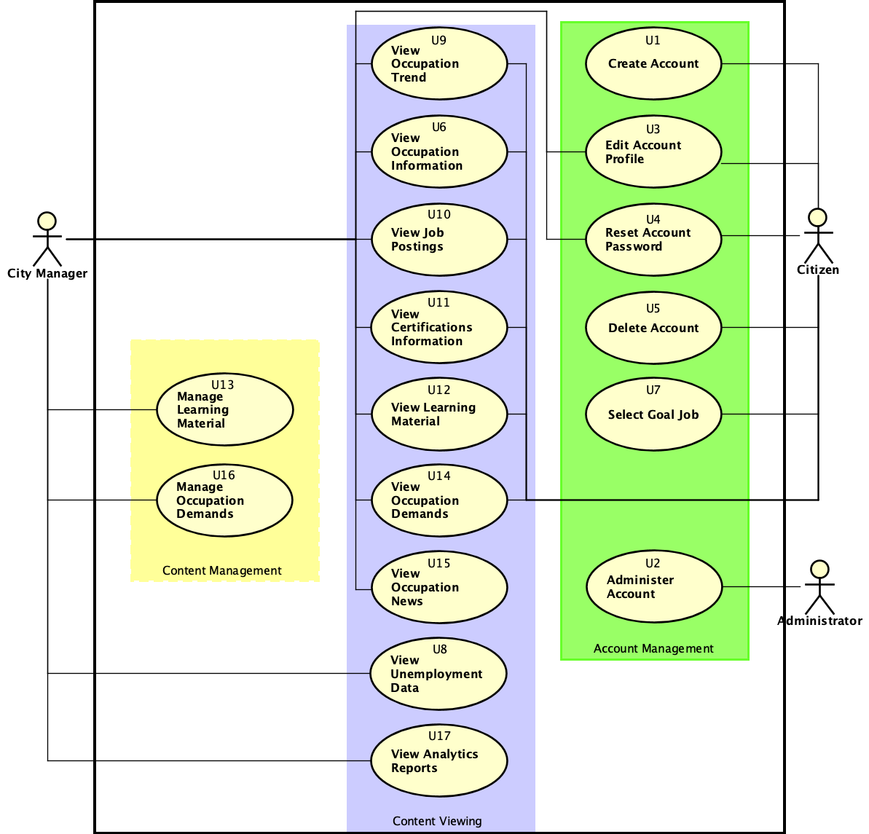
Functional Requirements (4)
Defined use cases → functional requirements specification
13
Notes:
I mention the structure of how the functional requirement for our system is developed
We came up with use cases of what system should do for the three actors, based on the expert interviews and also surveys, and standards
We have use cases and develop it into one or multiple functional requirement, also based on expert interviews and open standards
Some functional requirement covers multiple use cases
Then we also develop some requirement to fill in the gaps like how the content is viewed / The rest are to support the main ones (like account creation/profile stuff for data to feed the reports)

Slide 14
Functional Requirements (5)
User Requirements | System Requirements
FREQ-1 - Account Creation Citizens MUST be able to register for an account by initiating the signup process, and providing necessary information. | FREQ-1.1 System MUST provide a control to initiate the signup process. FREQ-1.2 System MUST collect the citizen’s email, password, legal name, current occupation, and postal code. FREQ-1.3 System MUST enforce password strength requirements. This may be achieved by either enforcing character restrictions (a mix of uppercase letters, lowercase letters, numbers, and symbols) or by measuring complexity (using a tool such as zxcvbn). FREQ-1.4 Users MUST receive feedback on the strength of their password as they enter it.
FREQ-12 – View Certifications Users MUST be able to view certifications applicable to the occupation they are currently viewing. | FREQ-12.1 System MUST display relevant information about each certification, such as a title and description. FREQ-12.2 Each certification MUST be clickable, allowing users to view more detailed information on a separate page. FREQ-12.3 This detailed certification page must contain the title, description, links to external resources, and any other relevant information obtained in the careeronestop dataset. FREQ-12.4 System MUST provide a unique URL for each detailed certification page to allow for browser capabilities such as bookmarking and history to function. FREQ-12.5 System SHOULD provide sorting and filtering capability for certifications.
FREQ-17 Manage Demand Smart city managers MUST be able to set demand targets for a given detailed occupation. | FREQ-17.1 System MUST allow smart city managers to input a demand target for a given detailed occupation.
14
Notes:
I use just three example user FREQ and their systems reqs for each categories.
Kind of the rough idea of what they look like
We gave team members the use cases and develop them into user and system requirements

Slide 15

Conclusion
Problem: Response to advancements in industry using a top-down approach takes time for mobilizing human resources
Conducted surveys, interviews to find out more regarding problems and developed requirements for a system to solve the problem
15
Notes:
- We’ve identified a problem from reading the literature, mobilizing human resources
- We conducted a survey and found that real people do in fact have the problem
- We used expert interviews and open standards and also survey to form requirements to solve the problem

