Slide 1
TTG Master
Team Awesome
Producing Critical Hits!

Slide 2
Team Awesome
Angelo Alfeo
Christopher Czyzewski
Adam Hutchins
We are the software developers
...But today, we're also your guides on an adventure!

Slide 3
Your quest...

Slide 4
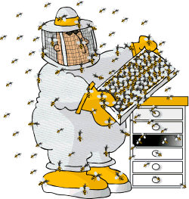
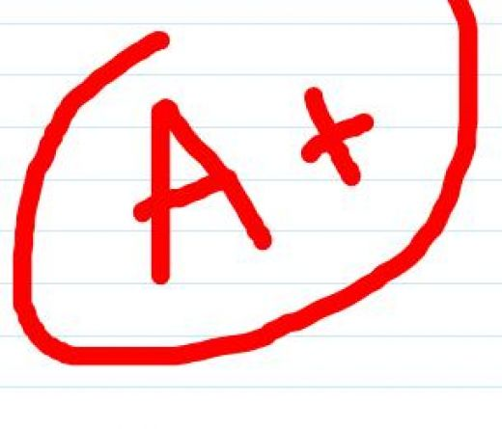
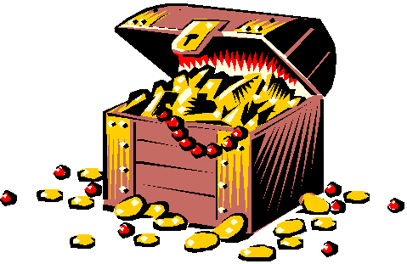
Defeat the dreaded Beekeeper and his horde of minions..
And acquire the sacred loot, the SD&D A+ of Legend...

Slide 5
Now let's meet our fellowship...

Slide 6
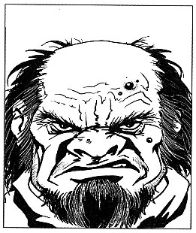
Thorg the Vengeful
His family was killed by a rampaging tribe of bees and documentation. Now he seeks his revenge...

Slide 7
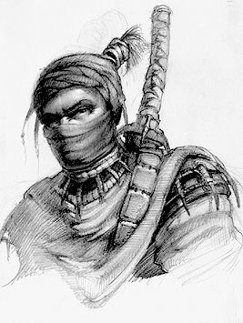
Ninja the Ninja
He's a ninja. Really, that's all you need to know. What more could you ask for than being a ninja?

Slide 8
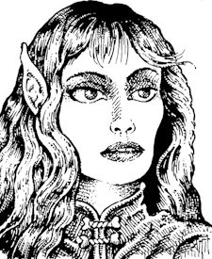
Serenity Purearrow
The obligatory party chick. Seeks to put an end to the unholy reign of the Beekeeper once and for all.

Slide 9
And now...
The Epic Battle Begins...

Slide 10
Why to Purchase our Product
Fun!
Easy to Use!
Online!
Universal!

Slide 11
How We Made It
Programmed in VB.net
Used Unified Process
Prioritized Use Cases
Worked Iteratively

Slide 12
Our Development Schedule
Iteration 1 (2/24) – Developed schedule, budget, glossary, conceived idea
Iteration 2 (3/17) – Updated Schedule, defined 80% use cases, elaboration documentation
Iteration 3 (4/7) – Began Construction, added board and piece functionality, chat ability
Iteration 4 (4/21) – Added options, worked on connection features
Iteration 5 (4/28) – Added dice, finished construction, released beta
Final Release (5/5) – Finished testing, end-user documentation

Slide 14
Features for the Future...
Transfer images
Load multiple pieces at once
Loading and saving game states
Allow mid-game connections
Cards
Private object functionality

Slide 15
Our group...
Met regularly on Wednesdays
Divided work evenly
Chris – Lead Programmer
Angelo – Head Documenter
Adam – Invaluable Jack of all Trades
Laid-back but dedicated style
No casualties

Slide 16
Issues
Unfamiliar with VB.net
  (and no one on campus will help you with it)
Had to drop features
Only three team members

Slide 17
What we got from the course:

Slide 18
THE END!!!

