Slide 1

QTLTableMiner⁺⁺: Semantic-mining of QTL tables in scientific articles
Gurnoor Singh
12th September, 2017
1

Slide 2
QTLTableMiner++
Extracts QTL statements from tables of an article.
QTL statement is a statement that shows of a trait to a genomic entity
Input: PMCIDs (Europe PMC)
Output: CSV file (List of QTL statements)
SQLite Db

Slide 3
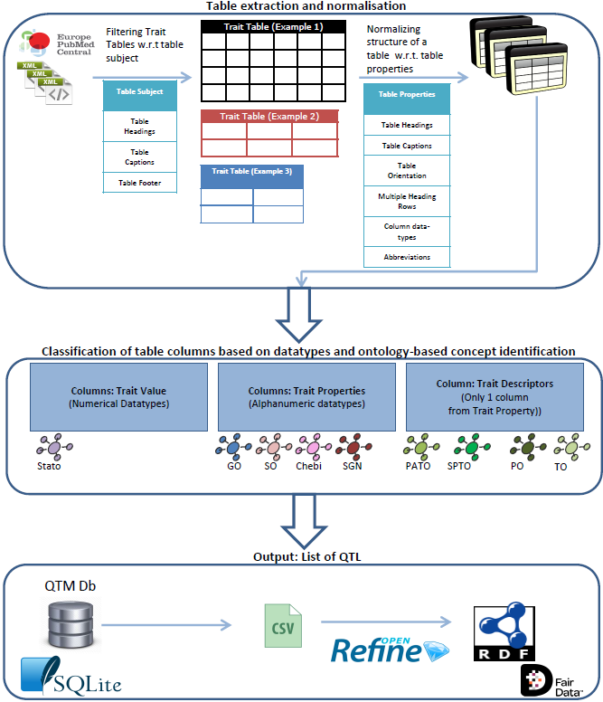

Slide 4

Tables in xml
<table-wrap id="Tab2">
<label>Table 2</label>
<caption>
Multiple regression analysis between phenotypic traits and population structure
</caption>
<table frame="hsides" rules="groups">
<thead>
<tr valign="top">
<th>Traits</th>
<th colspan="2">Regression results</th>
</tr>
<tr valign="top">
<th/>
<th>R<sup>2</sup></th>
<th>P-value</th>
</tr>
</thead>
<tbody>
<tr valign="top">
<td>Ascorbic Acid</td>
<td char="." align="char">0.170</td>
<td char="." align="char">0.001</td>
</tr>

Slide 5
Training set: Tomato
(TITLE:“tomato" OR TITLE:"solanum lycopersicum") AND (TABLE:"QTL" OR TABLE:"trait") AND (IN_EPMC:y) AND (LANG:"eng" OR LANG:"en" OR LANG:"us")
30 Articles

Slide 6
Test set: Potato
(TITLE:"potato" OR TITLE:"solanum tuberosum") AND (TABLE:"QTL" OR TABLE:"trait") AND (IN_EPMC:y) AND (OPEN_ACCESS:y) AND (LANG:"eng" OR LANG:"en" OR LANG:"us")
30 Articles

Slide 7
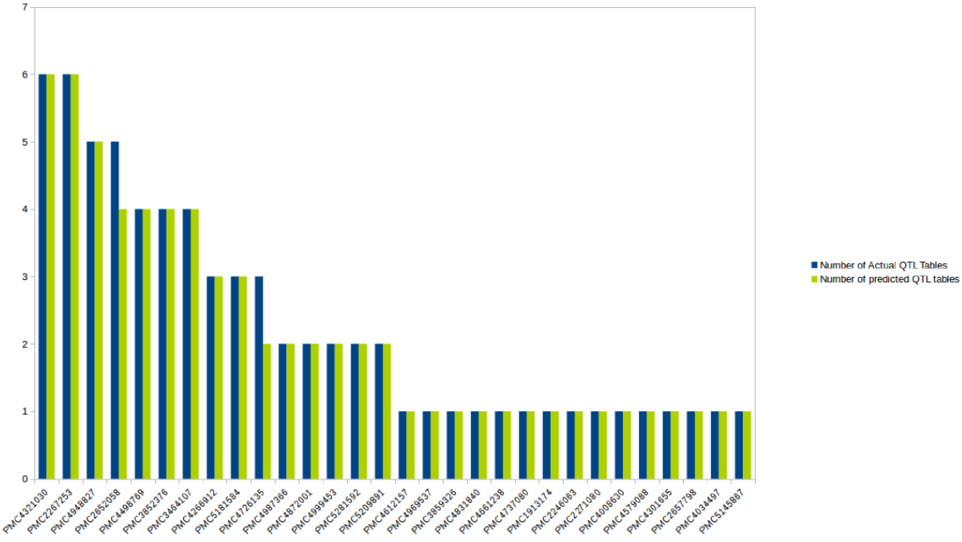
Training Set: Number of QTL Tables detected
PMC2652058
67/68

Slide 8
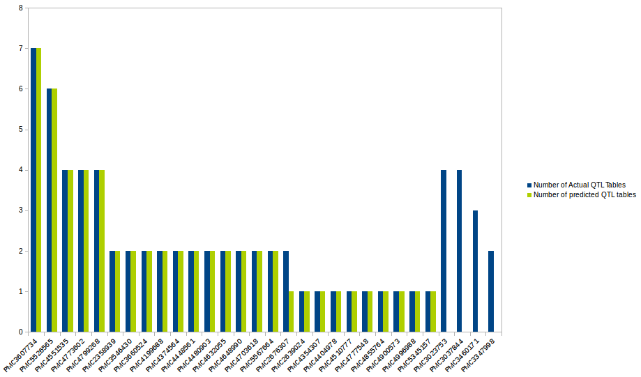
Test Set: Number of QTL Tables detected
57/71

Slide 9
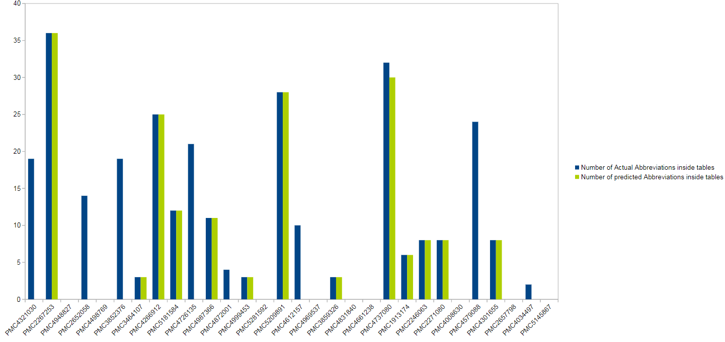
Training Set: Number of Abbreviations

Slide 10
Tet Set: Number of Abbreviations

Slide 11
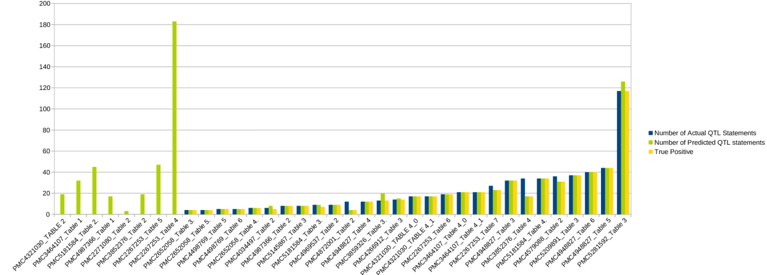
Training Set: Number of QTL Statements

Slide 12
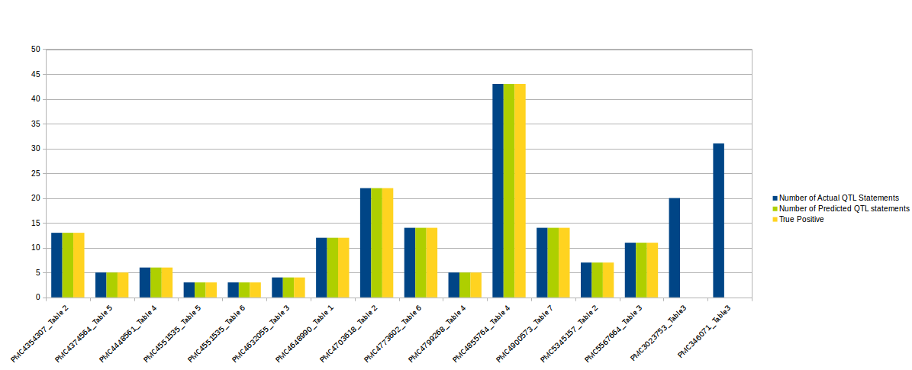
Test Set: Number of QTL Statements

Slide 13
Precision Training vs Test set
 | Training | Test
# of QTL Tables | 0.99 | 0.80
# of abbreviations | 0.61 | -
# of QTL statements | 0.93 | 0.76

