Slide 1
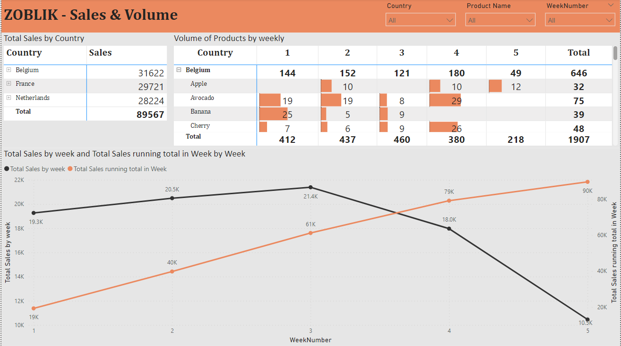
Sales & Volume
Filters : By applying filters for specific Countries, Products, and Week data, We can analyze sales & Volume.
Breakdown of country level overall sales, Added data view by selection through we can able to see detail view by country.
Volume of products by weekly, added product by drill down able to see product level volume sold.
Added Line Chart by comparing data weekly sales and Weekly running total sales.
1
2
3
4

Slide 2
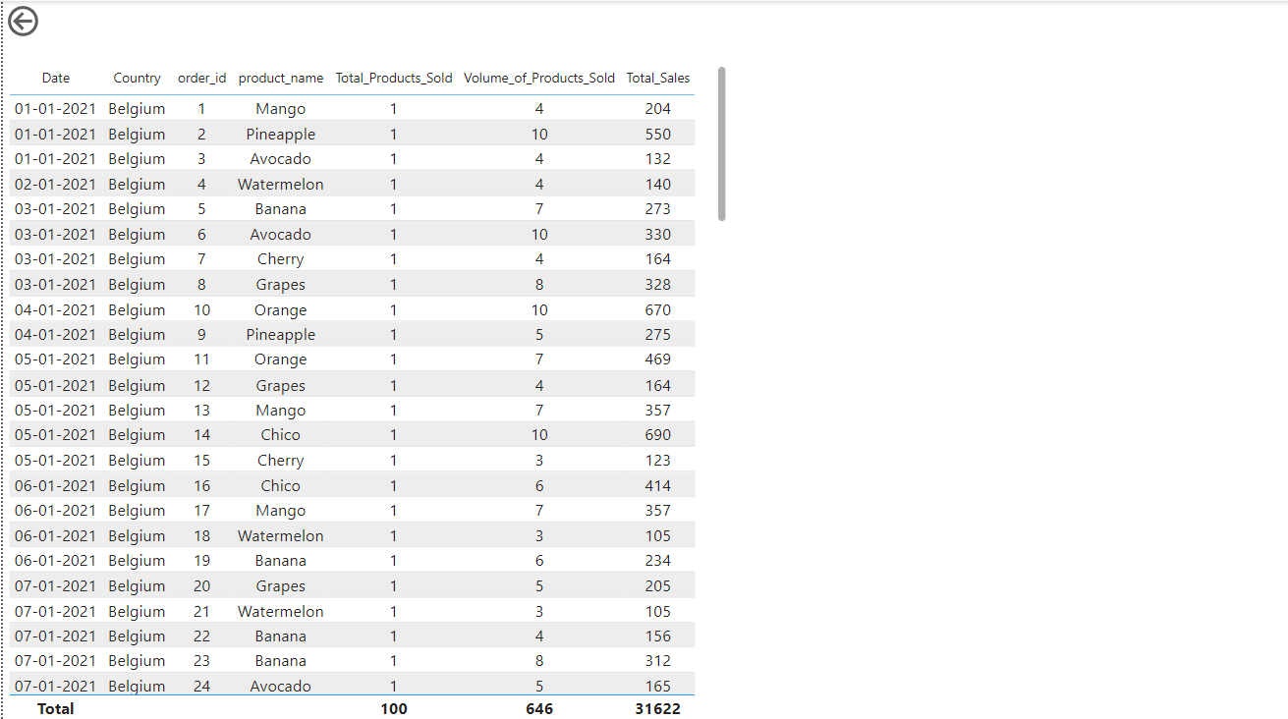
DETAIL VIEW

Slide 3
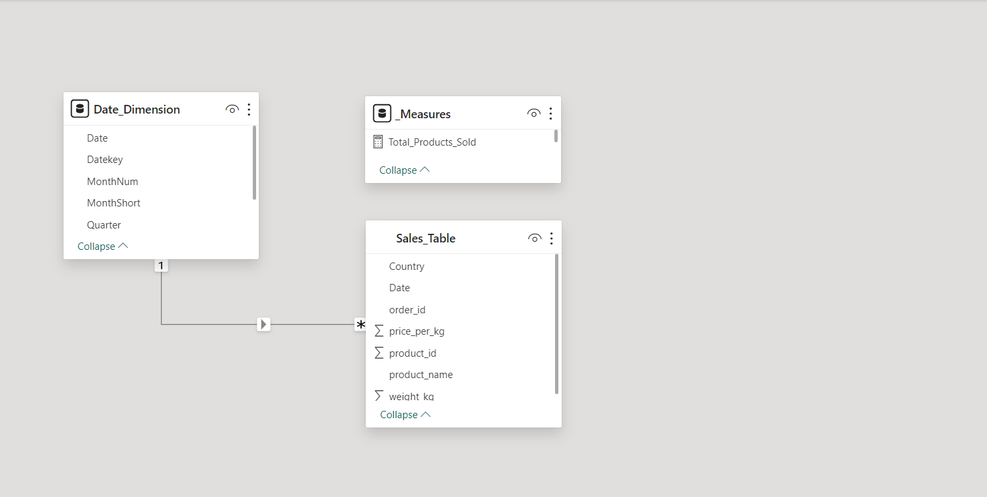
Data Model

