Slide 1

CUSTOMER CHURN ANALYSIS
Data-Driven Business Insights

Slide 2

PROBLEM STATEMENT
Customer churn leads to revenue loss
Acquiring new customers is expensive
Need to identify why customers leave
👉 Goal: Reduce churn using data insights

Slide 3
BUSINESS OBJECTIVES
Analyze customer behavior
Identify key churn drivers
Build predictive model
Provide actionable recommendations

Slide 4
DATASET OVERVIEW
Dataset: Customer Churn Data
Records: 500+
Features: Customer attributes + usage data
Target Variable: Churn (Yes/No)

Slide 5
DATA PREPROCESSING
Removed missing values
Removed duplicates
Standardized column names
Converted categorical variables
👉 Ensured clean and reliable dataset

Slide 6
EXPLORATORY DATA ANALYSIS (EDA)
Performed univariate and bivariate analysis
Used visualizations for insights
Identified patterns and trends

Slide 7
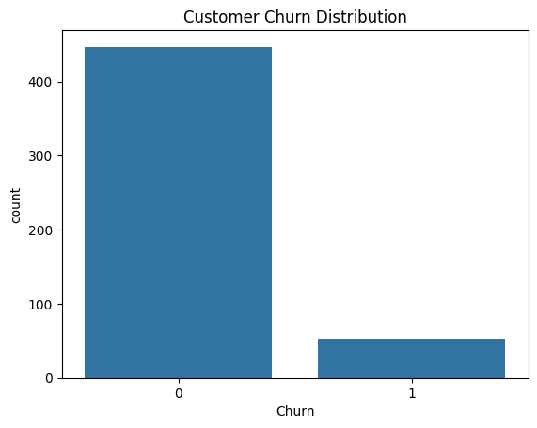
CHURN DISTRIBUTION
Insight:
Percentage of customers who churn
Helps understand problem scale

Slide 8
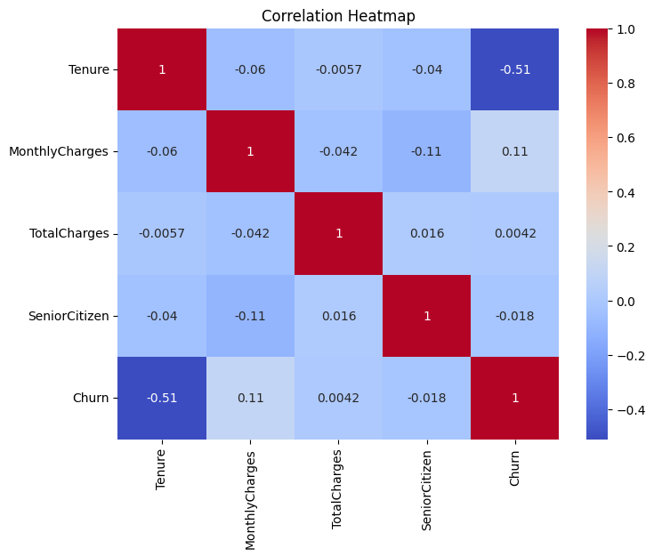
CORRELATION HEATMAP
Insight:
Identifies relationships between features
Helps in feature selection

Slide 9
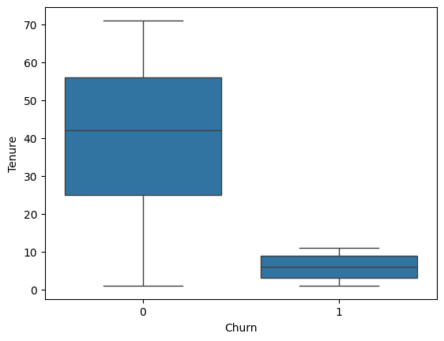
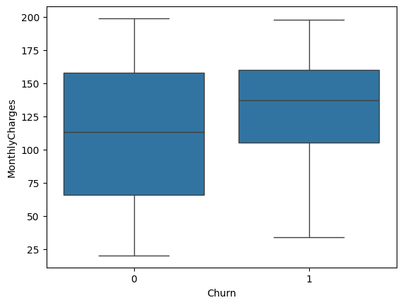
FEATURE VS CHURN ANALYSIS
Insight:
Certain features strongly influence churn
High variation observed in key attributes

Slide 10
MODEL BUILDING
Algorithm: Logistic Regression
Type: Binary Classification
Data Split: 80% Train / 20% Test

Slide 11
MODEL PERFORMANCE
Accuracy: 0.96
Precision: 0.98
Recall: 0.98
👉 Model effectively predicts churn
Accuracy: 0.96
precision recall f1-score support
0 0.98 0.98 0.98 93
1 0.71 0.71 0.71 7
accuracy 0.96 100
macro avg 0.85 0.85 0.85 100
weighted avg 0.96 0.96 0.96 100

Slide 12
KEY INSIGHTS
High-risk customers identified
Behavioral patterns affect churn
Early-stage customers churn more
Certain features strongly impact retention

Slide 13
BUSINESS RECOMMENDATIONS
Offer discounts to high-risk customers
Improve onboarding experience
Launch retention campaigns
Monitor churn indicators regularly

Slide 14
BUSINESS IMPACT
Reduce churn rate
Increase customer retention
Improve revenue
Better customer satisfaction

Slide 15
CONCLUSION
Data analysis helps understand churn
Predictive modeling enables proactive action
Data-driven strategies improve business outcomes

Slide 16
THANK YOU

