Slide 1
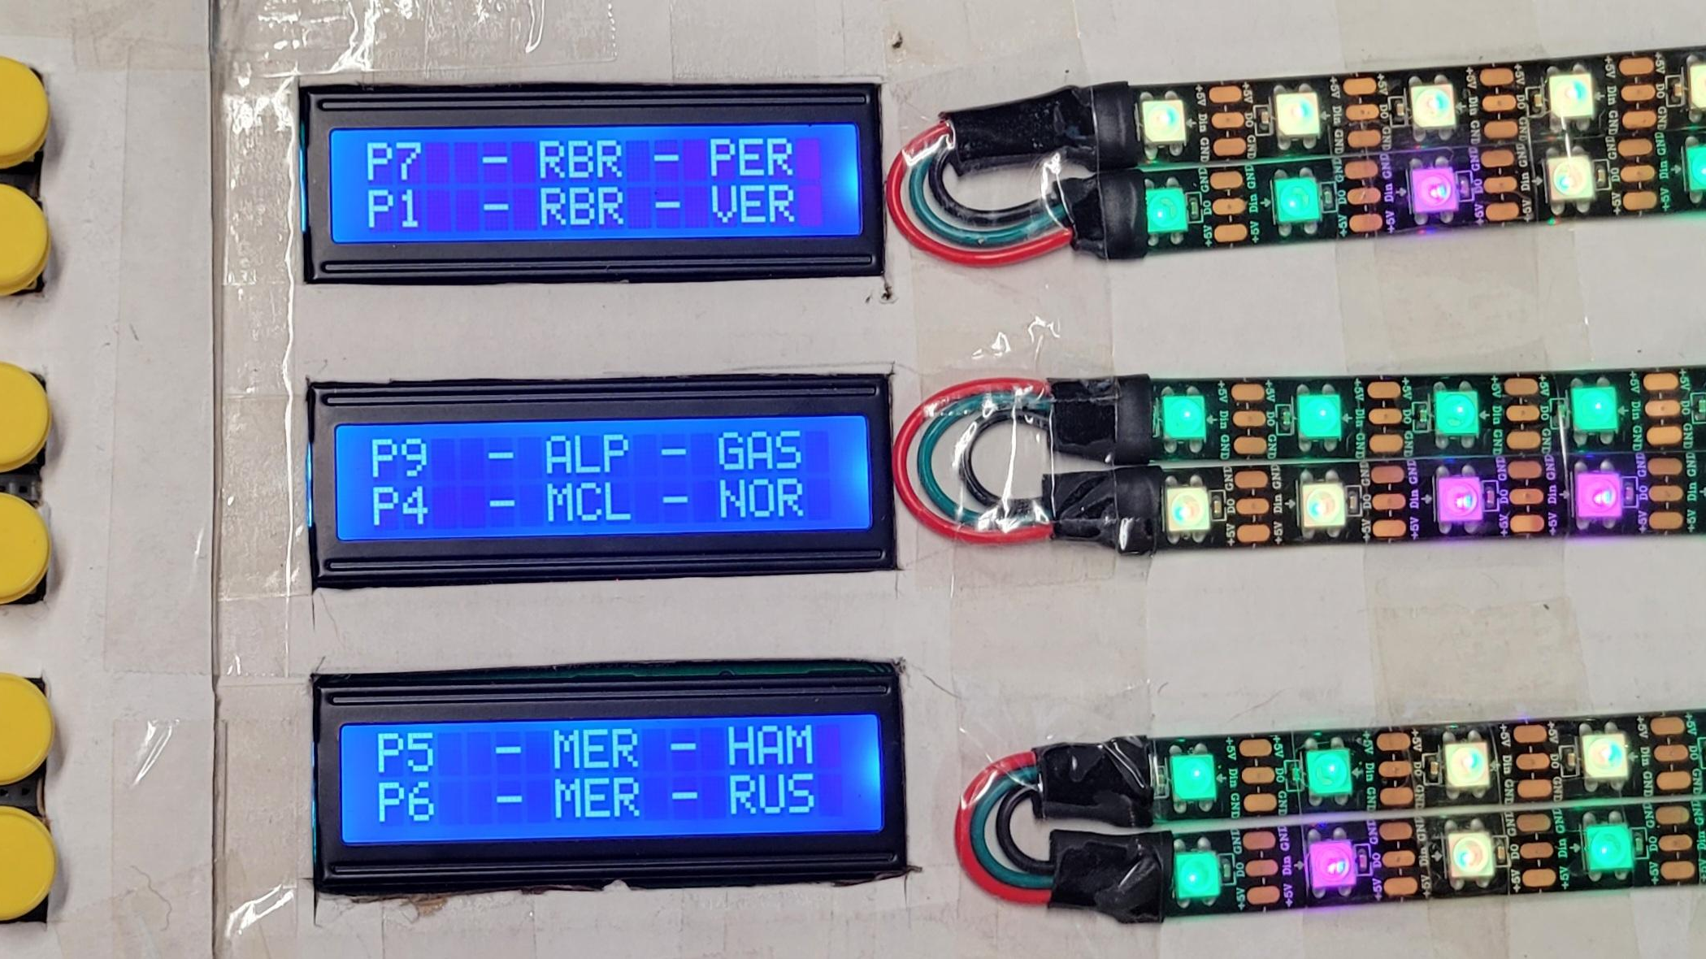
F1 QUALIFYING TRACKER
By Palin Wiseman

Slide 2
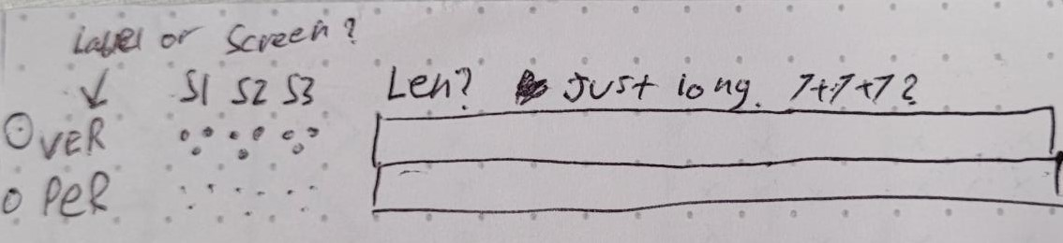
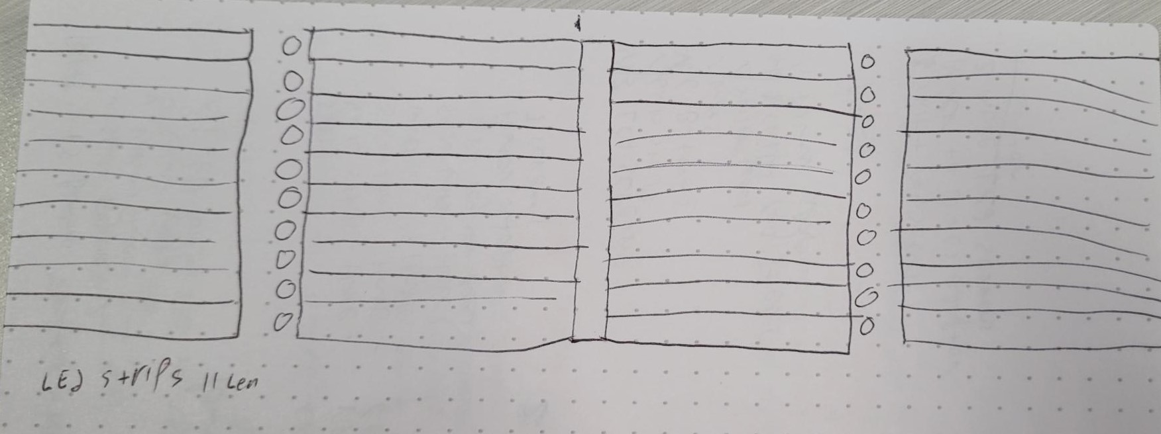
Design process
A device to improve my Formula 1 watching experience
First concept: All 20 drivers, all sectors, all mini-sectors
Scope was way too big; device would have taken up my entire desk (and cost a lot)
Refocused on qualifying and tracking
Temporary case and breadboard as I am continuing development after semester

Slide 3




Tech - PC
Streaming F1TV through MultiViewer
Running at least a commentary stream and a Live Timing stream
Race, qualifying, or practice
Live or replay
Running a Flask app API
Uses mvf1 python package by Rob Spectre
Getting driver data from MultiViewer
Posting driver to open perspective cam
Hosted with ngrok

Slide 4


Tech – Raspberry Pi 4
Running a python script
Uses requests package to interact with the API
Requests driver data
Posts driver number to focus on
Wired serial connection to the Arduino
Uses multithreading to read and write at the same time
Sends driver data to be displayed
Accepts button inputs to set new focused driver
Starts when plugged in and can recover from Arduino disconnection

Slide 5

Tech – Arduino Uno
Wired serial connection to Pi
Accepts driver data and mini-sector information
Sends driver number when button is hit
6 buttons, one for each driver
3 LCD screens, 2 drivers on each
Displays position, team, and name
6 strips of 5 LEDs
Most recent 5 mini-sectors for each driver this lap

Slide 6
The future?
3D printed case
Soldered circuit board
Improved code
Customize where windows open
Different driver selection logic for races
More displays
Session time
LED Matrix display for racing condition flags
Laps remaining

