Slide 1
INVESTMENT CASE STUDY SUBMISSION
Prashant Baliyan

Slide 2
Abstract:
Objectives:
To support Spark Funds understand the Global trends in investments between 5 to 15 Million
To identify the best sectors, countries, and a suitable investment type.
To identify the investments in English Speaking countries.
Identify best Investment type like venture, seed, private equity etc. suitable for investment.
Provide country details of most investments made in past.
Provide best sector investment potential under top 3 countries

Slide 3
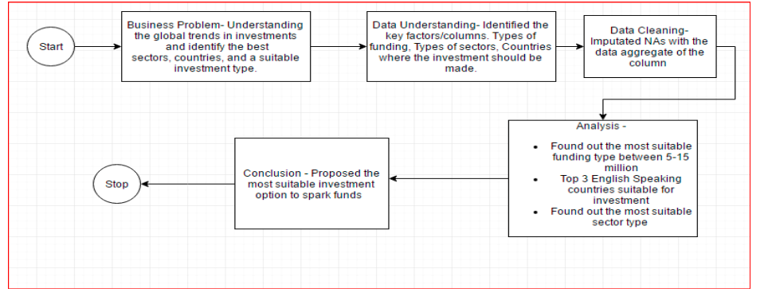
Problem solving methodology:

Slide 4
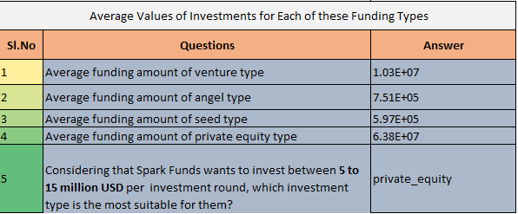
Analysis:
Analyzed the funding type and found out that venture type is most suitable investment type for requirement of 5M~15M.

Slide 5
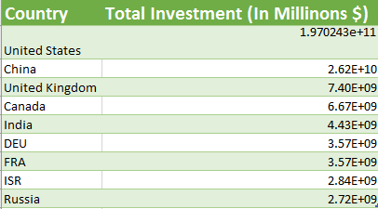
Analysis Country:-
Country Analysis – Found out the top 9 countries on the basis of the amount invested and then found out the top 3 English speaking Countries which raised the maximum investment for the chosen investment type i.e. venture type.

Slide 6
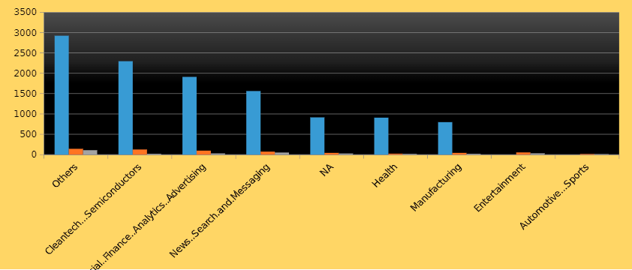
Analysis - Sector
Sector wise Analysis : Among the top 3 English speaking country, Others Sector has the highest funding for Venture type between 5 M to 15 M funding.

Slide 7

Funding Type:
The suitable Funding type between 5M to 15M is for Venture funding.

Slide 8
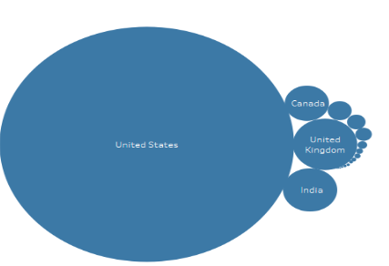
English Speaking Countries:
Top 3 English speaking countries based on the Total Funding raised respectively.

Slide 9
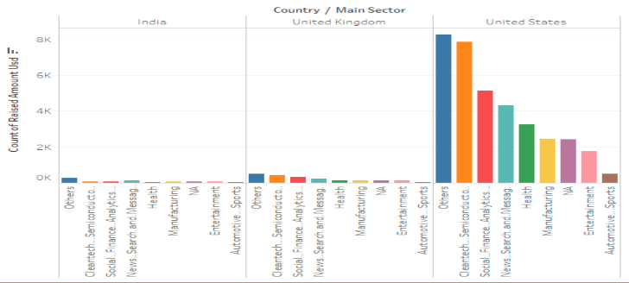
Top 3 Sectors:
The Top 3 sectors in the Top 3 countries.

Slide 10
Conclusions:
Following are the conclusions:
The Suitable option for Spark Fund is with the Range of 5M to 15M will be in Venture Funding.
The Top 3 English speaking countries are USA, UK & CANADA.
The Suitable sectors for Funding are Others, Biotechnology...Software and Advertising....Healthcare..Hardware+Software.

