Slide 1
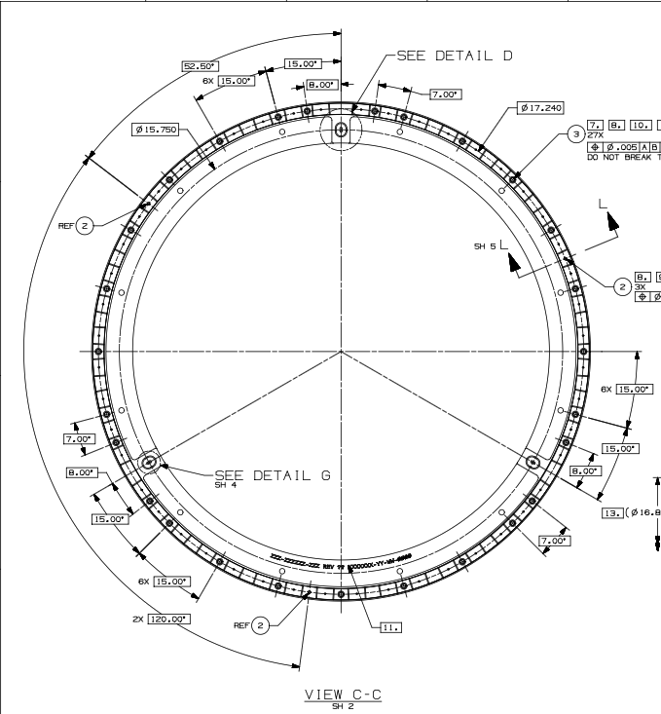
S3-P16
S1-P1
Top Reference tooling holes
Bottom Reference tooling holes
Fixture tooling holes
S3-P1
S1-P16
S2-P16
S2-P1

