Slide 1

Laser Template Generator
CAD DXF to Template G code generator

Slide 2
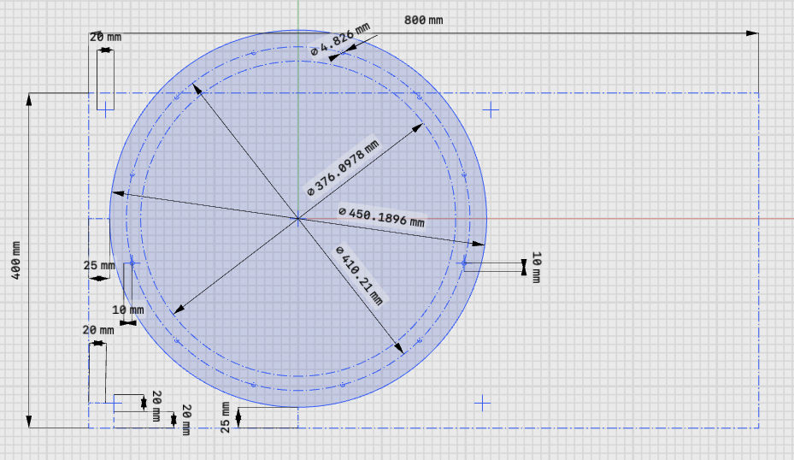
Generate a CAD sketch
Shapr3d example
Lines and circles to be engraved are drawn
Construction lines and circles are used to aid visuals but will not show up in the DXF file
Save the sketch in DXF format

Slide 3
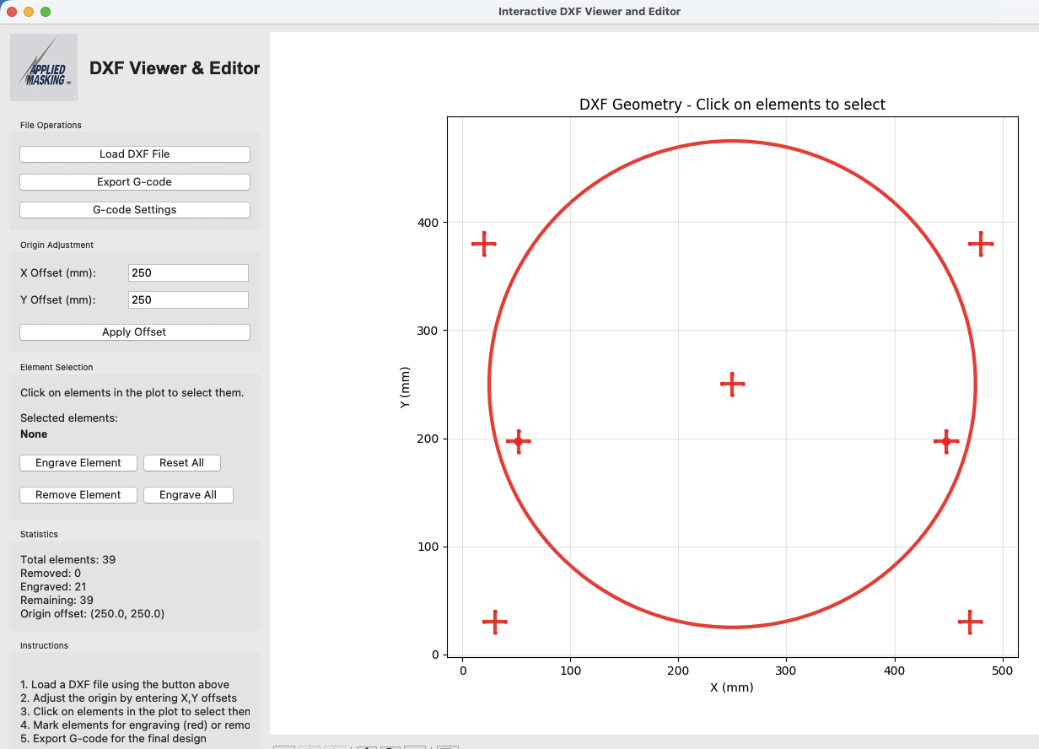
dxf2template.py GUI
Load the dxf file
Set the x and y offsets to align with laser work table
Update g-code settings as needed; laser height, power, federate
Select engrave all
Export the g-code

Slide 4
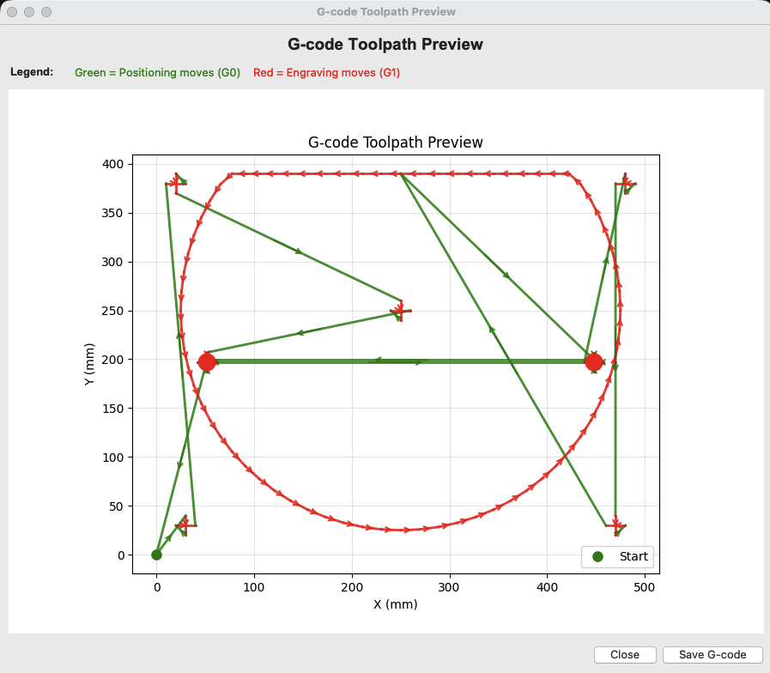
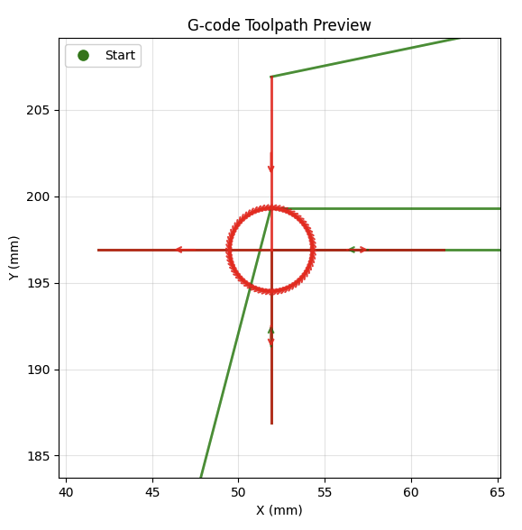
G-code preview
Paths outside laser range are truncated
dxf2template.py gives a preview of the g-code
Green are moves, red is engraving. Arrows show path direction.
Zoom in to see details

Slide 5
Next Steps
G-Code is saved as a *.nc file. It should be possible to load this into the laserGRBL code and create a template however:
We need to get the origin set
Likely use the laserGRBL to home the system and have the user jog to zero, zero in the lower left hand corner and set that as ”work origin”
The laser power, height and federate needs to be adjusted
Need to determine how Z works for the laser. When work origin is set, is that the right height for cutting.
Need to update the preamble and postscript code.

