Slide 1
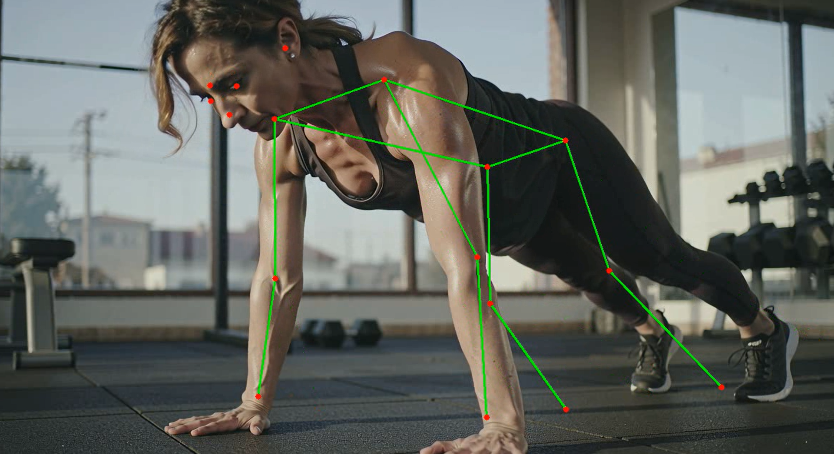
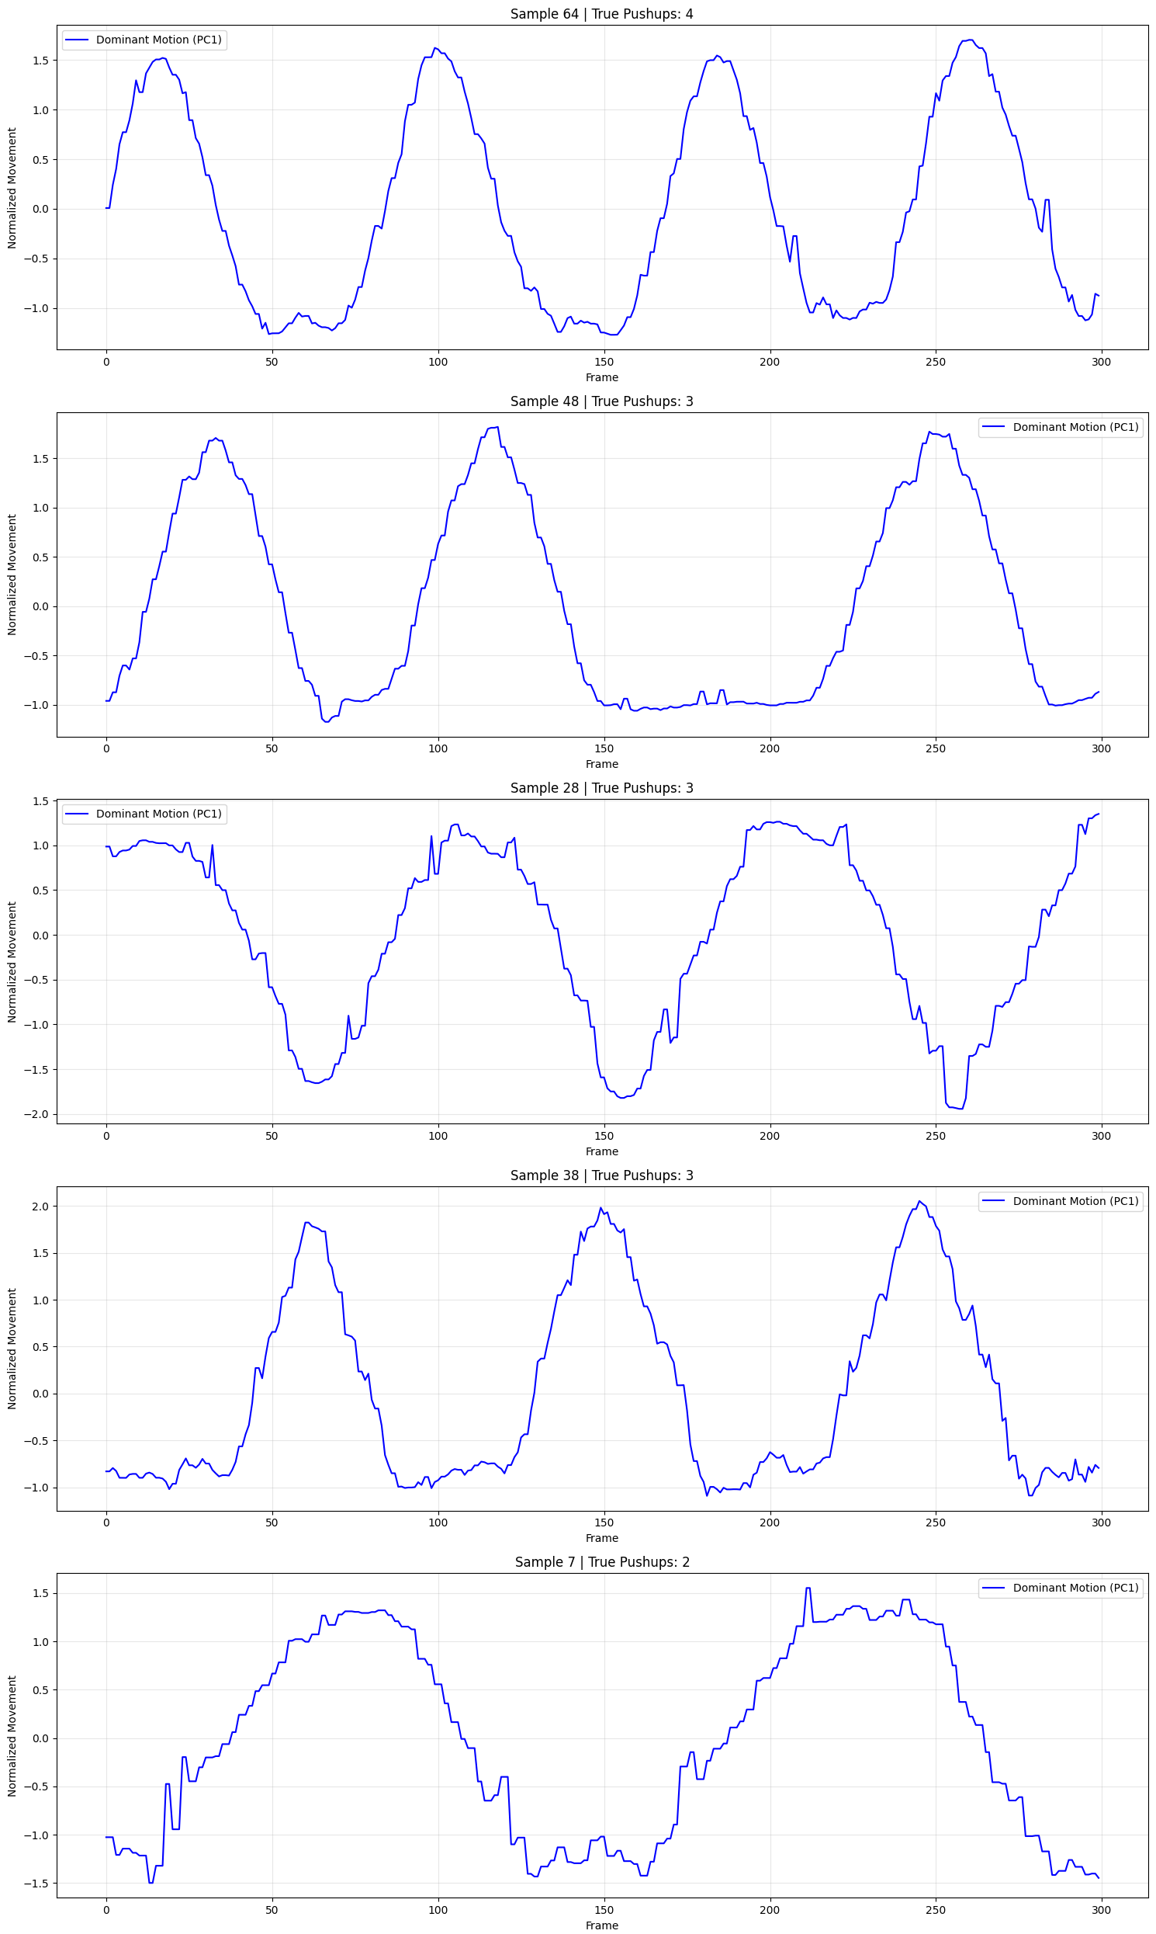
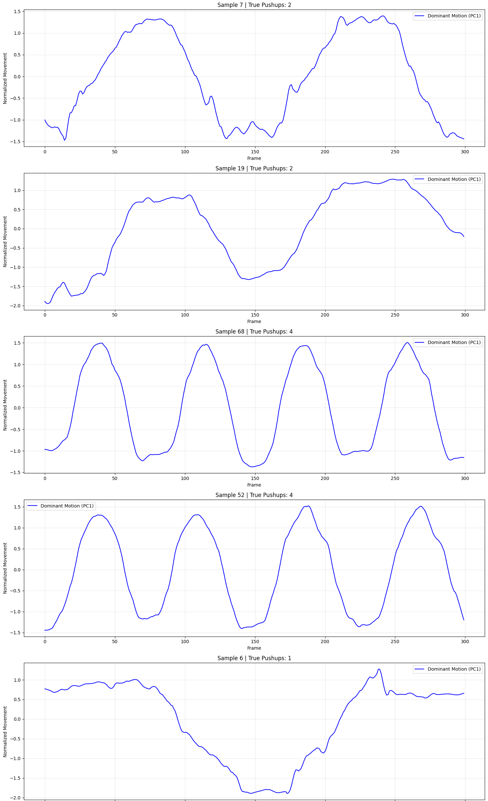
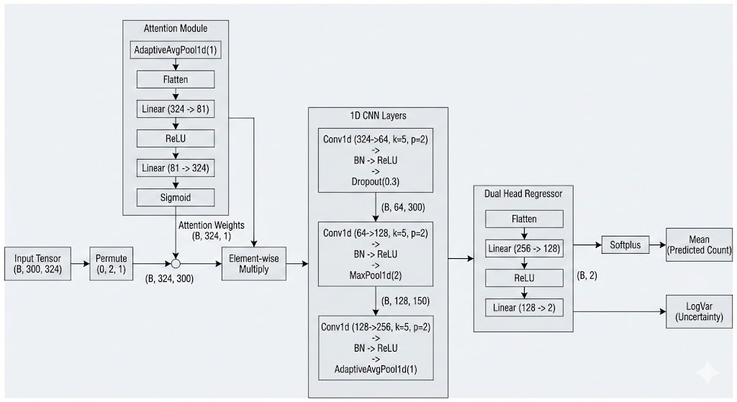
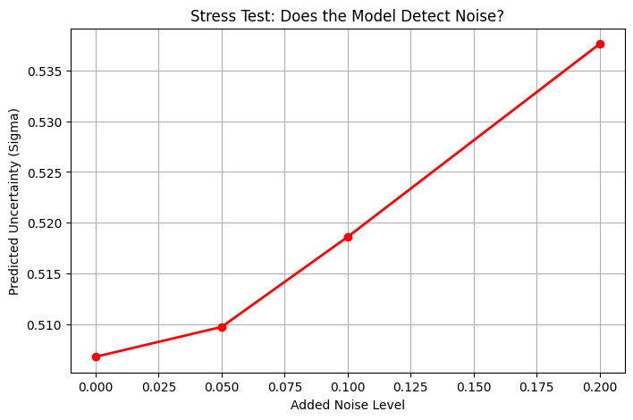
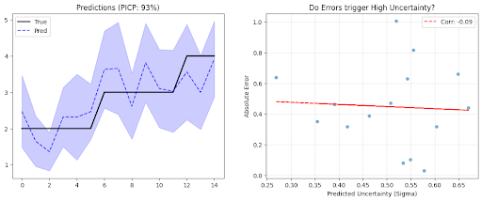
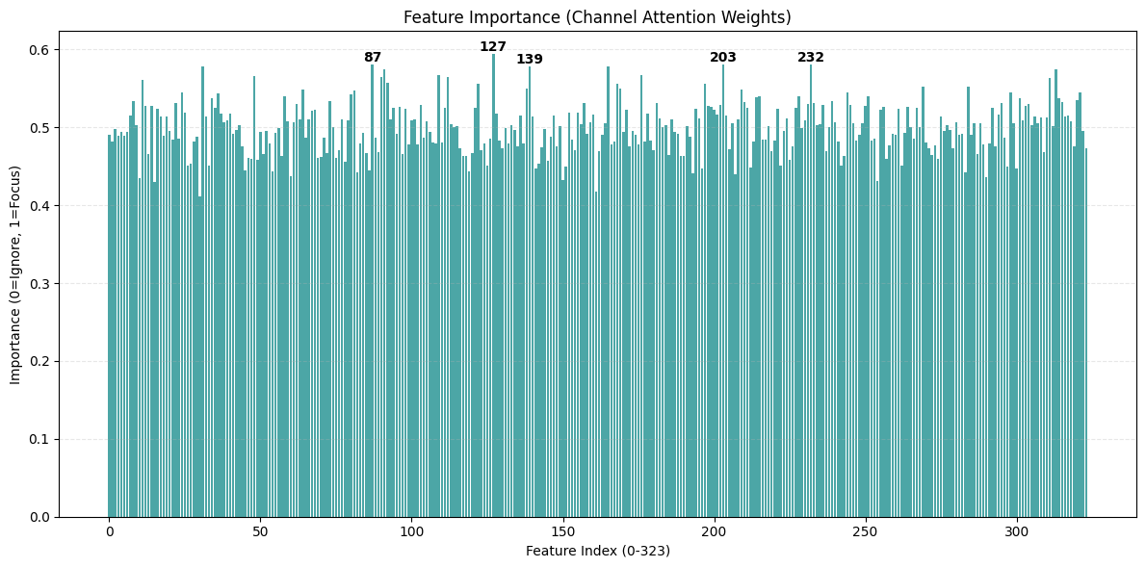
Probabilistic CNN Push-Up Counter: Architecture & Analysis
1. Learned Representations
2. Signal Extraction & Smoothing
3. Architecture
[ Paste Figure 1 Here ]
[ Paste Figure 3 Here ]
4. Probabilistic CNN (Uncertainty)
5. Adversarial Stress Testing
6. Attention Maps (Explainability)
[ Paste Figure 4 Here ]
[ Paste Figure 5 Here ]
[ Paste Figure 6 Here ]
Tech Stack: PyTorch | OpenCV | Probabilistic Deep Learning

