Slide 1
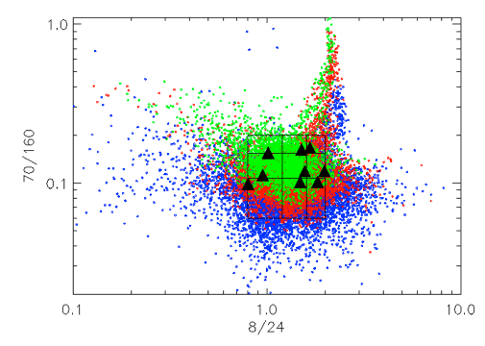
0.1 1.0
F_{ν}(70 μm)/F_{ν}(160 μm)
0.1 1.0 10.0
F_{ν}(8 μm)/F_{ν}(24 μm)

