Slide 1

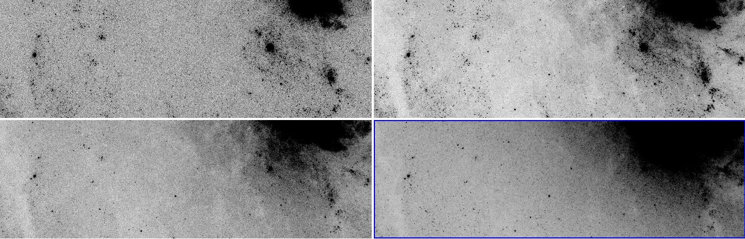
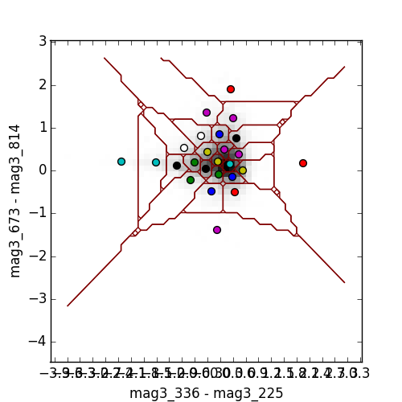
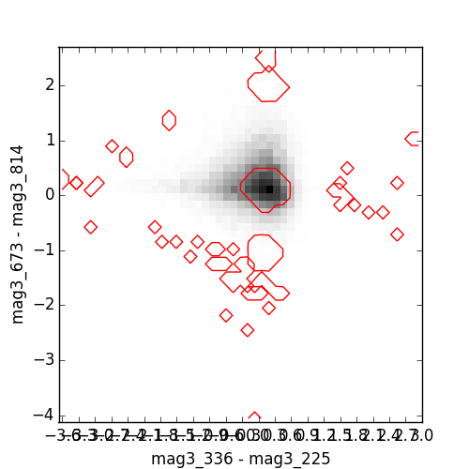
Clustering the M83 Galaxy
Alexander K. Kiar
Supervisor: Dr. P. Barmby
Western University
Photometry
Methods
Results

