Slide 1

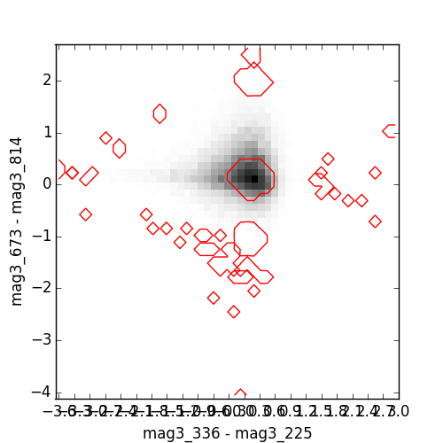
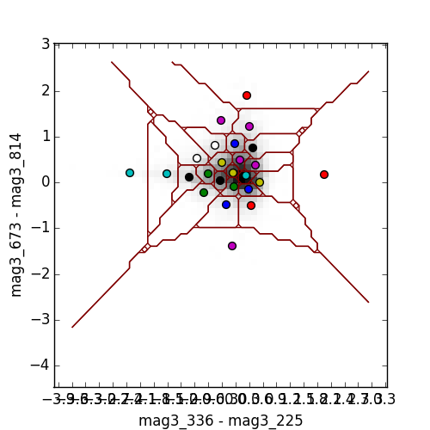
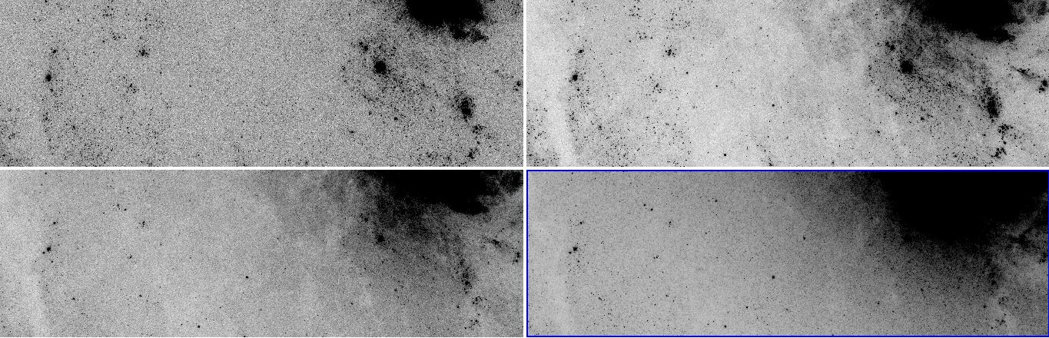
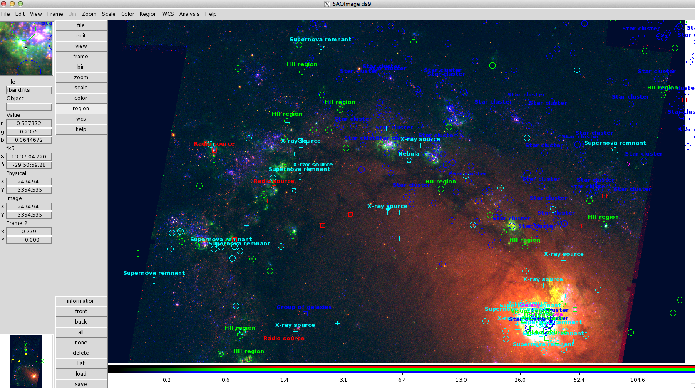
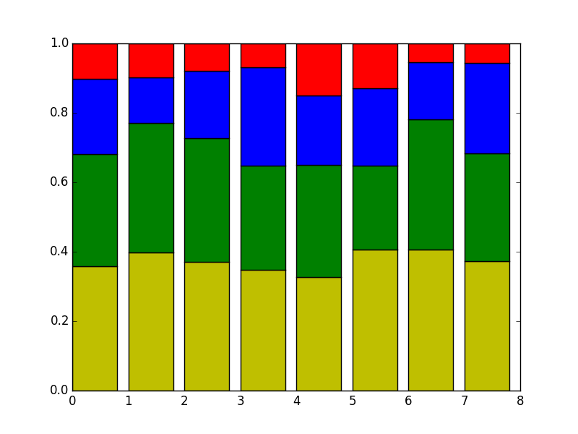
Clustering the M83 Galaxy
Alexander K. Kiar
Supervisor: Dr. P. Barmby
Western University
Abstract
Clustering Methods
The goal of this research is to determine which combinations of wavelengths identify certain celestial objects most accurately. Mean-shift and K-means clustering methods were used to identify and catalogue objects, and determine how many clusters of similar objects existed at a variety of wavelengths.
Mean-shift
K-Means
Mean-shift clustering finds local modes or peaks in a nonparametric density estimate. The method assigns each data point with the closest peak, and determines the number of clusters.
K-Means clustering minimizes the sum of squares objective function. The method picks a centroid of each, k, cluster, and assigns the closest points in the data set to each centroid.
Photometry
Results
- Trends in silhouette score
Wavelengths that give the best spread of objects/cluster
Location of certain types of objects based on color
Types of objects that are frequently found in certain colors
What is the accuracy of the clustering? Compare to other lists of objects
Photometry is the measurement and study of the amount of electromagnetic radiation that telescopes receive from celestial objects. Each object emits a specific set of wavelengths of light, which may not be visible to the eye, but reveal clues about the physical properties of the object.

