Slide 1

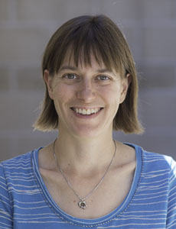
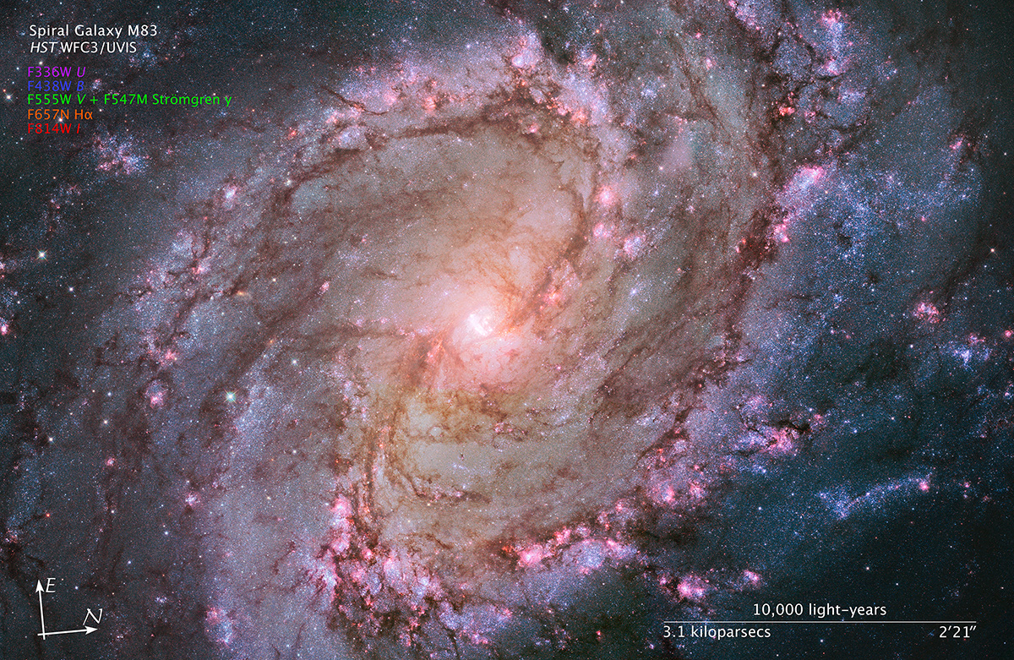
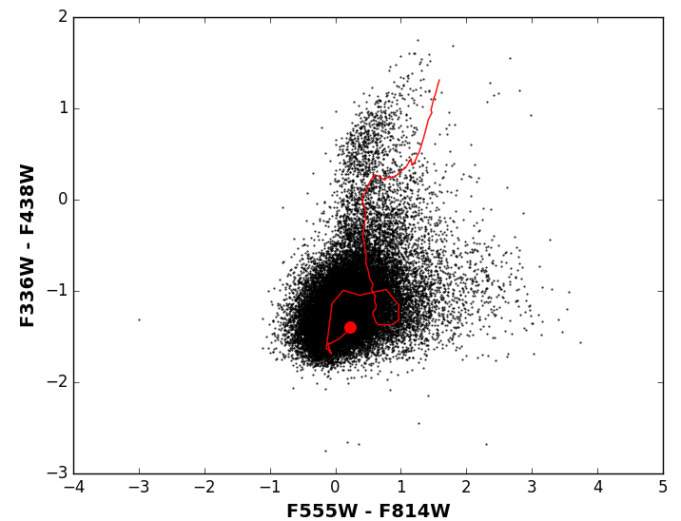
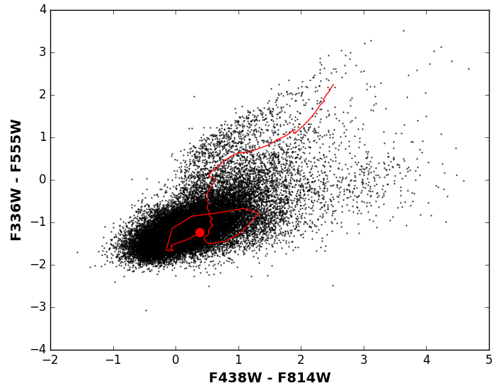
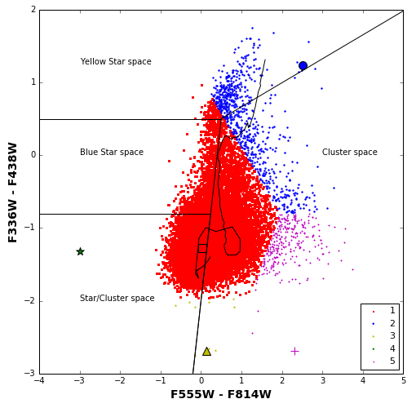
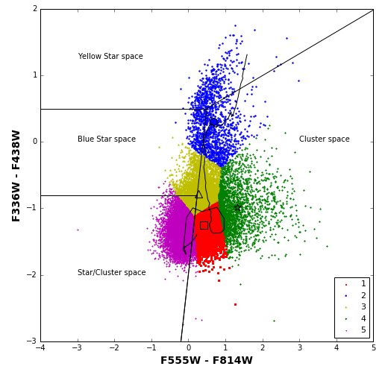
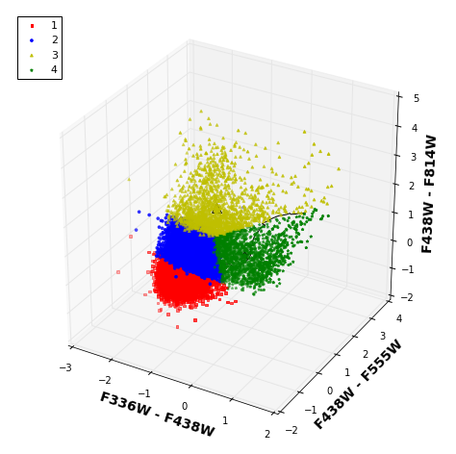
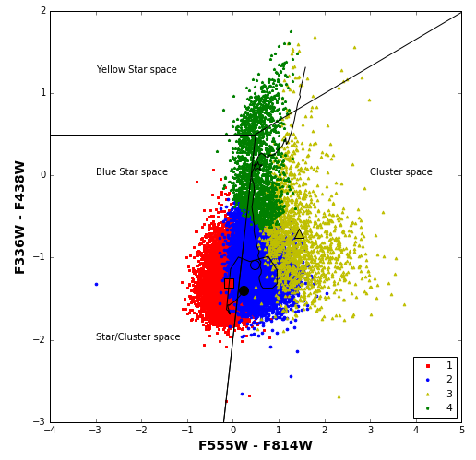
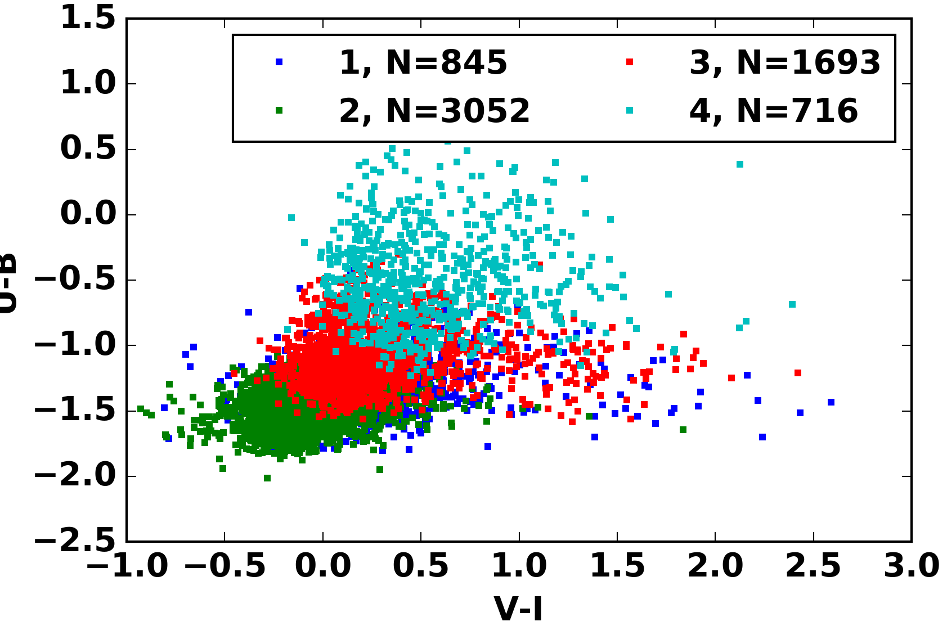
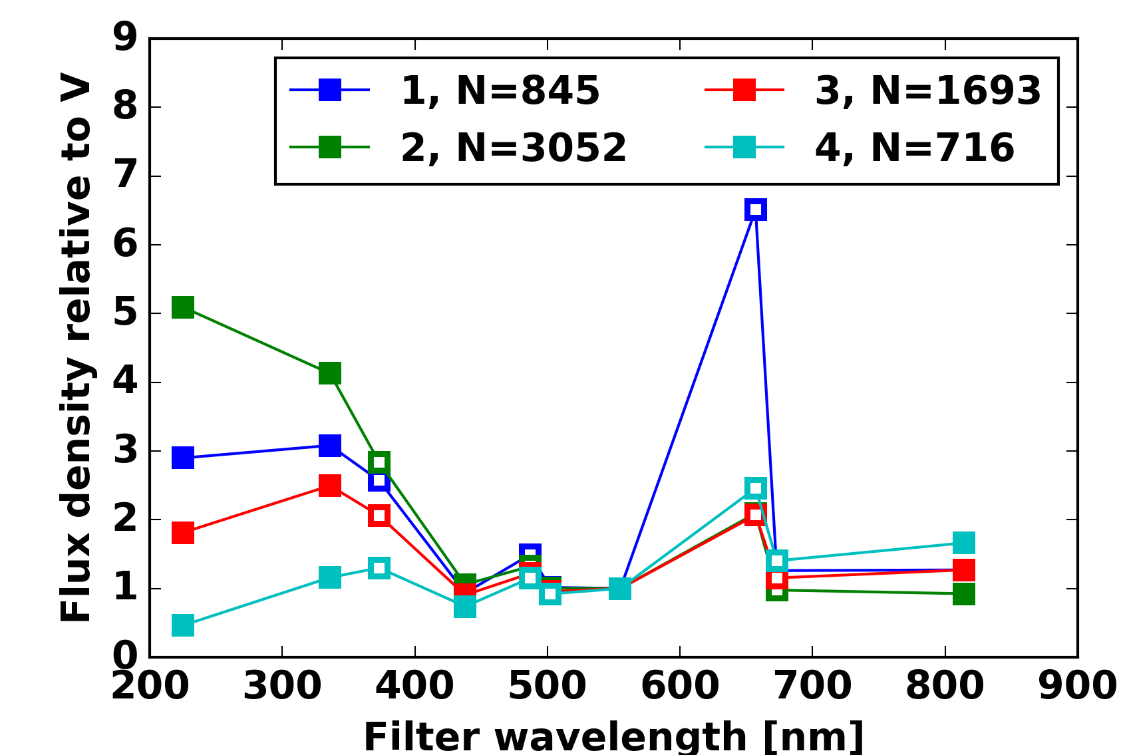
Deconstructing M83: colours of point sources in a nearby galaxy
@PBarmby
Kiar & P. Barmby, The University of Western Ontario
Abstract
Thousands of individual sources are detected in multi-band imaging observations of even a fraction of a nearby galaxy. This work analyzes a ten-band photometric catalog of nearly 70 000 point sources in Messier 83, made as part of the Early Release Science program with HST's WFC3. Two and three dimensional colour spaces were generated using various combinations of four bands and clustered with the K-Means and Mean Shift algorithms. Neither algorithm was able to consistently segment the colour distributions; however K-Means clustering of the UBVI colour space was able to identify a group of objects more likely to be star clusters and Mean Shift was successful in identifying outlying groups at the edges of colour distributions. The 10% of sources detected in all 10 bands were found to differ from each other most strongly in the ultraviolet and blue bands.
NASA, ESA, and the Hubble Heritage Team (STScI/AURA); Acknowledgement: W. Blair (STScI/JHU) and R. O'Connell (UVa)
Dataset
Catalog from Chandar et al. (2010)
1 WFC3 UVIS field: 162 x 162 arcsec
Observed in 10 filters (see Table)
Source detection on UBVI “whitelight” image, photometry in individual bands
Band | Name | #src S/N>5
F225W | Wide UV | 15011
F336W | U-band | 34129
F373N | OIII | 8878
F438W | B-band | 48858
F487N | H-beta | 13335
F502N | OII | 14654
F555W | V-band | 65652
F657N | H-alpha + NII | 23939
F673N | SII | 25295
F814W | I-band | 59600
Colour choice matters: same objects, same bands, but 2 sets of colours. Red line is super-solar SSP model from FSPS (Conroy et al. 2009), ages 10⁵ yr (red circle)-10^{10.3} yr.
Chandar et al region IDs
Cluster numbering is arbitrary
Cluster centres
Mean Shift: mostly one big cluster
K-Means: comparably-sized clusters
K-Means K=4 3D segmentation
Projection of K-Means K=4 3D segmentation (compare to 2D, left)
Clustering algorithm matters: UBVI 2D results, 5 clusters
Colour space dimensions matter: UBVI 3D results, 4 clusters
10-D clustering shows promise
K-means clustering on colours (relative to V) of 6800 objects detected in all bands
With 4 clusters, groups differ mostly in UV/blue; one group bright in H-alpha: young star clusters?
Similar results with colours relative to other bands, more/fewer clusters
Solid: broad bands
U-B
Open: narrow bands
References:
Chandar R., Whitmore B. C., Kim H., et al., 2010, ApJ, 719, 966
Conroy C., Gunn J. E., White M., 2009, ApJ, 699, 486
We acknowledge financial support from NSERC and the efforts of the WFC3 SOC in conducting the ERS program. This research has used NED, SIMBAD, Scipy and Astropy.

