Slide 1
Sequential Denoising of Quantum Monte Carlo Simulations with Deep Learning.
Pankaj Chouhan
Summer Intern, Material Science Division, Argonne National Laboratory.
Supervisors: Olle Heinonen and Sandeep Madireddy
Graduate Student, Department of Scientific Computing, Florida State University
Supervisor: Dr. Sachin Shanbhag

Slide 2
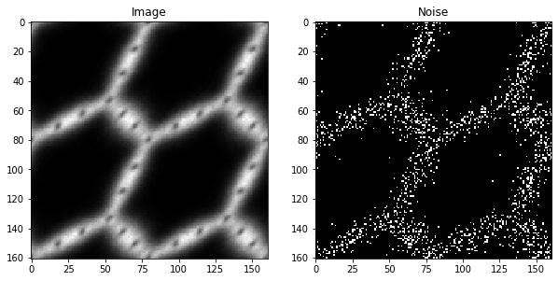
What’s Wrong with Quantum Monte Carlo Simulations?
QMC is Stochastic in Nature, Hence Produce Noise.
Ground Truth can be obtained by running a large number of Simulations.
Running simulations is costly.
This problem can be modeled into a video denoising problem where each frames correspond to simulation result at different time-steps and same spatial Noise.

Slide 3
Adaptation For QMC
t = 0
t = 1
t = T
QMC data is Volumetric, 101 x 101 x 101 (x, y, z)
Z_{i}=0
Z_{i}=1
Z_{i}=2
Z_{i}=101

Slide 4
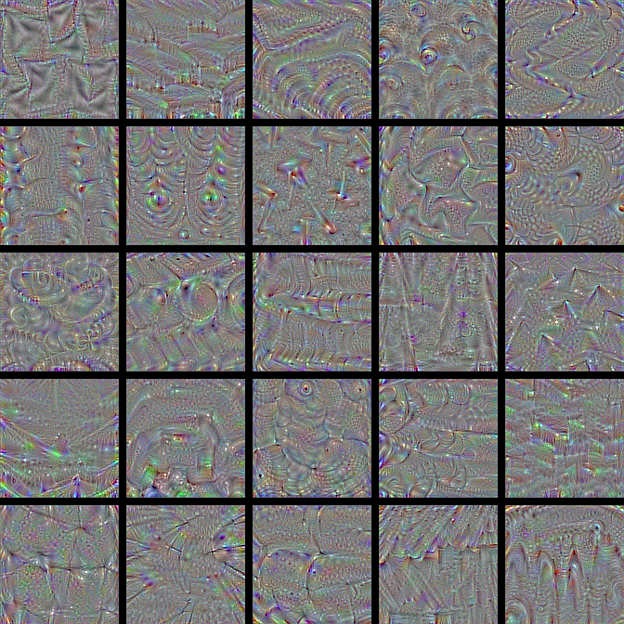
Approach 1, Model 1
To learn Common Noise among all timestep, and spatial character
CNN based Model(20 layers with BN)
Model 1
Noisy Sequence
Sequence without common noise
arXiv:1811.12766v2c [cs.Cv] 23 Feb 2019, Ehrat et.al.

Slide 5
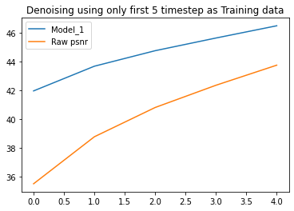
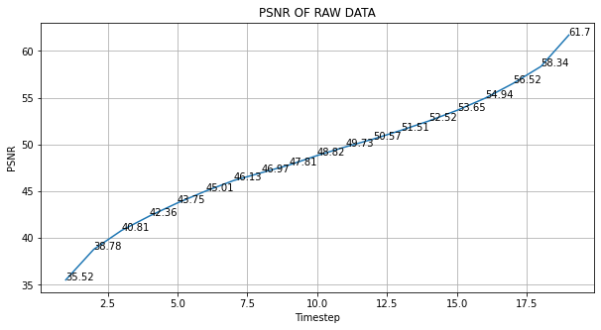
Approach 1, Model 1 Results
CNN Based model able to do the Spatial Denoising.
This Model doesn’t exploit the temporal information.
arXiv:1811.12766v2c [cs.Cv] 23 Feb 2019, Ehrat et.al.

Slide 6
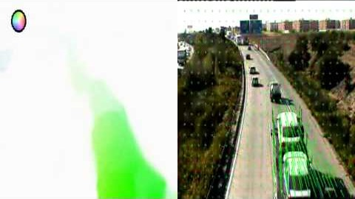
Approach 1, Model 2
Step 2 or Model 2 fine tune the weights of model 1 based on Noise2Noise One-Shoot Learning.
A mask of good pixel is created using optical flow to preserve the field.
Visualization of Optical flow
arXiv:1811.12766v2c [cs.Cv] 23 Feb 2019, Ehrat et.al.

Slide 7
Approach 1, Model 2
To learn temporal Noise
Fine Tune the weights of Model 1 by using Offline or Online Training.
Model 2
Spatially Denoised Sequence
Optical Flow
Spatially and Temporally denoised Sequence
arXiv:1811.12766v2c [cs.Cv] 23 Feb 2019, Ehrat et.al.

Slide 8
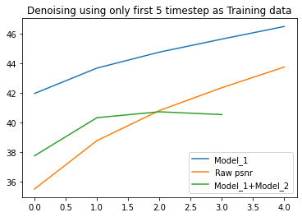
Model_1 + Model_2 Results and challenges
The Change in Noise level of consecutive frame is subtle and hence creating a good optical flow is a challenge.
The poor quality of mask created using optical flow expose the Field to Noise2Noise learning, and thus network starts to confuse the field with noise.

Slide 9
Approach 2, CNN+LSTM (CnnLSTM)
To Learn the Spatial Noise Character and Noise Progression with Time
5 CnnLSTM Layer.
CnnLSTM
Noisy Sequence from timestep 1 to t-1. Training data
A model that will Predict Sequence t+1,t+2,…, given t previous timestep
Noisy Sequence from timestep 2 to t. Target

Slide 10
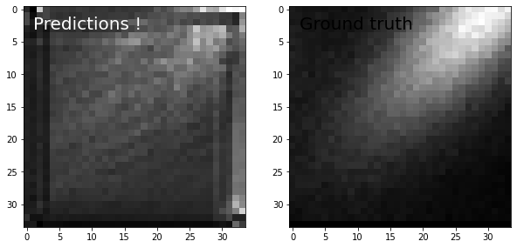
Approach 2, CNN+LSTM (CnnLSTM)
Future Work
Develop CnnLSTM model, current model is very trivial with only 5 layers.
Develop approach 1 without explicitly determining optical flow.

Slide 11
Approach 2, CNN+LSTM (CnnLSTM), Version 2
Twice the size of Initial Model, Use first 10 step as training data, and a patch size of 34.
8 CNNLSTM2D layer’s
Every CNNLSTM2D layer is followed by Batch Normalization
Kenrel Size=60,for CNNLSTM2D layer
Optimization routine AdaDelta, with lr = 0.01
Epoch = 200
loss_fn = tfk.losses.MeanAbsoluteError(reduction=tf.keras.losses.Reduction.SUM)

Slide 12
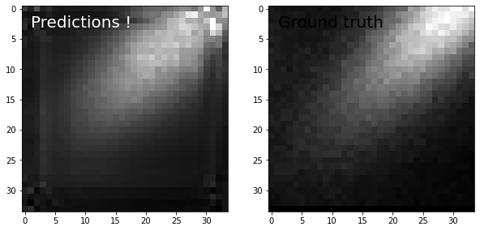
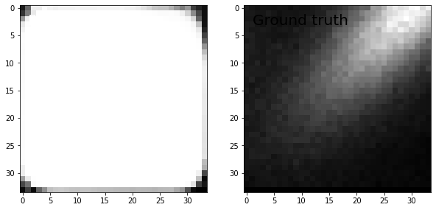
Approach 2, CNN+LSTM (CnnLSTM), Version 2
Prediction
One Step Ahead
Two Step Ahead

Slide 13
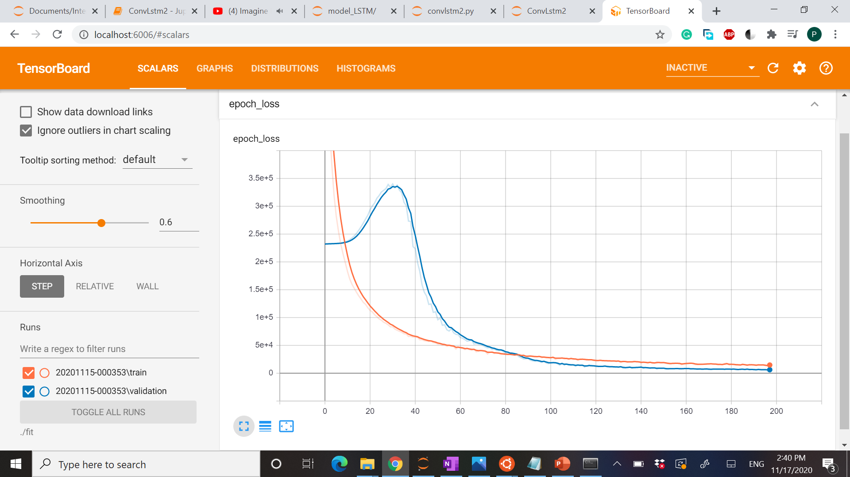
Approach 2, CNN+LSTM (CnnLSTM), Version 2

Slide 14
Acknowledgment
Olle G. Heinonen, Senior Materials Scientist, Materials Science Division, Argonne National Laboratory.
Sandeep R. Madireddy, Assistant Computer Scientist, Mathematcis and Computer Science Division, Argonne National Laboratory.
Sachin Shanbhag, Professor, Department of Scientific Computing, Florida State University.
Hyeondeok Shin – DMC calculations of noisy densities (NiO)
DOE-BES funding through the Computational Materials Center “Center for Predictive Simulations of Functional Materials”

