Slide 1
XEnsemble-1.0 Code Package
Wenqi Wei
Georgia Tech

Slide 2
Schema
Prediction portal
adversarial
Attack portal
generate
saved adversarial examples
load
Select input(benign or attack)
Input verifier
load
Input verifier method
Trained models
load
Output verifier
Red: code file
Yellow: saved data/model
White: flow component of the defense-prediction portal

Slide 3
arguments
This code is built on top of Feature Squeezing[1].
We consider the following arguments:
Dataset_name: dataset for the experiment, now support MNIST, CIFAR-10, ImageNet, LFW
Model_name: target model in use
Attacks: attack faced by the prediction system – adversarial example or OOD input
Input_verifier: input denoising method used for the input verifier
Output_verifier: models used for the output verifier
[1] Xu, Weilin, David Evans, and Yanjun Qi. "Feature squeezing: Detecting adversarial examples in deep neural networks." arXiv preprint arXiv:1704.01155 (2017).

Slide 4
Dataset_name, model_name and output_verifier
dataset_name | model_name or output_verifier
MNIST | CNN1, CNN1_30, CNN1_40, CNN1_half, CNN1_double, CNN2, CNN2_30, CNN2_40, CNN2_half, CNN2_double
CIFAR-10 | densenet, CNN1, CNN2, resnet-20, resnet-32, resnet-44, resnet-56, resnet-110
ImageNet | mobilenet, VGG-16, VGG-19, resnet-50, Inceptionv3
LFW | CNN1, CNN2
Red: default model, if do not use output verifier, this model will be used for prediction. Also, adversarial attacks are generated on those models.
Output_verifier choose multiple models from the list.

Slide 5
Description of the models
models | description | source | framework | comments
CNN1 | a 7-layer CNN | [1] | Keras(Tensorflow) | _half: #feature maps are reduced to half _double: #feature maps are doubled _30/40: training epochs
CNN2 | a 5-layer CNN | [2] | Keras(Tensorflow)
ResNet | a ResNet model | [3] | Keras(Tensorflow) | -20/32/44/56/110: # resnet layers
Densenet | a Densenet model | [4] | Keras(Tensorflow) | 40 layer, loaded a pretrained model
Mobilenet | a Mobilenet model | [5] | Keras(Tensorflow) | loaded a pretrained model
VGG | a VGG model | [6] | Keras(Tensorflow) | 16 or 19 layer, loaded a pretrained model
InceptionV3 | an InceptionV4 model |  | Keras(Tensorflow) | loaded a pretrained model
[1] https://github.com/carlini/nn_robust_attacks/blob/master/train_models.py
[2] https://github.com/tensorflow/cleverhans/blob/master/cleverhans/utils_keras.py
[3] https://github.com/keras-team/keras/blob/master/examples/cifar10_resnet.py
[4] https://github.com/titu1994/DenseNet/blob/master/densenet.py
[5] https://github.com/titu1994/MobileNetworks/blob/master/mobilenets.py
[6] https://github.com/fchollet/deep-learning-models

Slide 6
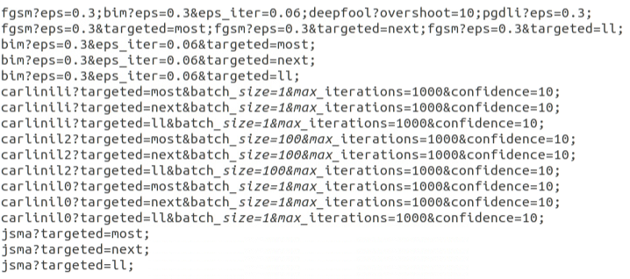
Attacks
Attacks type | Attack algorithm
untargeted | fgsm, bim, deepfool, pgd
Targeted (next class, most-likely and least-likely class) | FGSM, BIM, CW_i, CW_2, CW_0, JSMA
MNIST attack Parameter setting
Note: the attack input here need to be consistent with the attack_portal as the file is saved in the name of attack method, attack target model, and attack parameters.
We use the attack format as provided by Feature Squeezing(EvadeML), and we can only load one attack at a time.
Feel free to try the attack setting in Feature Squeezing and other attack parameters.

Slide 7
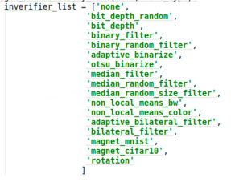
Input_verifier:
A variety choice of input denoising method is available.
Takes input verifier one by one with a separator “;”.
As provided by feature squeezing, added rotation.

Slide 8
XEnsemble Research
[1] Wenqi Wei, Ling Liu, Margaret Loper, Stacey Truex, Lei Yu, Mehmet Emre Gursoy, and Yanzhao Wu. "Adversarial examples in deep learning: Characterization and divergence." arXiv preprint arXiv:1807.00051 (2018).
[2] Ling Liu, Wenqi Wei, Ka-Ho Chow, Margaret Loper, Mehmet Emre Gursoy, Stacey Truex, and Yanzhao Wu, "Deep Neural Network Ensembles against Deception: Ensemble Diversity, Accuracy and Robustness.“ In the 16th IEEE International Conference on Mobile Ad-Hoc and Smart Systems (MASS), IEEE, 2019.
[3] Wenqi Wei, Ling Liu, Margaret Loper, Ka Ho Chow, Emre Gursoy, Stacey Truex, Yanzhao Wu. "Cross-layer Strategic Ensemble Defense against Adversarial Examples." In International Conference on Computing, Networking and Communications(ICNC), 2020.
[4] Wenqi Wei, Ling Liu, Margaret Loper, Mehmet Emre Gursoy, Stacey Truex, Lei Yu, and Yanzhao Wu, "Demystifying Adversarial Examples and Their Adverse Effect on Deep Learning", under the submission of IEEE Transaction on Dependable and Secure Computing.
[5] Wenqi Wei, and Ling Liu, "Robust Deep Learning Ensemble against Deception", under the submission of IEEE Transaction on Dependable and Secure Computing.

