Slide 1

Midterm Mastery

Slide 2
What I have enjoyed learning so far
CAP Theorem Explains Master-Slave Read Inconsistency
MapReduce: From Paper to Practice
Auto-Scaling in Product-API

Slide 3
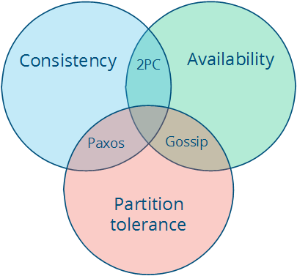
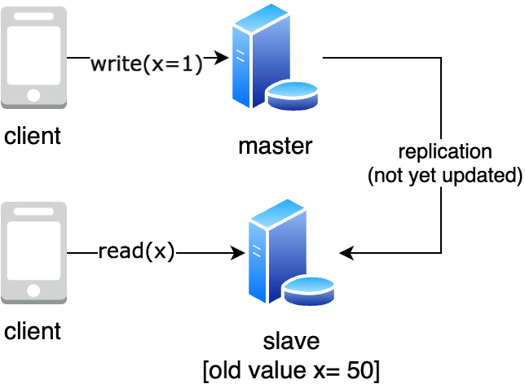
CAP theorem explains master-slave inconsistency

Slide 4
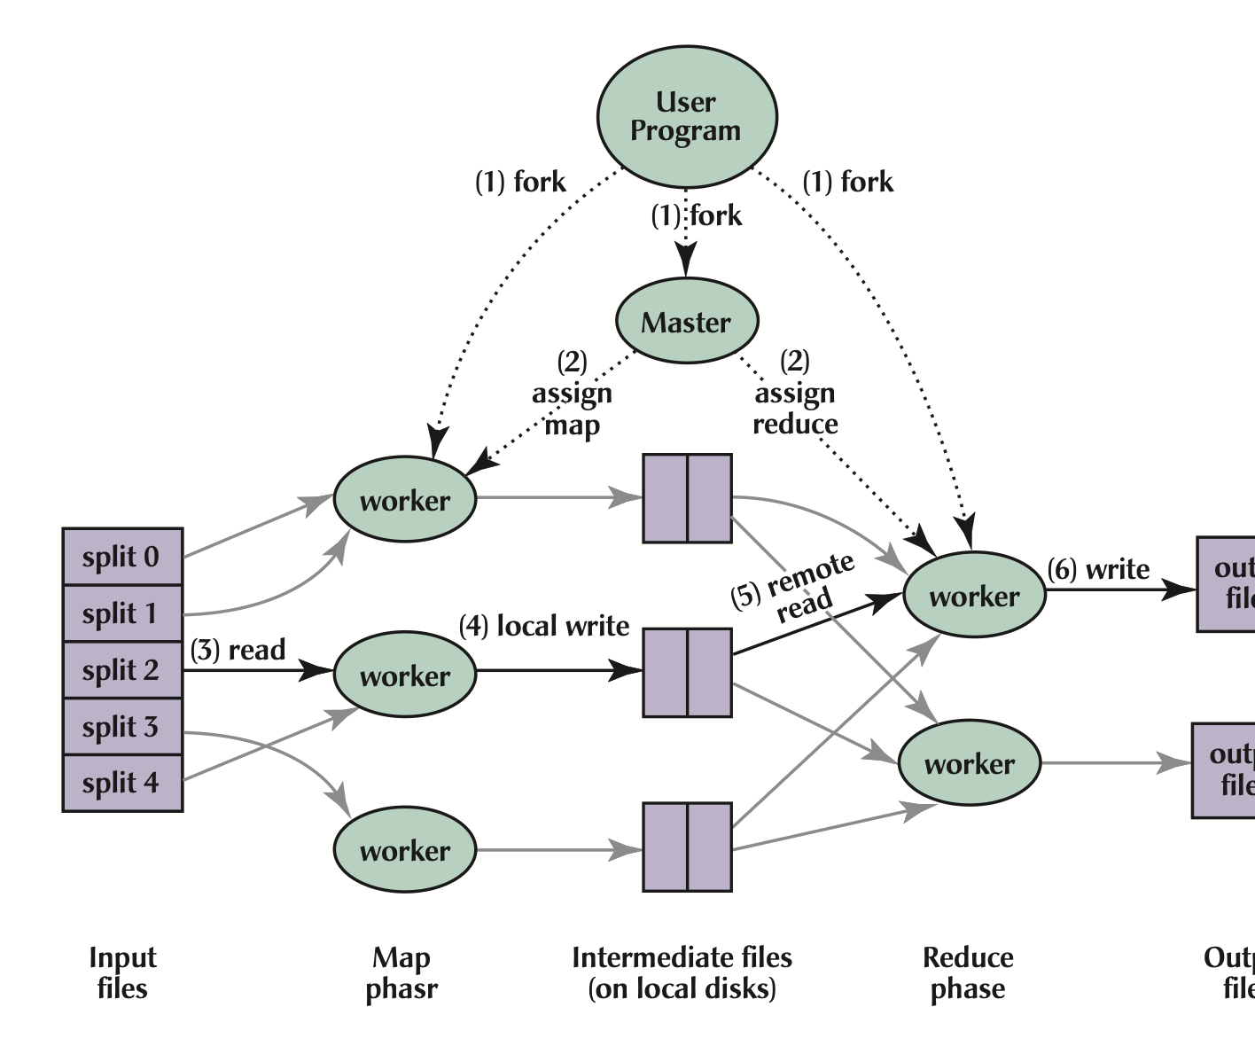
Mapreduce: from paper to practice
MapReduce = Simple Abstraction + Powerful Framework
Map: Transform data in parallel
Reduce: Aggregate results
Framework: Handles failures, scheduling, distribution

Slide 5
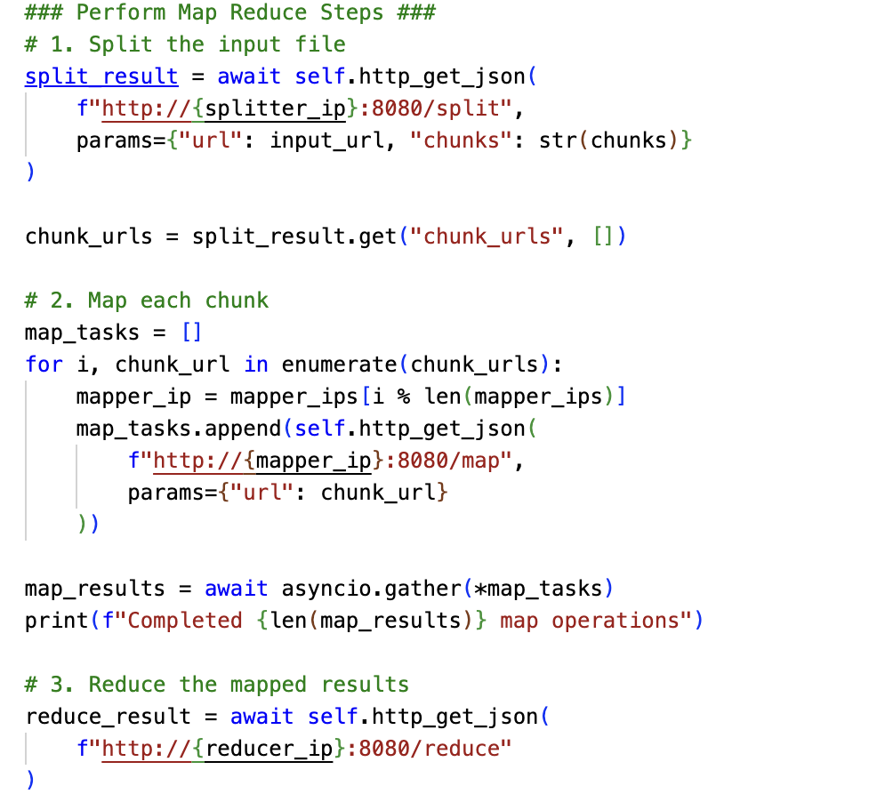
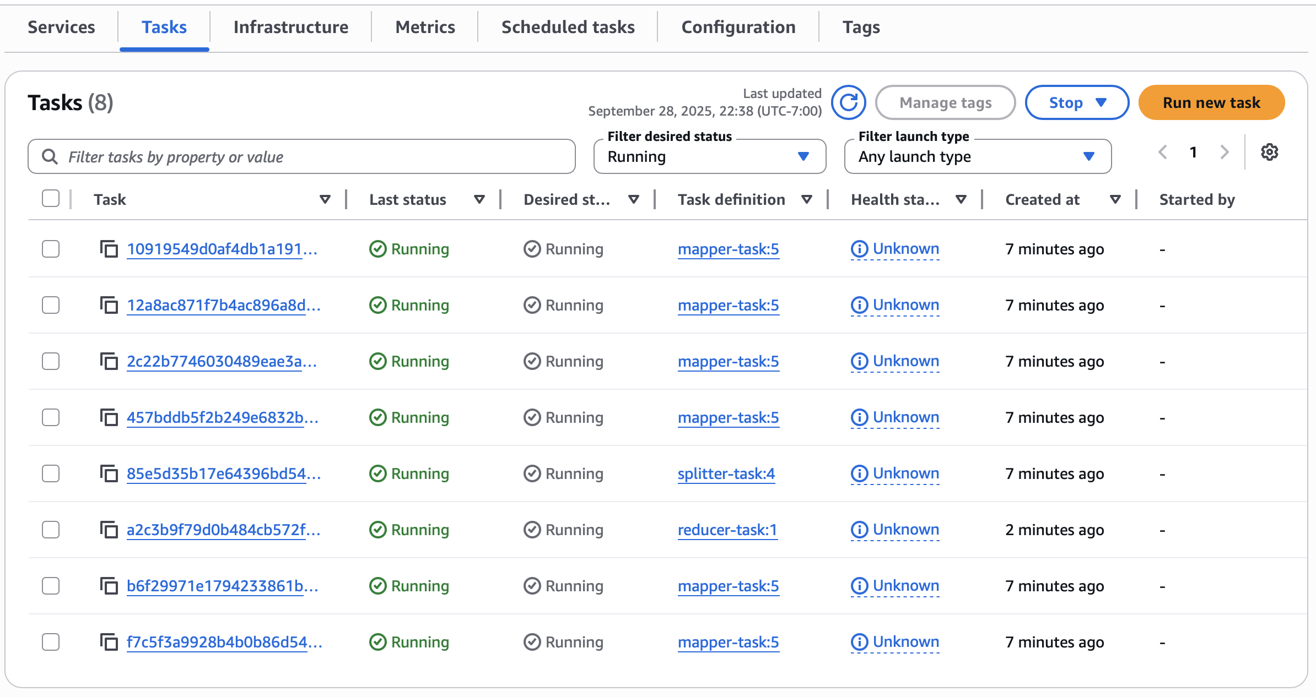
Mapreduce: from paper to practice

Slide 6
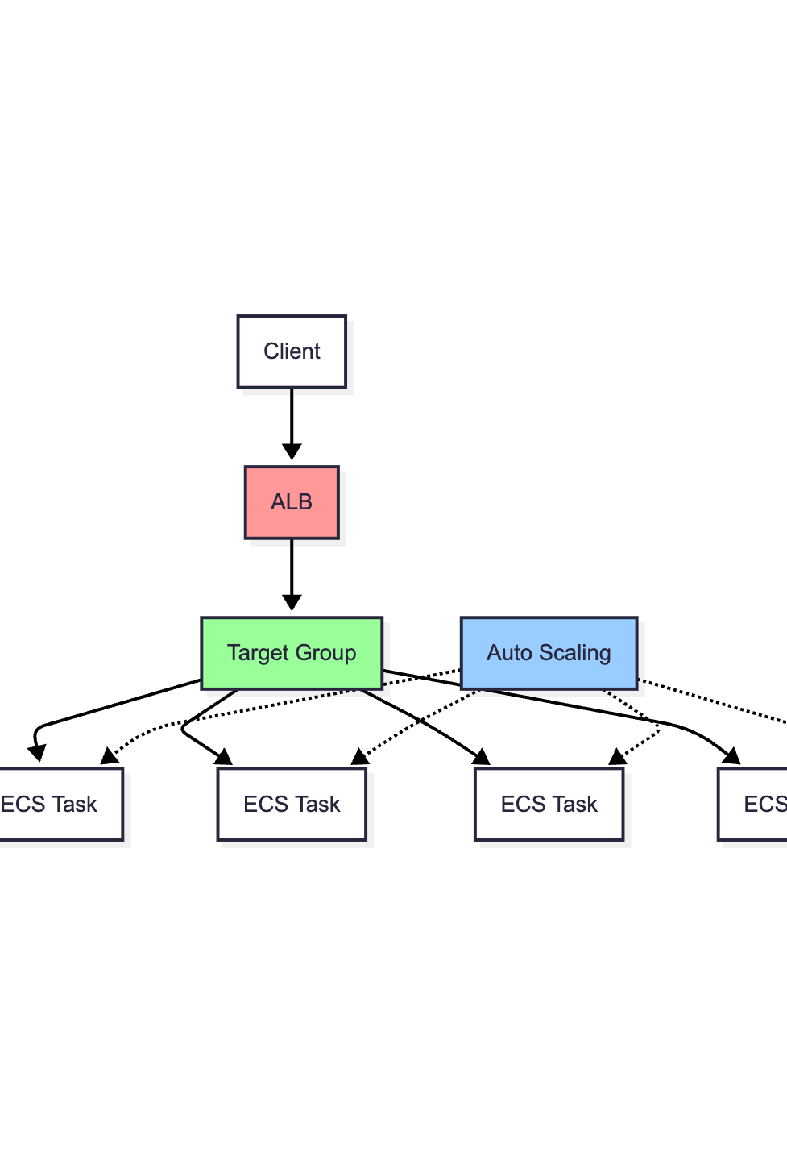
Auto-Scaling implementation
Users | Task Count | CPU Usage (%) | Memory Usage (%) | RPS | 50% Response Time (ms) | 95% Response Time (ms)
0 | 2 | 3 | 6 | N/A | N/A | N/A
20 | 2 | 40 | 10 | 9 | 40 | 200
40 | 2 | 70 | 14 | 17 | 70 | 440
60 | 3 | 80 | 15 | 25 | 55 | 430
80 | 4 | 75 | 18 | 34 | 47 | 340

Slide 7

Crashing & recovering
MapReduce Fault Tolerence

Slide 8
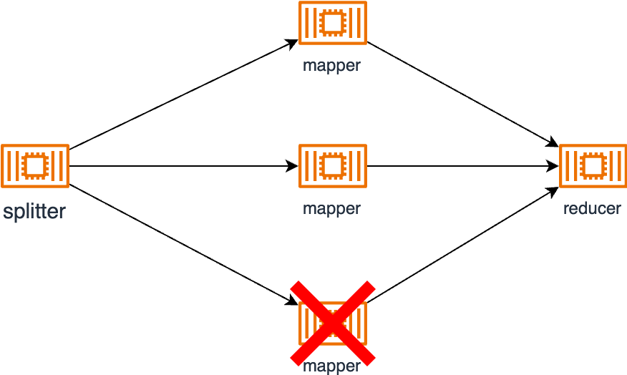
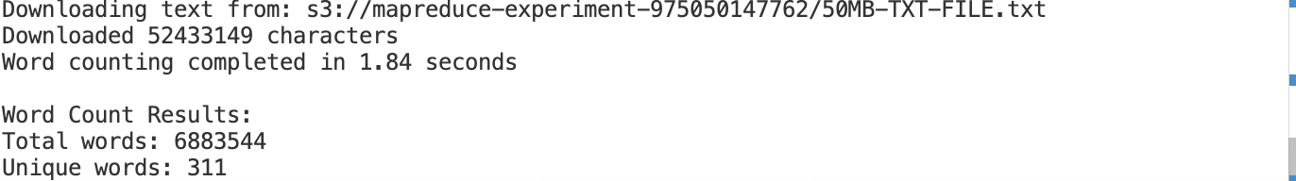
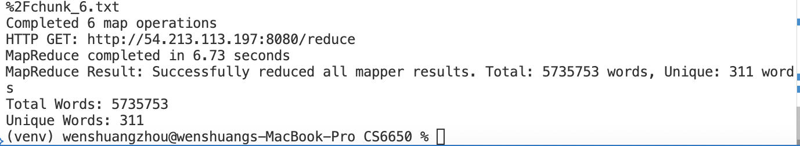
Partial mapper failed

Slide 9
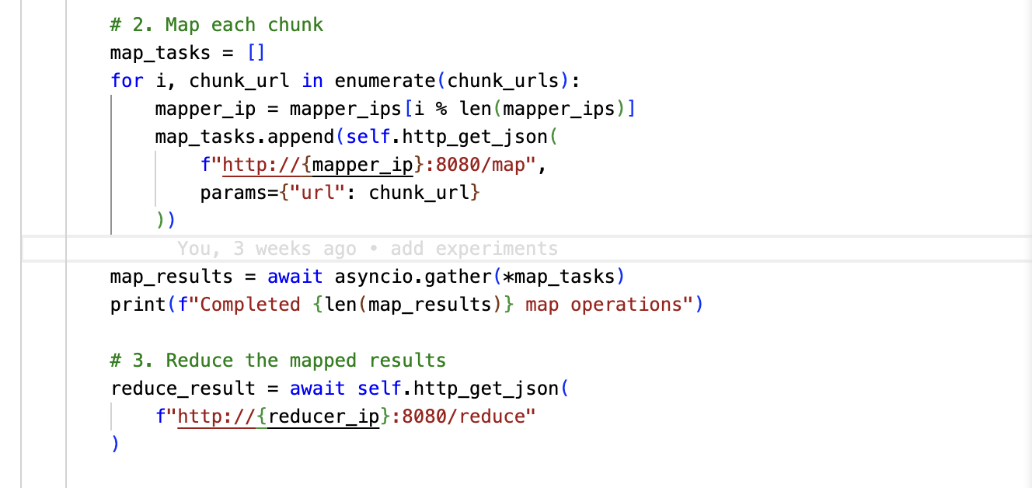
Fault Reason

Slide 10
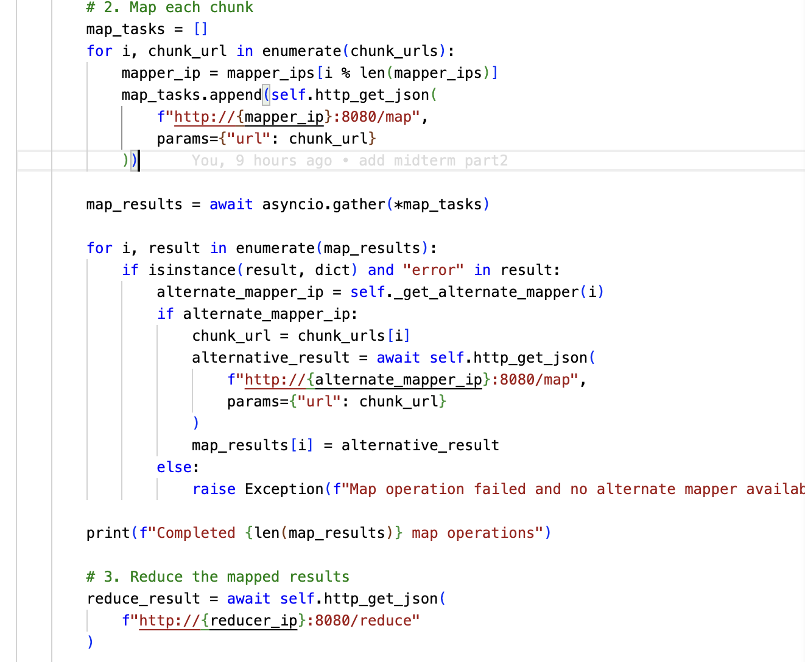
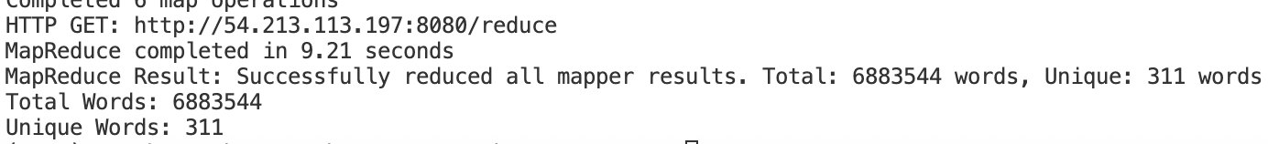
How to fix

