Slide 1


sectionA-folder
js
Javascript files
css
CSS style files
img
Pictures and diagrams files
icons
Icons files
refs
Third party tools files (if possible)
<sectionA-filename>.adoc
Documentation files
Documentation Generic Structure

Slide 2
Documentation Inclusion (1)
Hierarchical
sectionA-folder
<sectionA-filename>.adoc
Documentation files
include::sectionB-filename.adoc[leveloffset=+1,tag=all]
sectionB-folder
<sectionB-filename>.adoc
Documentation files

Slide 3
Documentation Inclusion (2) Agregation
sectionA-folder
<sectionA-filename>.adoc
Documentation files
include
sectionB-folder
<sectionB-filename>.adoc
Documentation files

Slide 4
sectionA-folder
Documentation Inclusion (1) Hierarchical
js
Javascript files
css
CSS style files
img
Pictures and diagrams files
refs
Third party tools files (if possible)
<sectionA-filename>.adoc
Documentation files
include
sectionB-folder
<sectionB-filename>.adoc
Documentation files

Slide 5
section-folder
Export to png, jpg
copy
Pictures and diagrams files
PNG
img
Third party tools
copy (if possible)
Third party tools files
refs
integrate
ADOC
<section-filename>.adoc
Documentation files
Convert with pandoc

Slide 6


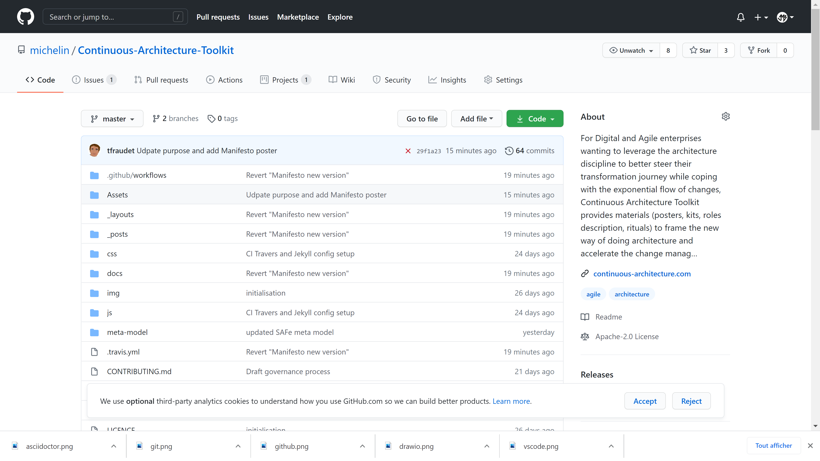
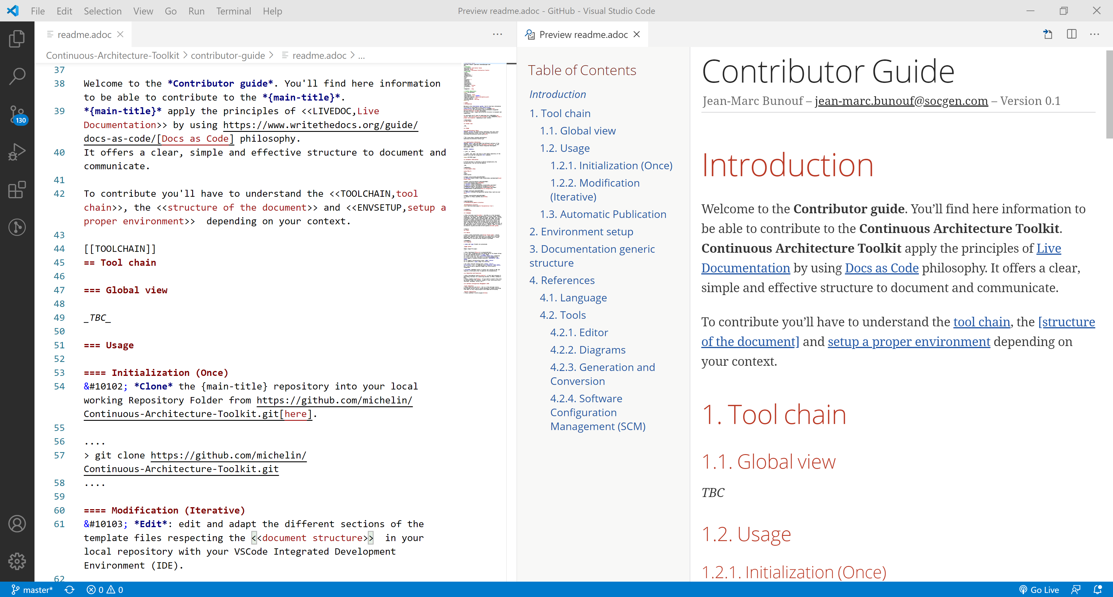


GitHub
VSCode
extensions
GitHub
1
2
3
Clone
Edit
Update
Automatic publication

