Slide 1
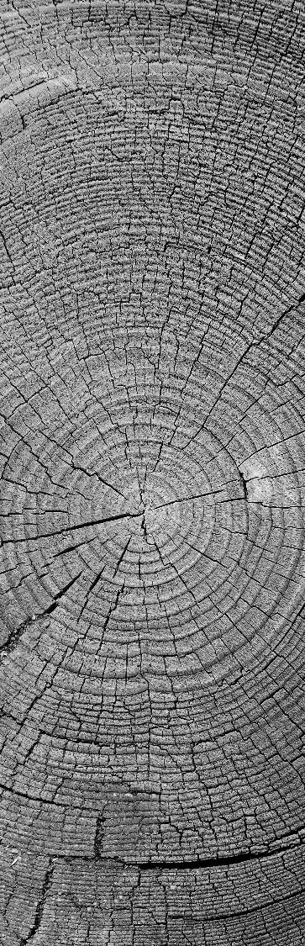
CRUD Application
PIERS BARBER
Yu-Gi-CRUD

Slide 2

Contents
The Brief
Idea
Technologies
CRUD Functionality
Testing
Live Demo
Difficulties
Successes
Wrap up

Slide 3
Brief
To create a CRUD application with utilisation of technologies and methodologies covered during training.
Scope
Documentation
Relational database
Python web application
Test coverage
Automated CI pipeline
Constraints
GCP MySQL
Flask Front end
Git Version Control
Jenkins CI server

Slide 4
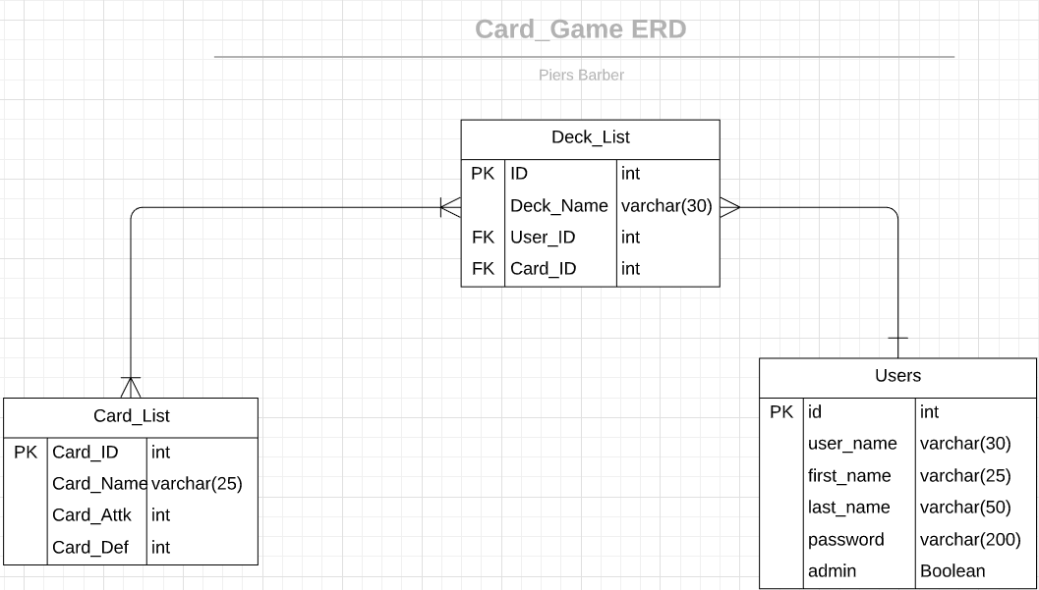
Yu-Gi-CRUD
A childhood obsession turned web-app
Idea
A simple web app for constructing Yu-Gi-Oh type decks
Log in
Create/Edit cards
Create/Remove decks
Search card database
Edit users
Change passwords

Slide 5
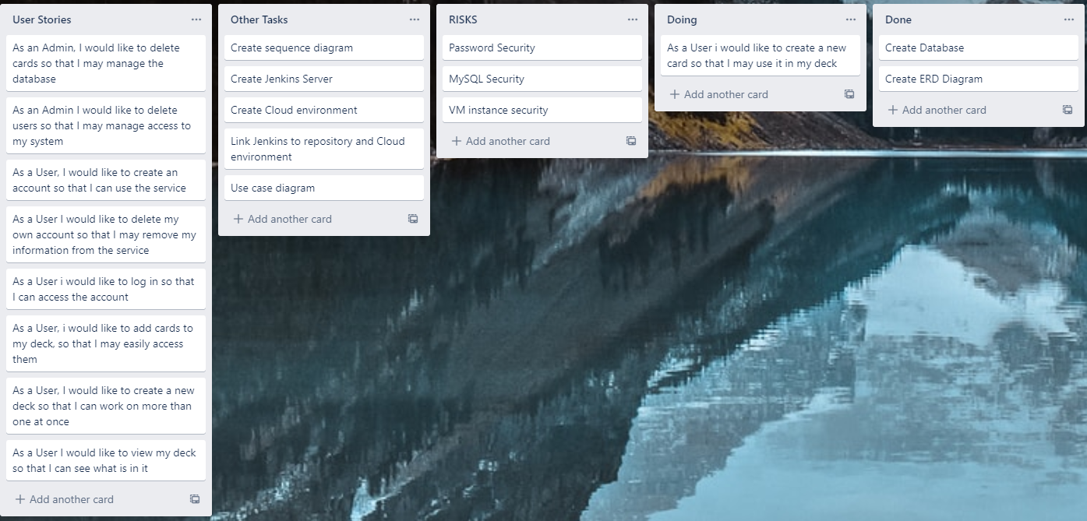
KANBAN

Slide 6

Technologies
Jenkins
Green Unicorn
Flask
Git
GCP
Python
MySQL

Slide 7
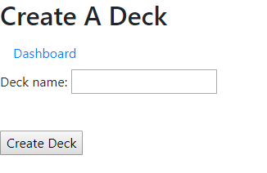
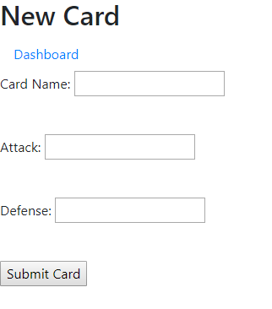

Create

Slide 8
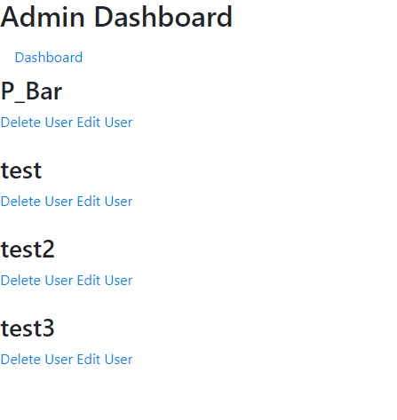
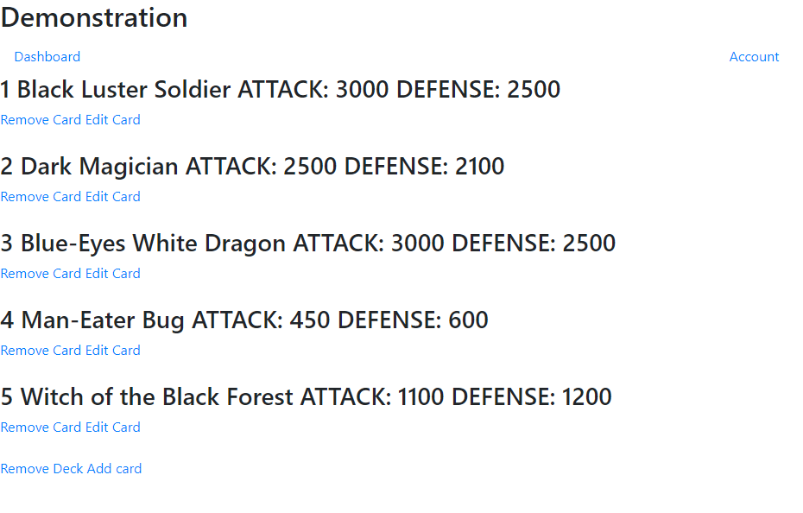
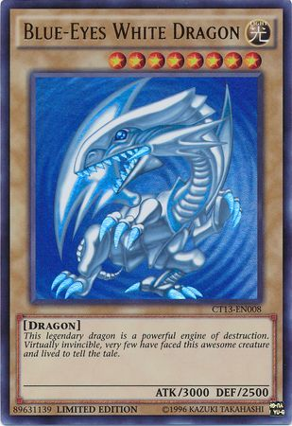
Read

Slide 9
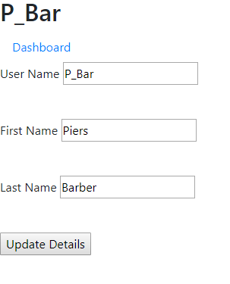
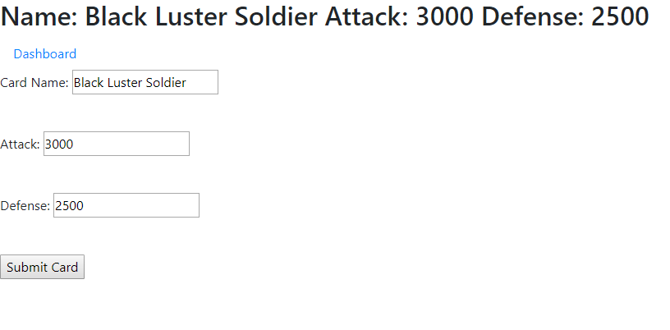
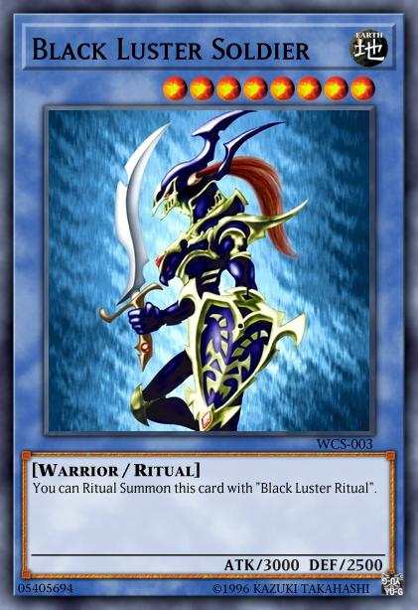
Update

Slide 10
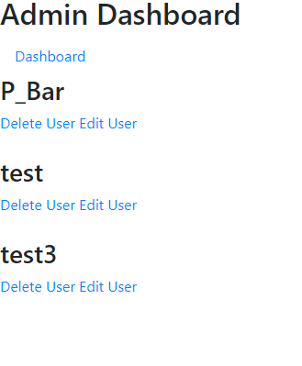
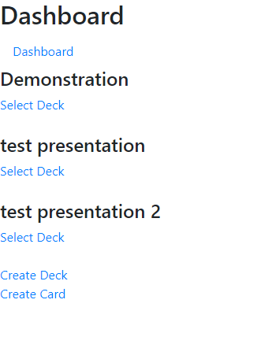
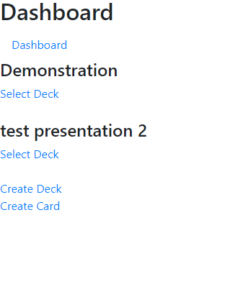
Delete
User deletion also removes all decks associated with that user

Slide 11
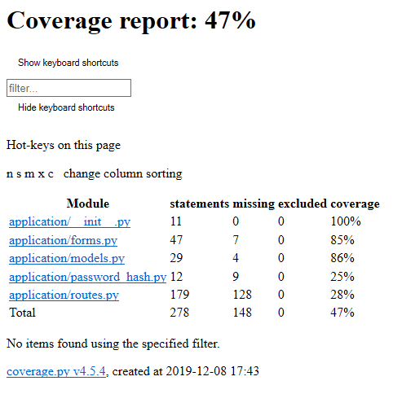
Testing
Improvements
Integration testing
Splitting of functions

Slide 12
Live Demo
http://35.246.125.174:8001/

Slide 13
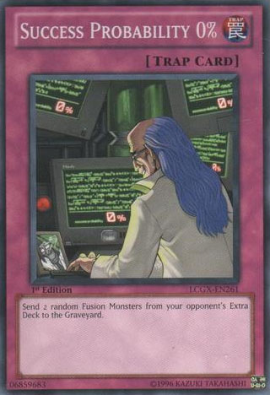
Difficulties
Design
Many to many table relationship
Displaying query data
Code
Admin Panel
Search Bar

Slide 14
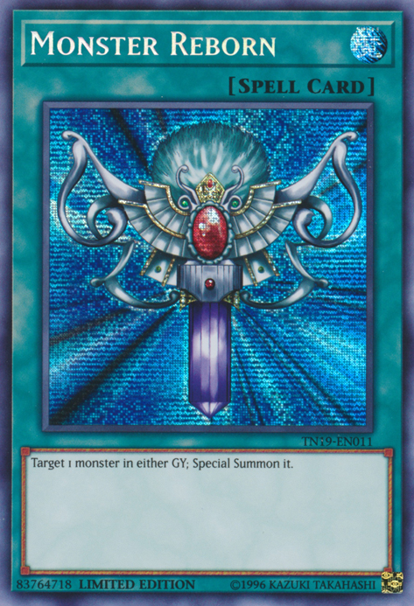
Successes
Design
Full CRUD Implementation
Efficient use of links
Code
Users have many decks
Admin can edit any user

Slide 15
Wrap up
Deliverables
Fully functional deployed web app
Automated jenkins pipeline
Testing suite
Future Improvements
Improve aesthetic
Search bar functionality
Integration testing
Admin ability to delete cards

Slide 16
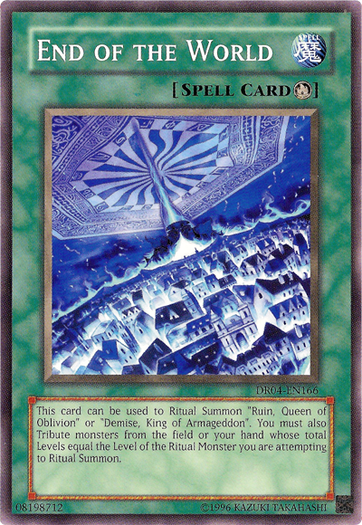
THANK YOU for listening
WOODGROVE BANK

