Slide 1

IMAGED – a pcp project

Slide 2
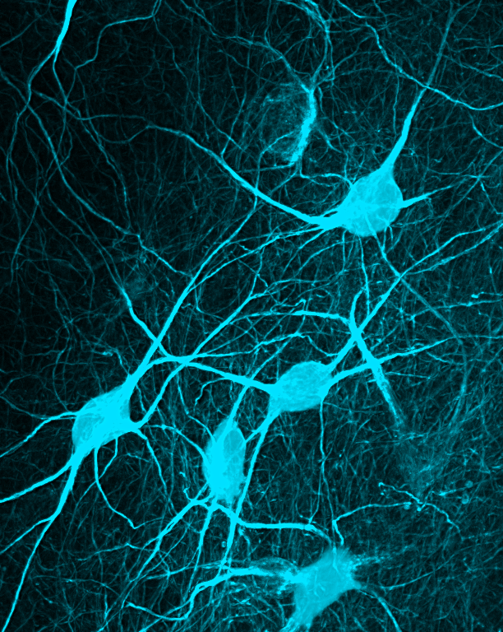
AGENDA
The vision
Our Github repo
Current status
Future Plans/Road map
Questions
This Photo by Unknown Author is licensed under CC BY-SA-NC

Slide 3
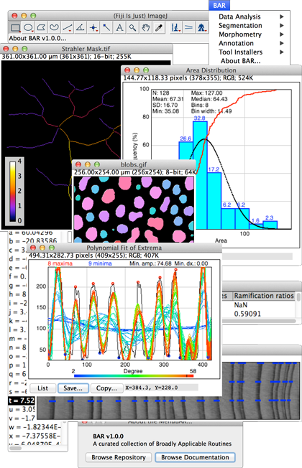
The vision
Create an image processor like ImageJ that…
Is mainly used for microscopy images
Does all the basics
Has automatic edge detection, counting, etc.
Has a graphical user interface
Is simply great.
Fiji - ImageJ

Slide 4
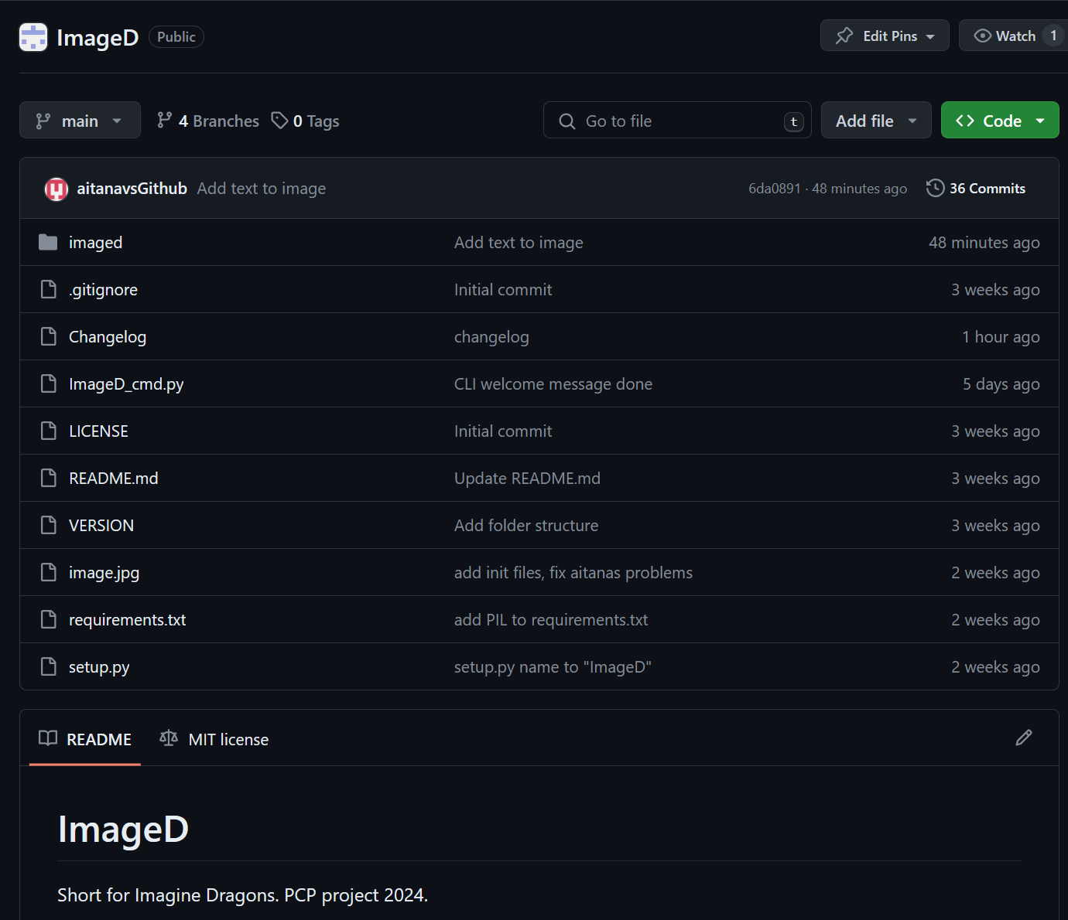
The Github repository

Slide 5
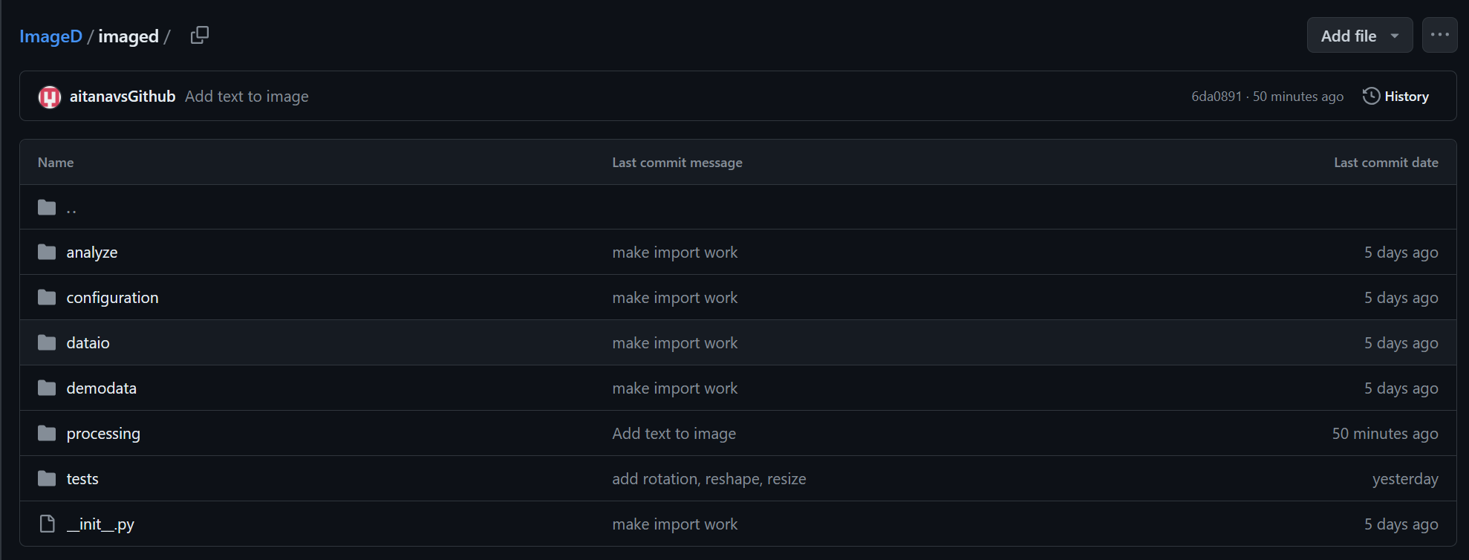
The Github repository

Slide 6
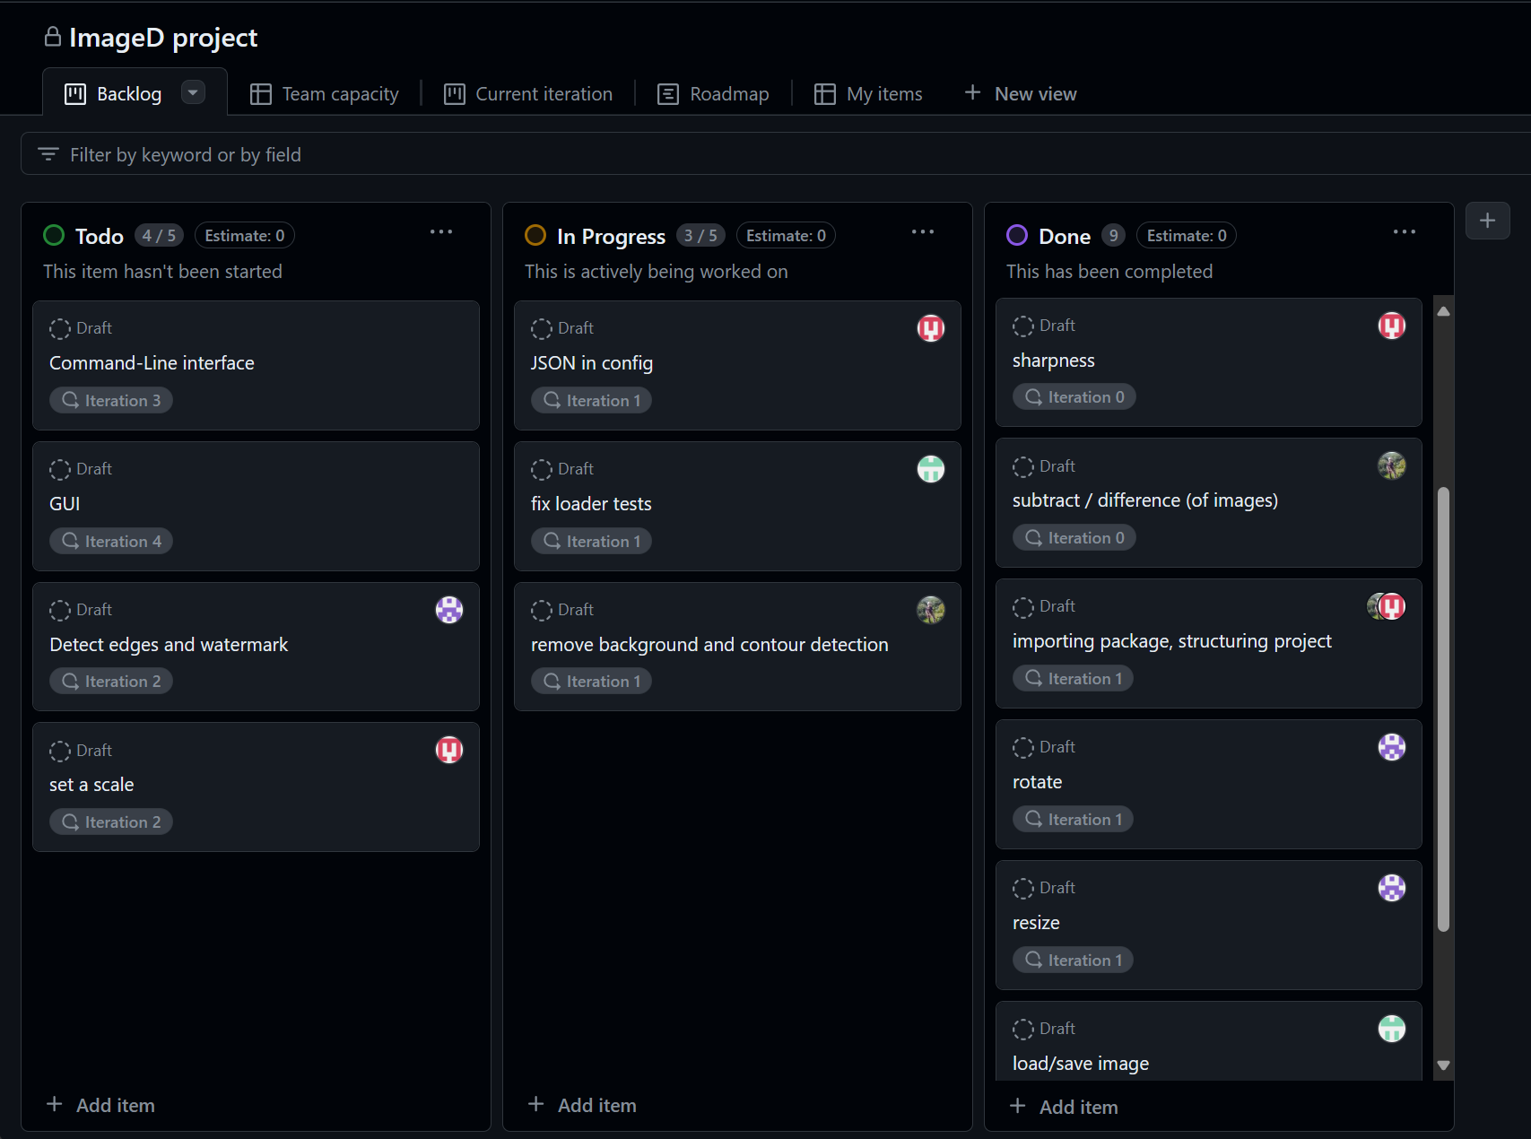
Current Status

Slide 7
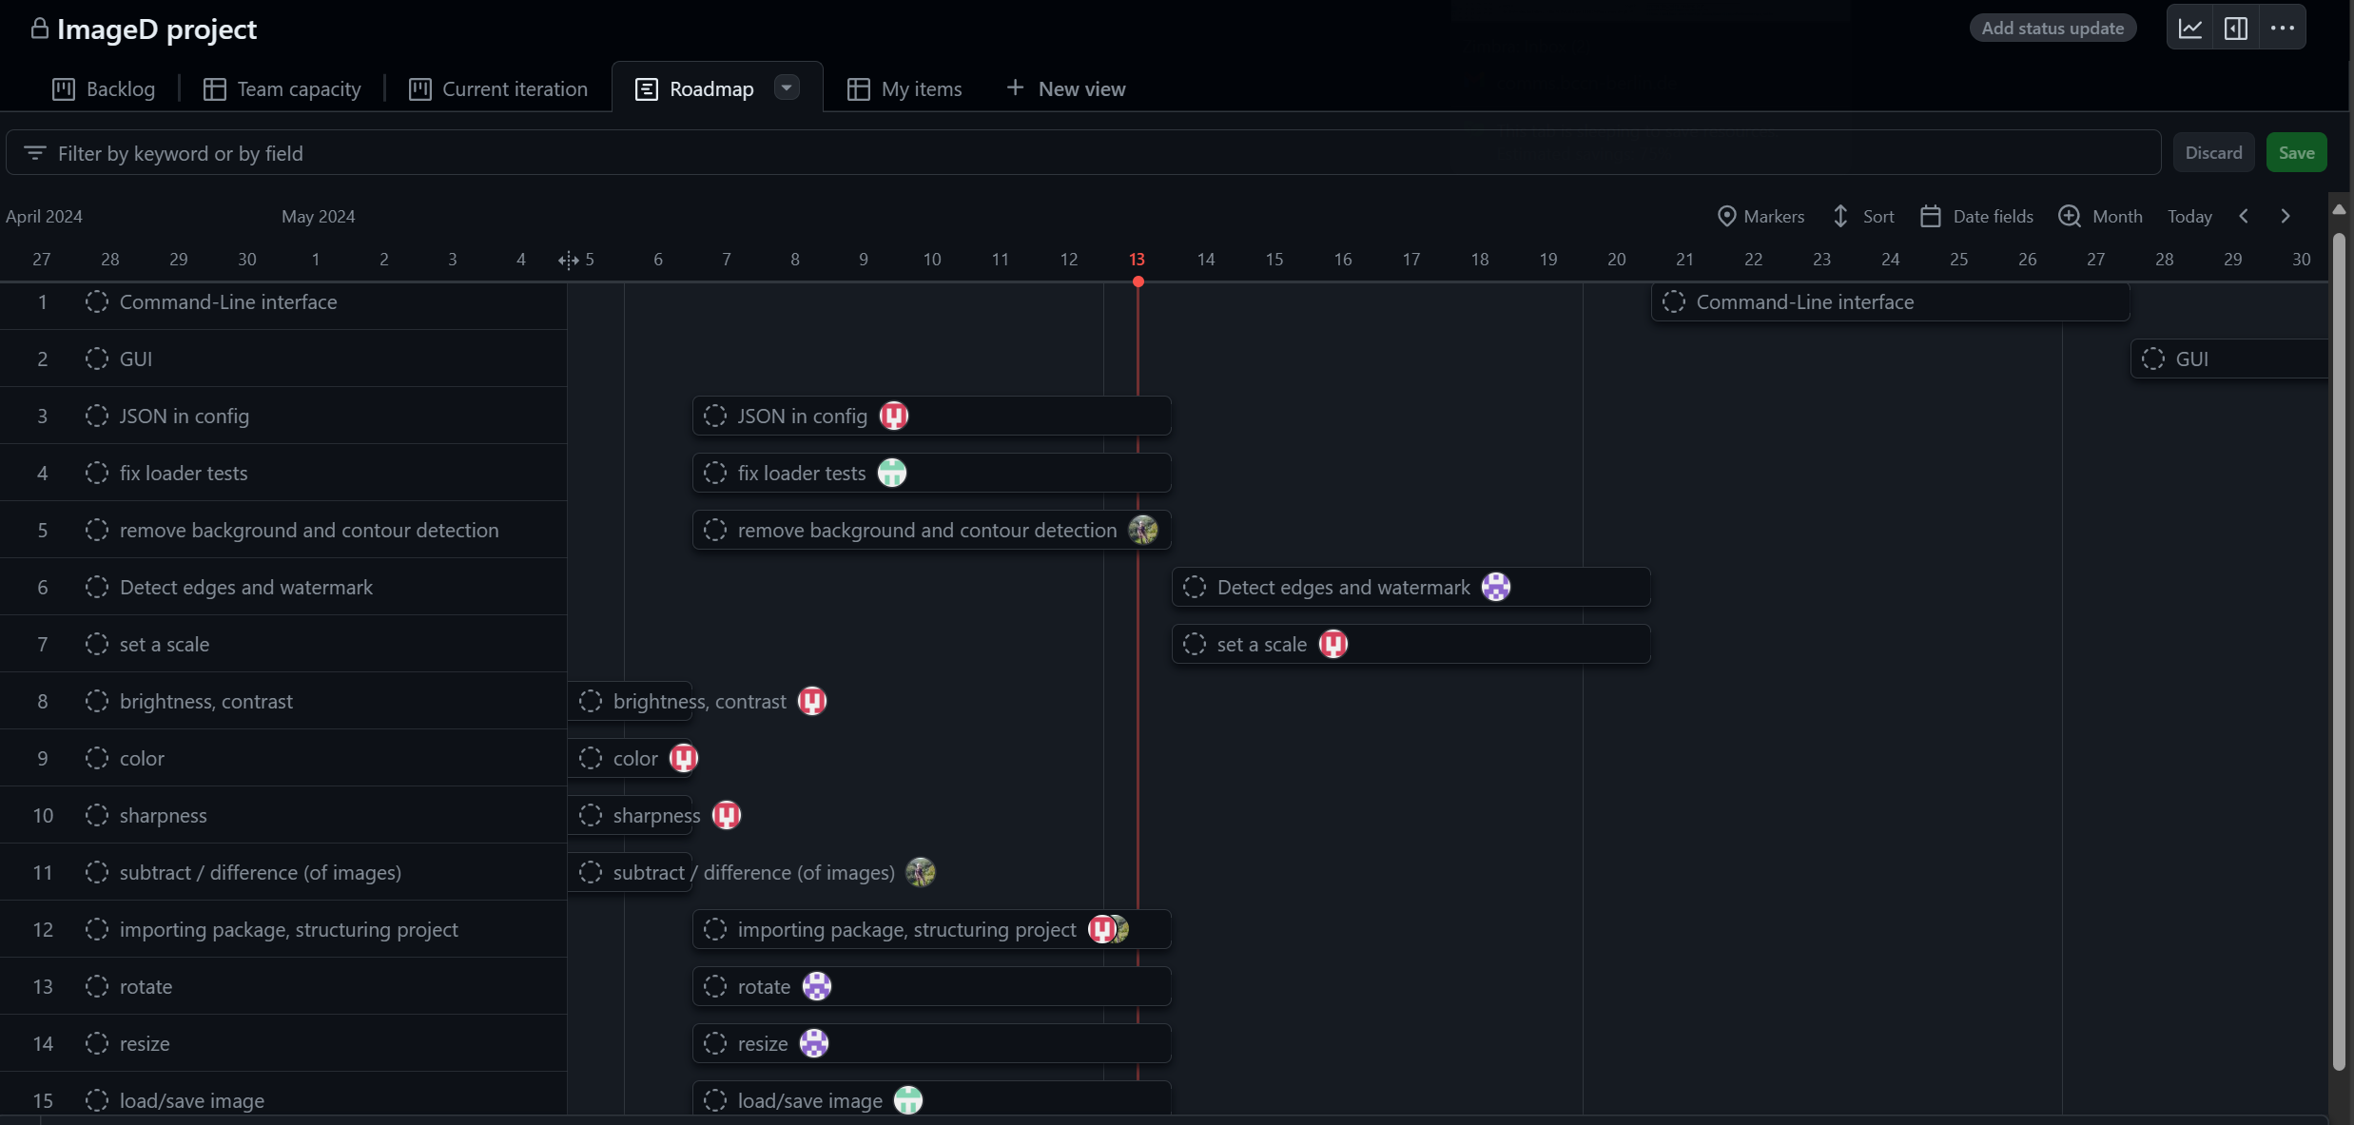
The Roadmap

Slide 8
Thank you!!
Questions?

