Slide 1
LENDING CLUB CASE STUDY
SUBMISSION
Name: Sumeet Savant & Parthesh Pujari

Slide 2
Abstract
Here we have dataset having information about the past loan applications and the status of those loans. Some of the loans are charged off , others are successfully paid and some are still running. Understanding the various driving parameters involved in the loan applications process, and their impact on the loan status has great good business value as it would help convert most of the loans as successful loans and thus lender’s investment is at lower risk.
In this case-study we analyse this dataset of past loan applications using the techniques of Exploratory Data Analysis (EDA) to identify various applicants and loan attributes which influence the tendency of loan getting default.

Slide 3
Analysis Approach
Data Understanding
Data Cleaning
Outlier Treatment
Univariate Analysis
Bivariate Analysis
Summarize Results
Understanding the dataset and various variables involved
Remove the unwanted columns which will not contribute for analysis
Remove the applicants historical and behavior related variables
Columns having Null values
Ignore variables having information after the loan approval like payment status or payment schedule
Check the data types for numerical variables
Removing outliers for numerical variables using box plots
Univariate analysis for target variable Loan status
Segmented Univariate Analysis for categorical and continuous variables
Identifying Derived metrics for analysis of continuous variables
Segmented Bivariate analysis on various categorical and continuous variables identified
Publish driving variables
Insights and observations

Slide 4
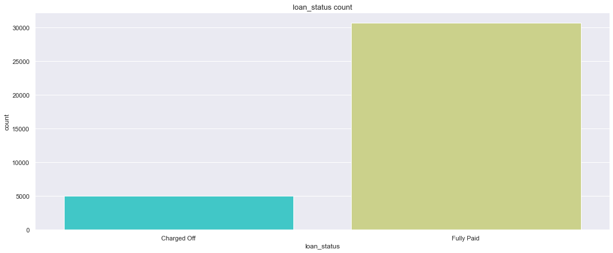
Univariate Analysis
Univariate Analysis for loan_status variable
~5000 loans have got “Charged Off”
Identifying the driving variables that influence this defaulting is important for Lending business

Slide 5
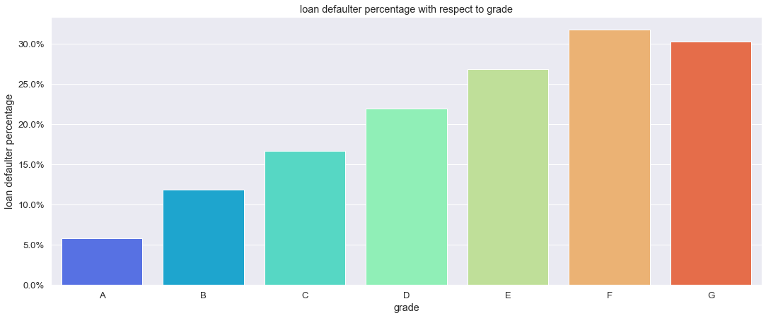
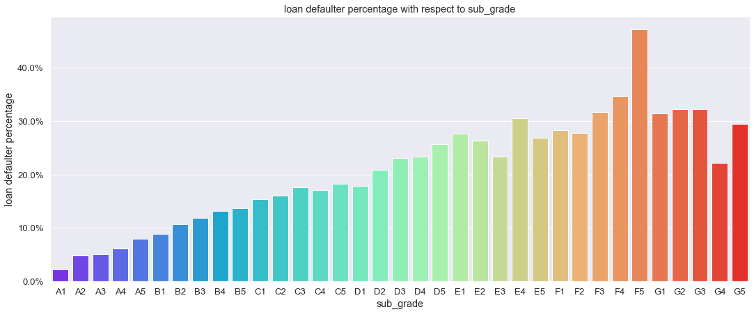
Effect of Loan Grading
Loan defaulter percentage increases with Grading
A to G
Loan Grading seems to be effective measure for estimating loan performance
Similar trend seen with Sub-Grades too
Within each grade the Loan Defaulter percentage increases with sub-grade
The results for Grades and sub-Grades F and G seem to not follow similar trend

Slide 6
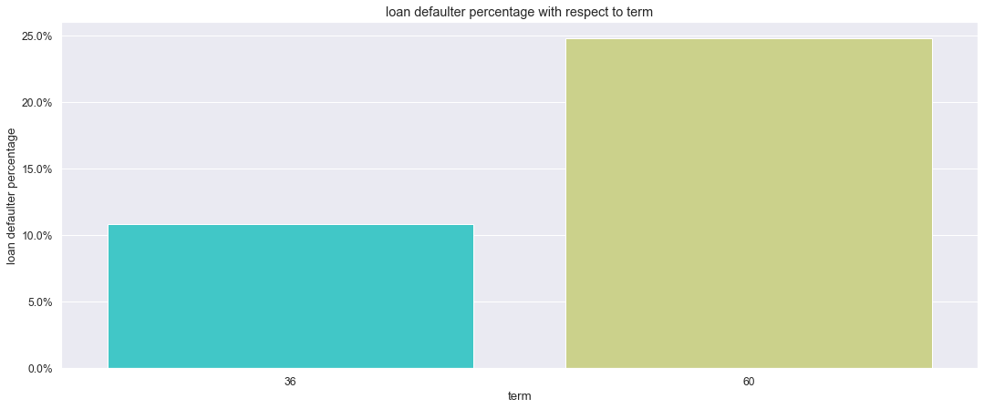
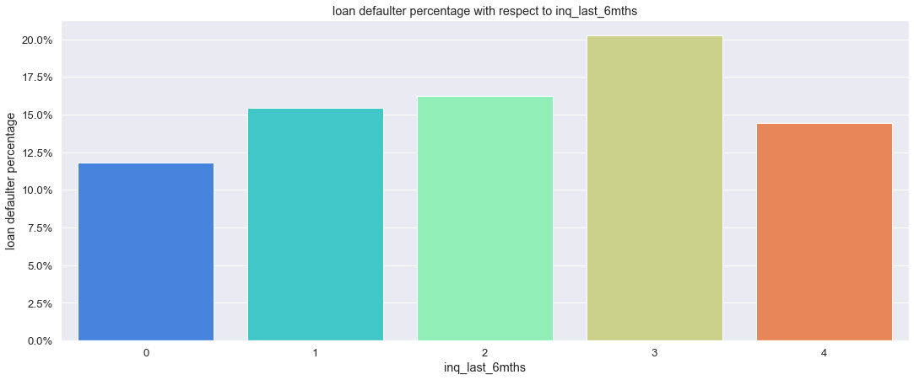
Loans with 60 months have higher Loan defaulter percentage
Clearly it is seen Long term loans are more risky
Inq_last_6mnths showing increasing trend for Loan Defaulter Percentage with number of inquiries

Slide 7
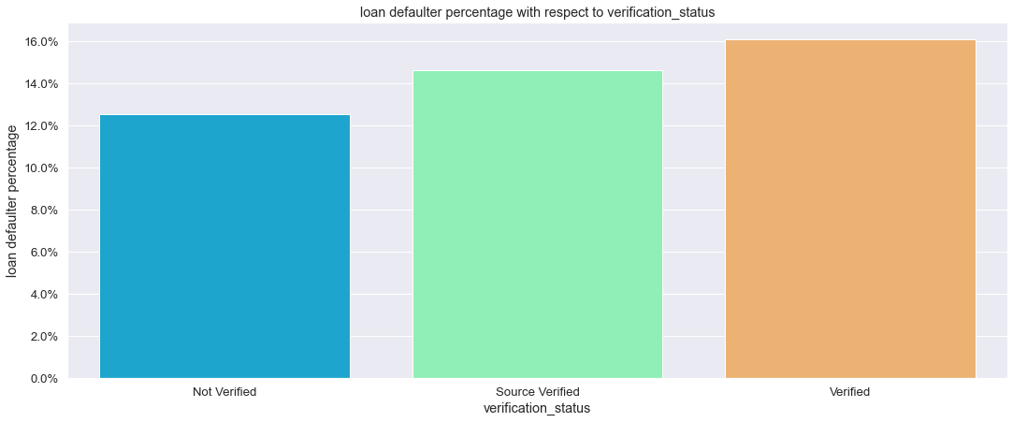
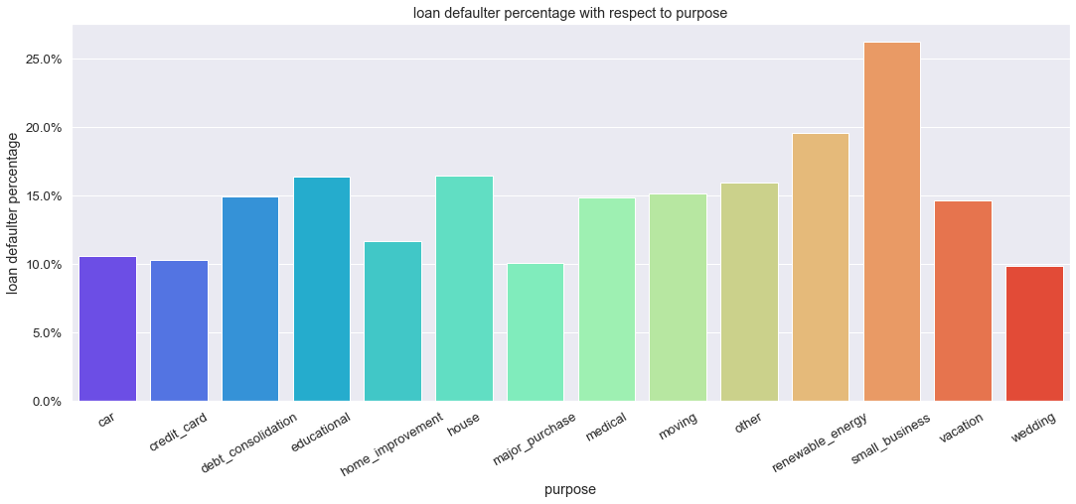
More number of Loan defaulters for Verified applications as against Not Verified
The verification process for the loan applications needs to be checked
Plot of Percentage of Defaulters to Purpose of Loans
Small_business Loans have maximum defaulters – more than quarter of the loans approved are failing which calls for higher scrutiny for these loan applications

Slide 8
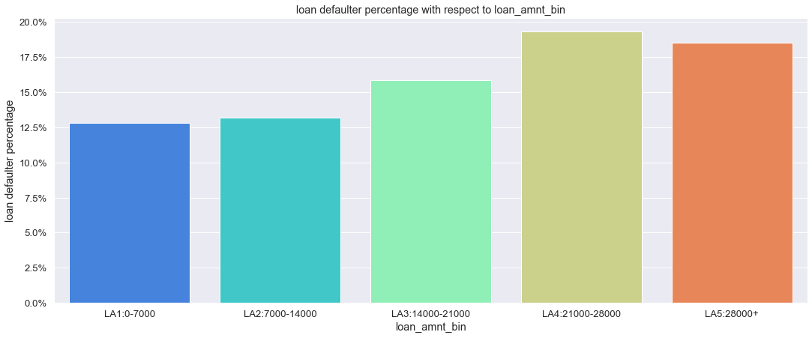
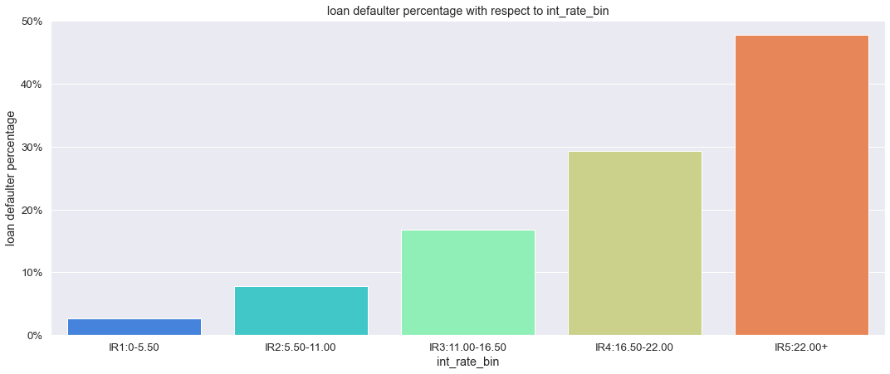
Effect of Loan Amount
Loan defaulter percentage increases with Loan Amount
Higher the loan amount greater is the risk of
defaulting the loan
Similar trend is seen with interest rate
Loan defaulter percentage increases with int_rate
Higher the int_rate greater is the risk of
defaulting the loan

Slide 9
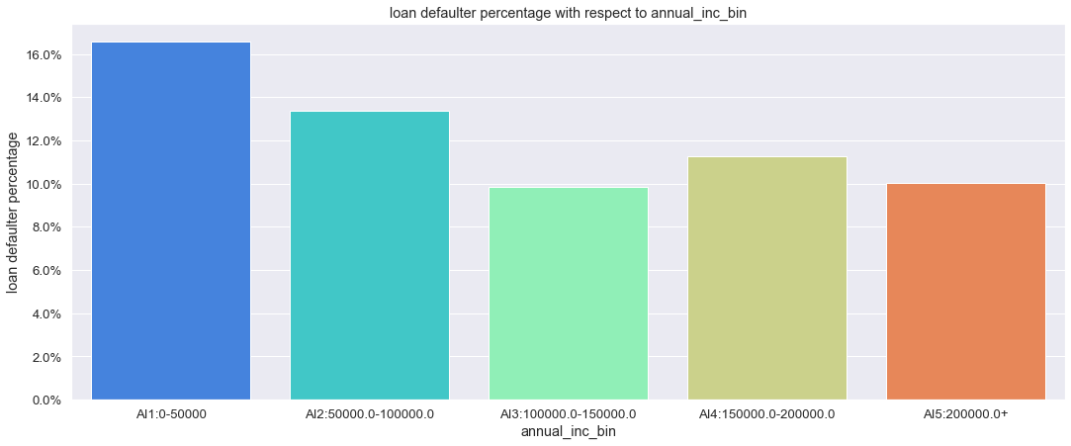
There is trend in loan defaulter percentage with annual income of the applicant
Higher the annual income of the applicant lesser is the loan defaulter percentage

Slide 10
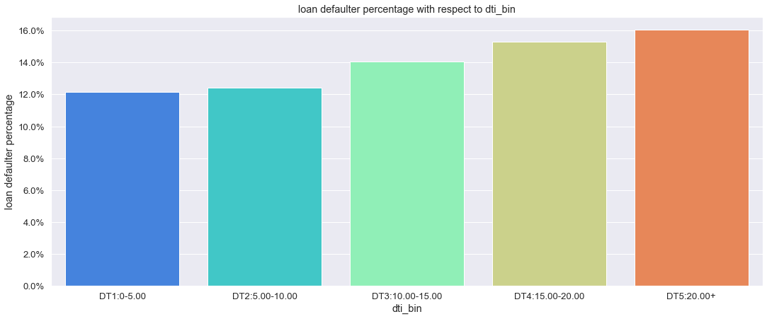
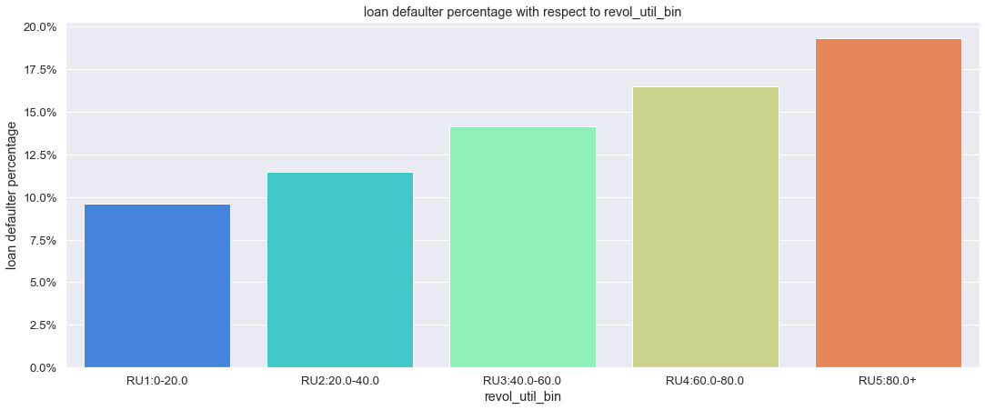
Effect of dti on loan defaulter percentage
Loan defaulter percentage increases with dti
Higher the debt to income ratio greater is the risk of defaulting the loan
Effect of revol_util on loan defaulter percentage
Loan defaulter percentage increases with revol_util
Higher the revol_util greater is the risk of defaulting the loan

Slide 15
Conclusions
Considering the funding type analysis Spark funds has the option to invest in venture funding type considering it can invest between 5-15 million USDs
From the country analysis USA seems to be most favorable country to invest.
With Sector analysis, Others sector is invested the greatest number of times in all the countries for venture funding type.
The second ranking sector - Social, Finance, Analytics, Advertisement is another good option as it has raised almost comparable number of investments as Others and similar trend is seen in other countries too.
It will be useful to perform such analysis for private_equity funding type too as for the investment range of Spark funds it can invest in private_equity companies and its funding can remain in Inter-quartile range between 25 percentile and median of the raised amount for private_equity. In that case accordingly we must apply filters to the data and restricting the number of investments only in that range.

