Slide 1

Job Candidates Project
From Plamen Petkov and Georgi Lazarov
The Red Aces

Slide 2

Content
We are looking In the future!
About us
Future plans
Used technologies
The Red Aces

Slide 3
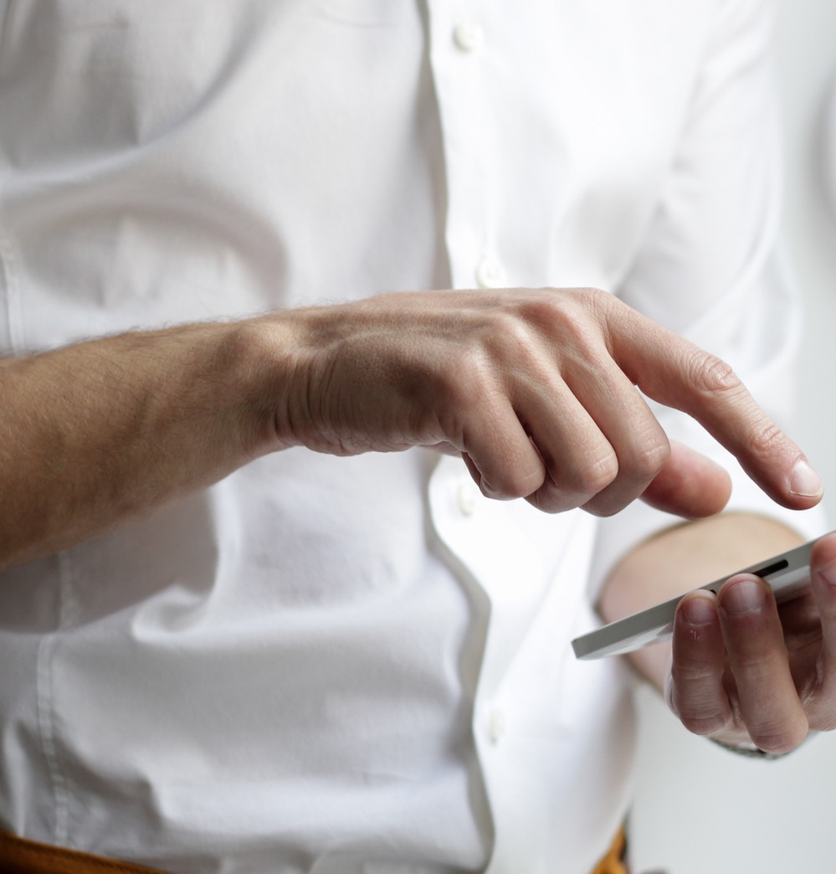
About Us
Georgi Lazarov
Back End developer, documentation and presentation.
Plamen Petkov
Front End developer, documentation and presentation.
WE ARE PROGRAMMERS
The Red Aces

Slide 4






Used technologies
Visual Studio
We used a lot of different technolgies
The Red Aces

Slide 5
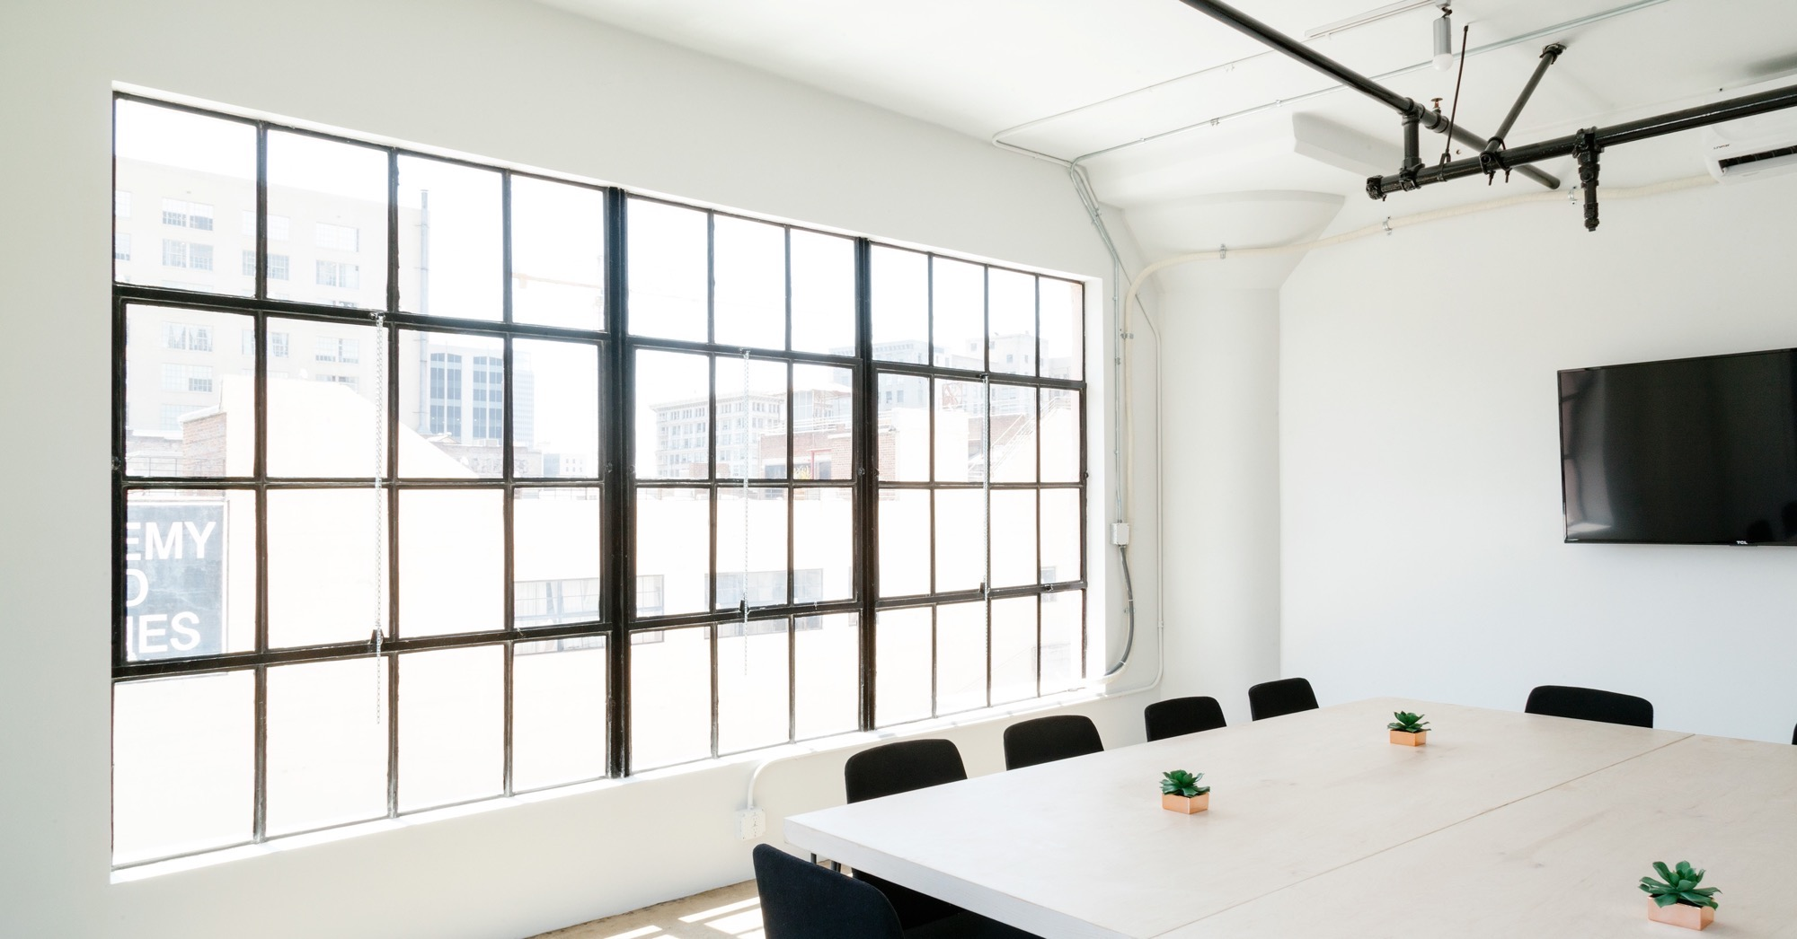
title
Future Plans
The Red Aces

Slide 6
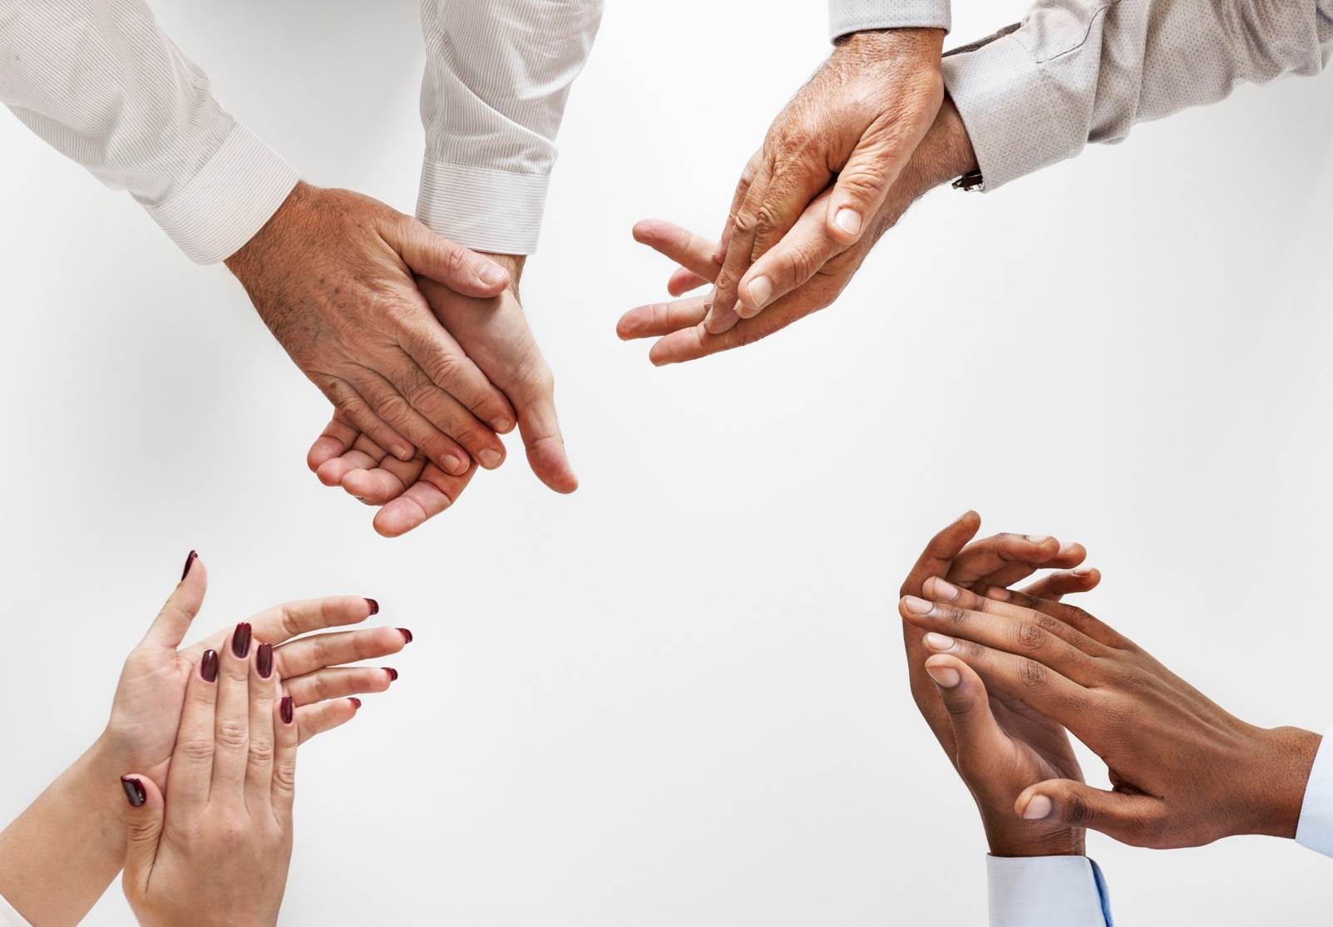
Thank You
For your attention
The Red Aces

