Slide 1

INTRODUCTION TO LINUX

Slide 2

WHAT IS LINUX?
Linux is a family of open-source, UNIX-like Operating Systems.
Technically, "Linux" refers to the kernel.
Multiple distributions are built around the Linux kernel: Ubuntu, Fedora, Arch, Debian, etc.

Slide 3
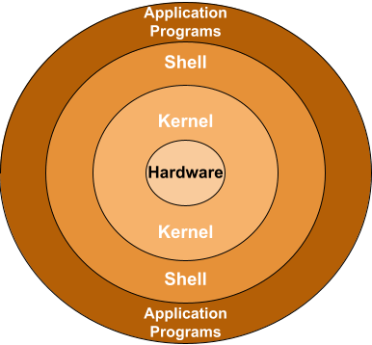
STRUCTURE OF A LINUX OS
Hardware: Physical components (CPU, Memory, I/O Devices)
Kernel: Core of OS (Manages memory, processes, files, devices)
Shell: Interface between user & kernel (e.g., bash, zsh)
Applications: Software tools (e.g., browsers, editors, players)

Slide 4

FEATURES
Portable: Runs on any hardware
Open Source: Free and community-driven
Multi-user & Multiprogramming
Secure: Regular updates, fewer vulnerabilities
Hierarchical File System

Slide 5
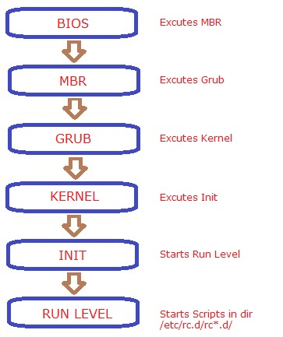
BOOTING PROCESS
BIOS/UEFI Initialization
Bootloader Execution (GRUB, etc.)
Kernel Initialization
Initramfs Loads
System Initialization (systemd/init)
Runlevel/Target Execution
User Login & Shell Access
​

Slide 6
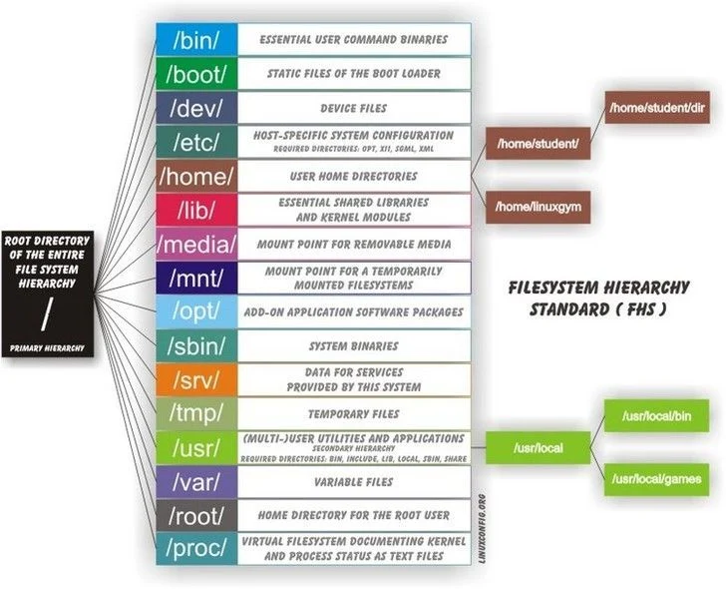
FILE SYSYTEM HIERARCHY
/: Root directory : The main directory of the OS
/bin: Essential binaries
/etc: Config files
/home: User directories
/var: Variable data
/usr, /tmp, /mnt, /media and more

Slide 7

GUI in linux
Window Managers: i3wm, dwm, hyprland
Desktop Environments: GNOME, KDE, XFCE, MATE
Lightweight GUI vs full GUI experience

Slide 8

BASIC LINUX COMMANDS
whoami: Current user
pwd: Print working directory
ls, ls -a, ls -l: List directory contents
cd: Change directory
mkdir, rmdir: Make/remove directories
touch: Create empty files
cat: Display file content
echo: Output text
man: Command manual
uname: System info
cp, mv: Copy/move/rename files
rm, rm -rf: Delete files/directories

Slide 9

REDIRECTION, APPENDING & PIPELINING
>: Redirect output (overwrite)
>>: Append output
|: Pipe output to next command

Slide 10

QUSTIONS?

