Slide 1
What is Python?
Python is a high-level, versatile, and interpreted programming language known for its readability and ease of use. It's widely used in web development, data science, machine learning, and more. Python was created by Guido van Rossum, and first released on February 20, 1991.
Why Python??
Python is very simple & easy
Free & Open Source
High Level Language
Developed by Guido van Rossum
It is a Portable Language

Slide 2
Python Character Set:
Letters : A to Z, a to z
Digits : 0 to 9
Special Symbols : + - * / etc.
Whitespaces : Blank Space, tab, carriage return, newline, formfeed
Other characters : Python can process all ASCII and Unicode characters as part of data or literals.

Slide 3


Input and Output in Python:
Taking input in Python: Python input() function is used to take user input. By default, it returns the user input in form of a string.
Printing Output using print() in Python: This function allows us to display text, variables and expressions on the console. Let's begin with the basic usage of the print() function:
Printing Variables: We can use the print() function to print single and multiple variables. We can print multiple variables by separating them with commas.

Slide 4
Variable:
In Python, a variable is a named storage location used to hold data values. It acts as a symbolic name that refers to an object in memory. Variables allow you to store and manipulate different types of data, such as numbers, text (strings) etc.
And in simple words, variable is a name given to a memory location in a program.
For example : name = “Python”, age = 22, price = 50.33
Rules for Naming Variables
To use variables effectively, we must follow Python’s naming rules:
Variable names can only contain letters, digits and underscores (_).
A variable name cannot start with a digit.
Variable names are case-sensitive (myVar and myvar are different).
Avoid using Python keywords (e.g., if, else, for) as variable names

Slide 5
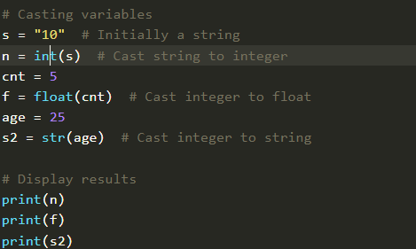
Type Casting a Variable:
Type casting refers to the process of converting the value of one data type into another. Python provides several built-in functions to facilitate casting, including int(), float() and str() among others.

Slide 6
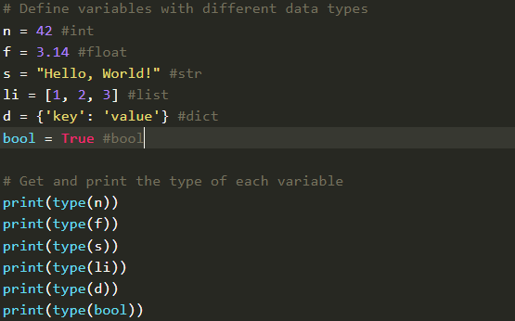
Getting the Types of Variable:
In Python, we can determine the type of a variable using the type() function. This built-in function returns the type of the object passed to it.

Slide 7
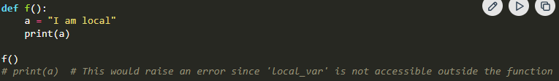
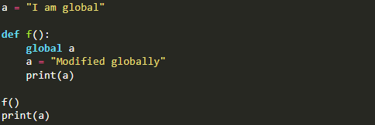
Scope of a Variable:
There are two methods how we define scope of a variable in python which are local and global.
Local Variables: Variables defined inside a function are local to that function.
Global Variables: Variables defined outside any function are global and can be accessed inside functions using the global keyword.

Slide 8
Identifiers in Python:
In Python, an identifier is a name used to identify a variable, function, class, module, or other entities within a program. They serve as labels to refer to specific elements in the code.
It is basically Names to variables, functions, classes, etc.
It an be used as variable names (if not a keyword).
It is User-defined, meaningful names in the code.
Examples: x, number, sum, result

Slide 9
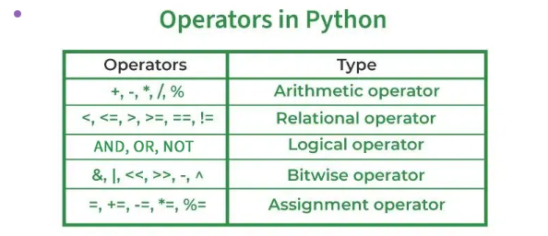
Python Operator:
In Python programming, Operators in general are used to perform operations on values and variables. These are standard symbols used for logical and arithmetic operations. In this article, we will look into different types of Python operators.
OPERATORS: These are the special symbols. Eg: + , * , /, etc.
OPERAND: It is the value on which the operator is applied.
Types of Operators in Python:

Slide 10
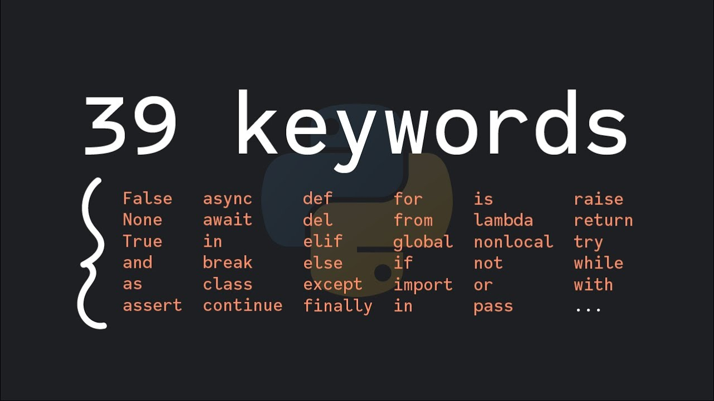
Keywords in Python:
Keywords in Python are reserved words that have special meanings and serve specific purposes in the language syntax. Python keywords cannot be used as the names of variables, functions, and classes or any other identifier.

Slide 11
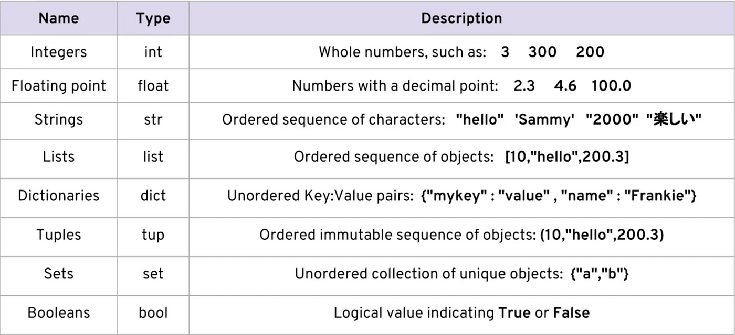
Data Types in Python:
Python Data types are the classification or categorization of data items. It represents the kind of value that tells what operations can be performed on a particular data. Since everything is an object in Python programming, Python data types are classes and variables are instances (objects) of these classes.

Slide 12
1. Numeric Data Types in Python:
The numeric data type in Python represents the data that has a numeric value. A numeric value can be an integer, a floating number, or even a complex number. These values are defined as Python int, Python float and Python complex classes in Python.
Integers - This value is represented by int class. It contains positive or negative whole numbers (without fractions or decimals). In Python, there is no limit to how long an integer value can be.
Float - This value is represented by the float class. It is a real number with a floating-point representation. It is specified by a decimal point. Optionally, the character e or E followed by a positive or negative integer may be appended to specify scientific notation.
Complex Numbers - A complex number is represented by a complex class. It is specified as (real part) + (imaginary part)j . For example - 2+3j

Slide 13
2. Sequence Data Types in Python
The sequence Data Type in Python is the ordered collection of similar or different Python data types. Sequences allow storing of multiple values in an organized and efficient fashion. There are several sequence data types of Python:
Python String
Python List
Python Tuple

Slide 14
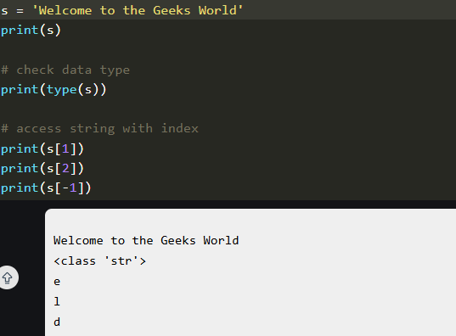
String Data Type:
Python Strings are arrays of bytes representing Unicode characters. In Python, there is no character data type Python, a character is a string of length one. It is represented by str class.
Strings in Python can be created using single quotes, double quotes or even triple quotes. We can access individual characters of a String using index.

Slide 15
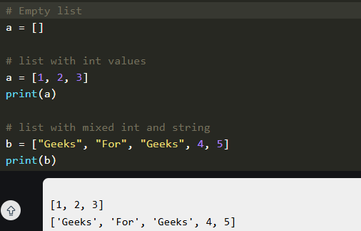
List Data Type:
Lists are just like arrays, declared in other languages which is an ordered collection of data. It is very flexible as the items in a list do not need to be of the same type.
Creating a List in Python: Lists in Python can be created by just placing the sequence inside the square brackets[].

Slide 16
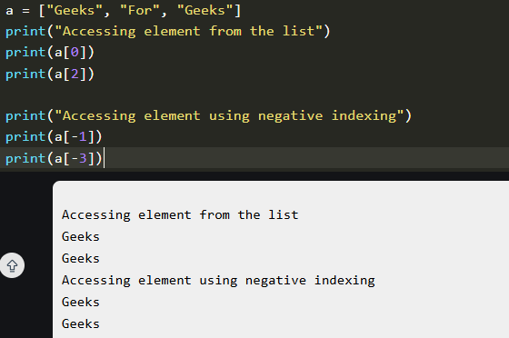
Access List Items:
• In order to access the list items refer to the index number. In Python, negative sequence indexes represent positions from the end of the array. Instead of having to compute the offset as in List[len(List)-3], it is enough to just write List[-3]. Negative indexing means beginning from the end, -1 refers to the last item, -2 refers to the second-last item, etc.

Slide 17
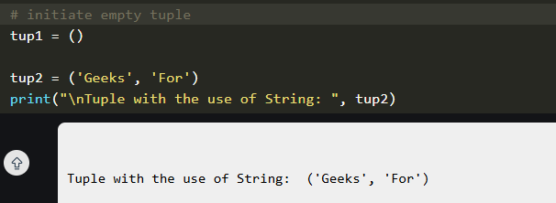
Tuple Data Type:
Just like a list, a tuple is also an ordered collection of Python objects. The only difference between a tuple and a list is that tuples are immutable. Tuples cannot be modified after it is created.
Note: Tuples can also be created with a single element, but it is a bit tricky. Having one element in the parentheses is not sufficient, there must be a trailing ‘comma’ to make it a tuple.

Slide 18
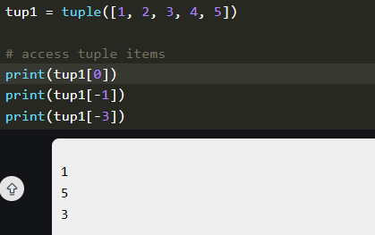
Access Tuple Items:
In order to access the tuple items refer to the index number. Use the index operator [ ] to access an item in a tuple.

Slide 19
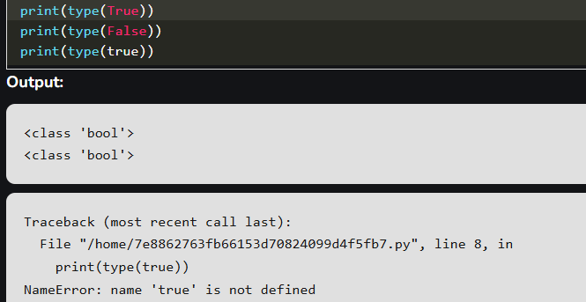
3.Boolean Data Type in Python:
Python Data type with one of the two built-in values, True or False. Boolean objects that are equal to True are truthy (true), and those equal to False are falsy (false). However non-Boolean objects can be evaluated in a Boolean context as well and determined to be true or false. It is denoted by the class bool.
Example: The first two lines will print the type of the boolean values True and False, which is <class 'bool'>. The third line will cause an error, because true is not a valid keyword in Python. Python is case-sensitive, which means it distinguishes between uppercase and lowercase letters.

Slide 20
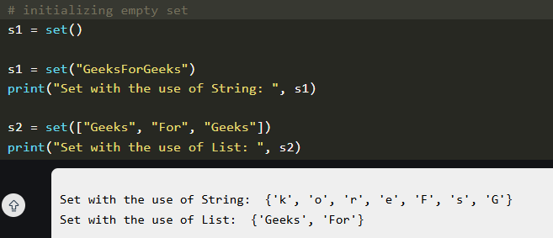
4. Set Data Type in Python
In Python Data Types, Set is an unordered collection of data types that is iterable, mutable, and has no duplicate elements. The order of elements in a set is undefined though it may consist of various elements.
Sets can be created by using the built-in set() function with an iterable object or a sequence by placing the sequence inside curly braces, separated by a ‘comma’. The type of elements in a set need not be the same, various mixed-up data type values can also be passed to the set. Example: The code is an example of how to create sets using different types of values, such as strings , lists , and mixed values

Slide 21
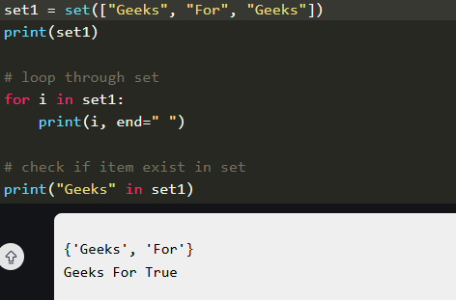
Access Set Items:
Set items cannot be accessed by referring to an index, since sets are unordered the items have no index. But we can loop through the set items using a for loop, or ask if a specified value is present in a set, by using the in the keyword.

Slide 22
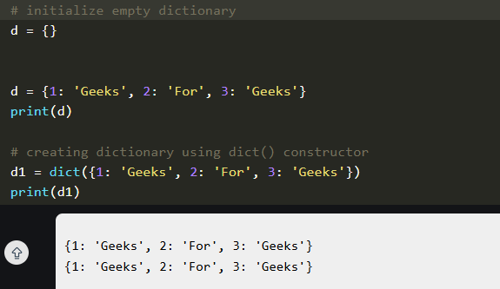
5. Dictionary Data Type:
A dictionary in Python is a collection of data values, used to store data values like a map, unlike other Python Data Types that hold only a single value as an element, a Dictionary holds a key: value pair. Key-value is provided in the dictionary to make it more optimized. Each key-value pair in a Dictionary is separated by a colon : , whereas each key is separated by a ‘comma’.
Create a Dictionary in Python: Values in a dictionary can be of any datatype and can be duplicated, whereas keys can’t be repeated and must be immutable. The dictionary can also be created by the built-in function dict().

Slide 23
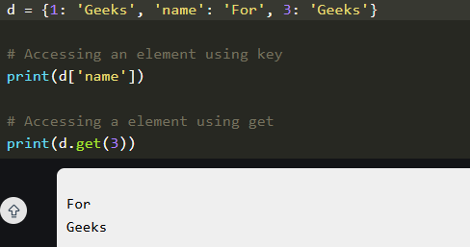
Accessing Key-value in Dictionary:
In order to access the items of a dictionary refer to its key name. Key can be used inside square brackets. Using get() method we can access the dictionary elements.

Slide 24
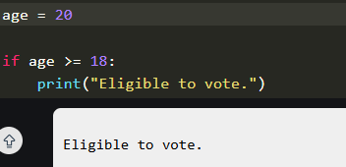
Conditional Statements in Python:
Conditional statements in Python are used to execute certain blocks of code based on specific conditions. These statements help control the flow of a program, making it behave differently in different situations.
If Conditional Statement in Python
If statement is the simplest form of a conditional statement. It executes a block of code if the given condition is true.

Slide 25
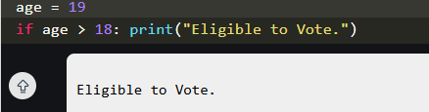
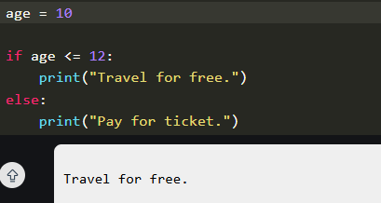
Short Hand if
Short-hand if statement allows us to write a single-line if statement.
If else Conditional Statements in Python
Else allows us to specify a block of code that will execute if the condition(s) associated with an if or elif statement evaluates to False. Else block provides a way to handle all other cases that don't meet the specified conditions.

Slide 26
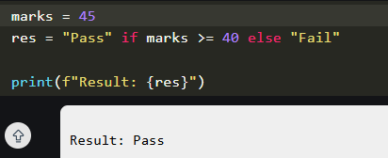
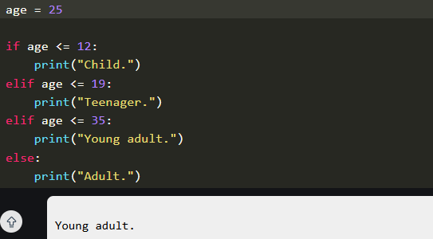
Short Hand if-else:
The short-hand if-else statement allows us to write a single-line if-else statement.
Elif Statement:
Elif statement in Python stands for "else if." It allows us to check multiple conditions , providing a way to execute different blocks of code based on which condition is true. Using elif statements makes our code more readable and efficient by eliminating the need for multiple nested if statements.

Slide 27
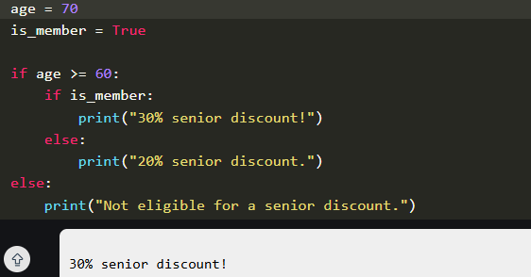
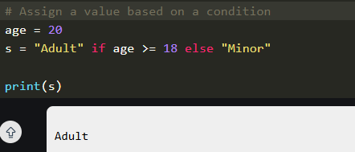
Nested if..else Conditional Statements in Python:
Nested if..else means an if-else statement inside another if statement. We can use nested if statements to check conditions within conditions.
Ternary Conditional Statement in Python
A ternary conditional statement is a compact way to write an if-else condition in a single line. It’s sometimes called a "conditional expression."

Slide 28
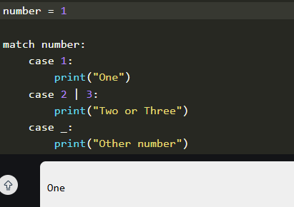
Match-Case Statement in Python:
Match-case statement is Python's version of a switch-case found in other languages. It allows us to match a variable's value against a set of patterns.

Slide 29
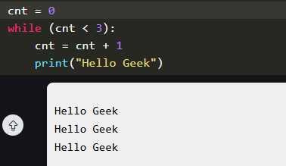
Loops in Python- For, While and Nested Loops:
Loops in Python are used to repeat actions efficiently. The main types are For loops (counting through items) and While loops (based on conditions). In this article, we will look at Python loops and understand their working with the help of examples.
While Loop in Python:
In Python, a while loop is used to execute a block of statements repeatedly until a given condition is satisfied. When the condition becomes false, the line immediately after the loop in the program is executed.
Python While Loop Syntax:
while expression:
statement(s)

Slide 30
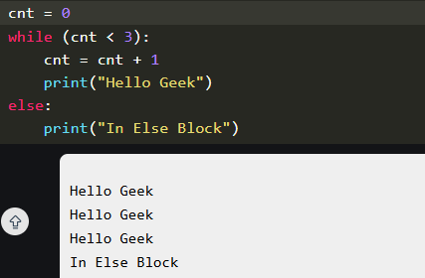

Using else statement with While Loop in Python:
Else clause is only executed when our while condition becomes false. If we break out of the loop or if an exception is raised then it won't be executed.
Syntax of While Loop with else statement:
while condition:
# execute these statements
else:
# execute these statements
Infinite While Loop in Python
If we want a block of code to execute infinite number of times then we can use the while loop in Python. Note: It is suggested not to use this type of loop as it is a never-ending infinite loop where the condition is always true and we have to forcefully terminate the compiler.

Slide 31
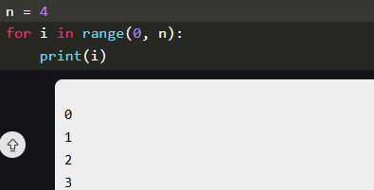
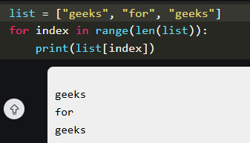
For Loop in Python:
For loops are used for sequential traversal. For example: traversing a list or string or array etc. In Python, there is "for in" loop which is similar to foreach loop in other languages. Let us learn how to use for loops in Python for sequential traversals with examples.
For Loop Syntax:
for iterator_var in sequence:
statements(s)
Iterating by the Index of Sequences
We can also use the index of elements in the sequence to iterate. The key idea is to first calculate the length of the list and in iterate over the sequence within the range of this length.

Slide 32
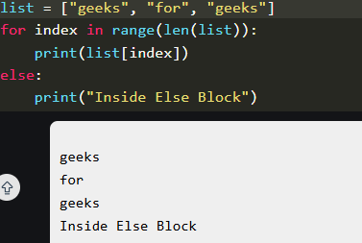
Using else Statement with for Loop in Python:
We can also combine else statement with for loop like in while loop. But as there is no condition in for loop based on which the execution will terminate so the else block will be executed immediately after for block finishes execution.

Slide 33
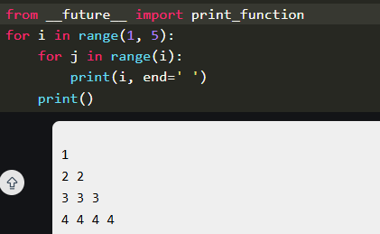
Nested Loops in Python:
Python programming language allows to use one loop inside another loop which is called nested loop. Following section shows few examples to illustrate the concept.
The syntax for a nested while loop statement in the Python programming language is as follows:
while expression:
while expression:
statement(s)
statement(s)
A final note on loop nesting is that we can put any type of loop inside of any other type of loops in Python. For example, a for loop can be inside a while loop or vice versa.

Slide 34
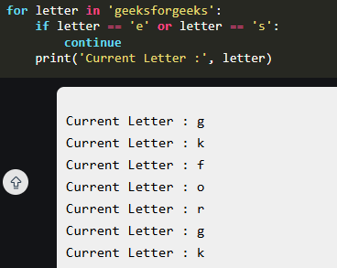
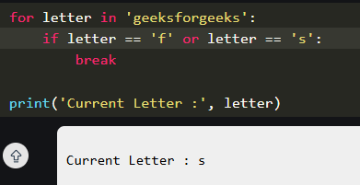
Loop Control Statements:
Continue Statement: The continue statement in Python returns the control to the beginning of the loop.
Break Statement: The break statement in Python brings control out of the loop.

Slide 35
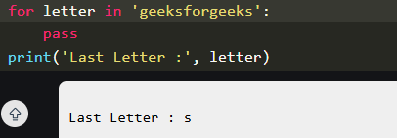
Pass Statement:
We use pass statement in Python to write empty loops. Pass is also used for empty control statements, functions and classes.

Slide 36
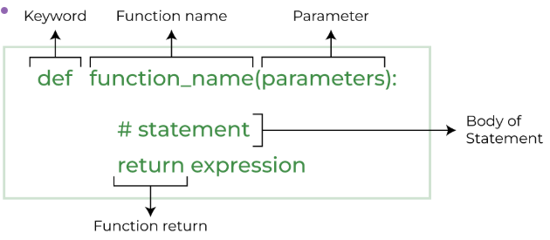
Python Functions:
Python Functions is a block of statements that does a specific task. The idea is to put some commonly or repeatedly done task together and make a function so that instead of writing the same code again and again for different inputs, we can do the function calls to reuse code contained in it over and over again.
Benefits of Using Functions
Code Reuse
Reduced code length
Increased readability of code

Slide 37
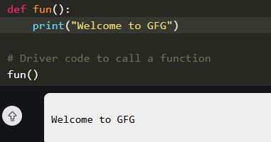
Types of Functions in Python:
Below are the different types of functions in Python:
Built-in library function: These are Standard functions in Python that are available to use.
User-defined function: We can create our own functions based on our requirements.
Creating a Function in Python:
We can define a function in Python, using the def keyword. We can add any type of functionalities and properties to it as we require.
Calling a Function in Python:
After creating a function in Python, we can call it by using the name of the functions Python followed by parenthesis containing parameters of that particular function. Below is the example for calling def function Python.

Slide 38

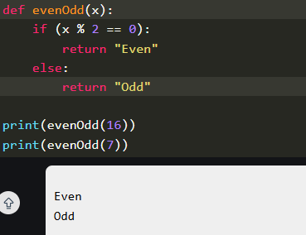
Python Function Arguments:
Arguments are the values passed inside the parenthesis of the function. A function can have any number of arguments separated by a comma, data_type and return_type are optional in function declaration.
Syntax for functions with arguments:
Let's understand this with an example, we will create a simple function in Python to check whether the number passed as an argument to the function is even or odd.

Slide 39
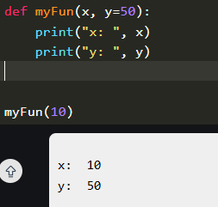
Types of Python Function Arguments:
Python supports various types of arguments that can be passed at the time of the function call. In Python, we have the following function argument types in Python:
Default argument
Keyword arguments (named arguments)
Positional arguments
Arbitrary arguments (variable-length arguments *args and **kwargs)
Default Arguments
A default argument is a parameter that assumes a default value if a value is not provided in the function call for that argument. The following example illustrates Default arguments to write functions in Python.

Slide 40
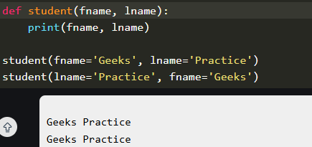
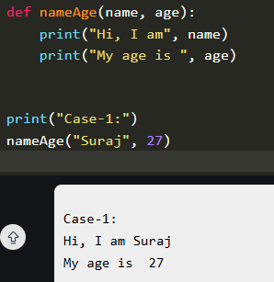
Keyword Arguments:
The idea is to allow the caller to specify the argument name with values so that the caller does not need to remember the order of parameters.
Positional Arguments:
Positional arguments are values passed to a function during its call, where the order of these values determines which parameter they correspond to within the function's definition. We used the Position argument during the function call so that the first argument (or value) is assigned to name and the second argument (or value) is assigned to age.

Slide 41
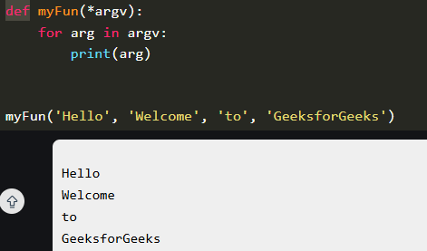
Arbitrary Keyword Arguments:
In Python Arbitrary Keyword Arguments, *args, and **kwargs can pass a variable number of arguments to a function using special symbols. There are two special symbols:
*args in Python (Non-Keyword Arguments)
**kwargs in Python (Keyword Arguments)
Example 1: Variable length non-keywords argument

Slide 42
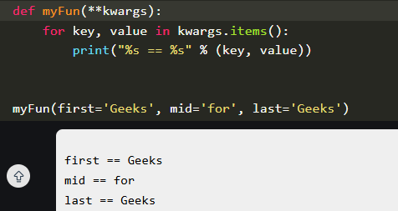
Example 2: Variable length keyword arguments:
Docstring
The first string after the function is called the Document string or Docstring in short. This is used to describe the functionality of the function. The use of docstring in functions is optional but it is considered a good practice.
The below syntax can be used to print out the docstring of a function.
Syntax: print(function_name.__doc__)

Slide 43
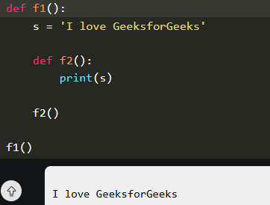
Python Function within Functions:
A function that is defined inside another function is known as the inner function or nested function. Nested functions can access variables of the enclosing scope. Inner functions are used so that they can be protected from everything happening outside the function.

Slide 44
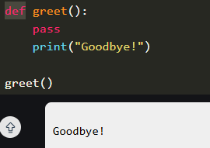
Use of Pass Keyword in a Function:
Pass keyword in a function is used when we define a function but don't want to implement its logic immediately. It allows the function to be syntactically valid, even though it doesn't perform any actions yet.
Explanation:
function fun() is defined but contains the pass statement, meaning it does nothing when called.
program continues execution without any errors and the message is printed after calling the function.

Slide 45
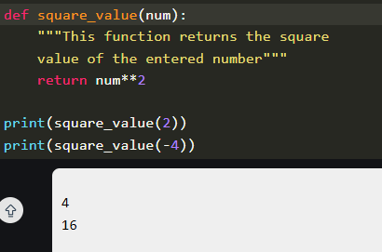
Return Statement in Python Function:
The function return statement is used to exit from a function and go back to the function caller and return the specified value or data item to the caller. The syntax for the return statement is:
return [expression_list]
The return statement can consist of a variable, an expression, or a constant which is returned at the end of the function execution. If none of the above is present with the return statement a None object is returned.

Slide 46
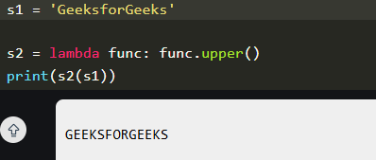
Python Lambda Functions:
Python Lambda Functions are anonymous functions means that the function is without a name. As we already know the def keyword is used to define a normal function in Python. Similarly, the lambda keyword is used to define an anonymous function in Python.
Python Lambda Function Syntax:
Syntax: lambda arguments : expression
lambda: The keyword to define the function.
arguments: A comma-separated list of input parameters (like in a regular function).
expression: A single expression that is evaluated and returned.

Slide 47
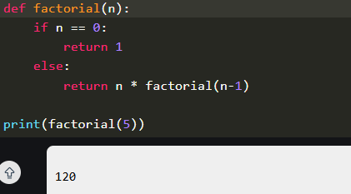
Recursion in Python:
Recursion involves a function calling itself directly or indirectly to solve a problem by breaking it down into simpler and more manageable parts. Recursion in Python refers to when a function calls itself. There are many instances when you have to build a recursive function to solve Mathematical and Recursive Problems.
Using a recursive function should be done with caution, as a recursive function can become like a non-terminating loop. It is better to check your exit statement while creating a recursive function.

Slide 48
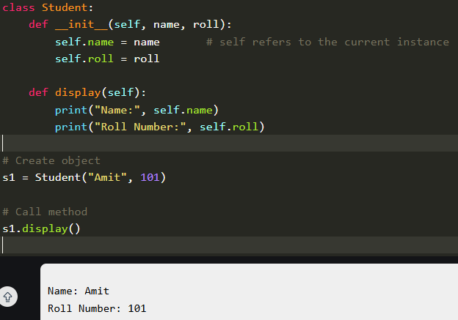
Why Python Uses 'Self' as Default Argument?
In Python, when defining methods within a class, the first parameter is always self. The parameter self is a convention not a keyword and it plays a key role in Python’s object-oriented structure.

Slide 49
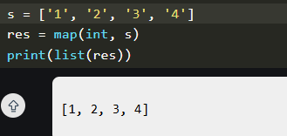
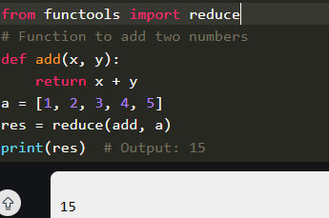
Map, Reduce and Filter Function in Python:
Map() Function:
The map() function is used to apply a given function to every item of an iterable, such as a list or tuple, and returns a map object (which is an iterator). Let's start with a simple example of using map() to convert a list of strings into a list of integers.
Reduce() Function:
The reduce(fun,seq) function is used to apply a particular function passed in its argument to all of the list elements mentioned in the sequence passed along. This function is defined in "functools" module.

Slide 50

Filter() Function:
The filter() method filters the given sequence with the help of a function that tests each element in the sequence to be true or not. Let's see a simple example of filter() function in python:

Slide 51

Decorators in Python:
In Python, decorators are a powerful and flexible way to modify or extend the behavior of functions or methods, without changing their actual code. A decorator is essentially a function that takes another function as an argument and returns a new function with enhanced functionality.
Decorators are often used in scenarios such as logging, authentication and memorization, allowing us to add additional functionality to existing functions or methods in a clean, reusable way.
decorator_name: This is the name of the decorator function.
wrapper: This is a nested function inside the decorator. It wraps the original function, adding additional functionality.

Slide 52

Higher-Order Functions:
In Python, higher-order functions are functions that take one or more functions as arguments, return a function as a result or do both. Essentially, a higher-order function is a function that operates on other functions. This is a powerful concept in functional programming and is a key component in understanding how decorators work.

Slide 53

Types of Decorators in Python:
Function Decorators: These are the most common. They take a function as input and return a modified function.

Slide 54


2. Class Decorators: Used to modify or enhance classes. The decorator receives a class object and returns a modified or new class.
3. Method Decorators: Used to decorate methods within a class. They often handle special cases, such as the self argument for instance methods.

Slide 55

Common Built-in Decorators in Python:
Python provides several built-in decorators that are commonly used in class definitions. These decorators modify the behavior of methods and attributes in a class, making it easier to manage and use them effectively.
@staticmethod
The @staticmethod decorator is used to define a method that doesn't operate on an instance of the class (i.e., it doesn't use self). Static methods are called on the class itself, not on an instance of the class.

Slide 56

@classmethod
The @classmethod decorator is used to define a method that operates on the class itself. Class methods can access and modify class state that applies across all instances of the class.

Slide 57

@property
The @property decorator is used to define a method as a property, which allows you to access it like an attribute. This is useful for encapsulating the implementation of a method while still providing a simple interface.

Slide 58

Chaining Decorators
In simpler terms chaining decorators means decorating a function with multiple decorators.

