Slide 1
Batch Number : CSE_153 Ideate and implement a system to enhance the quality of education in rural areas (PSCS_32)
CSE7101- Capstone Project
Review-1
Roll Number | Student Name
20221CSE0530 JNAN SOWRABH C 2) 20221CSE0308 PAVAN KUMAR M G 3) 20221CSE0680 JYOTHI PRASAD B L
Under the Supervision of,
Ms. Rakheeba Taseen
Assistant Professor
School of Computer Science and Engineering
Presidency University
Name of the Program: B.Tech Computer Science and Engineering
Name of the HoD: Dr. Asif Mohammed
Name of the Program Project Coordinator: Dr. Jayavadivel Ravi
Name of the School Project Coordinators: Dr. Sampath A K , Dr. Geetha A

Slide 2
Content
Problem Statement
Objectives
Background and Related work for title Selection
Analysis of Problem Statement
Innovation or Novel Contributions
Git-hub Link
Timeline of the Project
References

Slide 3
Problem Statement
Educational Access Gap Rural learners face limited access to quality study materials, trained teachers, and mentorship opportunities.
Digital Divide Poor internet connectivity and lack of affordable devices prevent equal participation in digital learning.
Language & Cultural Barriers Most digital content is in non-local languages, reducing comprehension and engagement.
Lack of Structured Skill Tracking No proper monitoring of literacy, communication, and technical skill progress at the community level.
Awareness & Opportunity Gap Many students remain unaware of available scholarships, government incentives, and career pathways.

Slide 4
Objectives
Provide localized digital study materials and verified mentor access.
Monitor literacy, communication, and skill progress.
Bridge the digital divide with offline-first solutions.
Inform about grants, loans, and incentives.
Connect disadvantaged learners to affordable internet.
Enable job opportunities through certification and training.

Slide 5
Background & Related Work
Existing programs: DIKSHA, SWAYAM, PM eVidya – limited rural adoption.
Barriers: language gaps, weak connectivity, lack of mentor-led models.
Research supports hybrid, mentor-assisted learning in low-resource areas.

Slide 6
Analysis of Problem Statement
Low internet penetration and affordability issues.
Non-localized content reduces engagement.
Limited awareness of financial aid and opportunities.
Weak industry connections for rural job seekers.

Slide 7
Innovation / Novel Contributions
Offline-First Hybrid Learning Model Works seamlessly in areas with low or no internet by using local school servers (Raspberry Pi) for content caching and periodic cloud sync.
AI-Driven Personalized Learning Paths Adaptive learning engine analyses student performance and suggests custom lessons to improve weak areas, including literacy and communication skills.
Integrated Opportunity & Support Hub A one-stop portal for accessing scholarships, government grants, skill-development programs, and local job listings.
Community Resource Sharing Shared devices, lab kits, and local library resources made available through schools and community centers.
Real-Time Skill Monitoring Dashboard Tracks literacy, technical skills, and employability readiness — accessible by mentors, students, and local authorities.
Local Mentor Network Verified educators and industry professionals connect with rural learners through live sessions and offline workshops.

Slide 8
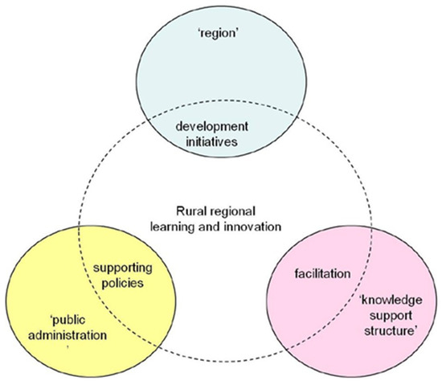
Representation in diagramatic form

Slide 9
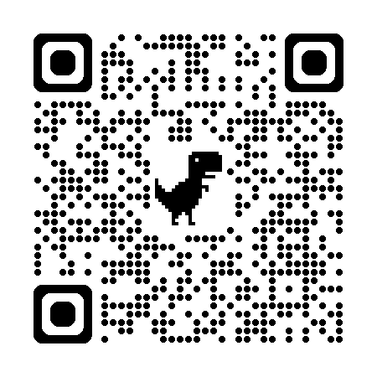
Github Link
https://github.com/PCSC-32CAPSTONEPROJECT-CSE-153/PSCS_32-capstone/upload/main

Slide 10
Technology Stack Components
Frontend: React.js (web PWA), HTML,CSS,JavaScript.
Backend: Node.js / Django.
Database: PostgreSQL / MongoDB.
AI/ML: Python (TensorFlow, Scikit-learn)

Slide 11
Software Requirements
Software:
OS: Windows/Linux
Development: VS Code, PyCharm
Database: PostgreSQL
Languages: Python, Node.js

Slide 12
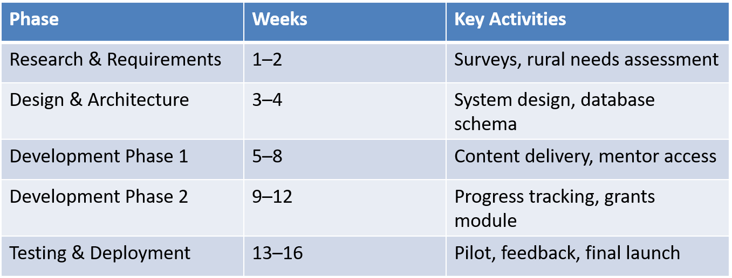
Timeline of the Project

Slide 13
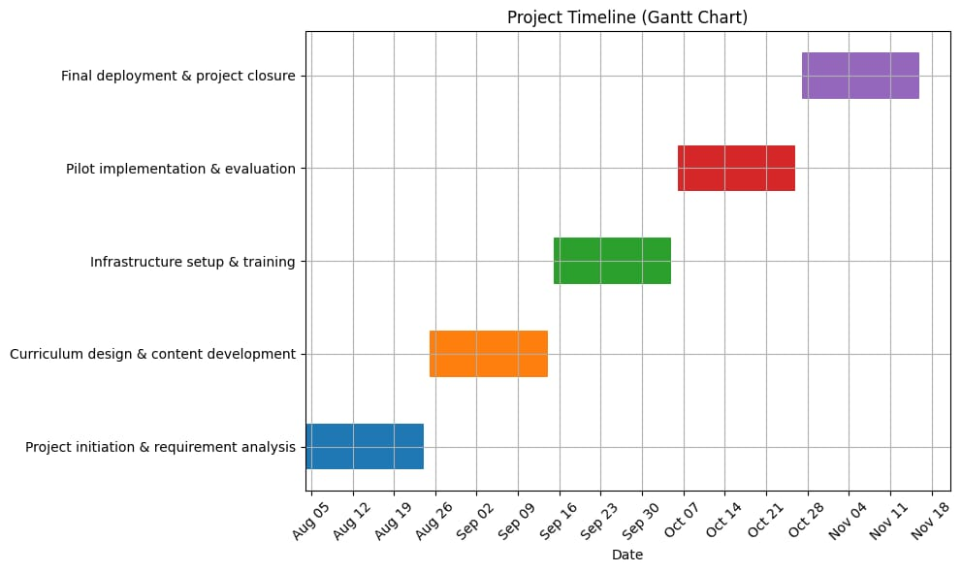
Gantt Chart

Slide 14
References
[1] A. Kumar, B. R. Patel, and C. Zhang, “Digital Learning for Rural Development: A Hybrid Approach,” IEEE Access, vol. 9, pp. 34567–34578, Mar. 2021.
[2] J. Smith, “AI-driven education systems in low-resource regions,” IEEE Transactions on Neural Networks and Learning Systems, vol. 32, no. 7, pp. 1234–1245, Jul. 2021.
[3] Government of India, “DIKSHA, SWAYAM, PM eVidya initiatives,” Ministry of Education, 2021.
[4] R. Sharma and P. Singh, “Leveraging AI and IoT for Inclusive Education in Rural Communities,” IEEE Internet of Things Journal, vol. 10, no. 5, pp. 4123–4135, May 2023.

Slide 15


