Slide 1

Handwritten Digit Recognition System Using Machine Learning
Presented By
Ujjwal Jindal (1900290100177)
Vikas Panwar(1900290100192)
Ujjwal Gupta (1900290100176)
Guided By
Asst. Prof. Gaurav Parashar
Department of Computer Science & Engineering
KIET Group Of Institutions, Ghaziabad
Dr. A.P.J. Abdul Kalam Technical University
Lucknow
Uttar Pradesh

Slide 2






INTRODUCTION
What is Handwritten Digit Recognition? Handwritten digit recognition is the ability of a computer to recognize the human handwritten digits from different sources like images, papers, touch screens, etc. and classify them into 10 predefined classes (0-9).
Why we need it? Digit recognition has many applications like number plate recognition, postal mail sorting, bank check processing, etc.
How will we do it? The mentioned project will be implemented with the help of machine learning algorithms applied using python programming language and the various libraries associated with it.

Slide 3
Technologies Required
Python
MNIST Dataset
TensorFlow
Keras
Tkinter(GUI)

Slide 4
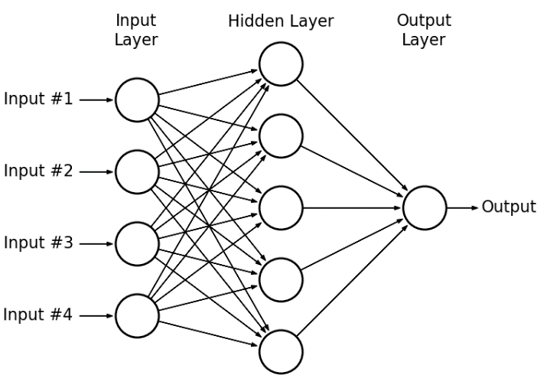
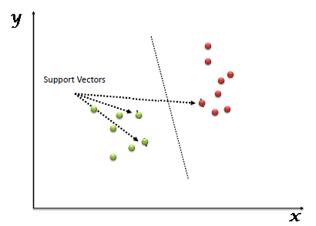
Various Algorithms Used:
Multilayer Perceptrons: Multilayer perceptron consists of three different layers, input layer, hidden layer and output layer used to classify the handwritten digits.
Support Vector Machines: SVM is a supervised ML method that intends to classify the data points by maximizing the margin among classes in a high-dimensional space.

Slide 5
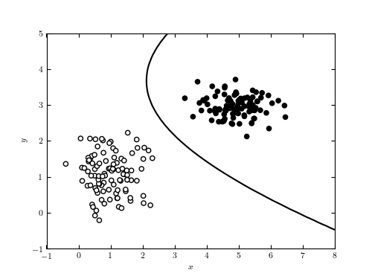
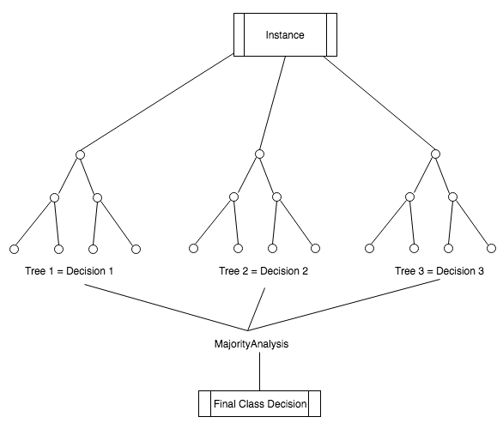
Naive Bayes: It is a probabilistic classifier which relies upon Bayes theorem with robust and naive independence assumptions. It is termed naive due to it relies on two important simplifying assumes that predictive attributes are conditionally self-reliant given the class, and it considers that no hidden attributes influence the prediction method.
Random Forest: In this algorithm, prediction is made by accumulating the predictions of the ensemble by superiority voting for classification. It returns generalization error rate and is more potent to noise.

Slide 6
PROBLEM STATEMENT
The problem statement for this project states the creation of a handwritten digit recognition system using machine learning for the conversion of handwritten decimal numbers to binary numbers(and/or other number systems).
The need of converting very long decimal numbers to other number systems that may be hard to type(due to a typing mistake being made) as compared to writing them on a paper instead helped us formulate the problem statement for this particular project. This will also help us to understand how various number systems work and are converted to one another. Implementing the small details for number system conversion will also help us become detail-oriented and not just focus on implementing the required machine learning algorithm to complete the project.
Solution of this problem statement will take place with the help of applying various machine learning studies alongside numerous programming techniques
Included within the computer science domain.

Slide 7
PROPOSED WORK
Our aim in the proposed work is to recognize user-defined handwritten digits and identify the complete number(in decimal number system by default) that is input by the user which is then converted to binary number system(and/or other number systems).
A graphical user interface(GUI) will be created for the same in which the user can input an image that will be then used to get a particular result based on the functionalities implemented within this project.
A machine learning model is to be created that will be trained and tested using a specific dataset.
Weights/Bias will be set while training the model and the model will then be evaluated based on specific conditions to provide the desired output.

Slide 8
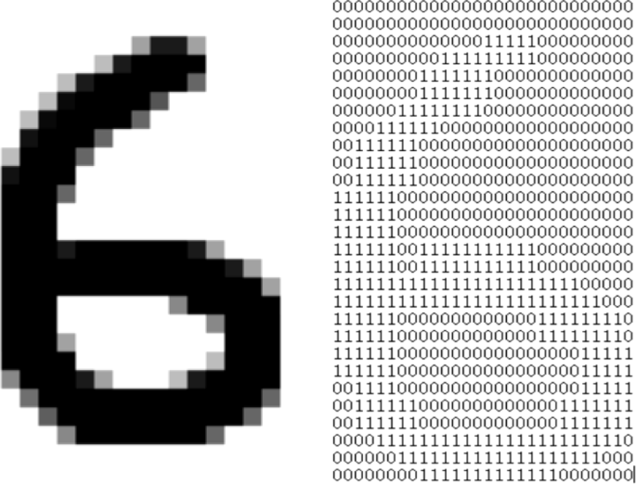
Here, our machine learning model will process the given gray-scale input image and derive a pattern using the relative 1's and 0's to recognize the input and produced the desired output in the form of a number label.
The image on the right shows how a handwritten digit I.e., a '6' is recognized as a pattern of 1's and 0's according to its black and white pixels.
This processed input will then be used accordingly to satisfy the functionalities implemented within our system.

Slide 9
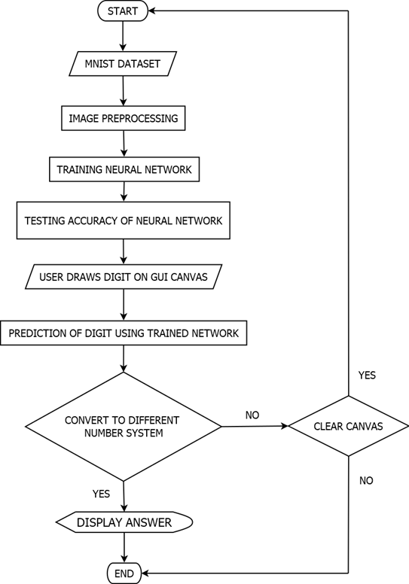
ACTIVITY
DIAGRAM

Slide 10
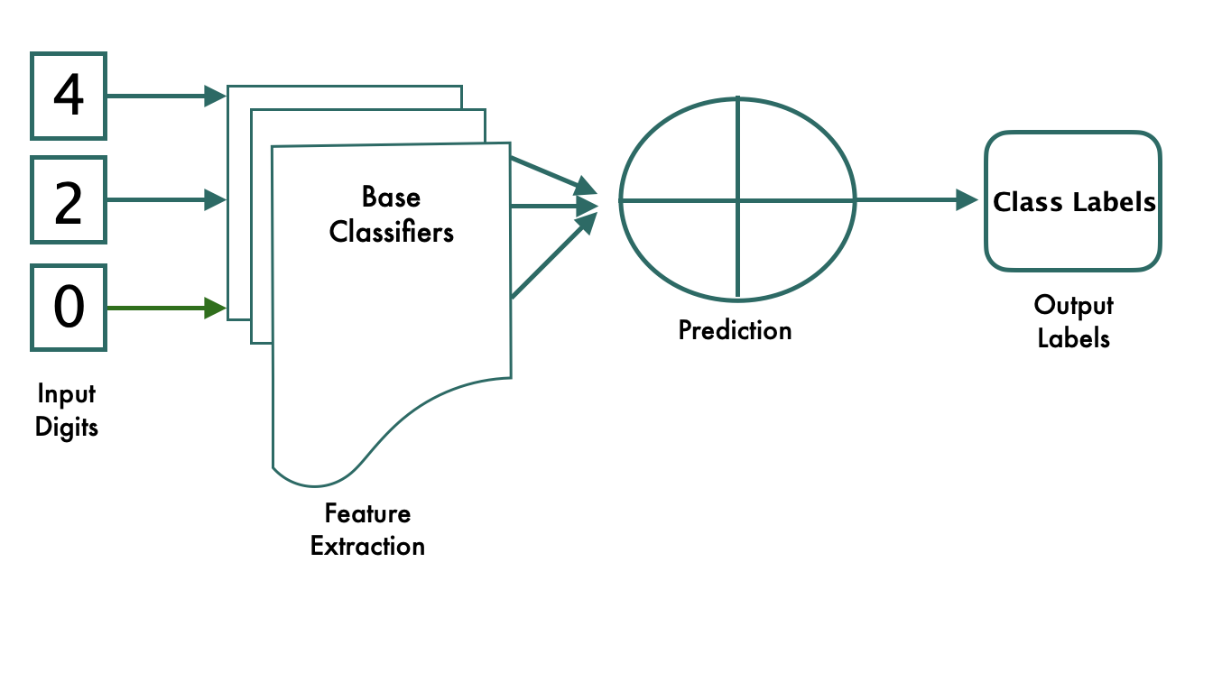
COMPONENT
DIAGRAM

Slide 11
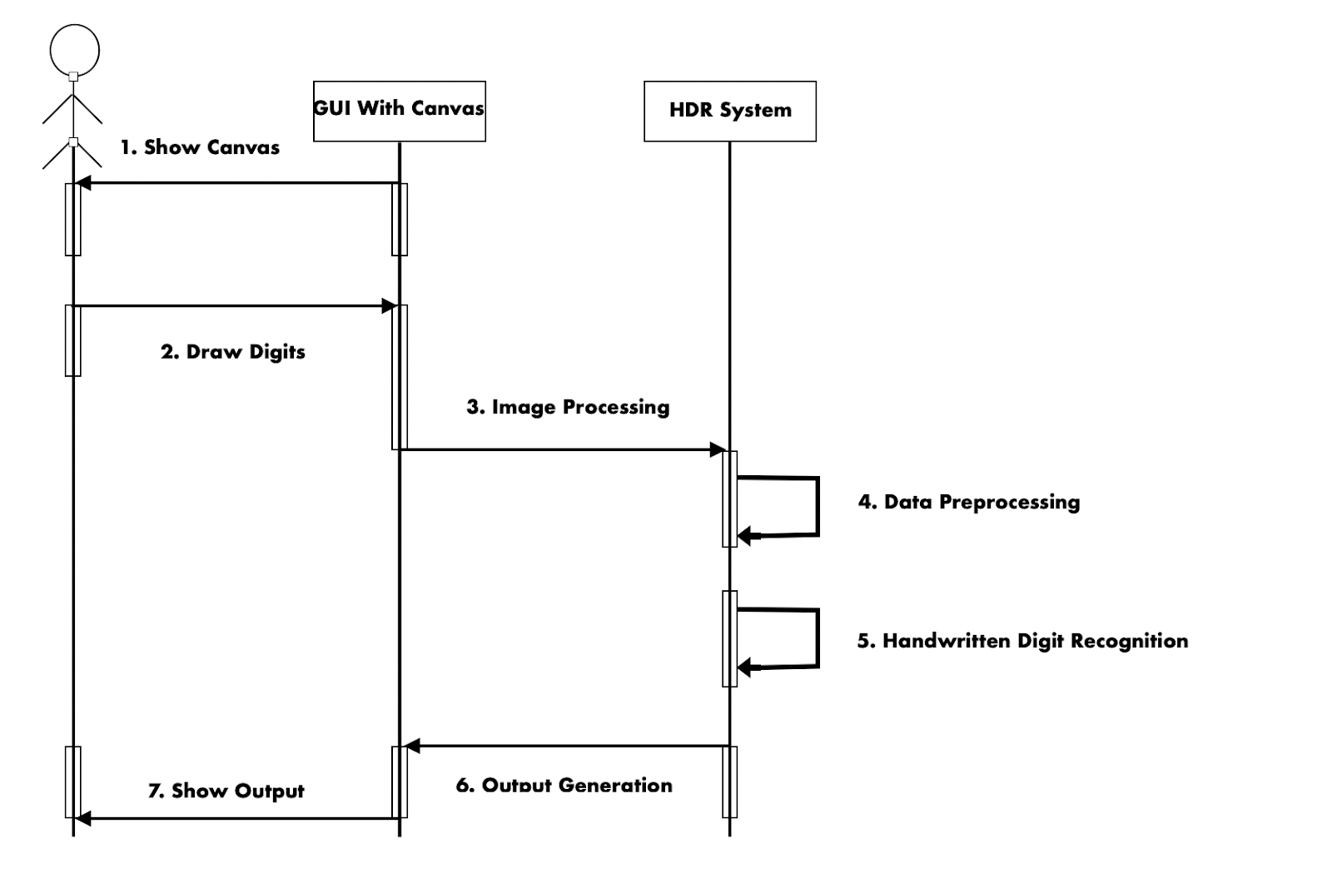
SEQUENCE
DIAGRAM

Slide 12
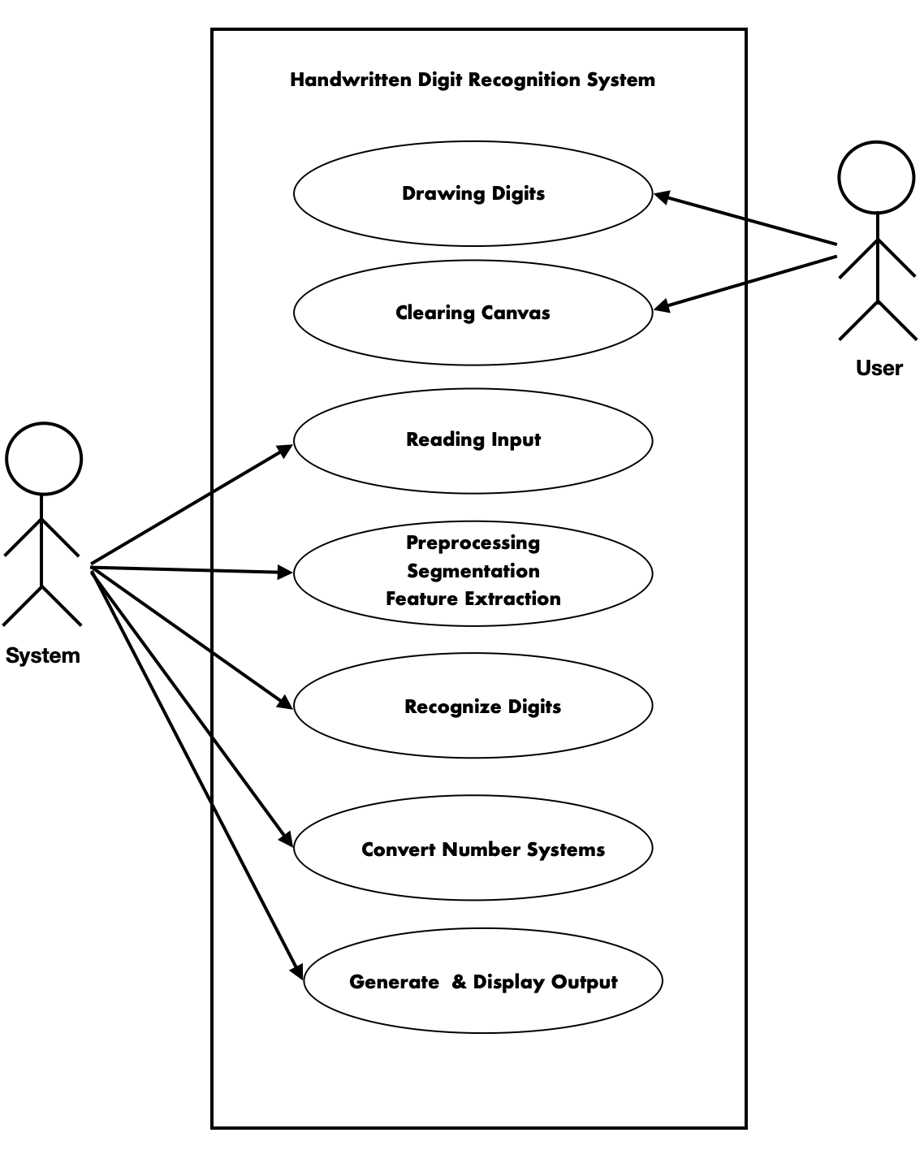
USE-CASE
DIAGRAM

Slide 13
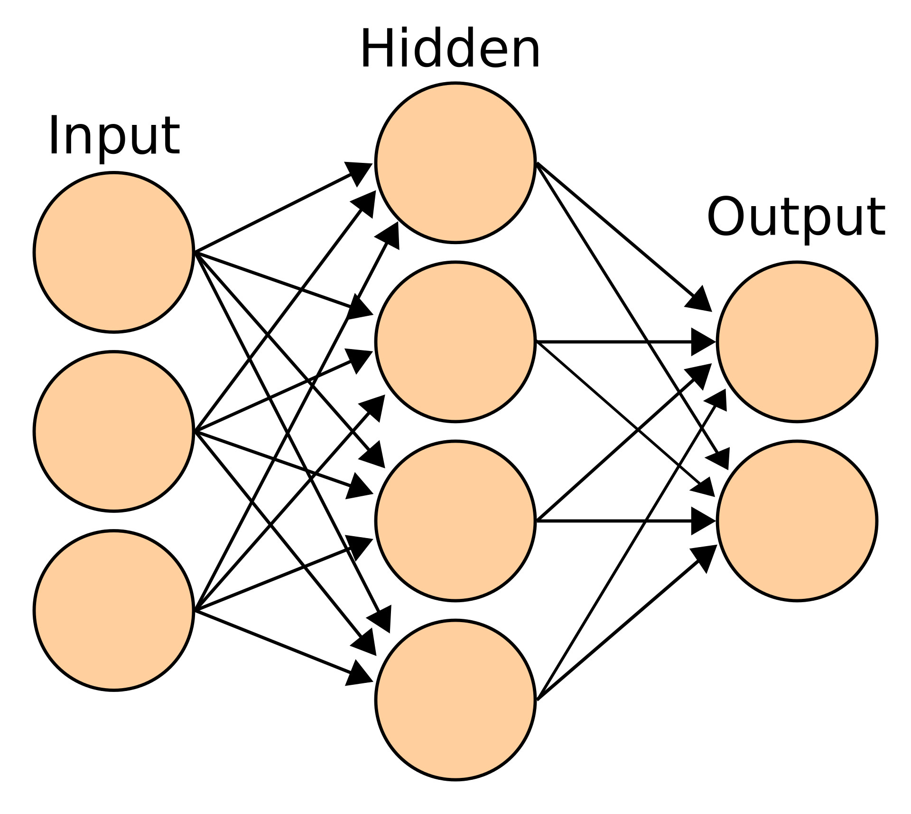
CONVOLUTIONAL NEURAL NETWORK
The image on the right shows how a convolutional neural network(CNN) works with the help of multiple neuron layers(namely input, hidden, and output layers).
In deep learning, a convolutional neural network is a class of artificial neural network, most commonly applied to analyze visual imagery.
In the context of a convolutional neural network, a convolution is a linear operation that involves the multiplication of a set of weights with the input, much like a traditional neural network. These weights are ultimately used to train the neural network for improving its accuracy and producing a reliable output.

Slide 14
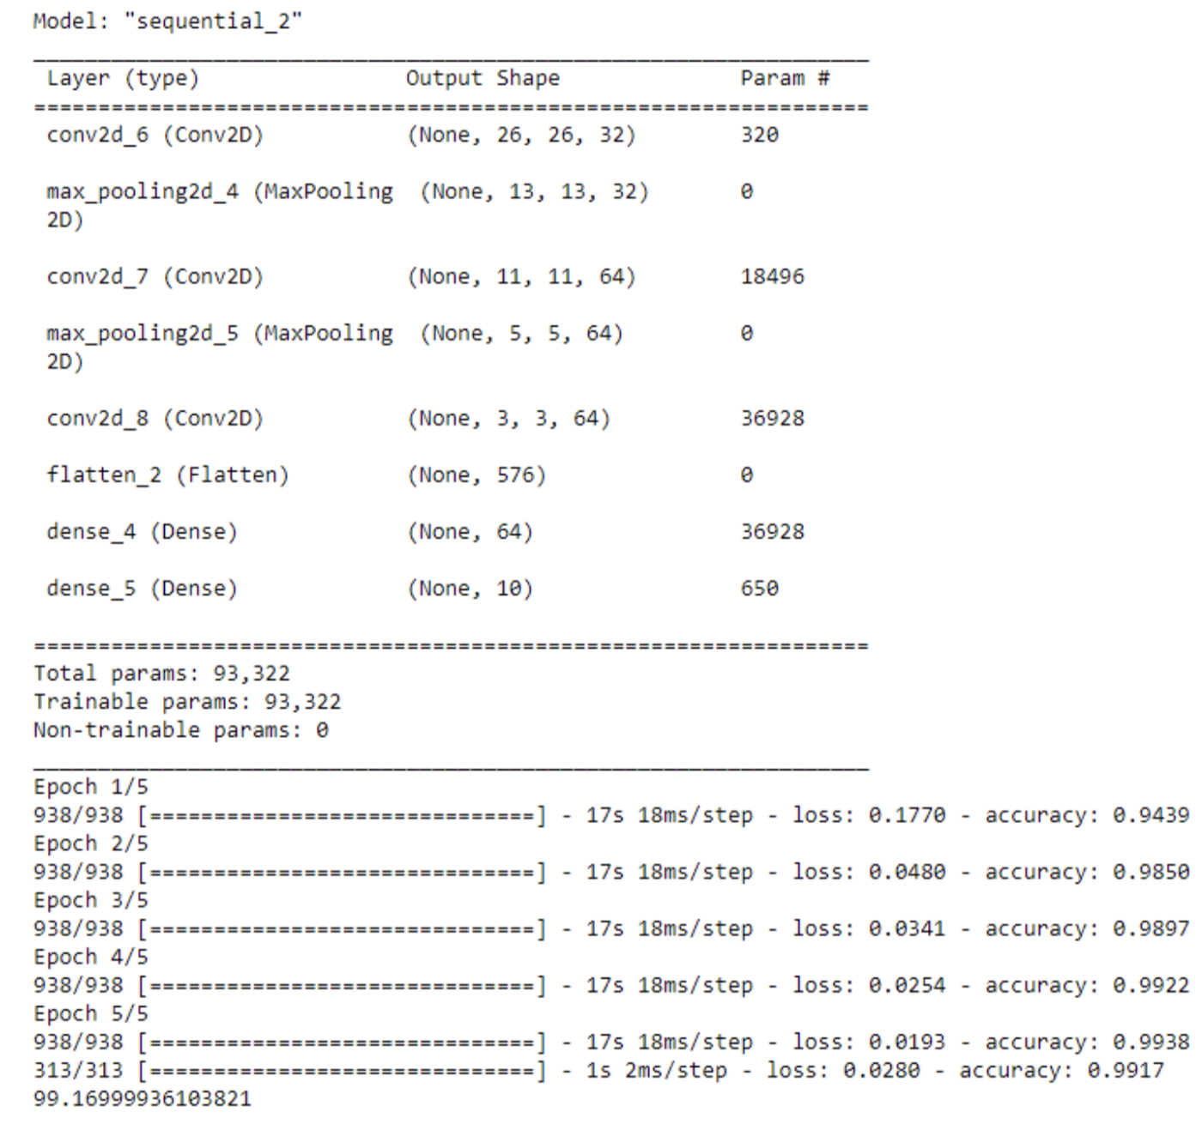
RESULT ANALYSIS
The front end design of this project will represent a basic GUI created using the standard interface library of python i.e., Tkinter.
The GUI will consist of 5 buttons alongside a canvas to draw handwritten digits in real-time. These buttons will be bound to particular functions which will be called upon/triggered by clicking on these buttons.
In the backend, a trained machine learning model is created using the Convolutional Neural Network (CNN) algorithm which uses additional neuron layers for feature extraction and in turn provides improved accuracy.
The accuracy provided by our machine learning model i.e., CNN will be of the order of 99.16% on execution through a standard of 5 epochs.

Slide 15
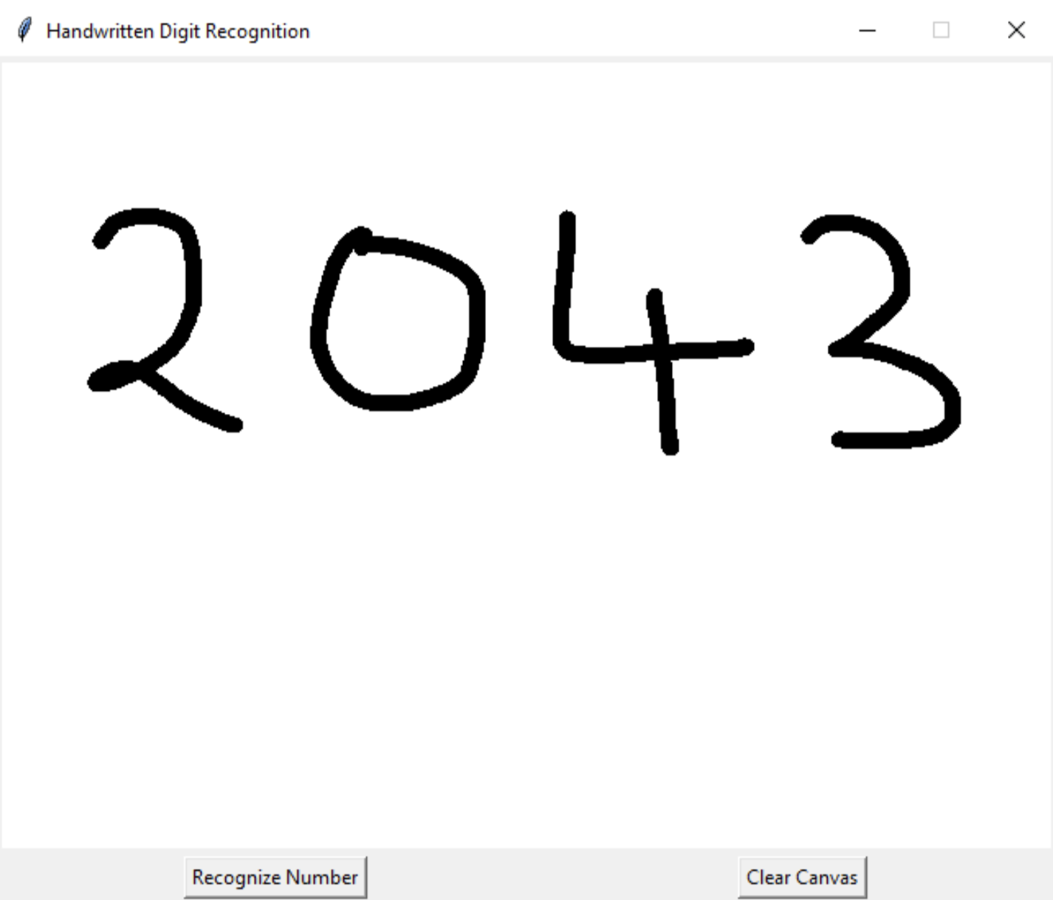
RESULT ANALYSIS
The corresponding image is the first section of the GUI I.e., the main window which will appear when the program runs.
This window consists of the canvas widget on which the user will be able to draw handwritten digits to ultimately recognize a number overall using the "Recognize Number" button widget.
If the user is not satisfied with the digits drawn by him/her, he/she can erase everything from the canvas by simply pressing the "Clear Canvas" button widget present on the bottom right corner of the GUI window.

Slide 16
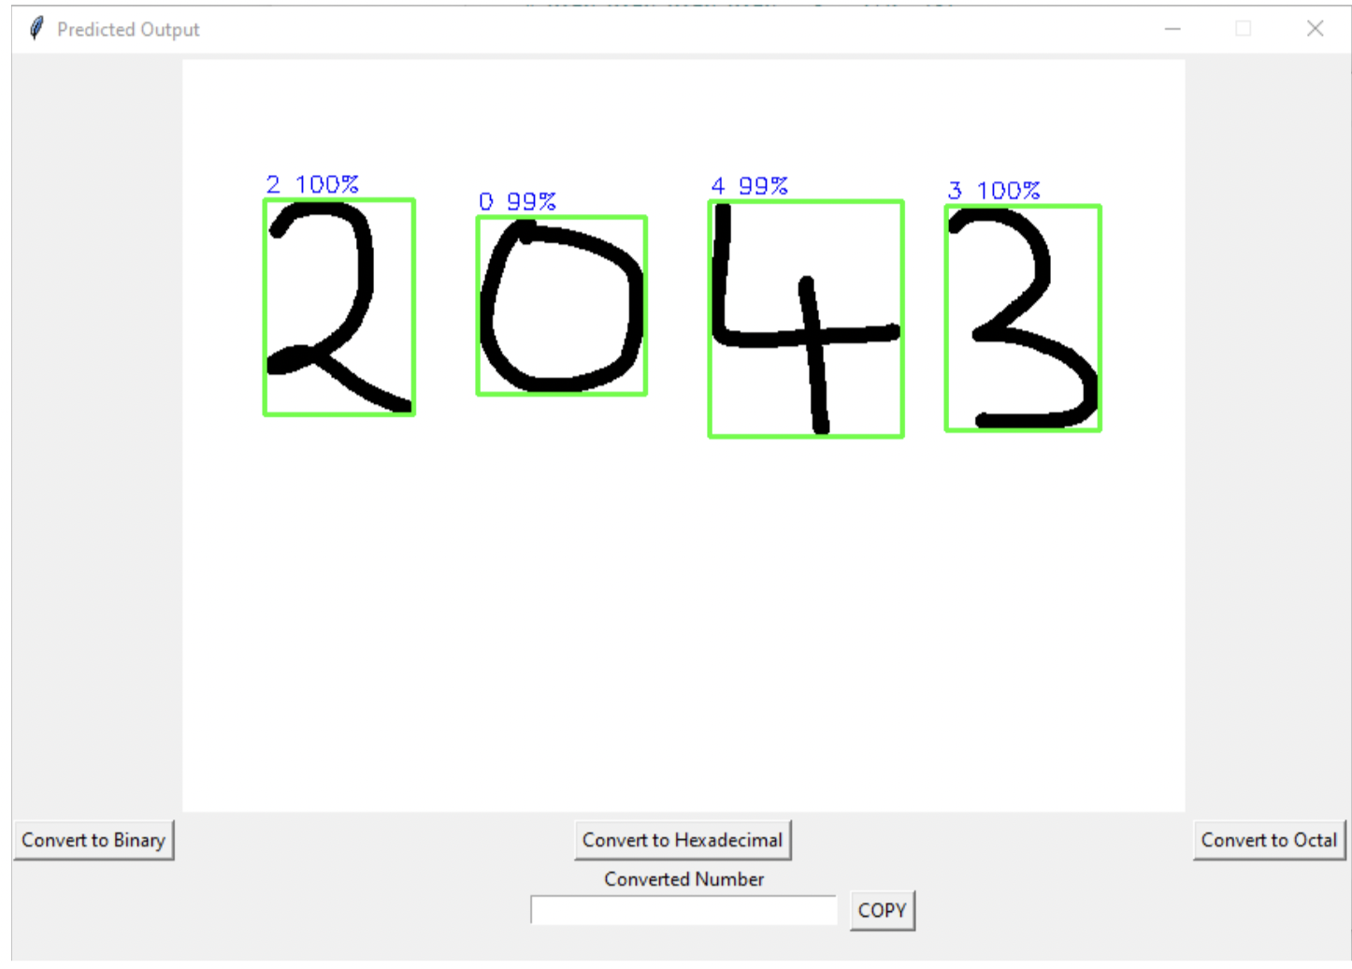
RESULT ANALYSIS
The corresponding image is the second section of the GUI I.e., the second window which will appear when the user clicks on the "Recognize Number" button widget present on the main window.
This window consist of a snapshot of the canvas of the point of time at which the user clicked on the "Recognize Number" button alongside the predicted labels and their corresponding accuracies.
This window will also consist of more button widgets which will enable the user to convert the recognized number into its binary/hexadecimal/octal equivalent.
This window will also contain an additional copy button widget to copy the output produced according to the user's choice.

Slide 17
CONCLUSION
With this presentation, we would like to conclude out project titled "Handwritten digit recognition using machine learning for converting decimal numbers to other number systems" by properly identifying the digits drawn at different angles and producing the desired results based on this identification.
Limitations:
Implementing this technology(I.e., handwritten digit recognition) on a large scale could evidently bring about several repercussions. Recognizing handwritten digits, if not used with good intentions, could lead to the manifestation of several social issues. People may use such a technology to identify bank pins, atm pins, etc. to perform monetary felonies.
Future Scope:
As the world is progressing towards automation, the use of such technology can have a great impact in the future. It can help several industries such as banking, postal, shipping, automobile, etc.
Furthermore it can be improved to automate the process of scanning digits/text information to help support many complex real-time applications.

Slide 18
REFERENCES
[1] Isha Jaggi, Anchit Shrivastava, Gupta Deepali, “Handwritten Digit Recognition Using Machine Learning”, Conference on Power Energy, Environment and Intelligent Control, (2019), unpublished.
[2] Rohan SethiIla, KaushikIla Kaushik, “Hand Written Digit Recognition using Machine Learning”, International Conference on Communication Systems and Network Technologies, (2020), pp. 2329- 7182.
[3] P. S. Nair, Assegie, T. A., “Handwritten digits recognition with decision tree classification: a machine learning approach,” International Journal of Electrical and Computer Engineering, (2019), pp.446-4451.
[4] Rabia KARAKAYA, Serap KAZAN, “Handwritten Digit Recognition Using Machine Learning”, Journal of Computer Science and Technology, vol. 25, Issue 1, (2021), pp.65-71
[5] Pranit Patil, Bhupinder Kaur, “Handwritten Digit Recognition using various Machine Learning Algorithms and Models”, International Journal of Innovative Research in Computer Science & Technology, Vol. 8, Issue 4, (2020), ISSN: 2347-5552.

Slide 19
REFERENCES
[6] Mayank Jain, Gagandeep Kaur, Muhammad Parvez Quamar, Et al., “Handwritten Digit Recognition Using CNN”, International Conference on Innovative Practices in Technology and Management, (2021), unpublished.
[7] Cheng-Lin Liu, Kazuki Nakashima, Hiroshi Sako, Hiromichi Fujisawa, “Handwritten digit recognition: Benchmarking of state-of-the-art techniques”, Journal of Computer Science and Technology, Vol. 36, Issue 10, (2003), pp.2271-2285.
[8] Priya, Rajendra Singh, Dr.Soni Changlani, “Handwritten Digit Recognition By Proximal SVM”, Journal of Emerging Technologies and Innovative Research, Vol-4, Issue-4, (2017), ISSN-2349-5162.
[9] Stephen R. Garner, “WEKA: The Waikato Environment for Knowledge Analysis”, Kings College of Engineering, Punalkulam, Pudukottai, Department of Computer Science: University of Waikato, (2021).
[10] P. Ghadekar, S. Ingole and D. Sonone, "Handwritten Digit and Letter Recognition Using Hybrid DWT-DCT with KNN and SVM Classifier", International Conference on Computing Communication Control and Automation, (2018), pp. 1-6.

Slide 20
REFERENCES
[11] Chandrajit Choudhury, Dibyakanti Mahapatra, Ram Kumar Karsh, "Generator Based Methods for Off-line Handwritten Character Recognition", Advanced Communication Technologies and Signal Processing, (2020), pp.1-6.
[12] Aun Irtaza, Ali Javed, Saleh Albahli, “An improved faster-RCNN model for handwritten character recognition”, Journal of Computer Science & Technology, (2020), Vol. 8, Issue- 4, ISSN: 2347-5552.
[13] Viragkumar N. Jagtap , Shailendra K. Mishra, “Fast Efficient Artificial Neural Network for Handwritten Digit Recognition”, International Journal of Computer Science and Information Technologies , Vol. 5, Issue 2, (2014), ISSN: 0975-9646, pp. 2302-2306.
[14] Samay Pashine, Ritik Dixit, Rishika Kushwah, “Handwritten Digit Recognition using Machine and Deep Learning Algorithms”, International Journal of Computer Applications, Vol-176, June (2021).
[15] Aarti Gupta, Rohit Miri, and Hiral Raja, “Recognition of Automated Hand-written Digits on Document Images Making Use of Machine Learning Techniques”, European Journal of Engineering and Technology Research, Vol. 6 Issue-4, May (2021), ISSN: 2736-576X.

