Slide 1


KIET Group of Institutions, Ghaziabad
(An ISO – 9001: 2008 Certified & ‘A+’ Grade accredited Institution by NAAC)
Project Presentation (Mini Project)
PROJECT NAME – BLOOD UNITY WEBSITE
BY TEAM MEMBERS : VIPIN YADAV, PRIYANSHU VARSHNEY, VIDIT SHARMA, ROHAN DEV, VINEET SINGH AND YUVRAJ SINGH
MENTORS NAME : ABHA MAURYA AND ABHINAV PATEL

Slide 2
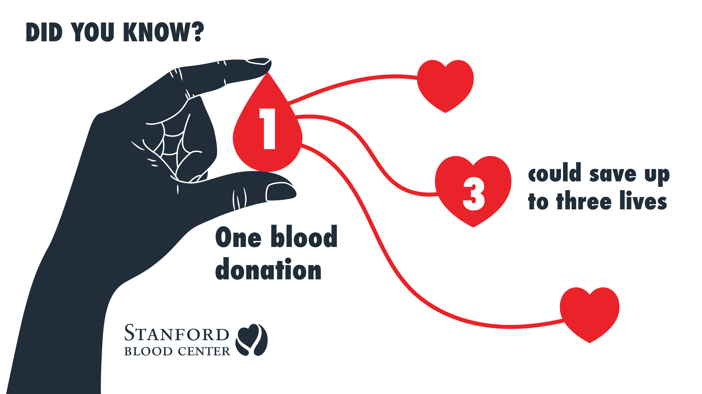

Problem Statement :
Insufficient donors and awareness about blood donation result in preventable deaths. A user-friendly blood donation website can bridge the gap and save more lives.

Slide 3
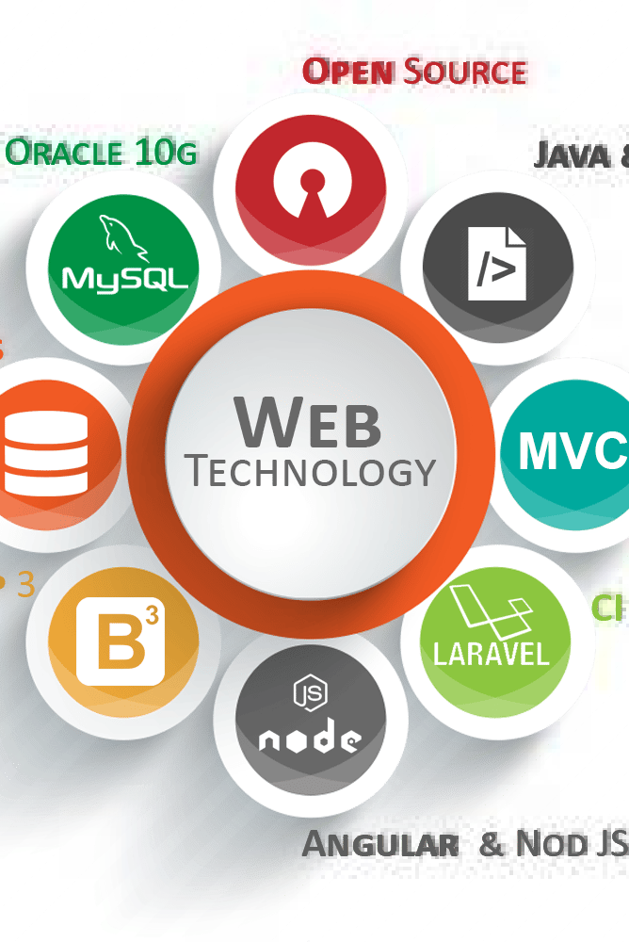

Introduction to Web Technologies : Frontend
Web technologies encompass HTML, CSS, and JS, which are the building blocks of modern websites. Learn how to implement all three and create amazing web experiences.

Slide 4
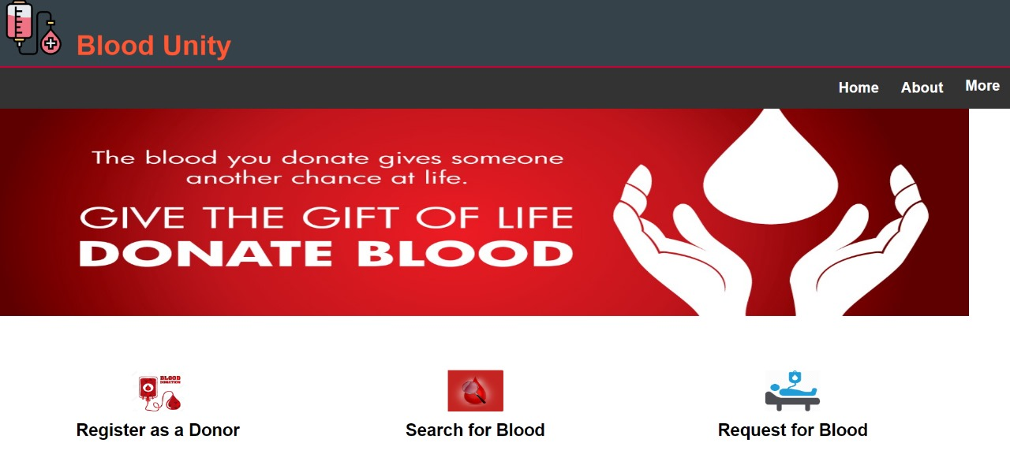
Blood Unity Website: Homepage (HTML,CSS & JS)
1

Slide 5
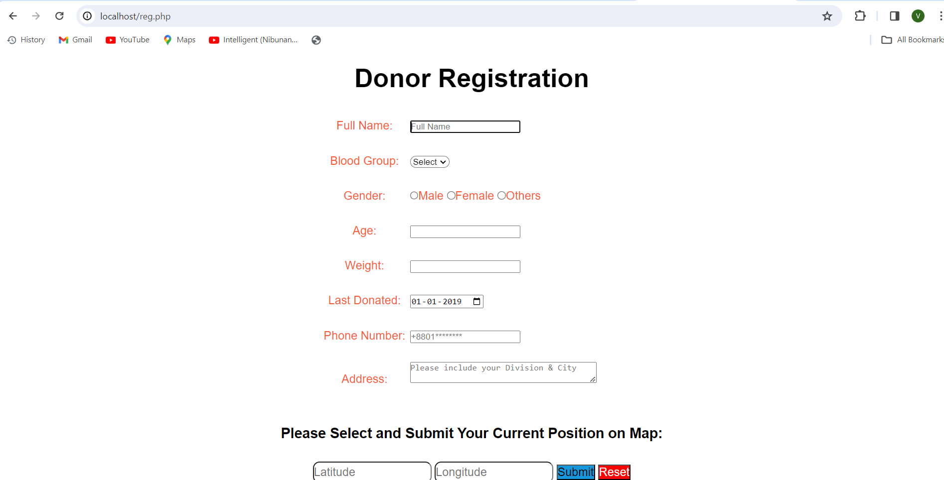


Slide 6


BACKEND
The backend of a blood donation website plays a vital role in managing the data and
functionality of the platform. Here are some key uses of the backend in a blood donation
website:
User Registration and Authentication
Donor Database Management
Matching Donors and Recipients
Reporting and Analytics
BACKEND TECHNOLOGIES USED:

Slide 7
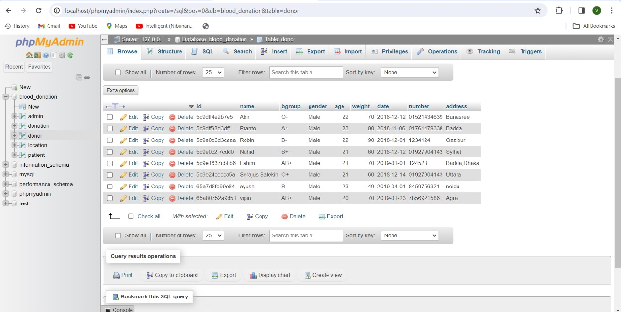
DATABASE STORED:

Slide 8

Mini Project details :
SOME FEATURES OF MY BLOOD DONATION WEBSITE :
User-friendly design
Comprehensive content
User registration and profile management for donors and recipients.
Mobile responsiveness
Strong security and trustworthiness

Slide 9
THANK YOU…

