Slide 1

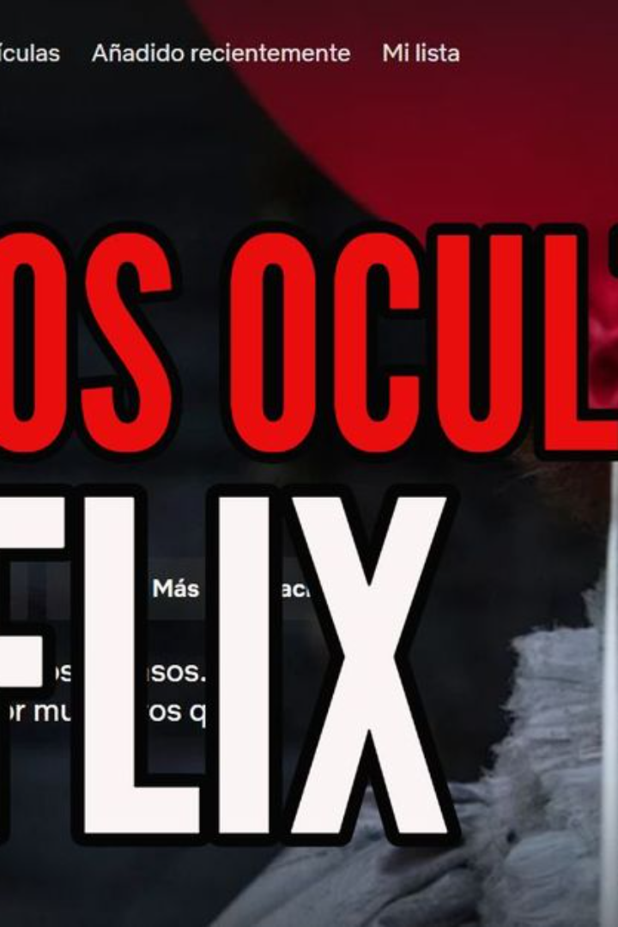

Netflix Clone Project
Creating a Netflix clone using HTML, CSS, and JavaScript is an ambitious project that involves replicating various features of the popular streaming platform. From designing the layout to integrating search functionality and video player, this project encompasses a wide range of technologies and functionalities.

Slide 2
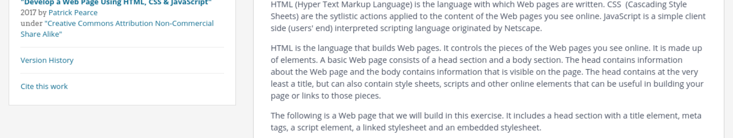
Technologies Used
1
HTML
2
CSS
3
JavaScript
Utilized for structuring web pages and creating semantic content.
Used for styling and designing the layout of the website, ensuring a visually appealing user interface.
Enabled the development of interactive and dynamic features such as the video player and search functionality.

Slide 3
Features of the Netflix Clone
User-Friendly Interface
Content Library
Personalized Recommendations
The platform will offer a seamless and intuitive user experience, similar to the original Netflix interface.
An extensive collection of movies, TV shows, and documentaries will be available for streaming.
Implementing algorithms to suggest content based on user preferences and viewing history.

Slide 4
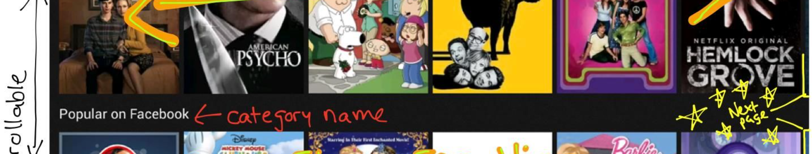
Design and Layout
Modern Interface
Responsive Design
Intuitive Navigation
The design will incorporate modern and sleek elements consistent with contemporary web standards.
Ensuring compatibility with various devices, enabling users to access the platform from desktops, tablets, and smartphones.
Logical and user-friendly navigation to enhance the browsing experience for users.

Slide 5



Search Functionality
User Input
Real-Time Filtering
Allowing users to input search queries and filter through the vast content library efficiently.
Implementing real-time search filtering to provide instantaneous results as the user types.

Slide 6

Integration of Video Player
1
Seamless Playback
2
High-Quality Streaming
Integration of a video player that supports smooth and uninterrupted content streaming.
Ensuring high-definition and stable streaming quality for an immersive viewing experience.

Slide 7
Challenges Faced During Development
1
Complex Data Management
2
Performance Optimization
Efficiently managing and organizing an extensive content library was a significant challenge.
Ensuring a fast, responsive, and seamless experience for users across different devices and network conditions.

Slide 8
Conclusion and Future Improvements
Achievements
Future Enhancements
Celebrating the successful replication of key Netflix features and functionalities within the clone platform.
Considerations for further feature additions, enhanced user personalization, and platform scalability.

