Slide 1
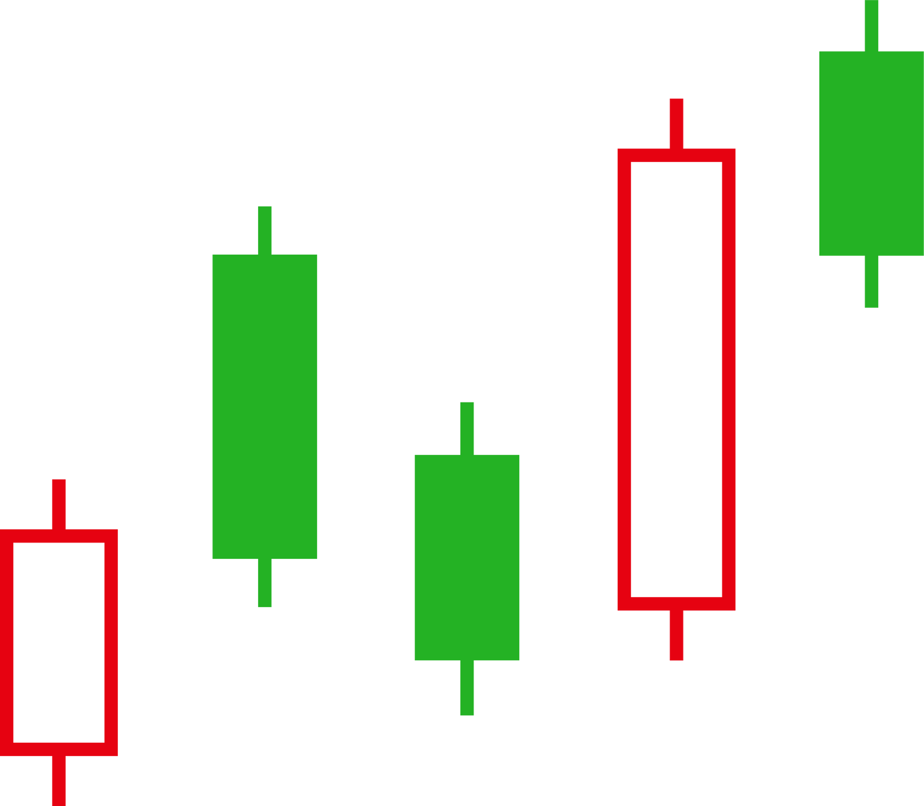




FINALGO
Algorithmic Trading Solution

Slide 2
OUR TEAM
AKSHAY KARANWAL
NAMAN AGRAWAL
ARSHIT TEOTIA
PUNEET SINGH

Slide 3
PROJECT INTRODUCTION
Development of an algorithmic trading system
Utilization of automation for trade execution
Analysis of real-time market data for identifying opportunities
Automatic execution of trades based on predefined strategies
Objectives include optimizing trading performance, managing risk, and capitalizing on market inefficiencies

Slide 4
APPROACH
Data Collection:
Fetch real-time market data from cloud API.
Retrieve candlestick data and chart.
Indicator Analysis:
Use indicators such as moving averages, RSI, Bollinger Bands, and MACD to identify trading signals.
Parameter Calculation:
Calculate breakout levels, retesting conditions, and stop-loss levels.
Set stop-loss levels to mitigate risk.
Live Testing and Deployment:
Conduct live testing in simulated trading environments.
Monitor real-time performance and execution quality.

Slide 5
PROJECT TECHSTACK
To visualize the candlestick chart and display technical indicators.
As the web application framework for Node.js, to simplify routing and middleware setup.
CHARTING LIB.
EXPRESS.JS
NODE.JS
REACT
For building the user interface and handling the frontend logic.
For building the backend server to handle API requests and business logic.

Slide 6
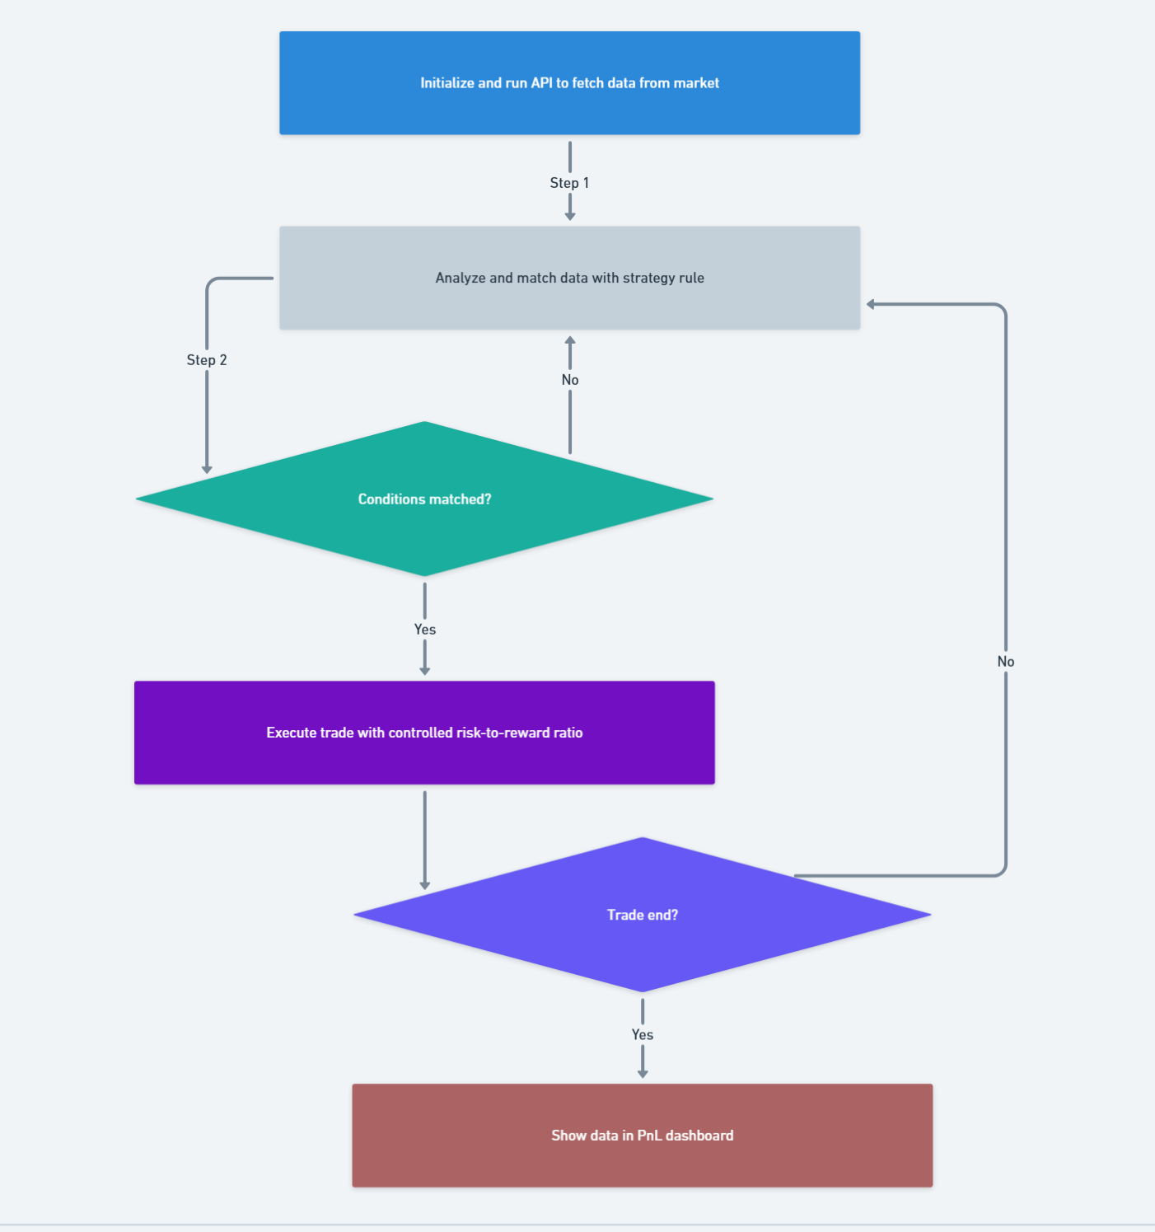
WORKING FLOWCHART

Slide 7
BENEFITS
1.Reduce Manual Work
2.Remove Emotions
3.Save Time
4.Back-Test Strategies
5.Quicker Execution

Slide 8
THANK YOU

