Slide 1


“ HEALWELL ”
TEAM MEMBERS:
SHRINKHAL ASTHANA (CSE-AI)
ANUSHKA SINGH (CSE-AIML)
BHUMI CHAUDHARY (CSE-AIML)
NIHARIKA BHATI (CSE-AIML)

Slide 2


TABLE OF CONTENT
INTRODUCTION
OBJECTIVE
WORKFLOW
FUNCTIONAL & NON-FUNCTIONAL REQUIREMENTS
TOOLS USED

Slide 3


INTRODUCTION
In an era where mental health is a growing concern, "HealWell" is a website that aims to provide a safe and supportive online platform for individuals seeking guidance, assistance, and resources related to their mental well-being.

Slide 4



OBJECTIVE
The primary objective of the "HealWell" website is to provide a user-friendly, secure, and accessible online environment that addresses mental health challenges and stress management.

Slide 5
OBJECTIVE:
The specific, measurable, achievable, relevant, and time-bound (SMART) objectives are as follows:
Anonymity and Confidential Support
Stress Detection and Management
Accessible Information and Resources

Slide 6
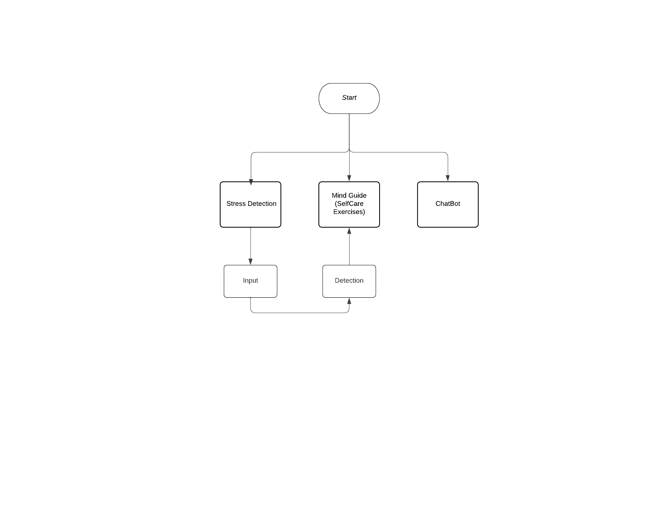

WORKFLOW

Slide 7
FUNCTIONAL REQUIREMENTS
Chatbot:
Anonymity: Users should be able to engage in anonymous conversations with the chatbot.
Mental Health Support: The chatbot should provide guidance and support for various mental health concerns.
2. Stress Detector:
Input Analysis: The stress detector should analyze user inputs to assess stress levels.
Feedback: Provide feedback and suggestions to help users manage stress effectively.
3. Self-Help Exercises:
Articles: Provide informative articles and self-help exercises related to mental health.

Slide 8



Non-Functional Requirements:
Security: Data privacy and security are paramount, ensuring all user interactions and data are encrypted and protected.
Performance: The website should load quickly and respond promptly to user actions.

Slide 9

TECHNOLOGIES USED:
Front-end Development: HTML, CSS and JavaScript for creating the user interface and ensuring a responsive design.
Back-end Development: Framework: Django.
RESTful API: Django Rest Framework.
Machine Learning Integration: TensorFlow.
Chatbot Integration: Using Django views and URL patterns.
Colab Notebook : Python for building the machine learning components of the chatbot and stress detector.

Slide 10


THANK YOU !

