Slide 1

KIET GROUP OF INSTITUTIONS
GROUP MEMBERS: SHREYA GOSWAMI (2100291530051) KHUSHI BANSAL (2100291530028) MAHI TYAGI (2100291530032) SALONI JAIN (2100291530047)
MindMatters

Slide 2
ELIGIBILITY FOR MENTAL HEALTH TREATMENT : A Predictive Approach

Slide 3
INTRODUCTION
In today's fast-paced world, mental wellness is essential for overall health. It impacts individuals and workplaces, influencing emotions, relationships, and productivity. Our project addresses a critical issue: the underutilization of professional mental healthcare.
Despite growing awareness and resources, there's a gap between those who need help and those who seek it. Surveys and media reports highlight this gap, motivating us to explore the factors affecting treatment-seeking decisions. We aim to uncover these causes, drive positive change, and enhance access to professional mental healthcare.

Slide 4
VISION
Empowerment
Bridging the Gap
1
2
Personalized Approach
Holistic Wellness
3
4
Empowering individuals to proactively address their mental health needs.
Bridging the mental healthcare utilization gap by understanding and addressing the factors that deter treatment-seeking.
Providing a personalized approach through predictive analysis, assessing an individual's treatment acceptance likelihood.
Integrating mental health as a core component of overall wellness for healthier, more fulfilling lives personally and professionally.

Slide 5
TECHNOLOGIES USED
Language | Python
Frontend | HTML , CSS , JavaScript
Framework | Flask
Backend | Machine Learning

Slide 6
APPROACH
The project employs a user-friendly Flask-based front-end to gather valuable insights from individuals through a series of targeted questions. By analyzing user responses, it leverages diverse machine learning algorithms to predict an individual's likelihood of seeking mental healthcare treatment. The approach hinges on understanding how factors, such as interference with work due to untreated symptoms or prior diagnosis, influence one's decision to seek professional help. Based on these predictive models, the project generates a binary 'yes' or 'no' outcome, providing a personalized and data-driven assessment of an individual's inclination toward mental healthcare, thus offering a critical step in enhancing mental health access and support.

Slide 7
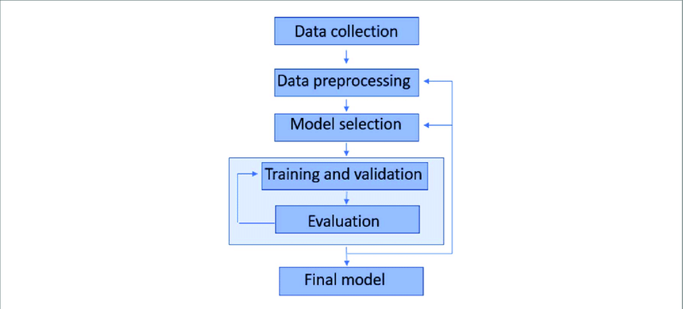
WORKFLOW

Slide 8
Data Analysis Models Used
Logistic Regression
K-Nearest Neighbors
Decision Tree
Random Forest
Bagging
Boosting
Stacking

Slide 9
Conclusion
Identified key factors influencing mental healthcare seeking.
Predictive models provide personalized insights.
Emphasized mental health as essential for overall wellness.
Potential to revolutionize mental healthcare access.
A brighter future for mental health and well-being.

Slide 10
THANK YOU

