Slide 1
TEAM MEMBERS
KESHAV
AYUSH
ASHUTOSH
UJJWAL
MENTORS
SHASWAT SIR
ARVIND SIR
TECHNOLOGY
STACK
INTRODUCTION
THANK
YOU
MINI PROJECT
CHESS.AI
FEATURES
SESSION: 2022-2023

Slide 2
TEAM MEMBERS
KESHAV
AYUSH
ASHUTOSH
UJJWAL
MENTORS
SHASWAT SIR
ARVIND SIR
TECHNOLOGY
STACK
MINI PROJECT
CHESS.AI
SESSION: 2022-2023
INTRODUCTION
THANK
YOU
FEATURES

Slide 3
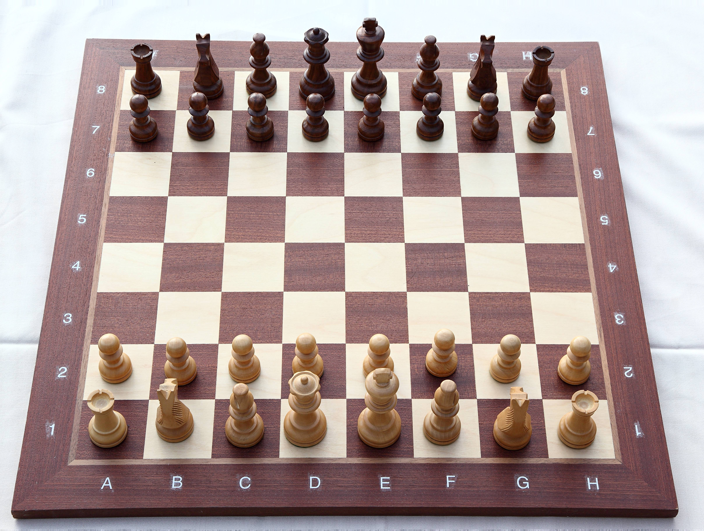
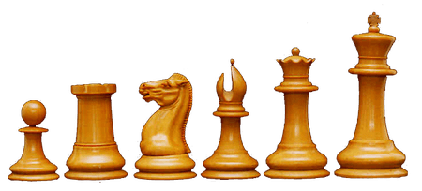
Introduction
Chess is a game that has fascinated human minds for centuries. The complex strategies, tactical maneuvers, and deep thinking required make it a perfect playground for the integration of Artificial Intelligence (AI),Creating a Chess Game with AI Support. Chess, often considered the "king of board games," is not just a game; it's a timeless battle of wits.

Slide 4
FEATURES
Play with friends
Play with computer
Analysing after game

Slide 5


Front end
HTML
CSS,BOOTSTRAP
JAVASCRIPT
ANGULAR.JS

Slide 6
Angular.js:-Angular.js is a popular framework of js and it help us to built a Single Page Application . And also it helps to implement the JavaScript functions.
JavaScript:- JavaScript is used within AngularJS controllers to control and manage different aspects of the game, such as updating the view (HTML) when the game state changes, handling user input, and managing game rules.

Slide 7
BACK END
PYTHON
DJANGO
DATABASE(MySQL)

Slide 8
Django:-
used to create the backend of your chess gaming website.
Set up a database (e.g., PostgreSQL, SQLite) to store user accounts, game records, and other data.
Implement server-side logic for managing game state, player authentication, handling game history

Slide 9
BUILDING THE GAME WITH AI
Implement Move Generation: Create functions to generate legal moves for the current position. This should include generating moves for all pieces on the board.
Minimax Algorithm: Implement the minimax algorithm, which is a recursive algorithm for searching through possible moves in a game tree. The algorithm considers both the player's and opponent's best moves, assuming they play optimally.
AI Move Selection: Develop a function to select the best move for the AI based on the minimax search results.
Incorporate AI into Game Loop: In your game loop, when it's the AI's turn, call the AI move selection function and execute the chosen move on the board.

Slide 10

Thank you

