Slide 1


How to be successful at Reading Plus
Your initial test in September set Reading Plus up especially for you and your reading ability.
It will continue to adjust to your results.
That is why it is important that you concentrate during the reading and vocabulary activities and complete the comprehension questions to the best of your ability.
Top Tips
Read the text carefully – try to find a quiet place if you can
Try your best on the vocabulary and comprehension questions
Use the reread button if you are unsure of an answer to a comprehension question
Make sure you complete the week’s challenges
Aim for 80% or higher to score a combo
This will really help you improve your score!

Slide 2
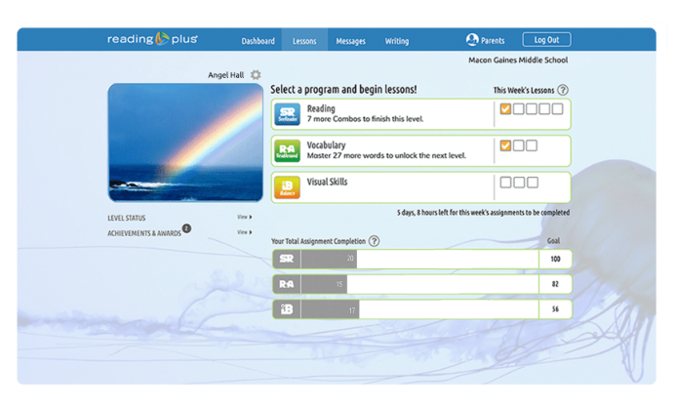
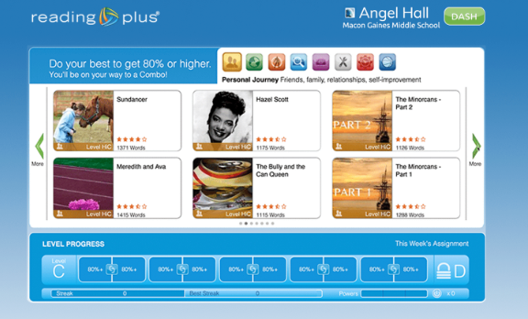
How to be successful at Reading Plus
Each week you have a certain number of set lessons to complete in three areas:
Reading
Vocabulary
Visual Skills
You need to complete all the lessons at 80% plus to score a COMBO! Multiple COMBOS allow you to move up the levels!
You can choose which texts you read – they are all suitable for your level of reading. Choose the texts you find interesting.

Slide 3

How to be successful at Reading Plus
The site code is rpparkc.
If you have forgotten your log on details, then please email your English teacher or Mrs Freestone.

