Slide 1
Test Functions
Main Program
ArmCont
F1,…,F6
ArmInit
InitDynam
Evaluate
ArmInit
InitDynam
Initialize
Control
Link2to1
Initialize
InitDynam
makeconst
Link3to2
Initialize
makeconst
Distance
makeconst
Make Body
Head, etc.
Azimuth
Vertical
Target Position
Environment

Slide 2
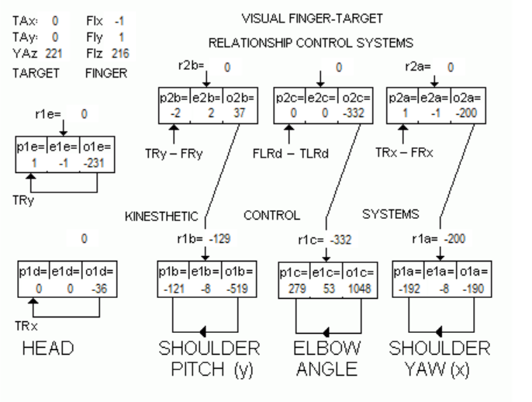
This Output was from s program written in Pascal (Delphi). Not the one which Warren sent me! Hence I am not considering its output. I downloaded it from the website just to have a feel that how it looks like. (So please forget about it and see as on next slide)

Slide 3
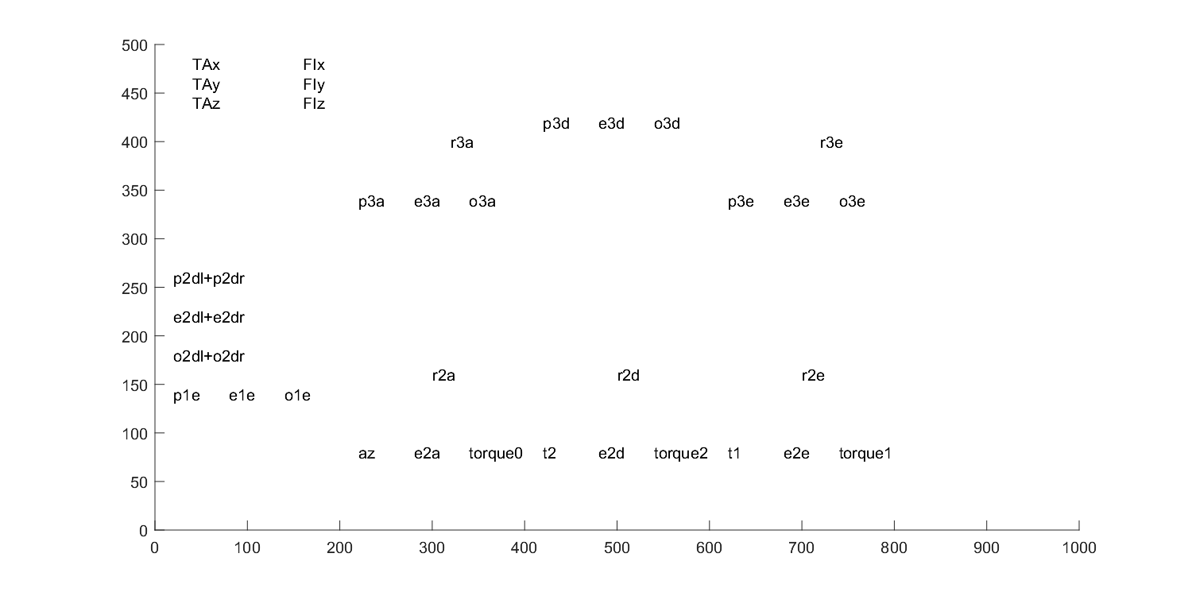
Text output from “Arm2.c”
Target and Finger positions
3rd Level
Gaze (percept, error, output) Not needed!
via Link3to2 function
2nd Level
p2a
p2e
p2e

Slide 4
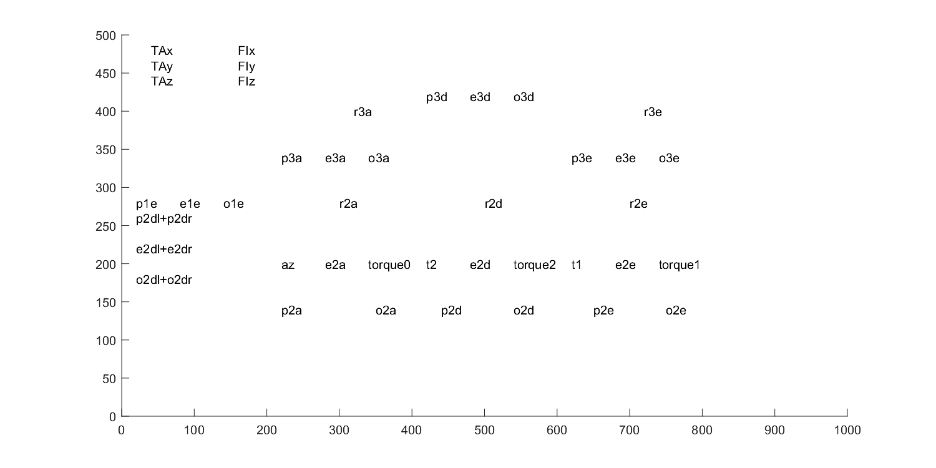
Till Environment function (Please see in first slide)
distance
azimuth
TLRD-FLRD
vertical
gain
FRX-TRX
gain
FRY - TRY
gain
via Link3to2 function
difference
difference
difference
via Link2to1 function
ArmCont function (Please see in first slide)

Slide 5
o2dr
Perception of Target as a Euclidean Distance between Target and Eye coordinates.
GazeR
p2dr = TRx
GazeL
p2dl = TLx
GazeBoth
p1e = TRy
rotateimage(&TRx,&TRy,TXR,TYR,TZR,theta2,phi2re);
TXR = TAx - RExr;
Starts from here
phi2re = gazexre;
gazexre = o2dr;

Slide 6
o3d
o2dr
Target to Finger
p3d = TLRd - FLRd;
GazeR
p2dr = TRx
GazeL
p2dl = TLx
GazeBoth
p1e = TRy
FLRd = FLx - FRx; TLRd = TLx - TRx;);
rotateimage(&TRx,&TRy,TXR,TYR,TZR,theta2,phi2re);
rotateimage(&TRx,&TRy,TXR,TYR,TZR,theta2,phi2re);
rotateimage(&FRx,&FRy,FXR,FYR,FZR,theta2,phi2re);
rotateimage(&TLx,&TLy,TXL,TYL,TZL,theta2,phi2le);
rotateimage(&FLx,&FLy,FXL,FYL,FZL,theta2,phi2le);
TXR = TAx - RExr;
Starts from here
FXR = FIx - RExr;
armcont(&az,&t1,&t2,o2a,o2e,o2d);
Starts from here
phi2re = gazexre;
o2d
gazexre = o2dr;
r2d

Slide 7
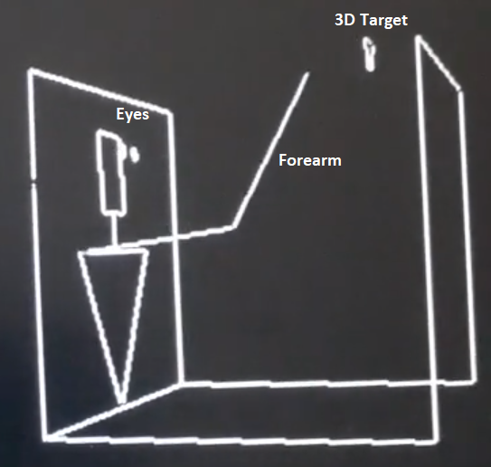
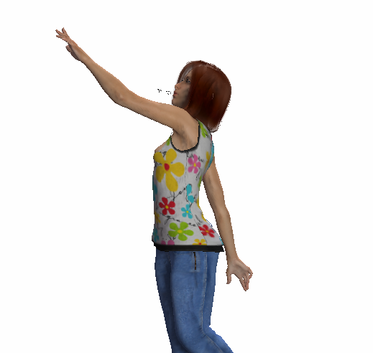
Finger Reference Position
Visual Error
(address)
cmp
Finger Position
VISUAL
k+∫
MAP
Retinal Image
Direct Visual Control
ref
Visual Map Control
cmp
KIN 2
k+∫
Joint Angle
ref
cmp
Muscle Dynamics
error
KIN 1
k

