Slide 1
PCWG
Peter Stuart
02 September 2014

Slide 2
Agenda (1)
Morning Session: 10am-1pm
10.00 – 10.05 “Welcome” Peter Stuart (RES)
10.05 – 10.30 “Review of Actions from Last Meeting” and “Round Robin 3 Results Overview – Rotor Equivalent Wind Speed with Veer” Peter Stuart (RES)
Commercial Considerations Presentations
  10.30 – 10.45 “Real World Contractual Experience of the Inner-Outer Range” Daniel Stevens (SSE)
  10.45 – 11.00 “Use of manufacturer specific inputs to refine energy yield predictions” Richard Whiting DNV GL
  11.00 – 11.30 Commercial Considerations Discussion
Break: 11:30 – 11:45 Coffee Break

Slide 3
Agenda (2)
Round Robins / Consensus Analysis
  11.45 – 12.15 Tour of Consensus Analysis Peter Stuart (RES)
  12.15 - 13:00 “Proposed Round Robin 4”:
    Exercise Definition:
      Application of site specific power curves
      Application of site specific power curves in conjunction with the turbulence renormalisation and rotor equivalent wind speed methods.
    Dataset overview and Q&A.
    RR using Black Box Model and/or Open Source Code.
Lunch 1pm – 2pm

Slide 4
Agenda (3)
Afternoon Session: 14:00 – 15:00
Technical presentations
  14.00 – 14.15 “Use of Nacelle LiDAR data to explore impact of using non-linear averages”, Chris Slinger (Zephir)
  14.15 – 14.30 “Power Performance Analysis using LiDAR simple terrain”, Alex Clerc (RES)
  14.30 – 14.40 “Practical Consideration using the Equivalent Power Approach”, Peder Bay Enevoldsen and Ioannis Antoniou (Siemens)
  14.40 – 14.50 “Calculation of REWS using CFX”, SSE, Paul Hosley
  14.50 – 15.00 “Impact of Ground Boundary on Production of Short Tower Turbines - A Conceptual Study”, (SEE, RWE, RES & DNV GL)

Slide 5
Agenda (4)
Coffee Break: 15.00 – 15.15
Discussion Session: 15.15 – 16.45
Guideline Document on the Presentation of Power Curve Information
Guideline Document on the Application of the Turbulence Renormalisation Method
Timescale for finalisation of guideline documents
PCWG Open Source Code
Is the consensus analysis for the Turbulence Correction Finalised?
Wrap Up: 16.45 – 17.00
Agenda for October meeting in US
Next Meeting (after October) Venue
PCWG New Email Address: pcwg@res-ltd.com
Future Roadmap / Group Focus
Continued public distribution of minutes and proceedings

Slide 6
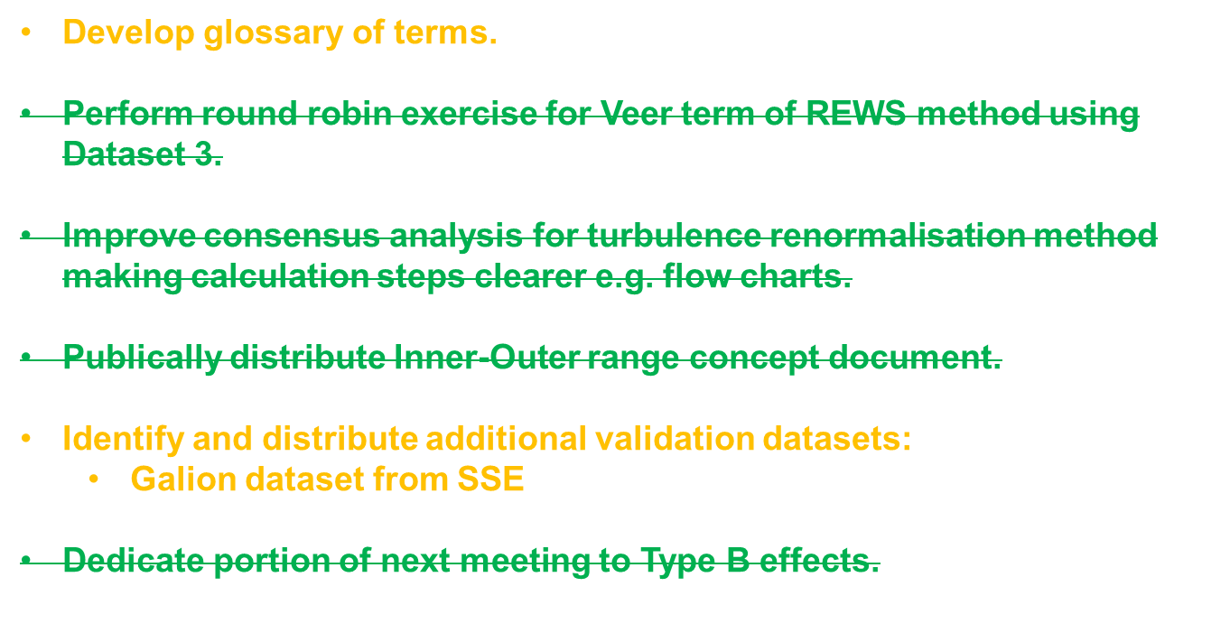
December 2013 Meeting Actions

Slide 7
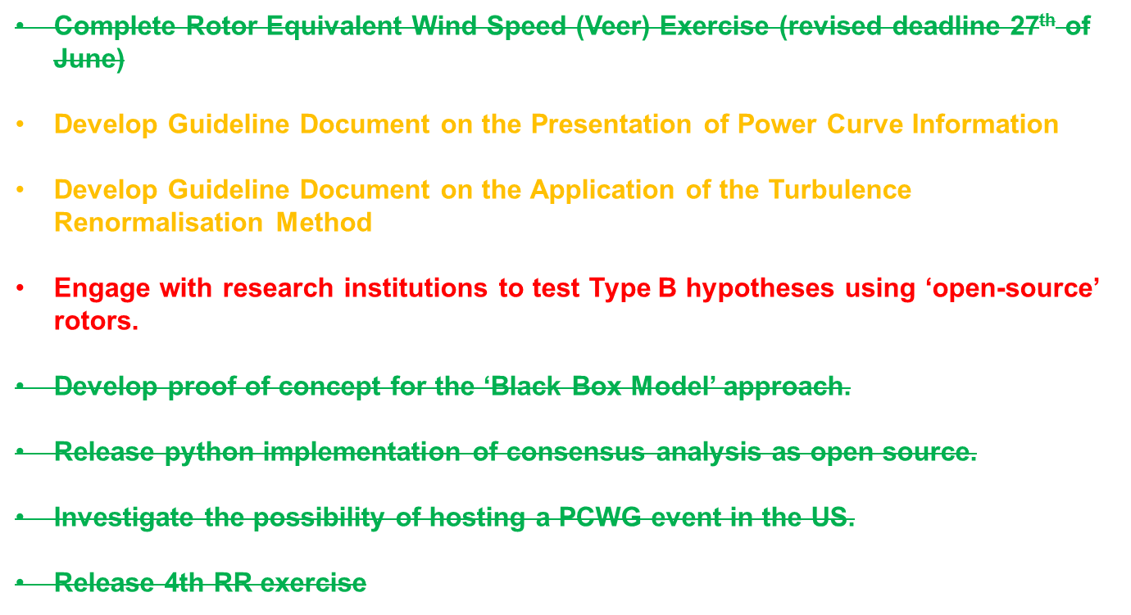
April 2014 Meeting Actions

Slide 8
PCWG: RR3 Exercise: Rotor Equivalent Wind Speed Considering Veer
Exercise 2.0 (Baseline):
For each dataset please calculate the SEP at the turbine location based on hub height wind speed.
Exercise 2.1 (Shear and Veer correction):
For each dataset please calculate the SEP at the turbine location based on rotor equivalent wind speed considering both the wind speed and wind direction from the LiDAR. The rotor equivalent wind speed should be derived by combining the cup anemometer and LiDAR measurements whereby the hub height wind speed from the cup anemometer is multiplied by the ratio of rotor equivalent to hub wind speed from the LiDAR.

Slide 9
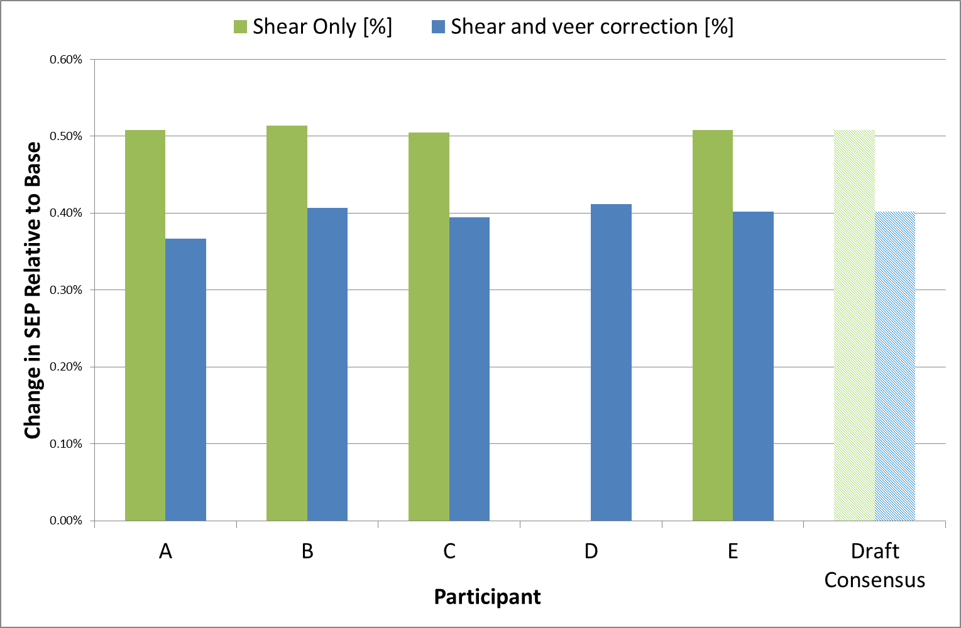
PCWG: RR3 Results Summary: Rotor Equivalent Wind Speed Including Veer

