Slide 1
Inner/Outer Range Warranty: SSE’s experience
2nd September 2014

Slide 2
Power Curve Warranty – new approach
Previous approach
Request PCW along with SPW during turbine tender process
Typically: IEC-61400-12-1 with additional requirements
Negotiate on finer detail (number of turbines to test)
Have yet to make a claim
Typically 95% or [100% - PPT uncertainties]
Power Performance Tests – expensive, restricted
Always need site calibrations
No ability to infer how that WTG will perform in other sites

Slide 3
Project X
>100MW onshore project in the British Isles
SSE tendered project as normal
Shortlisted OEMs provided with “PCW Requirements” document:
Inner/Outer definition in line with PCWG’s concept
Relaxed sector filtering (wakes only)
RS data allowed

Slide 4
Power Curve Warranty for Project ‘X’ (1)
Calculated Power Curve obtained for range of Air Densities
Inner Range stipulated as:
Shear: 0 to 0.35
TI: 5% - 15%
Inflow angle not to exceed +/- 8°
Remote Sensing
Permitted if terrain meets requirements of Annex B (i.e. no site calibration required)
RS unit must meet accuracy requirements of Ed. 2 of 61400-12-1 (CD 2013/07)

Slide 5
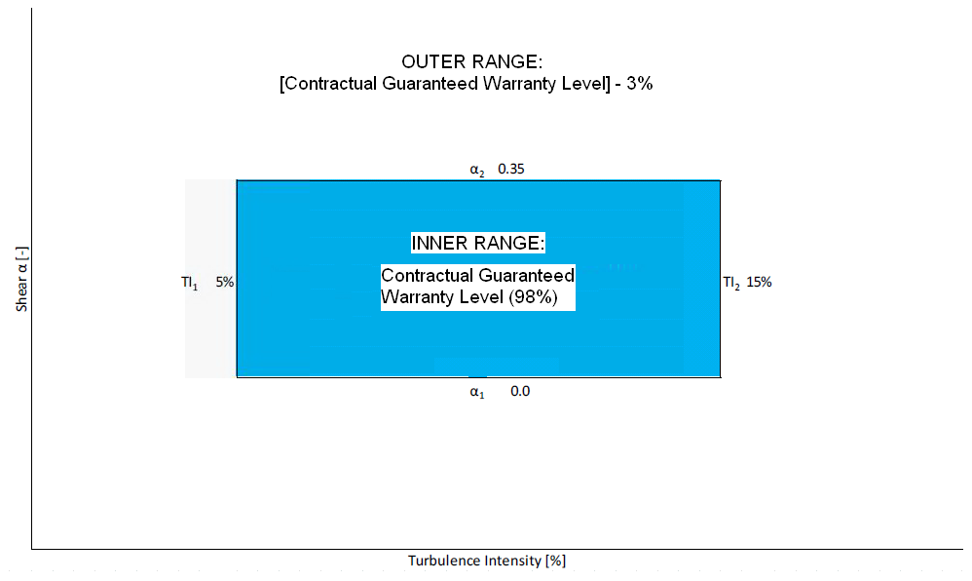
Power Curve Warranty for Project ‘X’ (2)
Each 10-min value from PPT is filtered
Assigned to Outer Range if:
- Shear* is below 0.35, AND
- Turbulence Intensity is between 5% and 15%
Otherwise belongs to Outer Range
*measured between lower blade and HH

Slide 6
Power Curve Warranty for Project ‘X’ (3)
A big step forward
Shows OEMs are willing to engage on the Inner/Outer concept
Enables us to widen envelope during turbine siting on future projects (especially on shear)
Aiming to include in Tender Requirements going forward → adds competition?
Proof is still in the testing
Still significant costs associated with testing at Project X (> 60 WTGs)
Remote sensing still out of the question (all test WTG locations need cali.)
Scope to relax this if bespoke RS campaign signed off by PPT consultant?

