Slide 1

Use of nacelle lidar data to explore impact of non-linear averaging
Chris Slinger, John Medley, Rhys Evans
chris.slinger@zephirlidar.com
+44 1531 650 757
02 September 2014

Slide 2
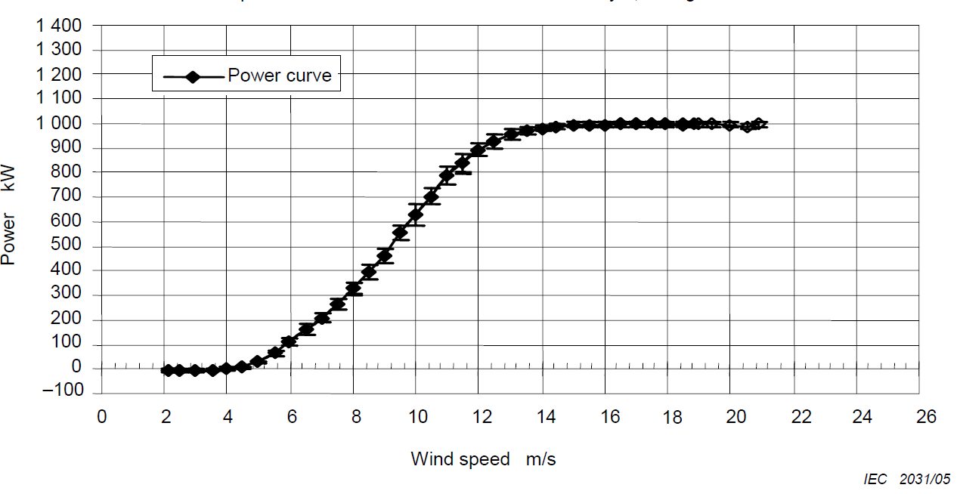
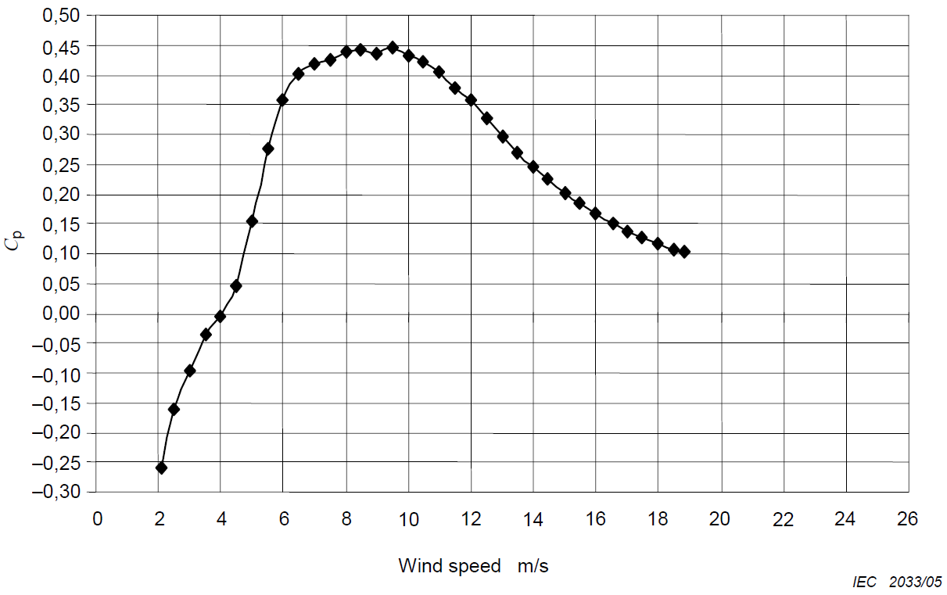


Background. From the April 2014 PCWG meeting: “Existing correction methods (ρ, RE, TI renorm) do not fully explain observations...”
10 minute mean wind speeds used
Erik Tűxen reminded us a more fundamental measure of performance is the relationship between the turbine’s electrical power and the wind’s kinetic power
The meeting also noted that averaging non-linear quantities can be misleading
Would 10 minute wind speeds based on mean energy be more useful than existing approaches (e.g. mean wind speeds with TI renormalisation) ?

Slide 3
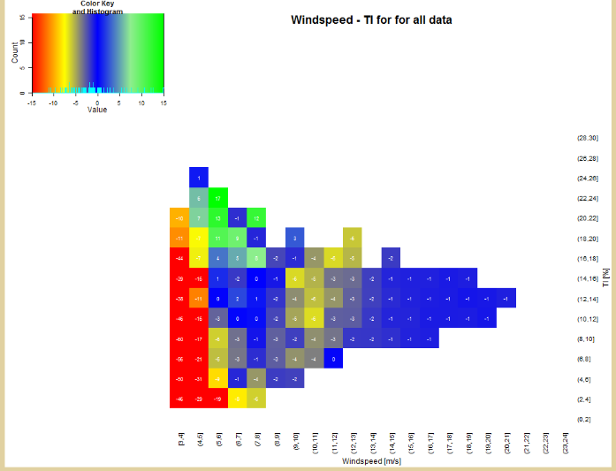
Aim of investigation
Use high frequency lidar measurement data to investigate these effects
Compare efficiency plots derived from 10 minute averaged wind speeds and those from 10 minute cubed-root-mean-cubed wind speeds
Compare power curves in a similar fashion
Use validation / Round Robin tools to analyse data too
e.g. Power deviations as a function of wind speed and turbulence
Also use high frequency lidar data to explore validity of 10 minute normal wind speed distribution assumption
Normal distribution is assumed in the TI renormalisation procedure

Slide 4
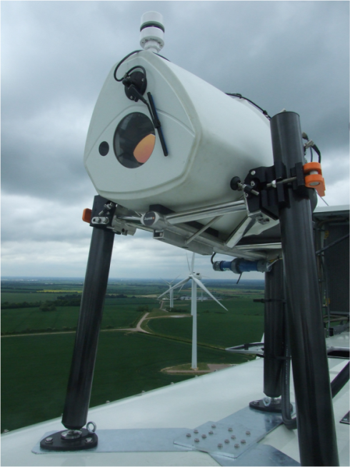
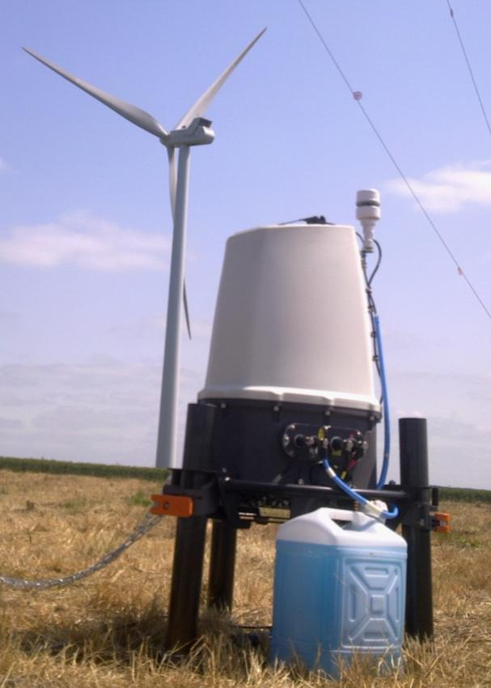
First dataset to be used
Project Cyclops: “Project Cyclops: the way forward in power curve measurements ?” Simon Feeney et al, EWEA 2014
New 2 MW Vestas turbine, flat on-shore site in UK
Use 1s data from nacelle-mounted ZephIR dual-mode lidar
Use 1s data from ground-based ZephIR lidar too
Collaborate with RES UK, who will analyse 1s metmast data too
ZephIR DM on turbine
ZephIR DM on ground

Slide 5
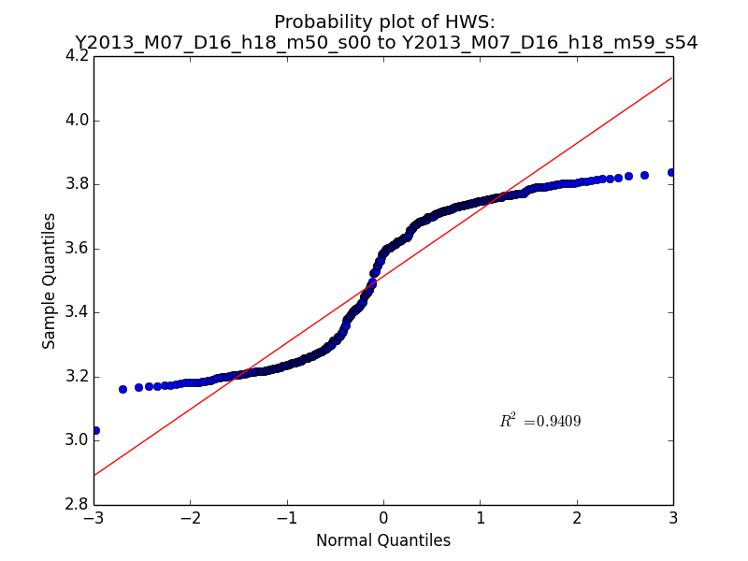
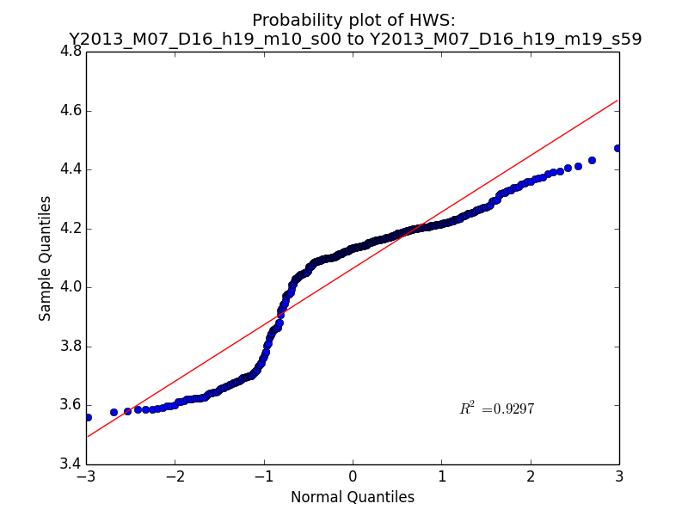
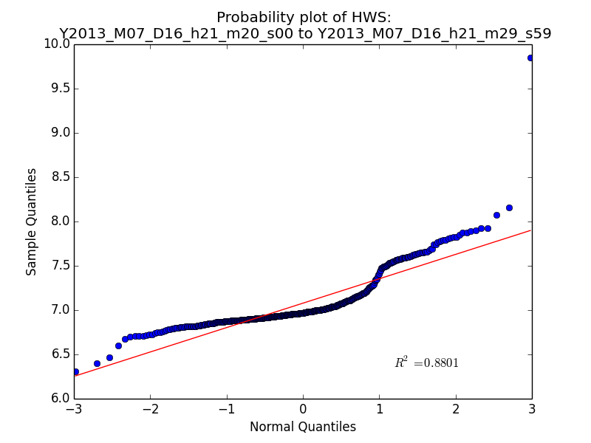
Initial results: normality of data
A graphical method of looking at the normality of a distribution is a QQ plot, comparing quantiles from the data to expected Gaussian quantiles. Gaussian data should give a straight line. Some examples are shown here:

Slide 6
Normality of data : skewness and kurtosis
Skewness and kurtosis are statistics that describe the shape of a probability distribution
Skewness measures asymmetry of the distribution
Kurtosis measures the how peaked (or how heavy-tailed) the distribution is
Kurtosis = -1.56 Kurtosis = 0.00 Kurtosis = +13.1
Notes:
Skewness: 3rd moment about the mean. Sign preserved, emphasis extreme values
Kutosis: based on the 4th moment. Kurtosis of 3 is a normal distribution. Plots have 3 subrtracted from them.

Slide 7
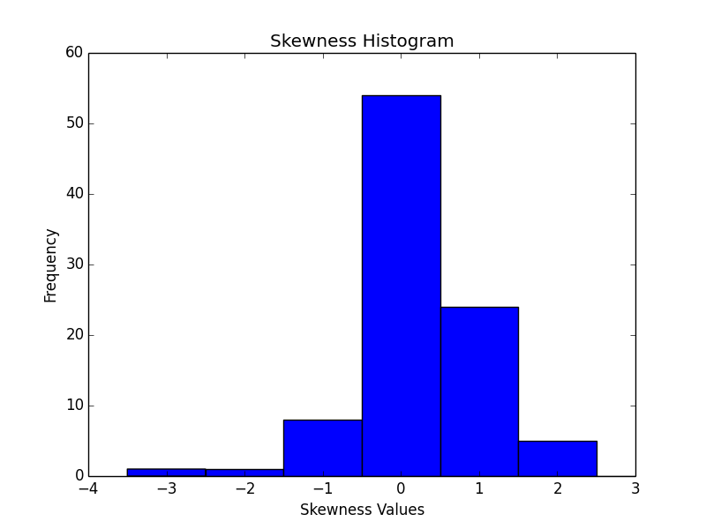
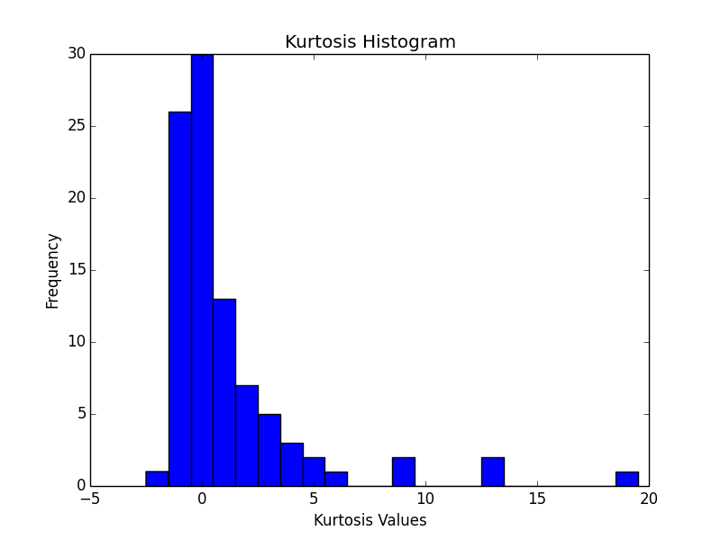

Normality of data : skewness and kurtosis
Skewness and kurtosis are statistics that describe the shape of a probability distribution
Skewness measures asymmetry of the distribution
Kurtosis measures the peakedness (or how heavy-tailed it is)
Other Normality tests are available, but a simple kurtosis filter looks easy to implement and may be sufficient – let’s try it and see!

