Slide 1
Practical considerations on the REWS approach
Peder Enevoldsen

Slide 2

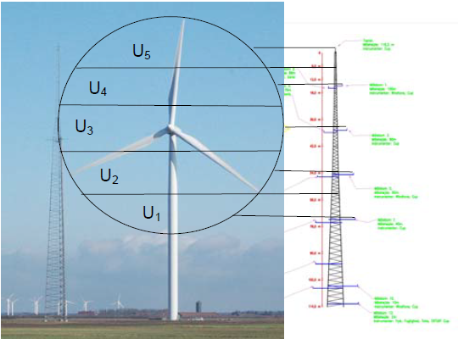
Summary
Good value of having the PCWG – and info on the web
Shared responsibility between developers and manufactures
Energy in disc on a site - and turbines ability to extract this energy
Developers are advised by consultants to consider shear in full rotor disc
Example: Høvsøre test site back in business in winter months

Slide 3
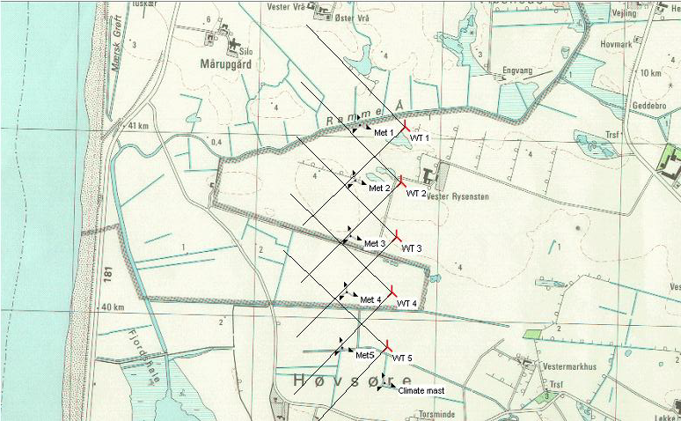
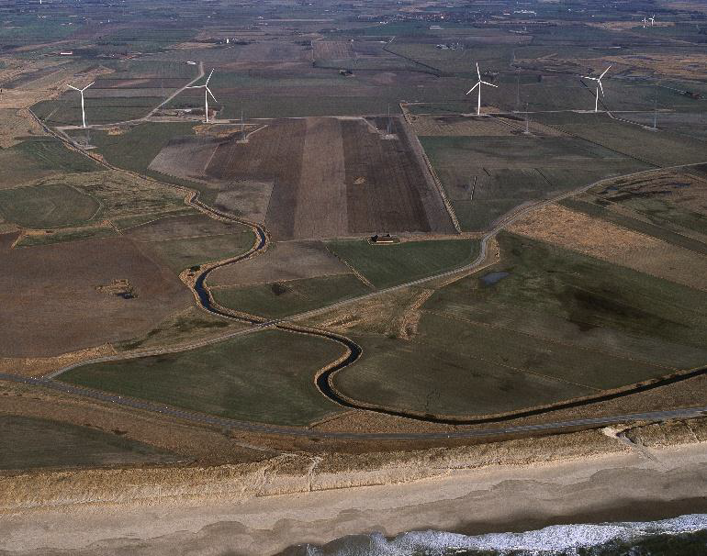
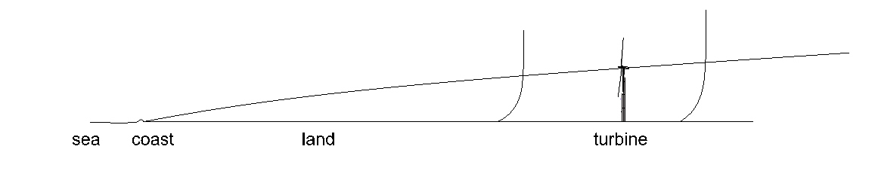
Example: Høvsøre test site
Coastal near site – triggers internally BL (2-4% loss in AEP using HH)
Summer and winter match with
REWS approach

Slide 4
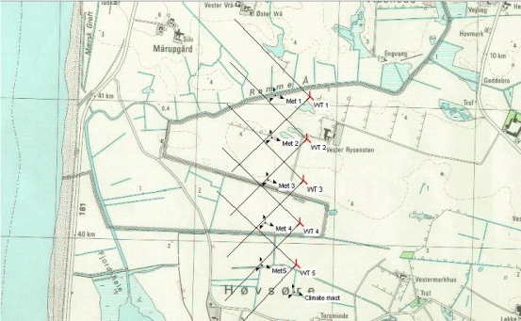
Example: Høvsøre test site
What if a new wind farm was build at the Høvsøre site?
Low performance during winter should be expected!
Lidar measurements used for estimating performance
- using actual diameter, hub height, wind rose etc.

Slide 5
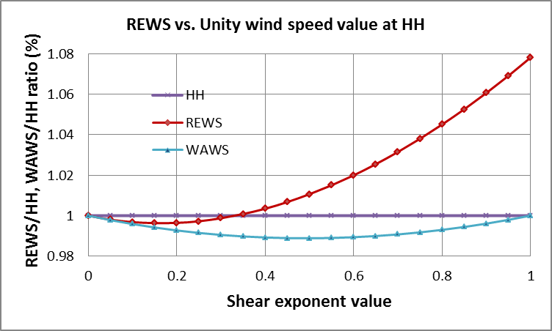
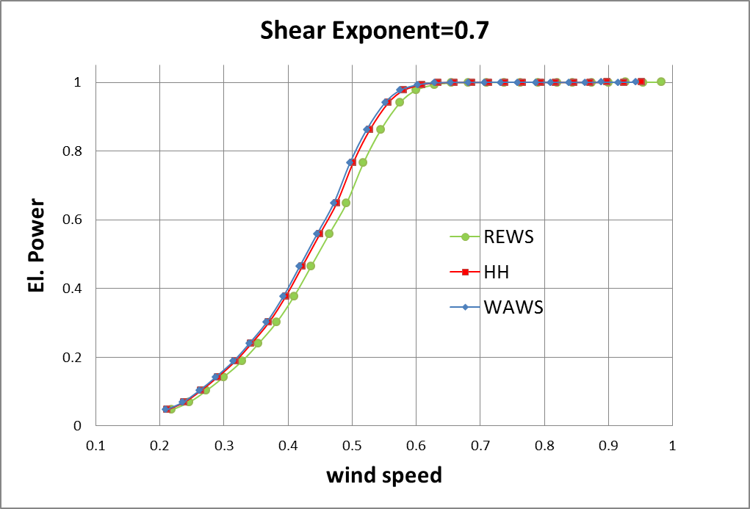
Future work at SWP…
Further evaluating measurements with various shear and veer
Comparing BEM results with field applying narrow filters
Improving on induction models in BEM models used in analysis
Comparing typical shear with ‘clean’ alfa shears
…

