Slide 1
REWS – using ANSYS CFX (CFD)
2nd September 2014

Slide 2
Application of REWS in Windmodeller
SSE employ ANSYS CFX ‘Windmodeller’ for wind flow modelling on complex sites. Used for:
Turbine/site suitability assessments
AEP
WM can potentially provide a shortcut to implementing REWS using velocity extraction from CFD-Post
In theory, shortcut covers shear, inflow angle and veer corrections
Also being used to investigate physics behind observed correlation between yield variance and tower “stubbiness”

Slide 3
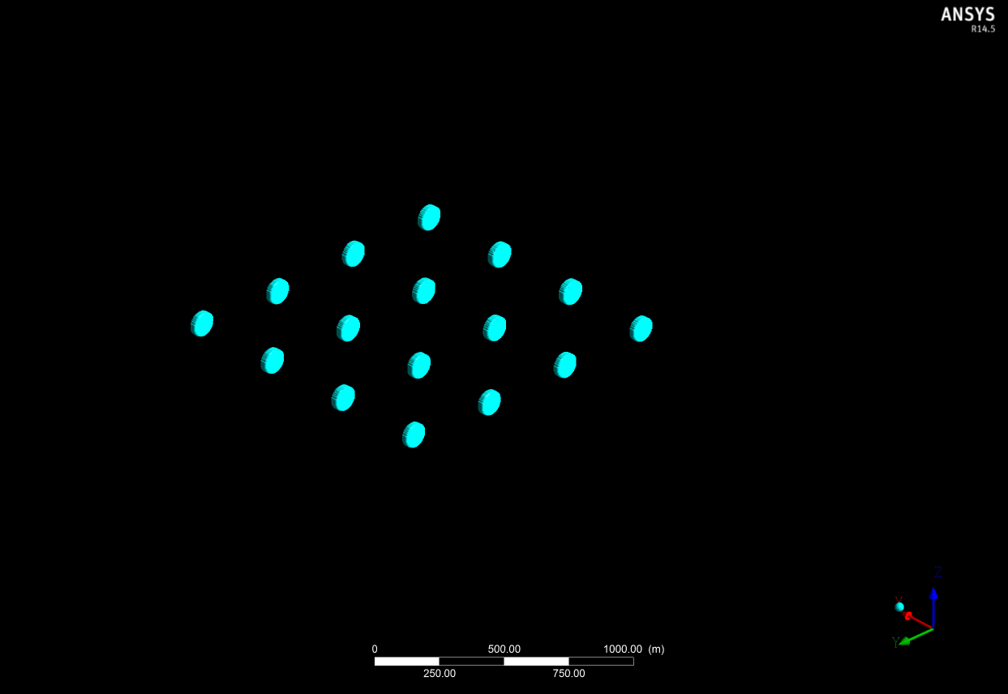
Turbine Layout
Inflow

Slide 4
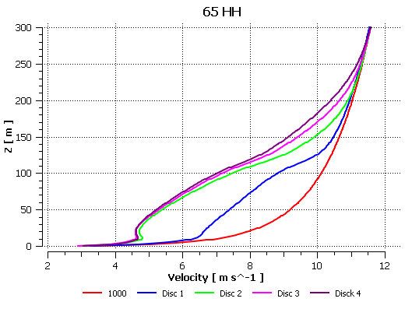
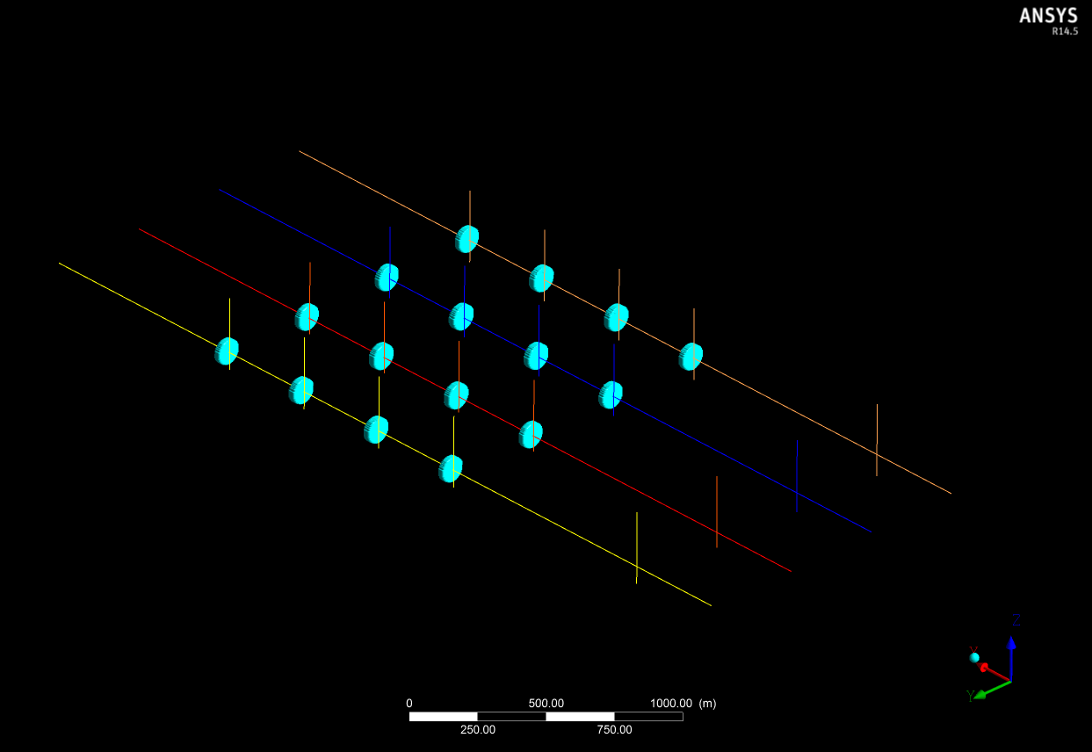
Boundary Layer Extraction
Sampling Lines placed 20m in front of individual turbines and at 1000m upstream to calculate inflow velocity profiles
Samples taken vertically across turbine discs to validate flow conditions
Graphs plotted but can also be exported for further analysis

Slide 5
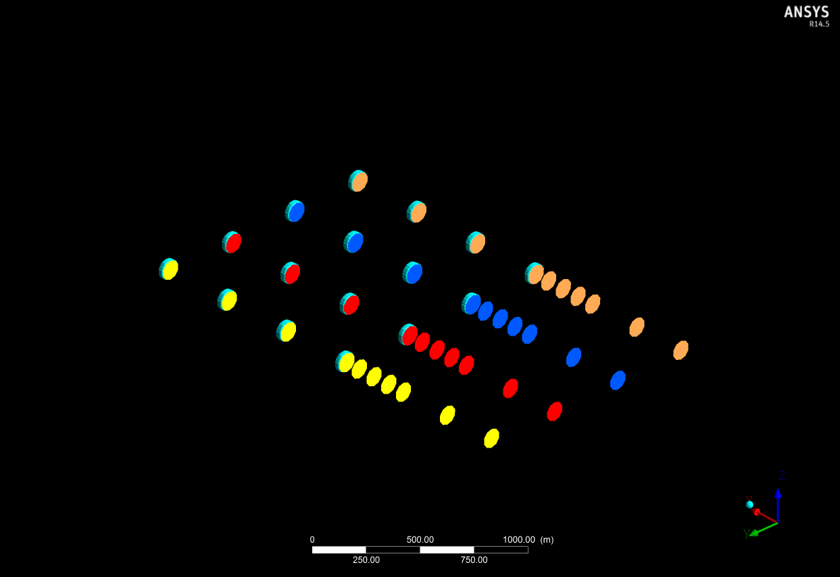
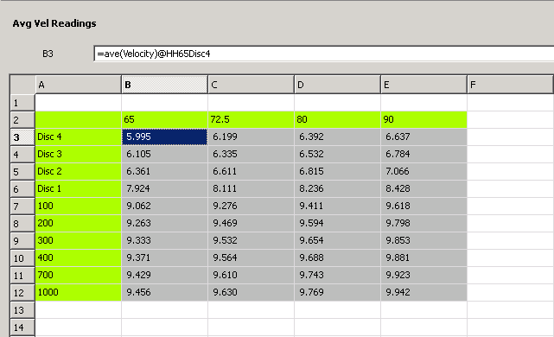
Circular Discs Average Inflow Velocity
This is essentially an automated REWS calculation. As velocity perpendicular to rotor disc are considered, effects of inflow angle and veer are accounted for.
Notes:
Taking component velocity through the disk

Slide 6
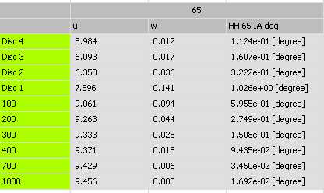
Inflow Angles
Use Cartesian values calculated within CFX-Post to find inflow angles as u and w components of velocity are known.
=atan((ave(Velocity w)@HH65Disc4)/(ave(Velocity u)@HH65Disc4))

Slide 7
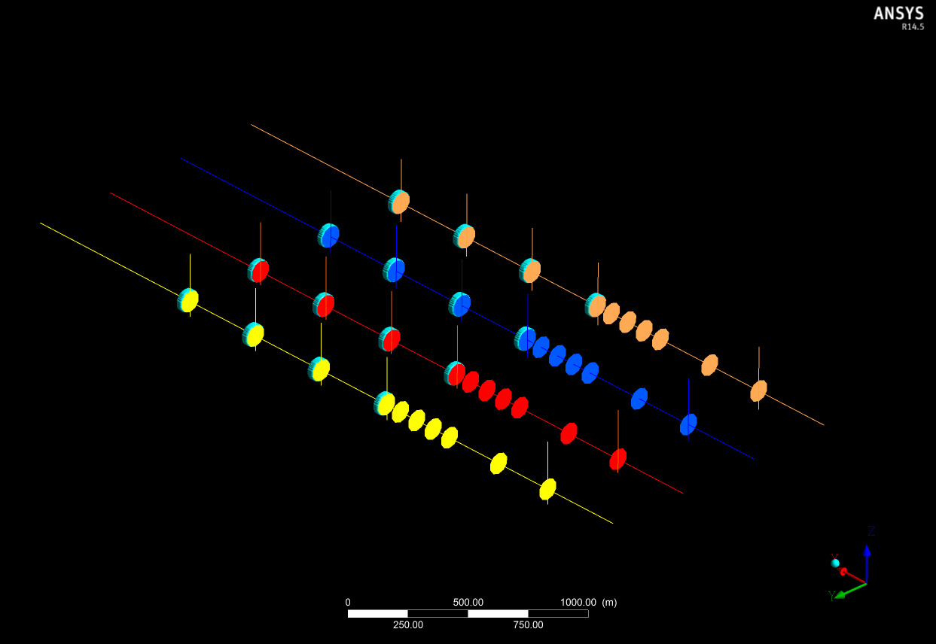
Full Setup File
Ability to run multiple cases once a set up file has been created
Attention to spacing required to avoid wakes influencing results!

Slide 8
Conclusion
WM can potentially provide a shortcut to implementing REWS using velocity extraction from CFD-Post
Approach saves time over manual implementation
Reliant on model accuracy → good first order approximation?
Has lead on to investigations of “tower stubbiness” using velocity profile extractions, using activator discs assuming constant Ct over the rotor

