Slide 1




Impact of Ground Boundary on Production of Short Tower Turbines - A Conceptual Study

Slide 2
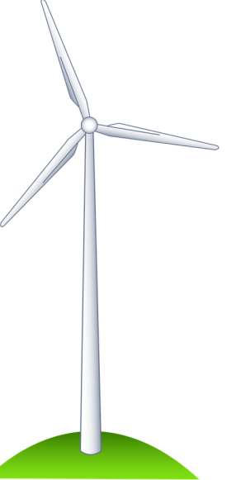
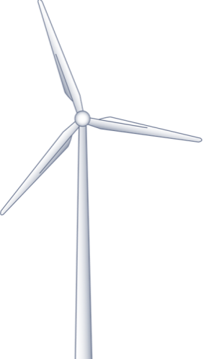
Outline of Short Tower Issue
Question:
For a given input free stream energy (i.e. fixed V_{eq}), can two turbines with the same rotor diameter and power curve, but different hub heights be expected to product the same energy?
It is conventional to ignore the interaction of the rotor stream tube and the ground boundary, but is this realistic?
Energy
V_{eq} = X
Energy
V_{eq} = X
‘Tall’ Tower
‘Short/Stubby’ Tower
Two turbines have same diameter, but different hub heights.

Slide 3
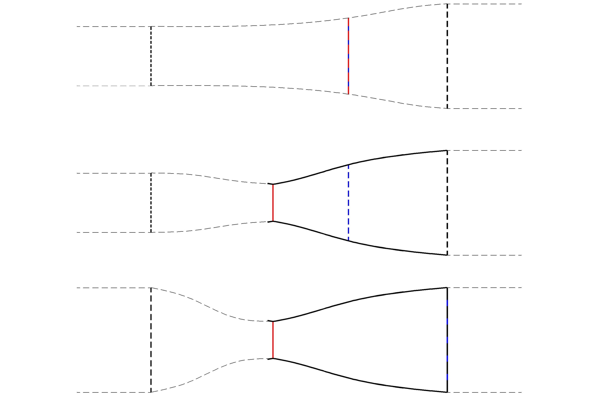
Axial Flow Theory
At what hub height does the influence of the ground boundary being to influence the stream-tube?
Far Wake
Freestream
A_{s} = Source Area
V_{ext}
V
V_{w}
A_{ext}
A_{w}
p₀
p⁺
p⁻
p₀
Ground Boundary
How might the ground boundary influence the production of:
A single turbine?
A wind farm?

Slide 4
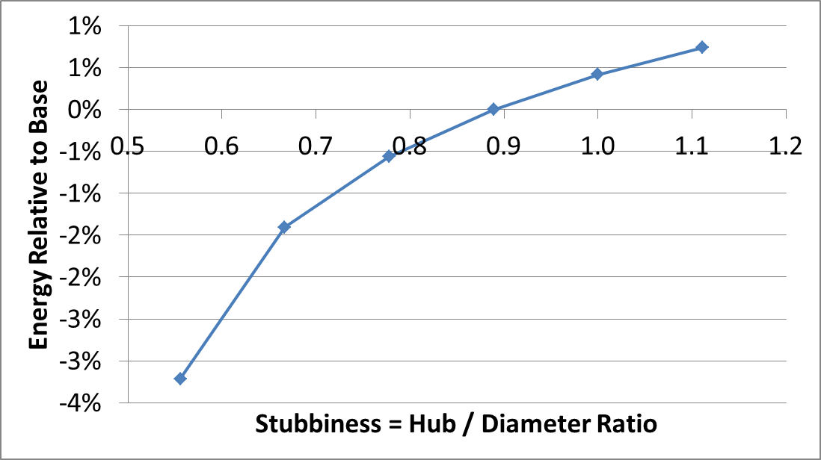
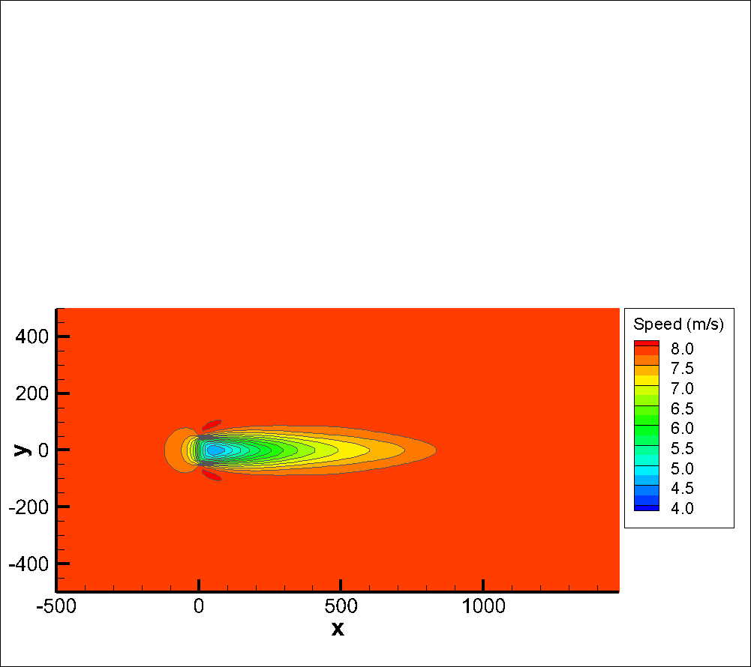




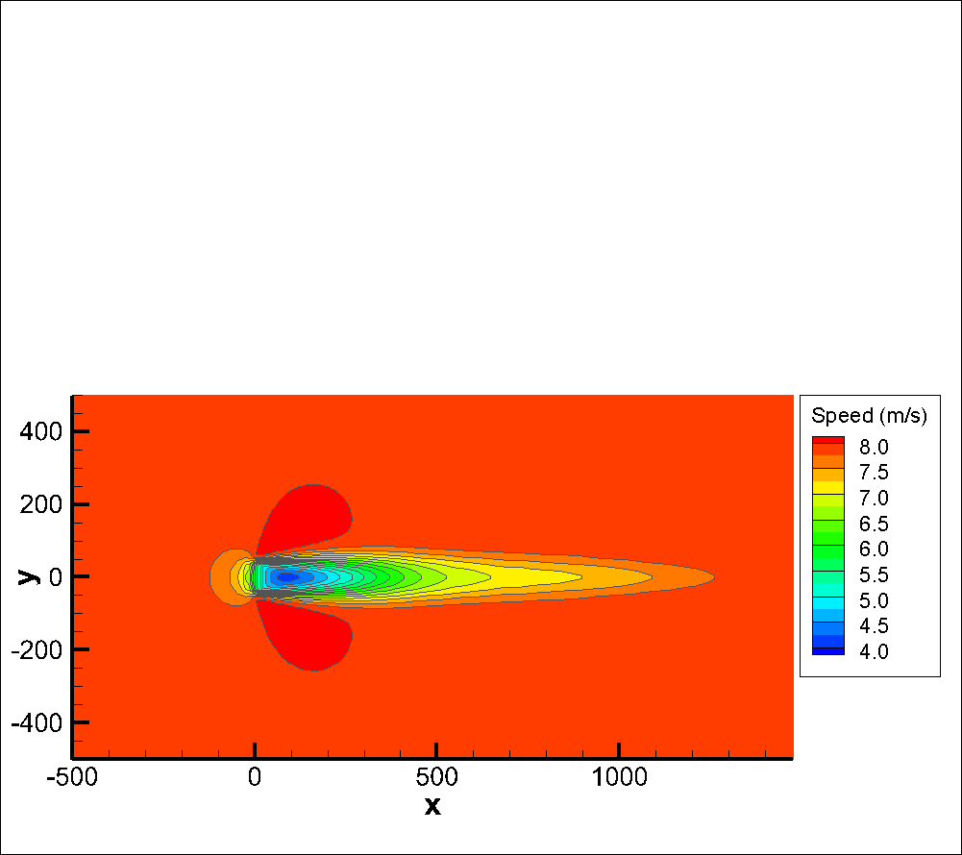
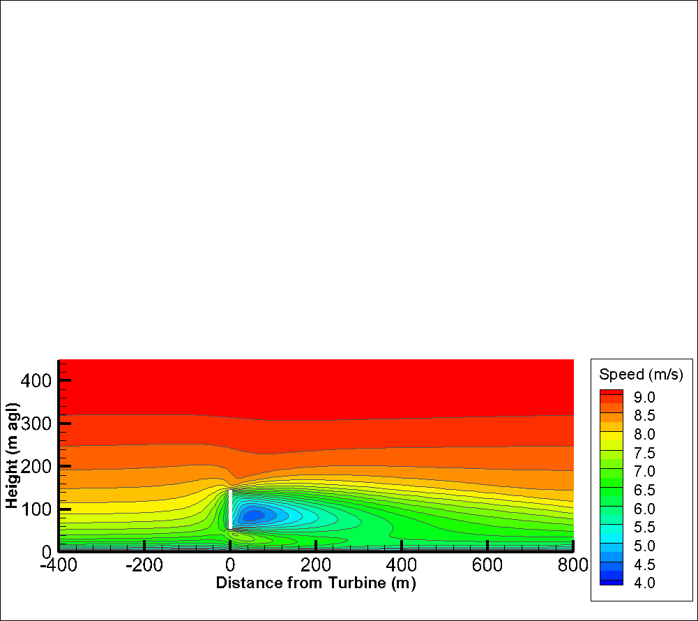
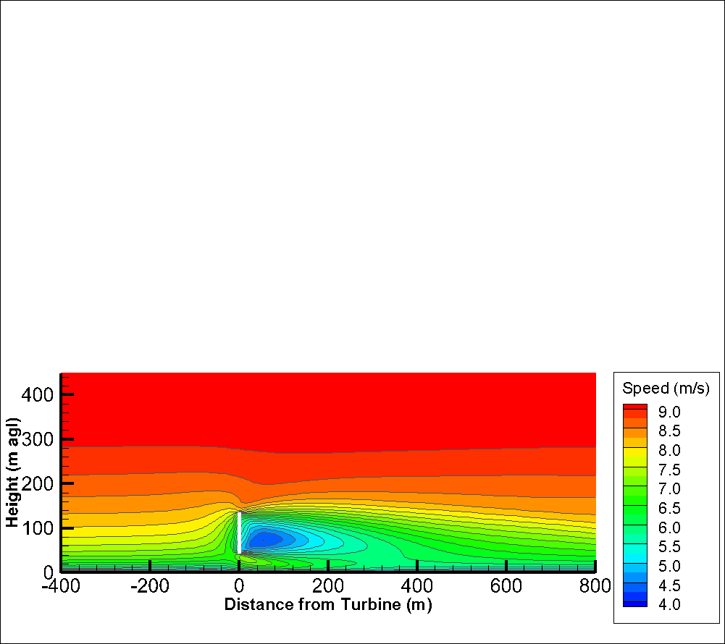
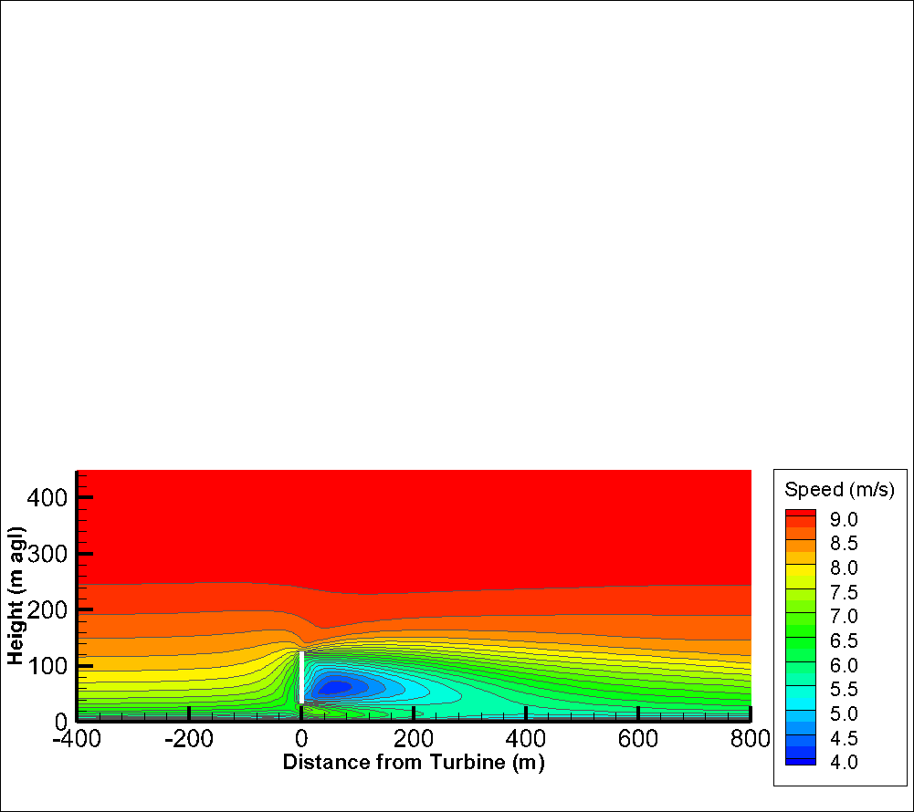
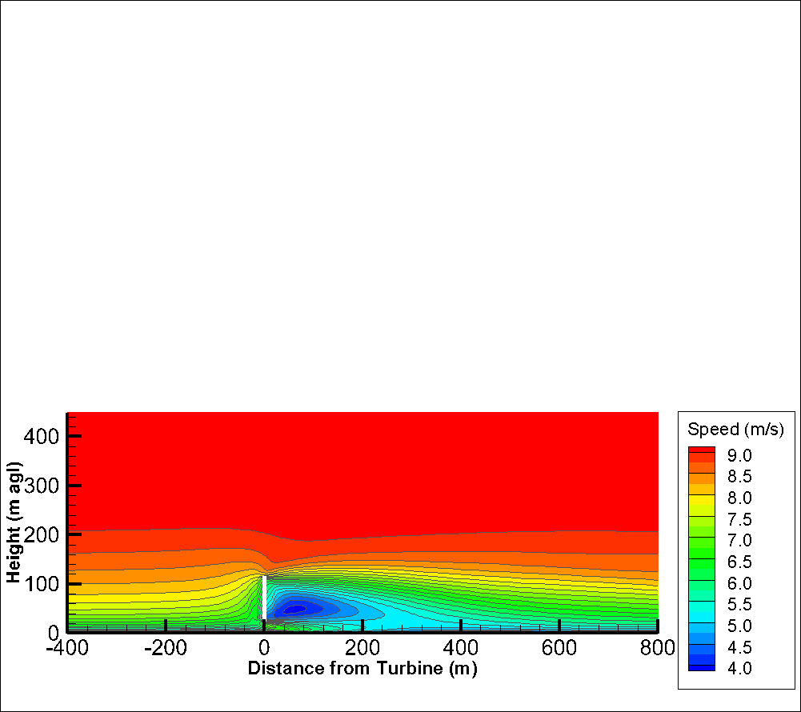
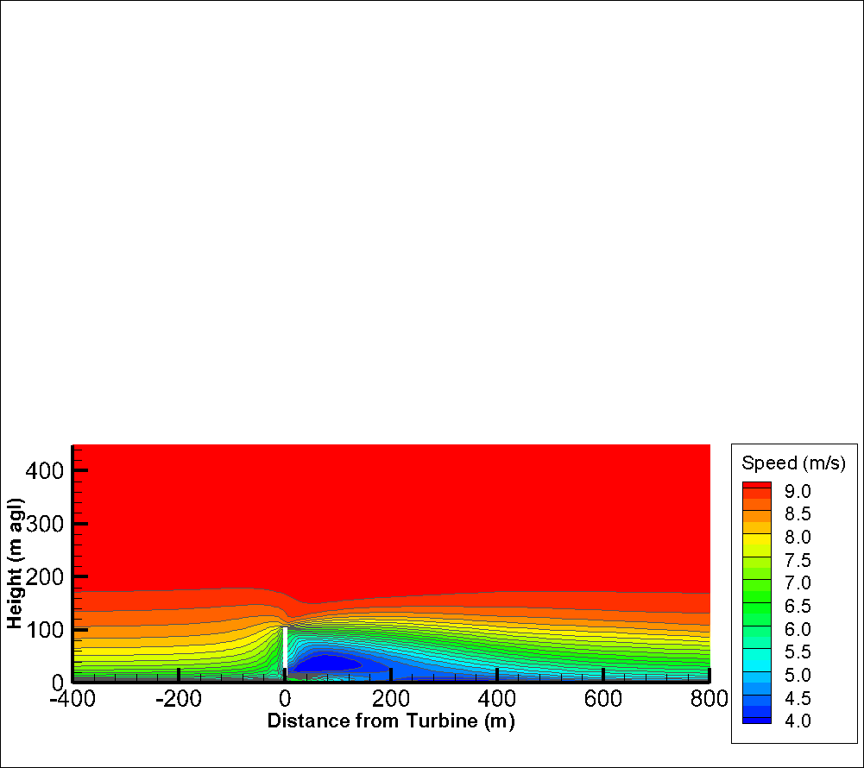
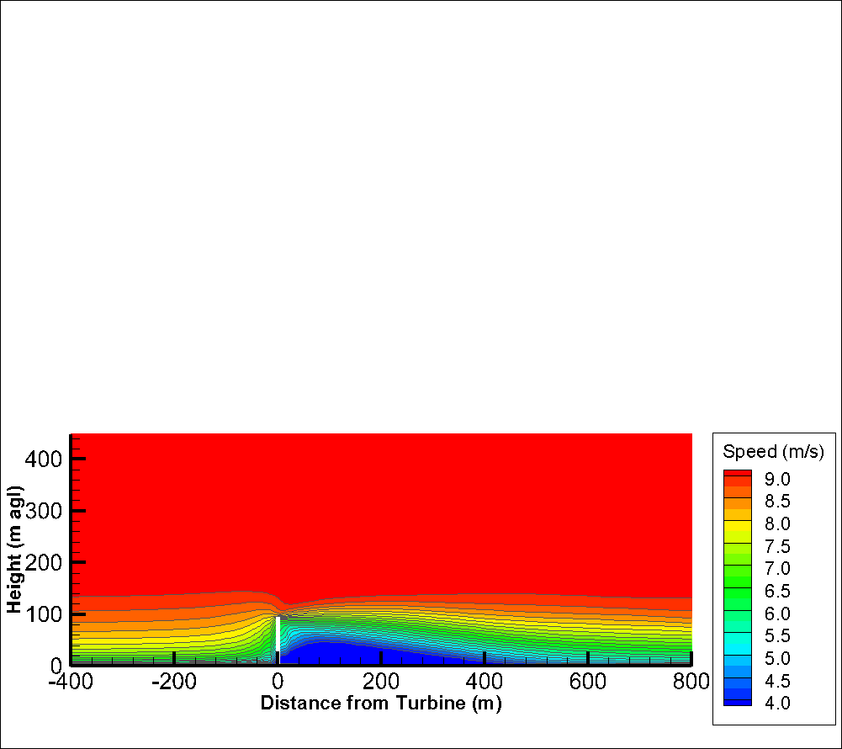
RES CFD Simulations
1 Turbine Fixed Diameter, Variable Hub
HH / D = 0.56
HH / D = 0.78
HH / D = 0.67
HH / D = 1.11
HH / D = 1.00
HH / D = 0.89
Draft/Provisional Results
Simulated Power = Velocity at Rotor * Force
CFD simulations of wind turbine rotor and ground boundary. Velocity tuned to keep free stream energy at rotor approximately constant.
Asymptotic behaviour does not make sense →more work needed.
Downstream turbines see wake elongation (c.f. ground plane reflection wake model). Increased wake effects.
Upstream turbine sees ground blockage effect i.e. reduced rotor speed gives reduced power.

Slide 5
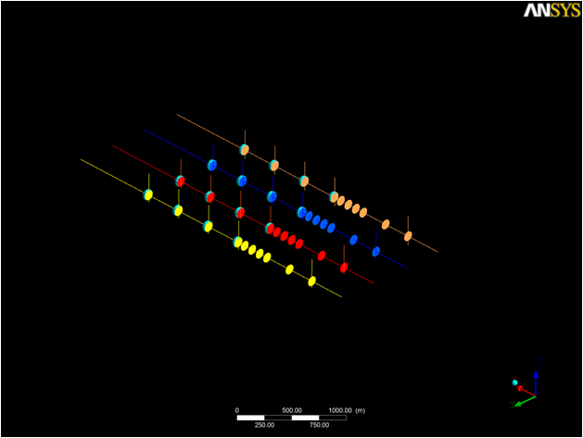
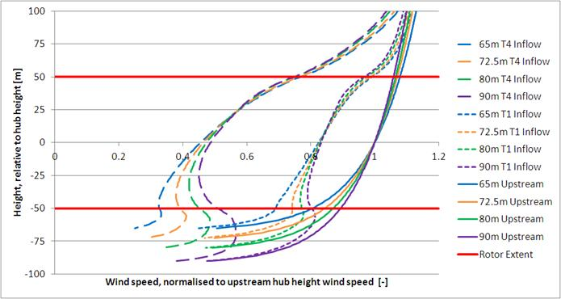
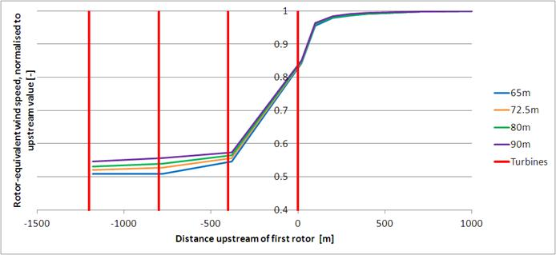
SSE CFD Simulations:
4*4 Array Fixed Diameter, Variable Hub
Draft/Provisional Results
T1 = Upstream Turbine (large dashed lines)
T4 = Downstream Turbine (small dashed lines)
Upstream of T1 (solid lines)
Results indicate reduction in power at both upwind and downwind turbines.

Slide 6
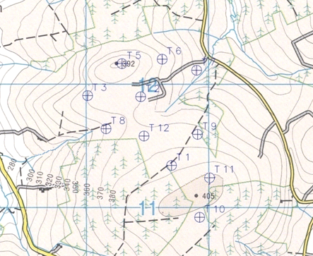
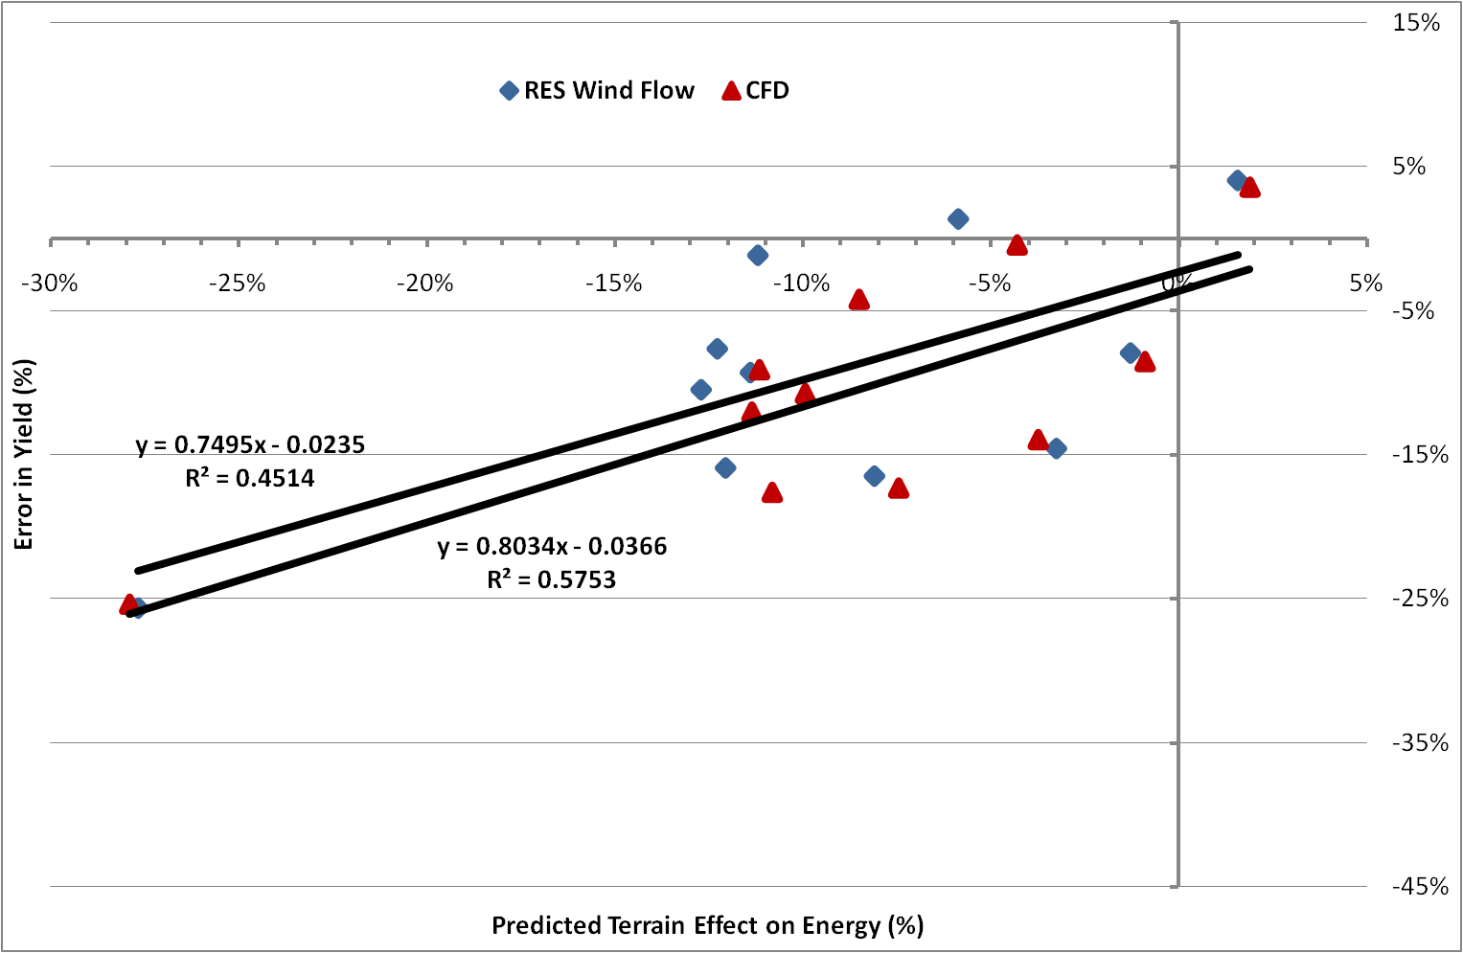
Implications for Predicted Pattern of Performance?
If the interaction between the turbine and the ground is significant for stumpy towers how might this influence the pattern on production onsite?
Are the turbines at the hill top/bottom more/less effect than a turbine in flat terrain?
Wind Farm Performance Verification – Part 2: RES, BWEA 31 - 22 October 2009

Slide 7
Implications for Power Performance Testing?
At a given distance upwind of a turbine, could the blockage effect upwind of a stumpy tower be larger than that of a tall tower?
Could this be helping mask a performance loss due to stump towers?
No Blockage
Blockage?
‘Tall’ Tower
‘Short/Stumpy’ Tower

Slide 8
Questions/Discussion

