Slide 1
Resource Assessment Standards & Best Practices
Jason Fields Wind Energy Engineer National Wind Technology Center

Slide 2
Status
There is no standard for wind resource assessment

Slide 3
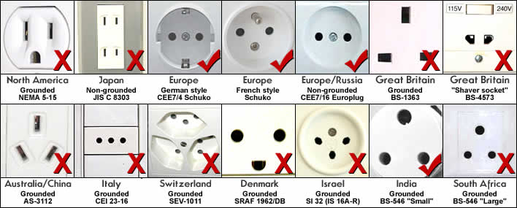
Status
Do we need one?
Notes:
Basic concept of standards is to reduce costs and challenges of operating in multiple markets. Examples of pros and cons: electricity grids, wind turbines, automobiles, wind permitting, shipping crates.
Standards are a hallmark of mature industries

Slide 4
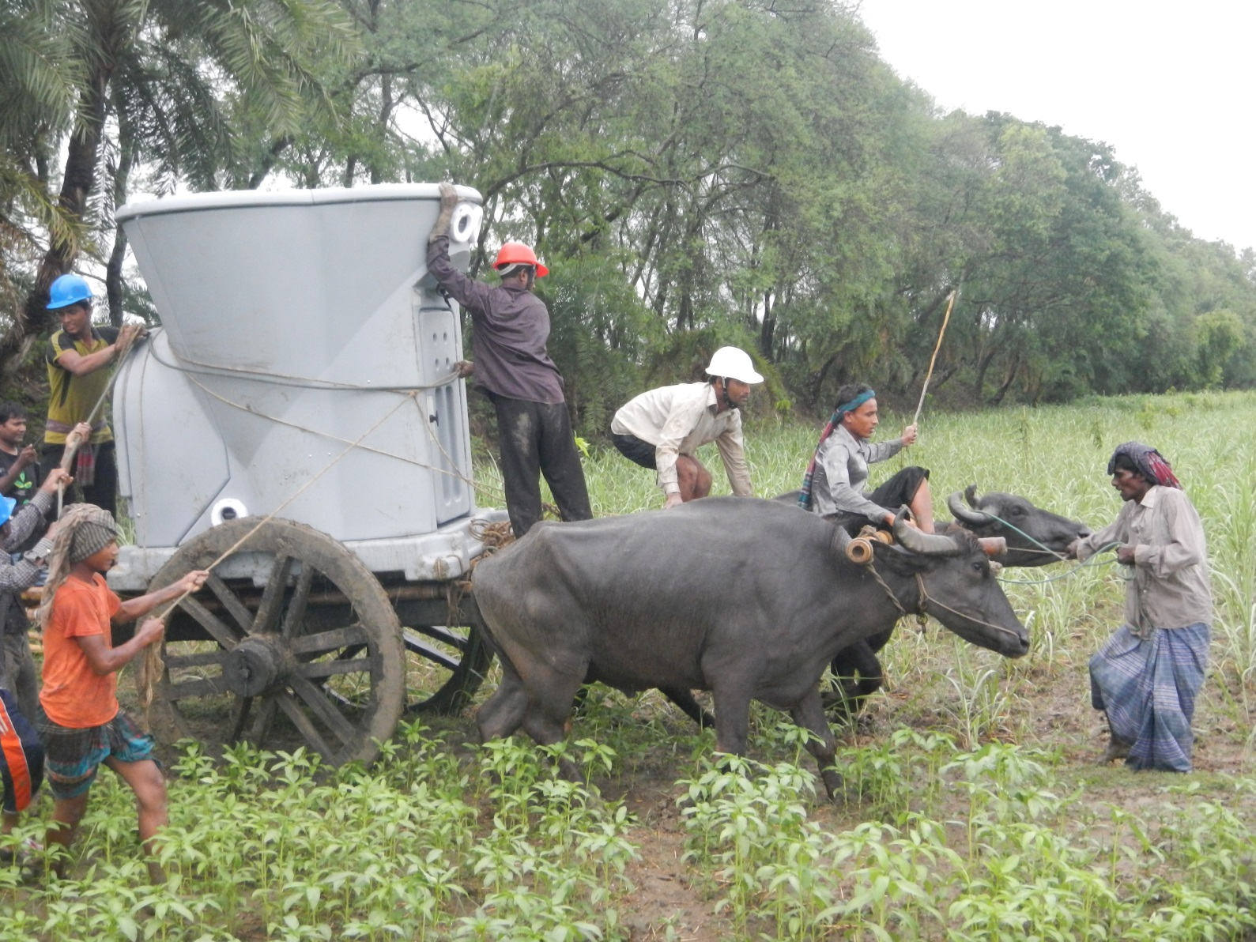
Status
Do we need one?
Photo Credit: Harness Energy
Notes:
Real world is messy. Particularly developing countries. Standards can ease the transition to new markets.
Having a codified best practices and accessible international reference can ease the transition to new markets.

Slide 5
Status
Do we need one?
Yes. Broad disagreement on practices and results
AWEA Poll: 70% of WRA audience uses standards and best practices
Real Question: What needs to be standardized?

Slide 6
Bits and Bobs
Existing related standards & best practices
Other documents/collaborations
IEC 61400-1,3 Wind Turbine: Design Requirements
IEC 61400-12-1 Power Performance Testing
IEC 61400-26 Availability: Technical Specification
MEASNET “Evaluation of site specific winds”
Consortium Loss & Uncertainty definitions
Wind Resource Assessment: A Practical Guide to Developing a Wind Project
IEA Wind Task 32 Remote Sensing
IEA Wind Task 31 Windbench and Wakebench
IEA Task 11 75th meeting on complex terrain
AWEA WRA working group
Power Curve Working Group

Slide 7
But wait there is a standard
IEC 61400-15 “Assessment of Wind Resource, Energy Yield and Site Suitability input conditions for wind power plants”
New Work Item proposed early 2013
NP ratified almost unanimously Summer 2013
Member selection Fall, Winter 2013
Kickoff meeting- Feb 2014 @ NWTC

Slide 8
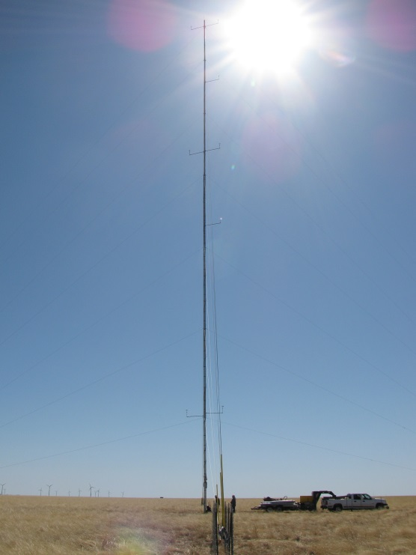
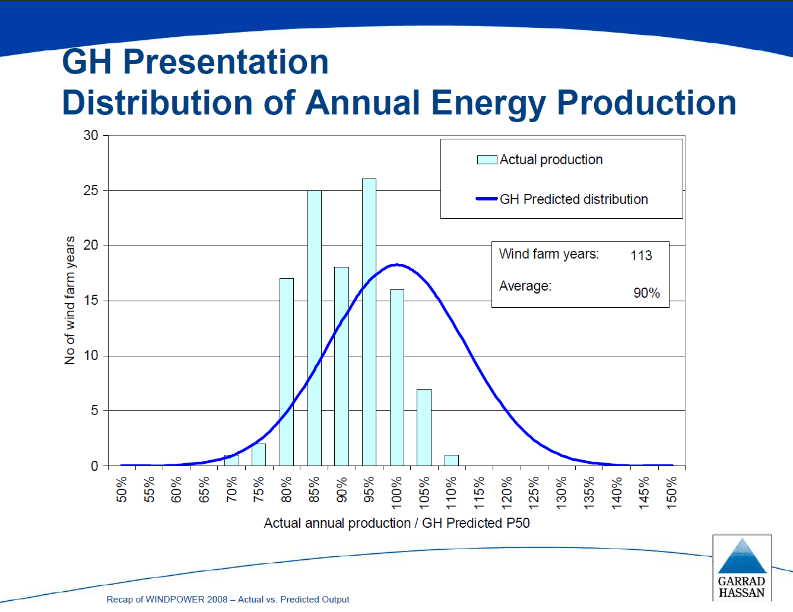
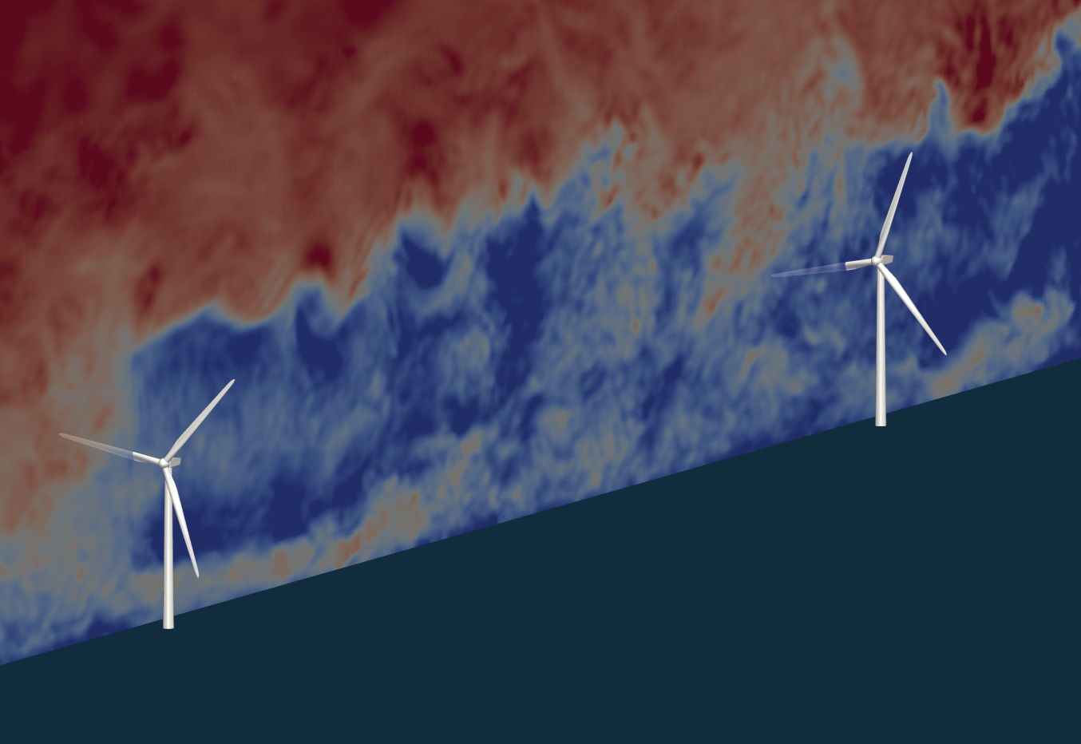
What are they doing?
Measurements
Data Analysis
Site Suitability
Modeling
Flow model
Wake model
AEP Estimation & Reporting
Loss & Uncertainty Quantification

Slide 9
Who is it?
Official Breakdown
Country | Panel Members
Germany | 6
US | 7
Spain | 4
Denmark | 4
Japan | 4
France | 3
Great Britain | 4
Italy | 2
Sweden | 1
Korea | 1
Total | 36
Geographic coverage, 10 countries and 3 continents
Notes:
Sizable membership that is growing. Also strong representation typically with 25+ members at first two meetings

Slide 10
Who is it?
Official Breakdown
Sector | Panel Members
Consulting | 10
Developer/Owner | 7
Research/ Certification Body | 5
Turbine OEM | 9
Equipment OEM | 2
Industry Group | 3
Total | 36

Slide 11
Official scope language
Definition, measurement, and prediction of the long-term meteorological and wind flow characteristics at the site
Integration of the long-term meteorological and wind flow characteristics with wind turbine and balance of plant characteristics to predict net energy yield
Characterizing environmental extremes and other relevant plant design drivers
Assessing the uncertainty associated with each of these steps
Addressing documentation and reporting requirements to help ensure the traceability of the assessment processes

Slide 12
Official scope language
Definition, measurement, and prediction of the long-term meteorological and wind flow characteristics at the site
Integration of the long-term meteorological and wind flow characteristics with wind turbine and balance of plant characteristics to predict net energy yield
Characterizing environmental extremes and other relevant plant design drivers
Assessing the uncertainty associated with each of these steps
Addressing documentation and reporting requirements to help ensure the traceability of the assessment processes

Slide 13
Current Approach
Uncertainty framework through which decisions can be made
Robust discussion of normative versus informative

Slide 14
IEC 61400-15 timeline
Committee Draft: September 2015
Committee Draft for Vote: September 2016
Final Draft International Standard: May 2017
International Standard: September 2018
CD
CDV
FDIS
IS
2015
2016
2017
2018

Slide 15
Current Progress
2 Meetings held
3rd Meeting Nov 2014 @ DNV-GL(UK)
2 subgroups created
Uncertainty
Site Suitability
Draft language started
US Mirror committee formation

Slide 16
How to get involved
US Mirror committee
Matt Filippelli(AWS Truepower) taking lead
Other countries may still have spots
Official group liasons
Martin Strack MEASNET
PCWG?

Slide 17
Contact Information
Jason Fields
Secretary IEC 61400-15
NREL-National Wind Technology Center
Jason.fields@nrel.gov
303-384-7150
http://www.nrel.gov/wind/

