Slide 1

Inflow angle and Energy Production
Jørgen Højstrup
Wind Solutions / Højstrup Wind Energy
Power Curve Working Group, Louisville
6 October 2014

Slide 2
CONTENTS
Energy loss by non-zero inflow angle
Directional variation
Inflow angles and energy loss from real sites

Slide 3
Factors influencing Power Curve
Wind speed
Air density
Turbulence intensity
Directional variation
Inflow angle
Wind shear
Vertical wind veer

Slide 4
Inflow angle negligible?
Wind speed
Air density
Turbulence intensity
Directional variation
Inflow angle
Wind shear
Vertical wind veer

Slide 5
Inflow angle negligible?
- For conventional IEC 61400-12-1 verification
Expensive and difficult to erect masts in sloping terrain
High uncertainty on site calibration
Most often you select turbines for PC verification in more benign terrain with small inflow angles
With Spinner Anemometer and LIDAR verification there are no practical problems in doing PC verification also in complex terrain.

Slide 6

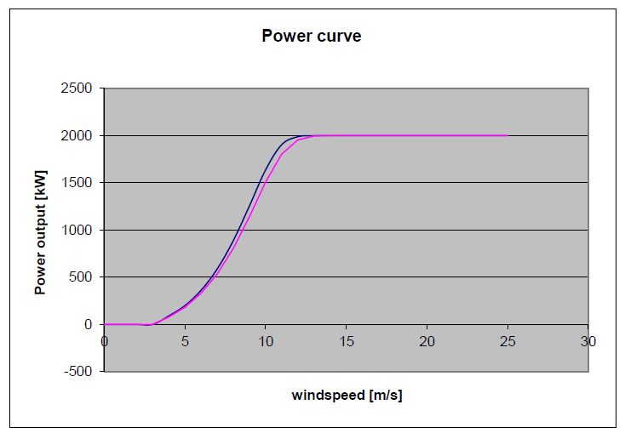
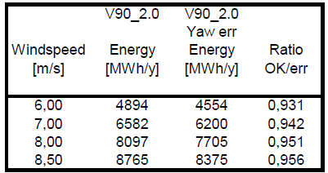
Calculate Energy Loss
15 deg yaw error
Wind vector
Yaw error
Component that generates energy
AEP lost:

Slide 7
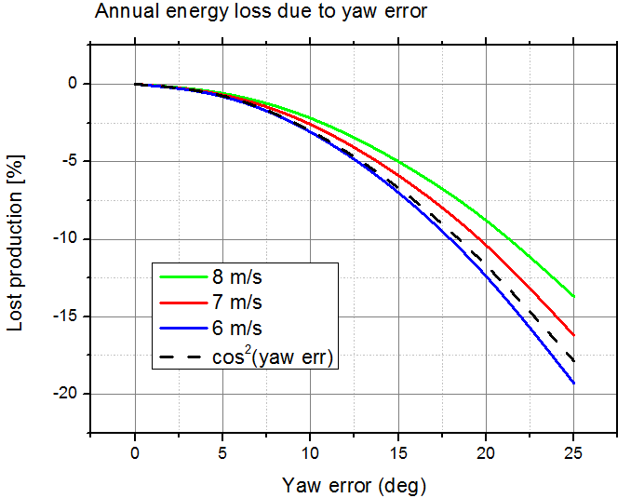
Yaw- (and inflow-) error => Lower Production

Slide 8
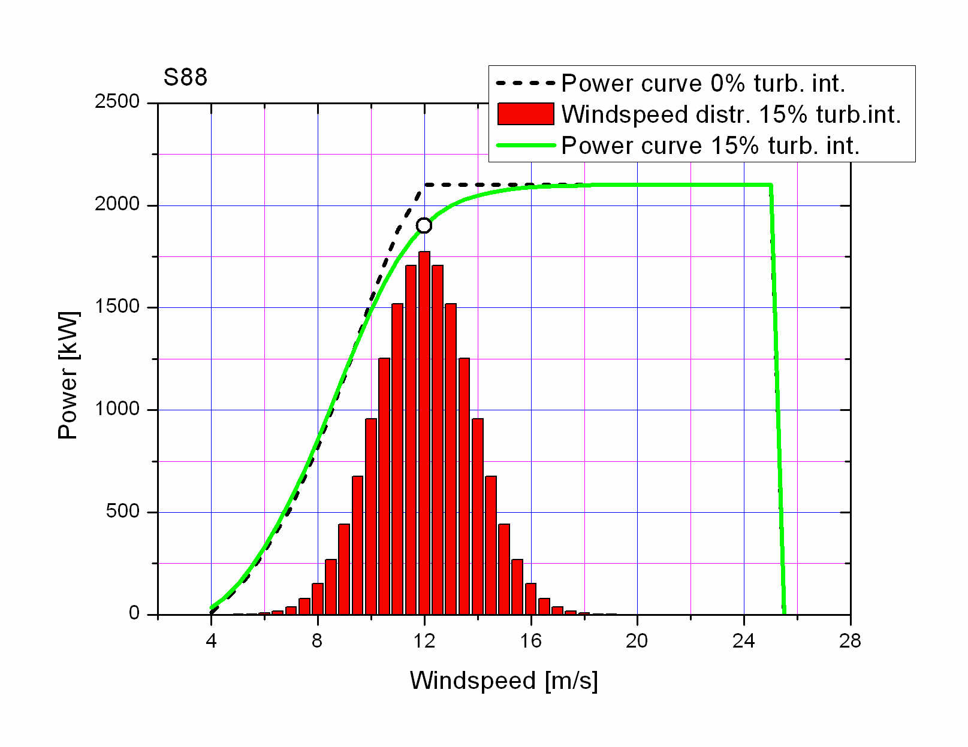
The “Usual” turbulence effect on power curve, but there is more ...

Slide 9
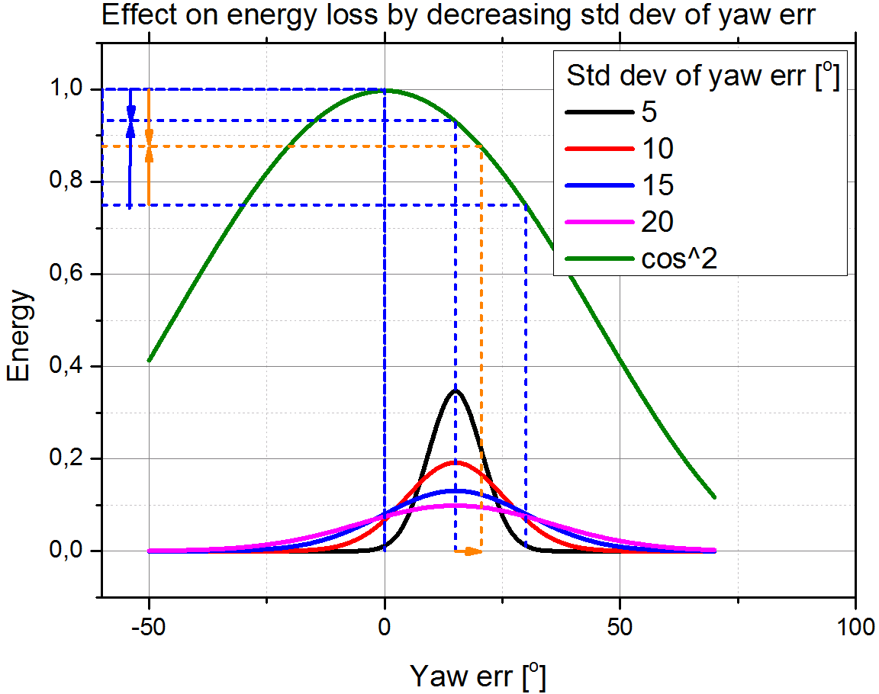
Energy loss by directional variations

Slide 10
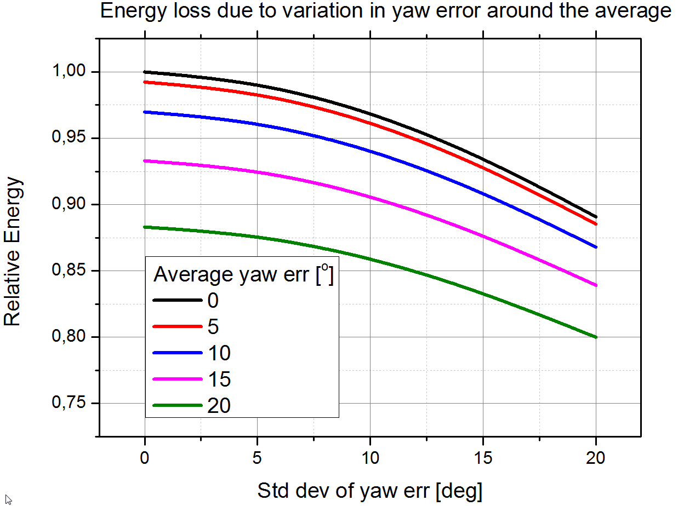
Energy loss by directional variations

Slide 11
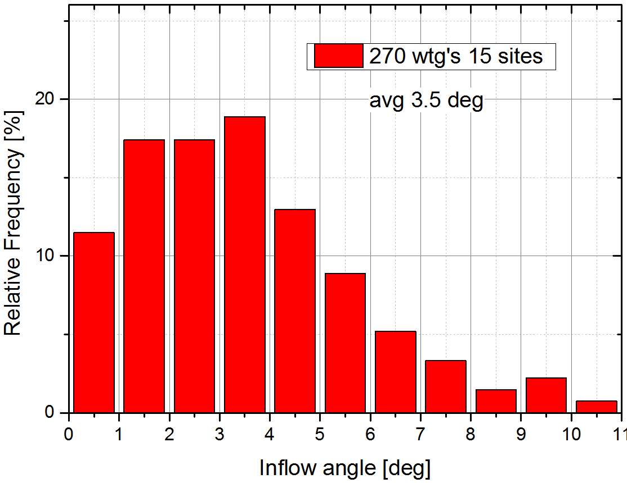
Average inflow angle (calculated) 15 recent sites, 270 turbines

Slide 12
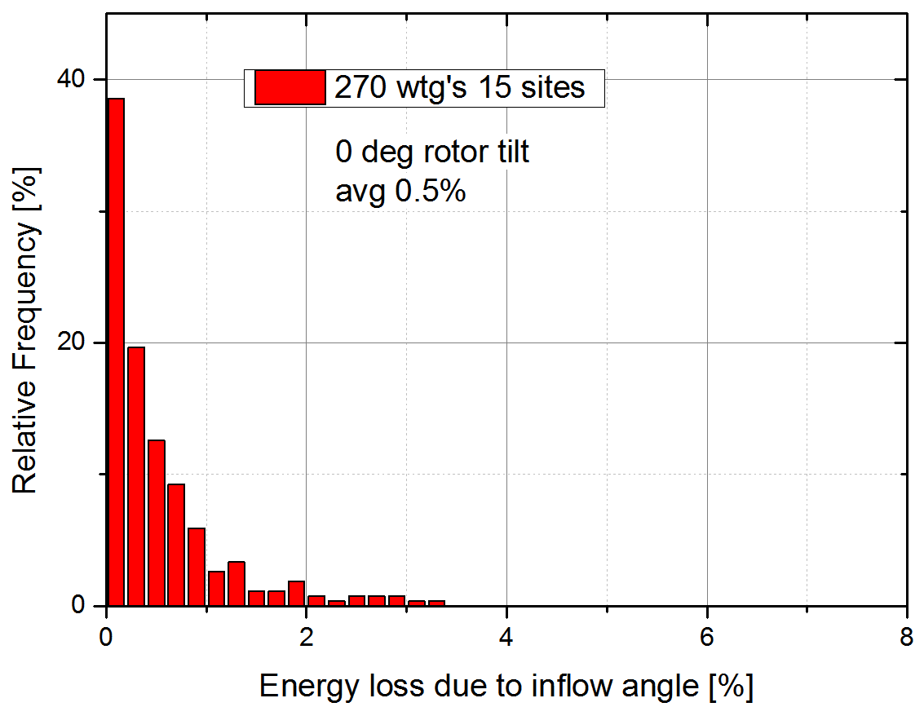
Rotor not tilted: avg 0.5% energy lost

Slide 13
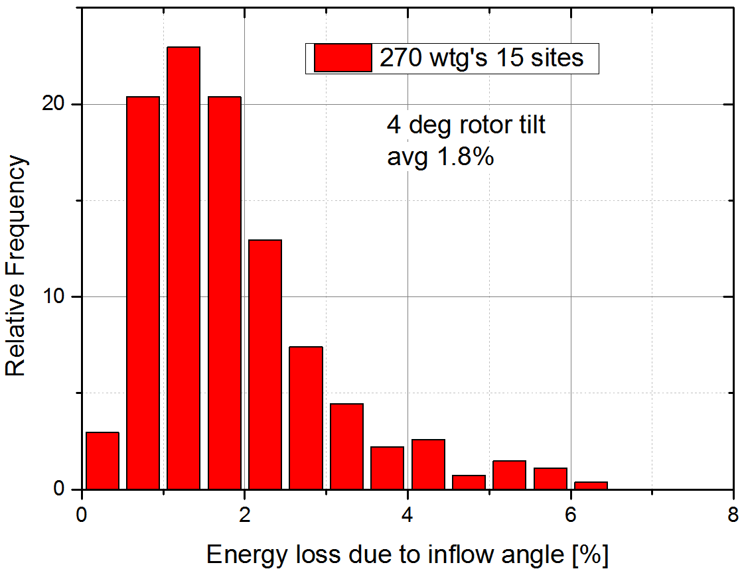
Rotor tilt 4 deg: avg 1.8% energy loss

Slide 14
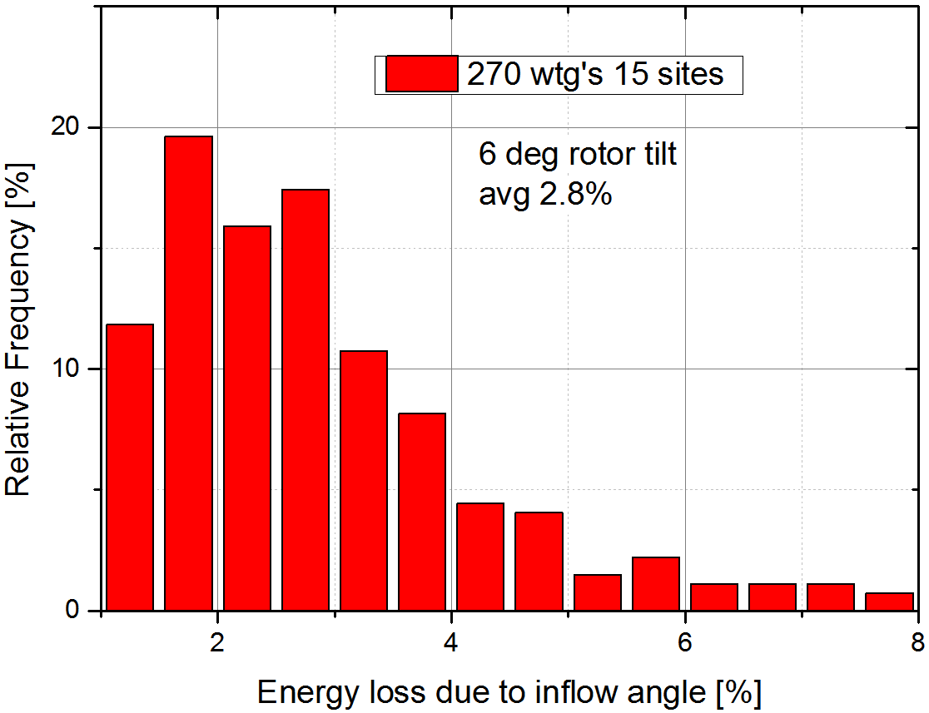
Rotor tilt 6 deg: avg 2.8% energy loss

Slide 15
CONCLUSIONS
Inflow angle can have significant influence on energy production
Range 0 – 8 %
Average 2.8 % for 6 deg rotor tilt

Slide 16
Thank you for your attention
Højstrup Wind Energy & Wind Solutions
www.wind-solutions.com
Jorgen@hojstrup.eu

