Slide 1

PCWG meeting Louisville CO USA October 2014 Maintenance team MT12-1 Revision of IEC61400-12-1: Wind Turbines – Part 12-1: Power performance measurements of electricity producing wind turbines Troels Friis Pedersen DTU Wind Energy

Slide 2
Status of MT12-1 October 2014 History of IEC61400-12-1:
1992 TC88-WG6 started work
1998 IEC61400-12:1998 ed.1 published
2000 TC88-MT13 revision of IEC61400-12 into three documents -121, -122, -123
2005 IEC61400-12-1:2005 ed.1 published
2008 TC88-MT12-1 started revision of IEC61400-12-1, ed.1
2013 IEC61400-12-2:2013 ed.1 published

Slide 3
Status of MT12-1 October 2014 History of IEC61400-12-1, revision 2:
2008 MCR on MT12-1 revision
2011 CD1 circulated
2013 CD2 circulated
2015 CDV to be circulated March
2015 FDIS to be circulated August
2015 IS to be published November

Slide 4
Status of MT12-1 October 2014
Main issues in revision of standard:
Re-definition of wind speed to rotor-equivalent wind speed taking wind shear and wind veer into account in measurements (major new concept)
Inclusion of remote sensing equipment (Lidars, Sodars) with verification and classification procedures in annex L (major task of revision)
Inclusion of sonic anemometers
Revision of site calibration with inclusion of shear measurements (major task of revision)
Turbulence normalisation procedure included in annex M (major task of revision)

Slide 5
Status of MT12-1 October 2014
Measurement configuration overview:
Wind measurement configuration | 1. Meteorology mast to hub height and remote sensing to all heights | 2. Meteorology mast below hub height and remote sensing to all heights | 3. Meteorology mast above hub height | 4, Meteorology mast to hub height
Typical application | Large turbines in flat terrain (see Annex B) | Large turbines in flat terrain (see Annex B) | Large and small turbines in all types of terrain | Large turbines in complex terrain, and small turbines in all types of terrain
Wind measurement sensors | Clauses 7.2.2, 7.2.4 | Clauses 7.2.2, 7.2.4 | Clauses 7.2.2, 7.2.3 | Clause 7.2.2
Normalisation procedures for climate specific power curve determination | Normalisation with air density, vertical wind speed shear; Clauses 9.1.1 and 9.1.3.3 | Normalisation with air density, vertical wind speed shear; Clauses 9.1.1 and 9.1.3.3 | Normalisation with air density, vertical wind speed shear; Clauses 9.1.1 and 9.1.3.3 | Normalisation with air density; Clause 9.1.1
Additional uncertainty due to lack of measurement | No additional uncertainty dependent on measurement height coverage; Annex E.5.4.2 | No additional uncertainty dependent on measurement height coverage; Annex E.5.4.3 | No additional uncertainty dependent on measurement height coverage; Annex E.5.4.2 | Additional gross uncertainty for large turbines due to lack of vertical wind speed shear; Annex E5.4.5
Optional normalization procedures | Normalisation with turbulence, wind direction shear and flow inclination angle; Clauses 9.1.5 and 9.1.4 | Normalisation with turbulence, wind direction shear and flow inclination angle; Clauses 9.1.5 and 9.1.4 | Normalisation with turbulence, wind direction shear and flow inclination angle; Clauses 9.1.5 and 9.1.4 | Normalisation with turbulence and flow inclination angle; Clause 9.1.5

Slide 6
Status of MT12-1 October 2014 October 2014 - 53 experts representing:
9 Wind turbine manufacturers
4 Lidar manufacturers
2 Sodar manufacturers
10 Consultancies / testing institutes
10 Wind farm owners
1 Certification institute
10 Research institutes / universities
7 Other groups

Slide 7
Status of MT12-1 October 2014
Meetings Dates Agenda
Seattle 7-8 January 2009 Organising work
Risø 13-15 May 2009 Presentations/subgr
Boston 6-8 October 2009 Subgr/presentations
Madrid 9-11 February 2010 Subgr/improvements
Hamburg 8-10 June 2010 Subgr/proposals/docs
Glasgow 5-7 October 2010 WD1 Subgr/drafting
Greenville 10-12 May 2011 WD1 Comments
Aarhus 16-19 August 2011 WD2 Comments ->CD
London 24-26 April 2012 CD National comments
Bremen 18-20 June 2012 CD National comments
Burlington 9-11 October 2012 CD Drafting -> CD2

Slide 8
Status of MT12-1 October 2014
Continued…
Meetings Dates Agenda
Paris 14-16 January 2014 CD2 SG/Nat. Comments
Beijing 6-8 May 2014 CD2 Consistency
Louisville 7-9 October 2014 CD2 Open issues ->CDV
Geneva? 27-29 January 2015? CDV finalization
Europe? June 2015? CDV Nat. comments

Slide 9
Status of MT12-1 October 2014
Update on documents:
MCR 88_319e_MCR 2008-06
CD 88_422_CD circulated 2011-11
CD2 88_460e_CD circulated 2013-07
CDV planned 2015-03
FDIS expected 2015-08
IS expected 2015-11
Stability date 2017

Slide 10
Status of MT12-1 October 2014
Future revision of IEC61400-12-1:
MT12-1 decided not to extract wind measurement procedures from the standard this time
At next revision wind measurement procedures shall be excluded from the power performance standard
Different wind measurement technologies shall have their own standard/technical specification
The concept of equivalent wind speed should be considered by other WG’s → WG15
The split up of documents should be considered in the strategy for the future organisation of standards in TC88

Slide 11
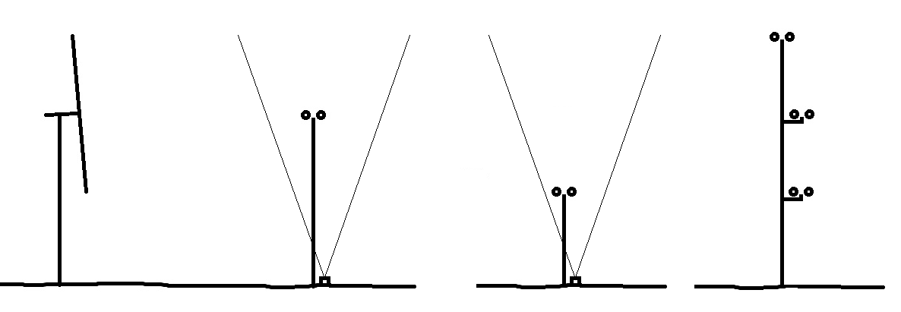
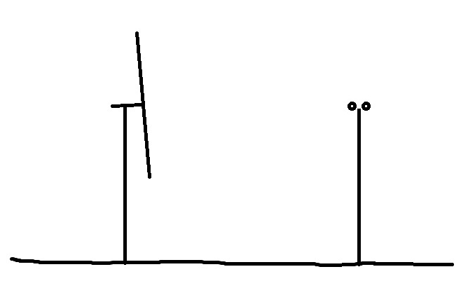
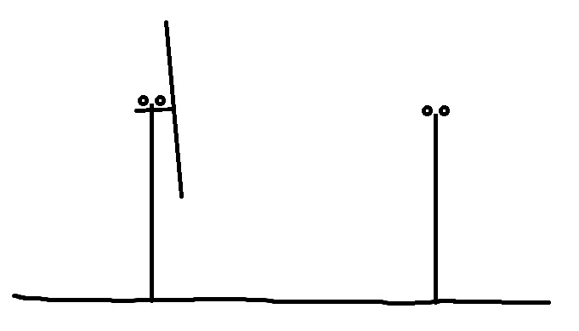
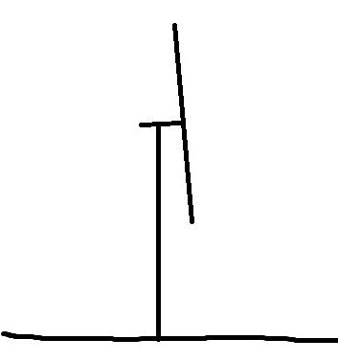
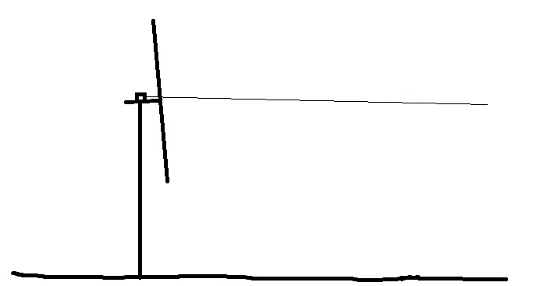
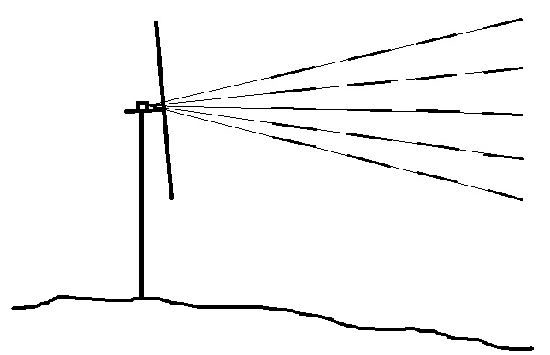
Status of MT12-1 October 2014
Status:
IEC61400-12-1 rev. 2
IEC61400-12-1
IEC61400-12-2
Flat
Complex
Challenges:
Nacelle Lidar 2-beam
Nacelle Scanning Lidar
Windscanner

Slide 12
Status of MT12-1 October 2014
New strategy on measurement standards as part of TC88 new strategy on organisation of standards:
A basic standard on description of the wind and requirements to measurement of wind parameters?
A standard for each type of wind measurement technology (handling, traceable calibration, classification, verification, uncertainty) ?
Connecting power performance, loads and noise measurements to measurements of wind plus requirements to accuracy?

Slide 13
Status of MT12-1 October 2014
New strategy on measurement standards?:
Power performance
Siting measurements
Loads measurements
Noise measurements
Wind measurement requirements
(definitions, traceable calibration, classification, uncertainty etc.)
Nacelle anemometry
Mast measurements
Windscanners
Ground based lidars
Sodars
Nacelle based lidars

