Slide 1
Relative Performance Differentials of Saliency Models with Co-Registered IR-VIS Images
Peter Caruana
EECS 4422, Fall 2019

Slide 2
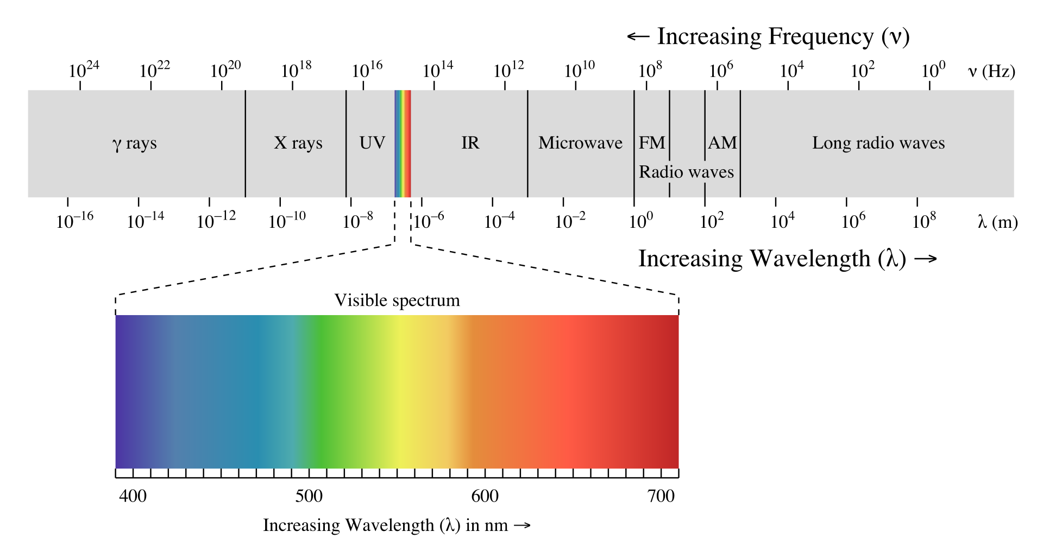
Motivation
Humans see light on the visible spectrum, which is wavelengths from about 300nm to 700nm. Typically cameras only record light in this spectrum range
But we are able to record intensities of other wavelengths of light. IR cameras are able to see the light emitted by thermal radiation from objects.
Things that emit noticeable thermal radiation tend to be things which humans find important. Vehicles, electronics, animals, other humans etc.

Slide 3
Why care about IR?
In situations where there is no visible light, there is almost always a usable abundance of IR light
Using IR images for computer vision opens up a large array of applications where there is not enough visible light.
You may have noticed that a large portion of the day on earth is entirely devoid of light. (Night)

Slide 4
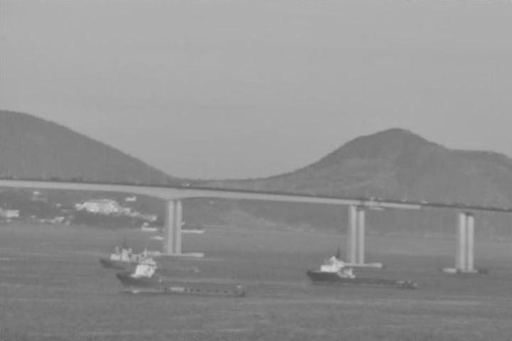
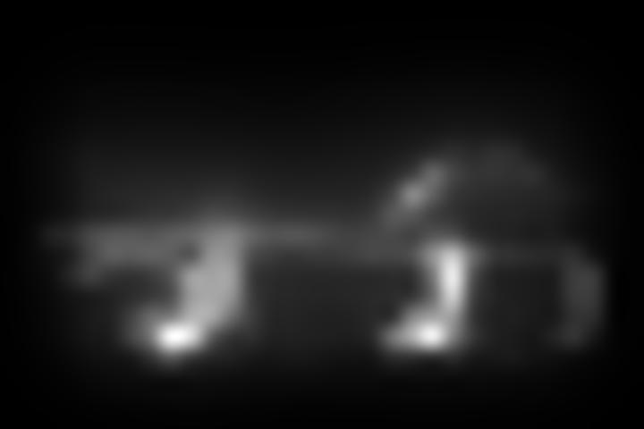
Saliency
Saliency models aim to segment images with the goal to adapt the information in an image to show what is interesting or important
Almost all saliency models are designed/trained with visual images in mind. In fact I can only find 1 paper which aims to design a model specifically for use with IR images.
(IR Saliency Detection via a GCF-SB Visual Attention Framework, Zhao et. Al.)
Image from: Visible-Infrared Database – SMT Lab
GBVS Saliency Map

Slide 5
Question(s):
Can saliency models be used on IR images? How do they compare in performance to VIS images?
Are there any use cases in which IR and VIS images are interchangeable?

Slide 6
Methods - Datasets
I used the Visible-Infrared Database - SMT/COPPE/Poli/UFRJ and IME
Various datasets
All IR and VIS image pairs are Co-Registered. This is IMPORTANT – In order to compare performance the images need to at least be of the same scene!

Slide 7
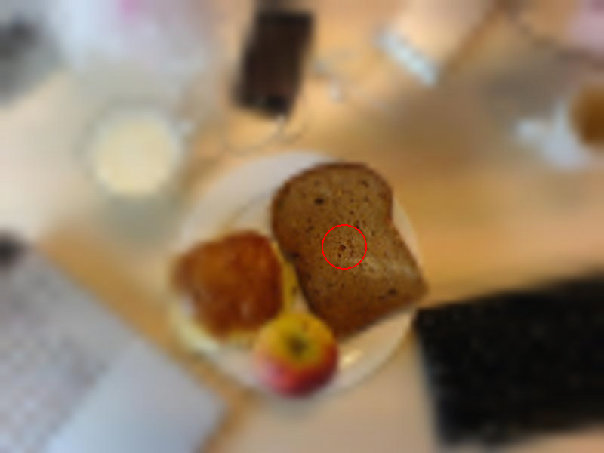
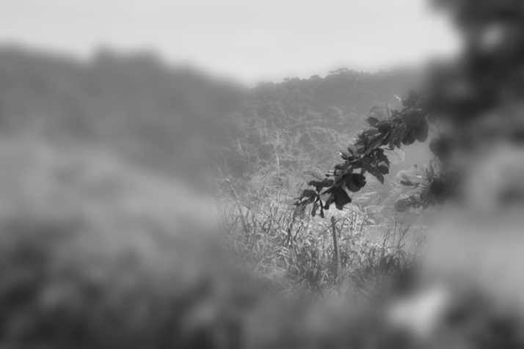
Methods – Ground Truth Data
Need ground truth data to assess performance
SALICON method: Mouse-Contingent Free-Viewing paradigm
Uses mouse tracking in leu of eye tracking to generate human saliency maps
Mouse Contingent Stimuli – From SALICON: Saliency in Context
My implementation

Slide 8


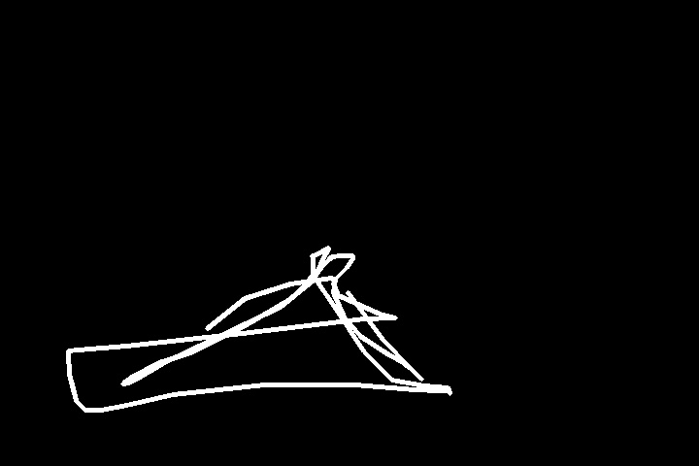

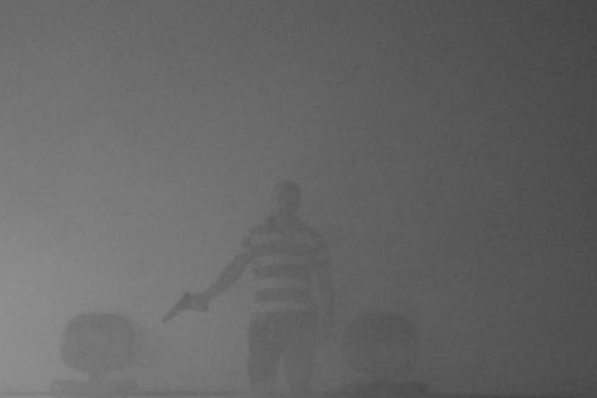
Methods – Ground Truth Data
Mouse tracking data is blurred then added up. The final image is normalized to achieve a map which is brightest in areas with the most overlap
Requires a decent size pool of participants to get accurate data.
+

Slide 9
Methods – Saliency Model Implements
Used SMILER (Saliency Model Implementation Library for Experimental Research) for implementation of saliency models. [C. Wloka et. Al.]
Models used:
AWS
DVA
GBVS
IKN
RARE2012
Mix of classical and deep net models. I avoided models which rely on colour (e.g. CVS).
(…Also this is what I could get working)

Slide 10
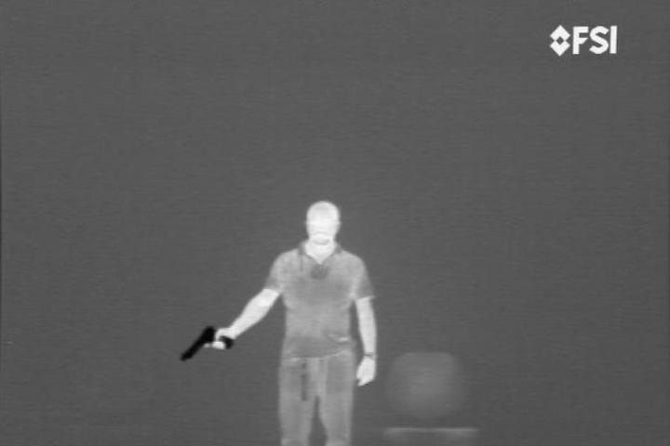
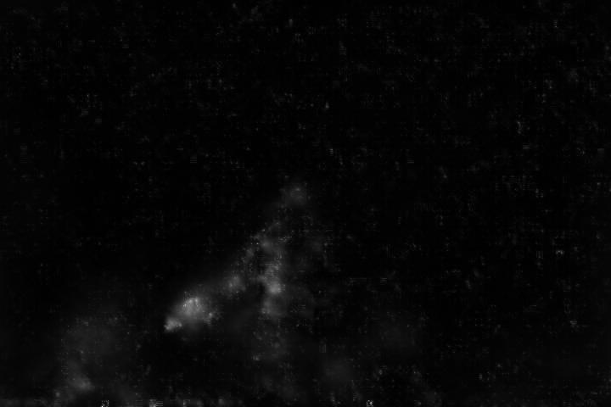
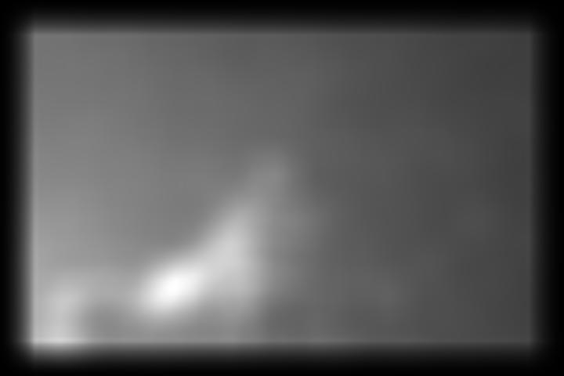
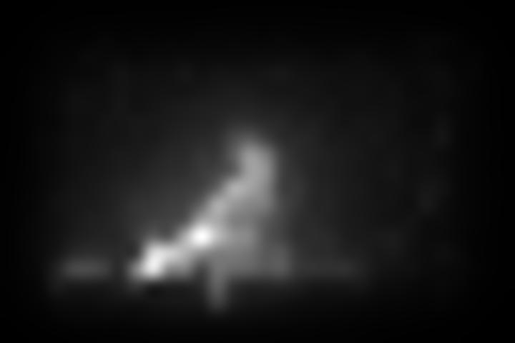
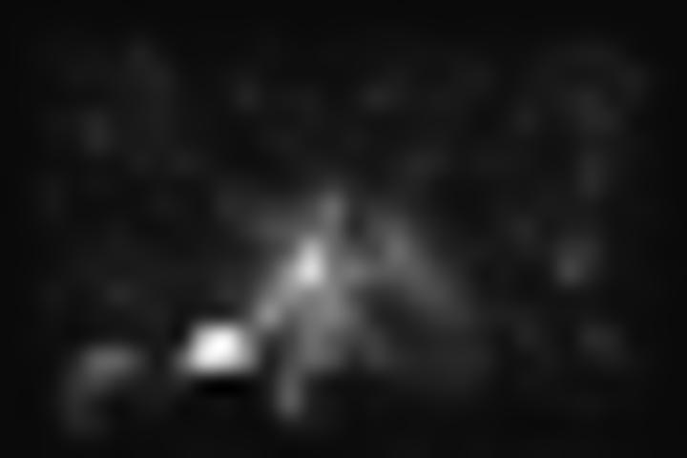
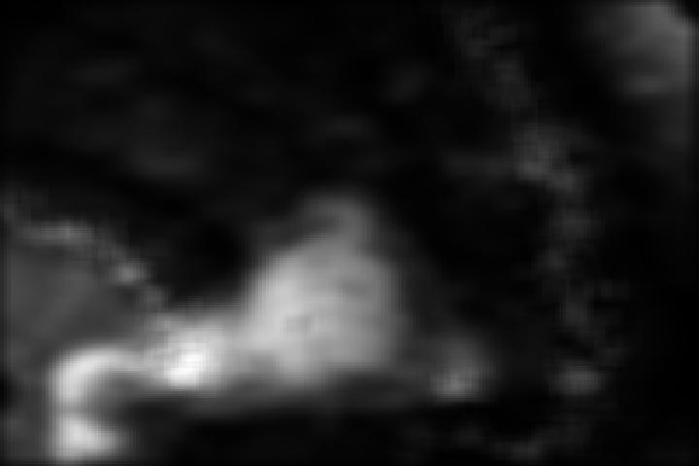
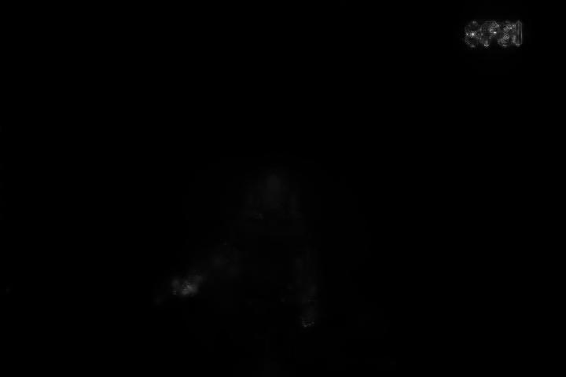
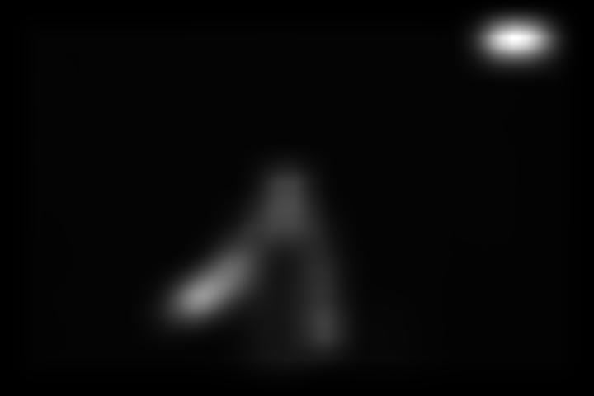
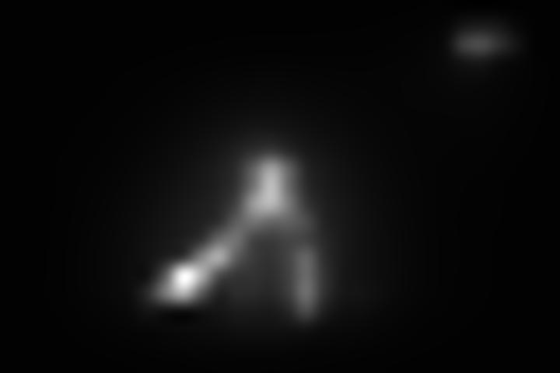
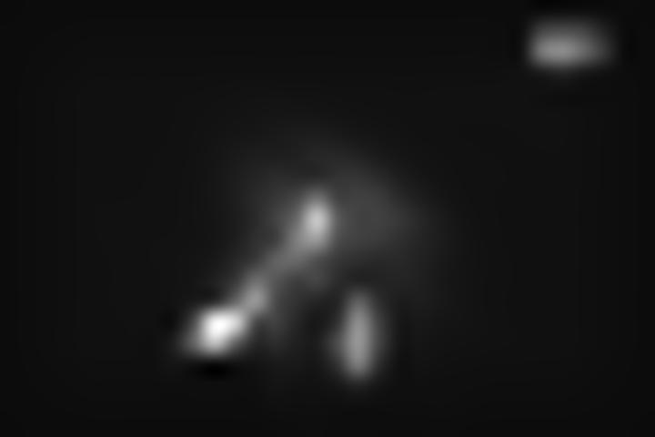
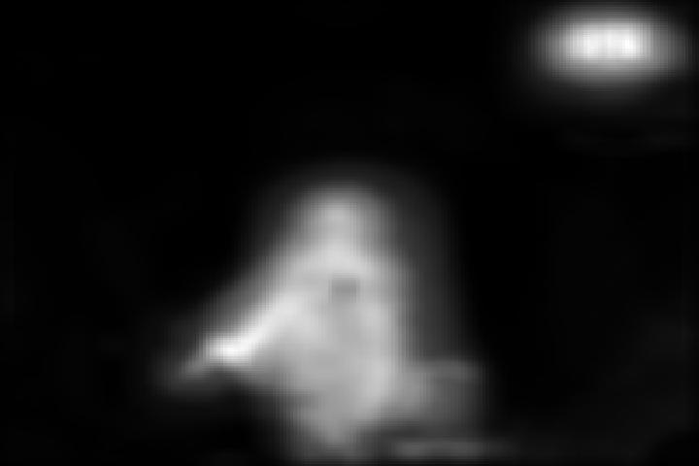
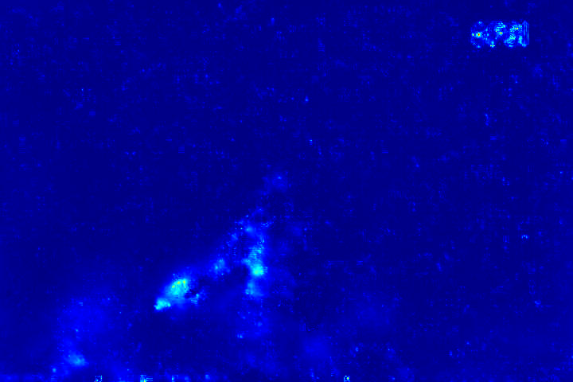
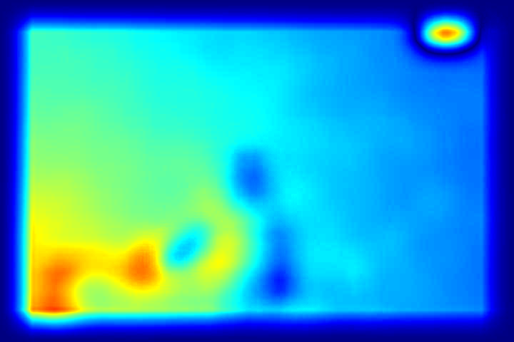
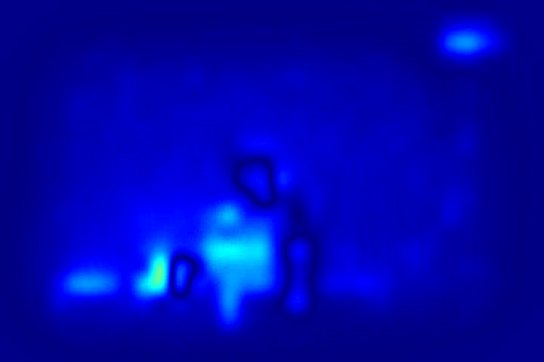
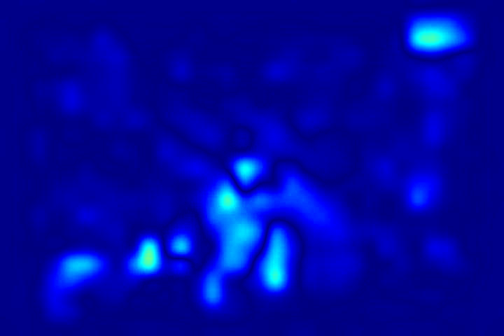
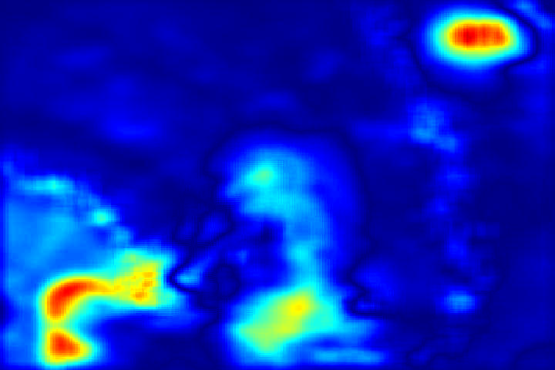
Input images
VIS/IR – Lab_1230_take5
AWS
DVA
GBVS
IKN
RARE2012
VIS
IR
Difference

Slide 11
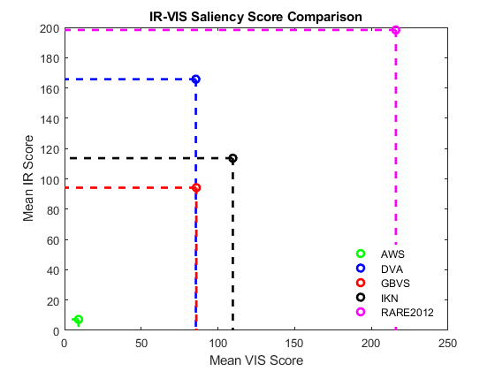
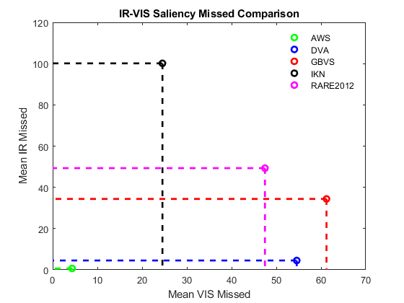
Metrics – Score/Missed

Slide 12
Metrics – Score/Missed
Computed ROI for human map
Calculated score and missed metrics based on map ROI for the VIS and IR saliency maps.
We can see that across the various models, score between IR and VIS appears similar. However the VIS images actually tend to have a lot more misses.
Some Caveats*
This analysis was done on a small subset (22 pairs)
Human maps need much more participants to be more robust

Slide 13
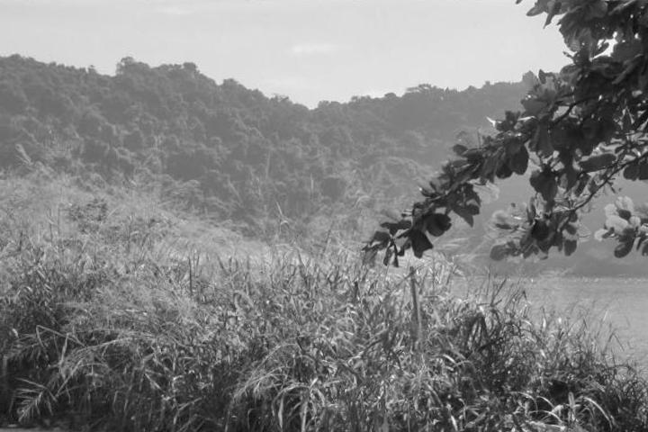
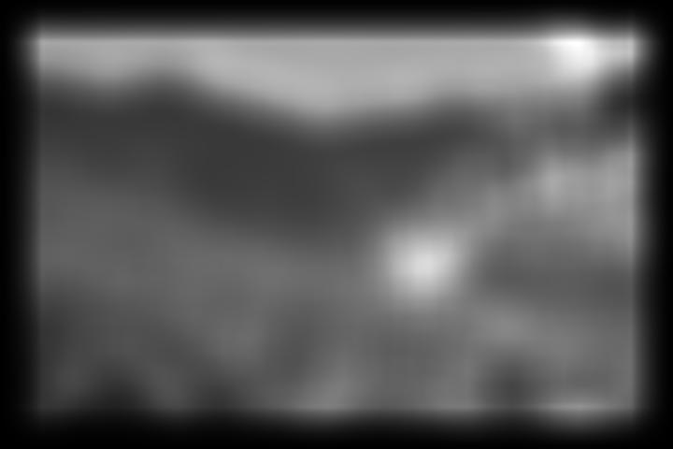

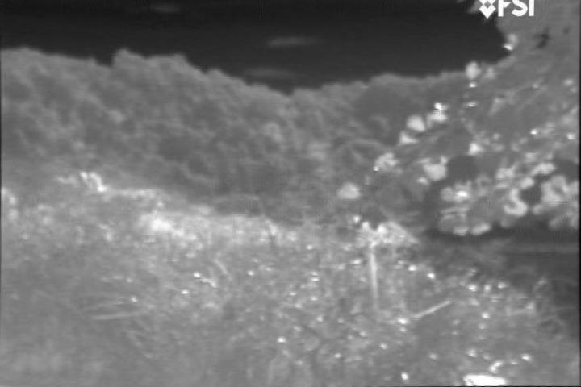
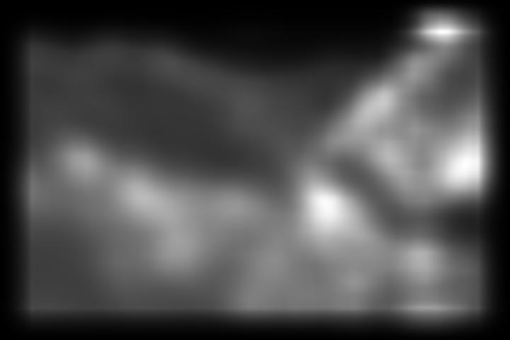
Metrics – Analytical
VIS Image
(DVA) VIS Sal
We can see that the human map tends to focus on the tree in the top right.
Though not exactly the same, qualitatively both the VIS and IR have high saliency values around that same object shape.
Human Map
IR Image
(DVA) IR Sal

Slide 14
Questions?

Slide 15
Sources
[1] - https://en.wikipedia.org/wiki/Visible_light_communication#/media/File:EM_spectrum.svg
[2] - IR Saliency Detection via a GCF-SB Visual Attention Framework, Zhao et.al
[3] – SMILER: Saliency Model Implementation Library for Experimental Research, C. Wloka, T. Kunic, I. Kotseruba, R. Fahimi, N. Frosst, N. Bruce, J. Tsotsos (York University, University of Manitoba, Google Brain Toronto, Ryerson University), (2018)
[4] – Visible Infrared Database, SMT/COPPE/Poli/UFRJ and IME

