Slide 1

INCOME PREDICTION BASED ON CENSUS DATA
GGROUP 12
HARI NARAYAN GURRAM SAI DEEPTHI GALI SAHIL SUSHIL MAHAJAN PRABHAT CHANDA RUCHIRKANTH GANDIKOTA

Slide 2

PROBLEM DEFINITION
The objective of this project is to build a classification model that predicts whether an individual’s income exceeds a threshold of $50,000 per year, based on their demographic and employment related attributes.
The problem can be formulated as a binary classification task, where the target variable is binary, indicating whether the individual falls into the “high-income > $50K/yr” or “low-income <= $50K/yr” category.

Slide 3

DATA DESCRIPTION
The data is taken from the UCI Machine Learning Repository - https://archive.ics.uci.edu/dataset/20/census+income
The Census Income dataset provides a collection of demographic and employment related attributes for individuals. Each record in the dataset represents an individual, and the goal is to predict whether their income exceeds a threshold of $50,000 per year.
It consists of 48,842 records and 15 features in total among which 9 are categorical and 6 are numerical variables.

Slide 4
DATA PREPROCESSING
Handling Sparse Columns:
Identified columns with a high prevalence of zero values (>90%).
Dropped columns 'Capital - gain' and 'Capital - loss' due to their predominantly zero values.
Removing Duplicates:
Detected and eliminated duplicate entries in the dataset.
Handling Missing Values:
Identified and removed rows containing values denoted as "?", ensuring data consistency and reliability.
Dropped Columns:
Dropped 'Fnlwgt' due to its nature as a weighting factor and 'Education - num' as it redundantly encodes information already present in the 'Education' column.

Slide 5
DATA SPLITTING
Split the dataset into training (70%), validation (15%), and test (15%) sets for model development and evaluation.

Slide 6
LABEL ENCODING AND SCALING
Applied label encoding to the following categorical variables:
Education
Marital - status
Relationship
Race
Sex
Native - Country
Workclass
Occupation
Scaled all features using Standard Scaler for consistent numerical representation in the model.

Slide 7
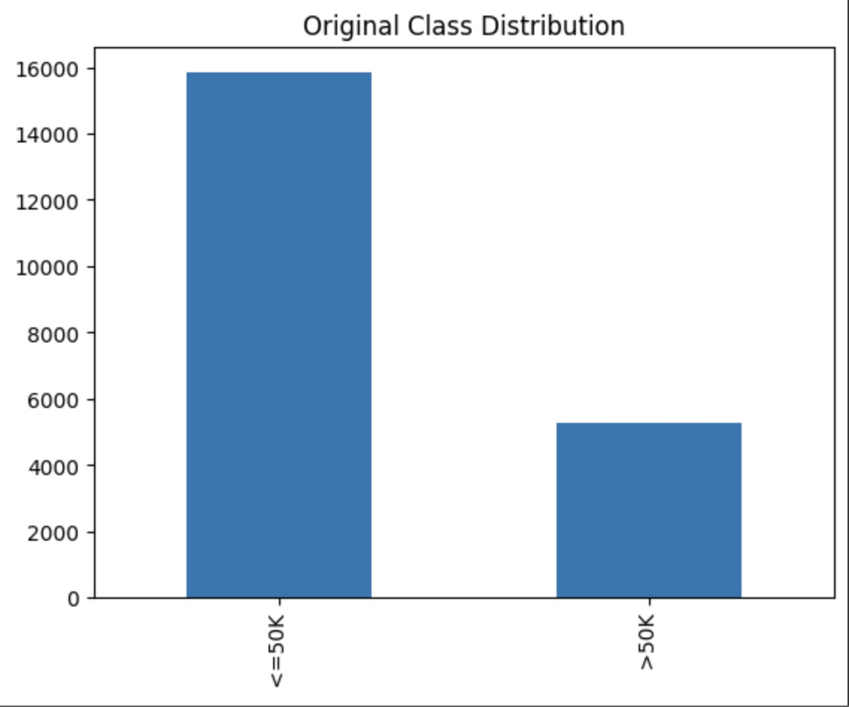
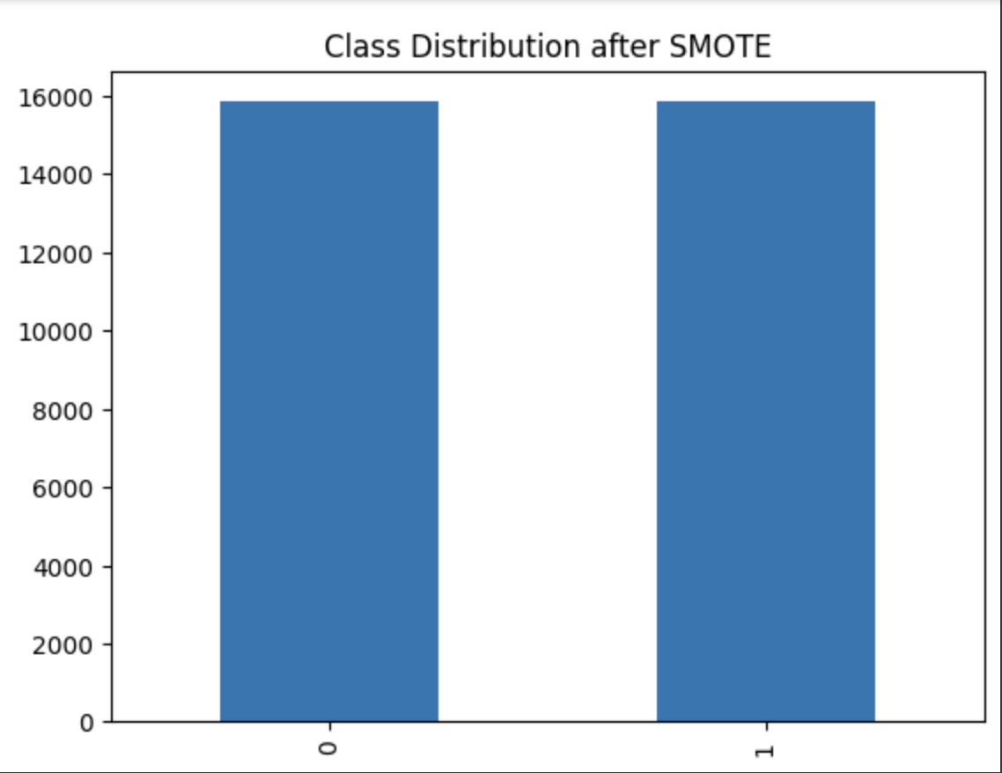
ADDRESSING IMBALANCED DATA
Identified imbalanced data.
Applied SMOTE (Synthetic Minority Over-sampling Technique) to create synthetic samples, balancing the dataset for improved model training.

Slide 8
LOGISTIC REGRESSION
Logistic regression is well-suited for predicting binary outcomes, making it appropriate for scenarios where the response variable has only two possible classes.
Logistic regression provides interpretable results, allowing a clear understanding of how changes in predictor variables impact the log-odds of the binary outcome.

Slide 9
MODEL PERFORMANCE
LearningRate | Accuracy_Training_Data | Recall_Training_Data | Accuracy_Test_Data | Recall_Test_Data
0.00000001 | 0.6943223575185532 | 0.8258520066287196 | 0.6440591534931157 | 0.8348082595870207
0.0000001 | 0.694754665321709 | 0.8257079040276677 | 0.6455889852116268 | 0.8298918387413963
0.0001 | 0.694754665321709 | 0.8259240579292456 | 0.6463539010708822 | 0.8298918387413963
Despite variations in the learning rate, there are no substantial changes in the performance on both the training and test datasets.
This stability may indicate that the model is robust to small variations in the learning rate.

Slide 10
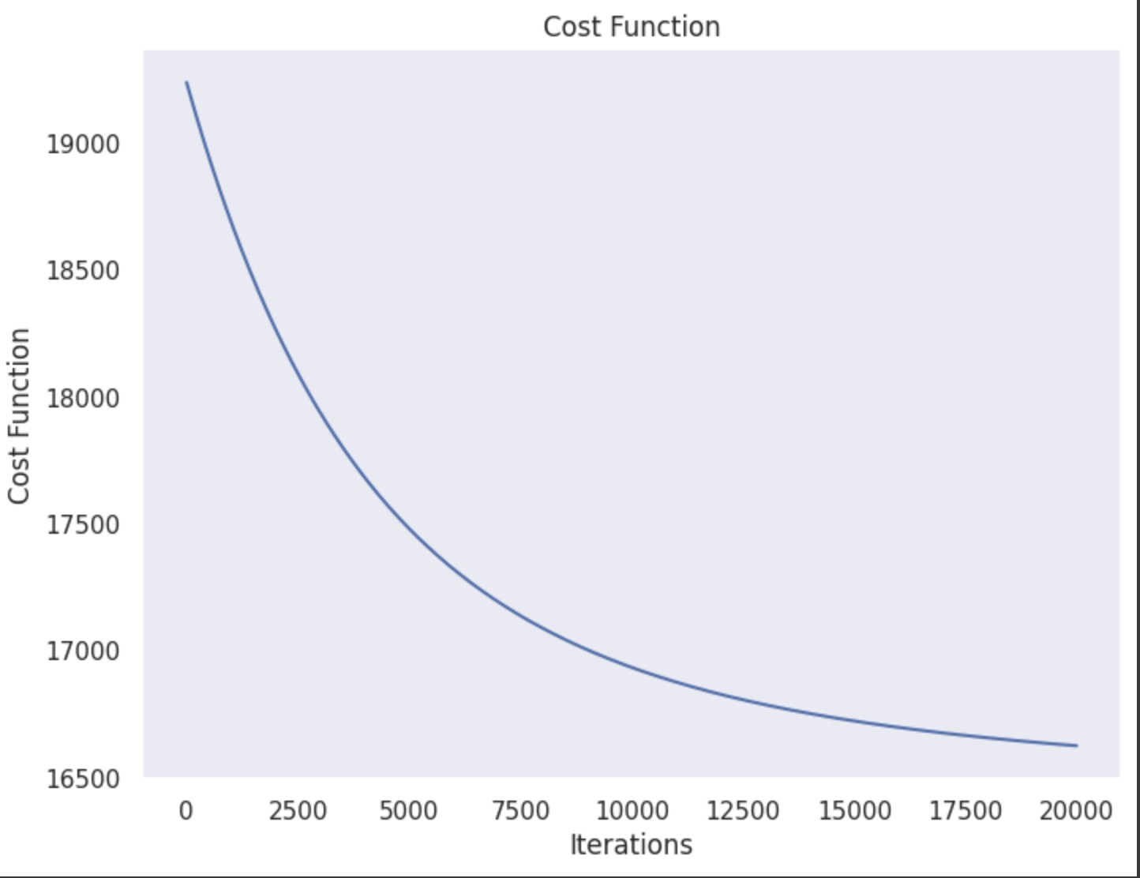
COST FUNCTION VS ITERATIONS
Learning Rate: 0.00000001

Slide 11
USING L2 - REGULARIZATION
LearningRate | Regularization_Param | Accuracy_Train_Data | Recall_Train_Data | Accuracy_Test_Data | Recall_Test_Data
0.00000001 | 0.01 | 0.7013473593198357 | 0.7998414871388428 | 0.6695563488016318 | 0.8112094395280236
Using L2 regularization in logistic regression has demonstrated an improvement in both accuracy. The regularization term effectively addresses overfitting, leading to a more robust and generalizable model.

Slide 12
NAIVE BAYES
The model assumes that features are conditionally independent, simplifying the modeling process.
Its simplicity makes it particularly suitable for scenarios with two possible outcomes.

Slide 13
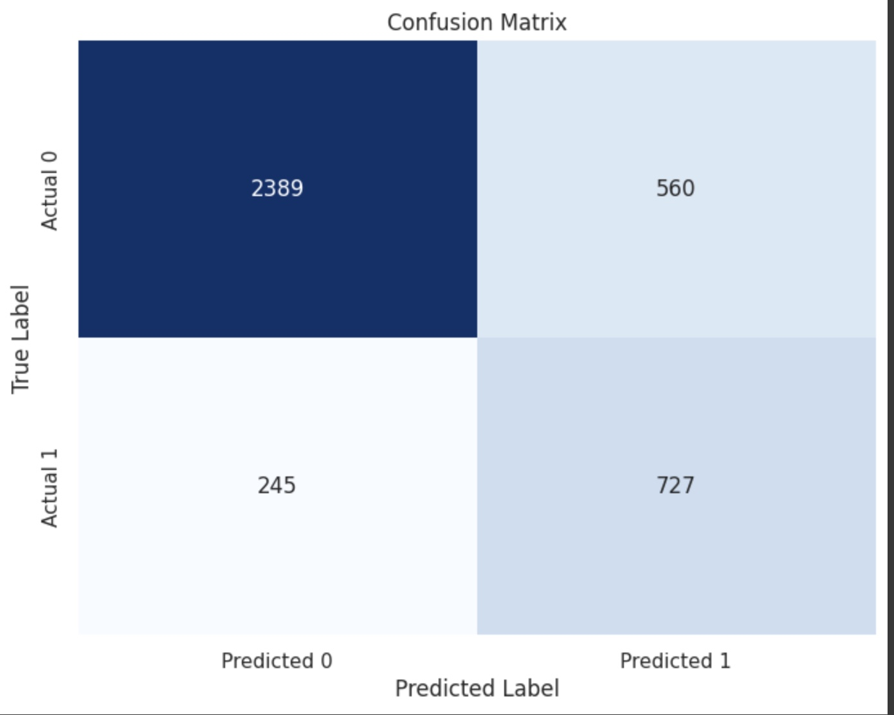
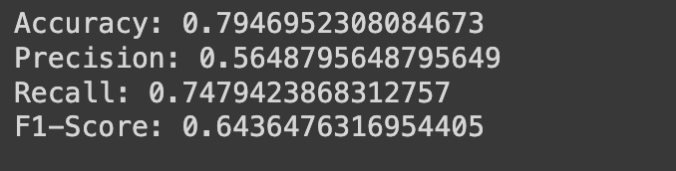
These metrics suggest that the Naive Bayes model is performing reasonably well, achieving a good balance between precision and recall for the binary classification task

Slide 14
NEURAL NETWORKS
In this project Neural networks excel at capturing intricate patterns in data, while the ReLU activation function introduces crucial non-linearity, enhancing the model's ability to understand complex relationships.
ReLU mitigates the vanishing gradient problem, promoting stable gradient flow during training. This characteristic, coupled with neural networks, facilitates effective training even in deep architectures.

Slide 15
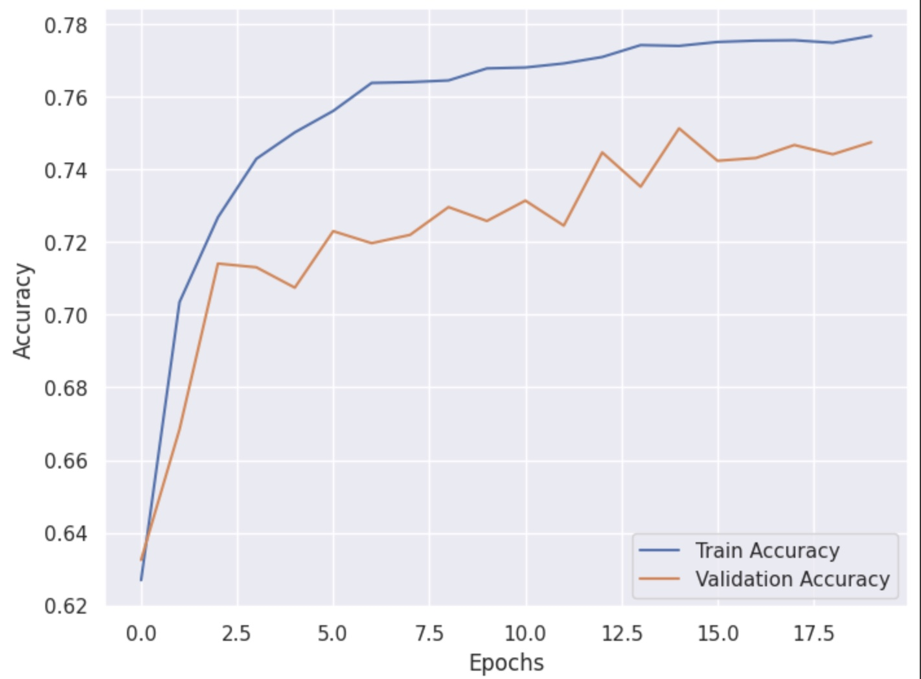
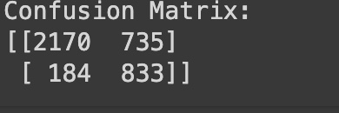
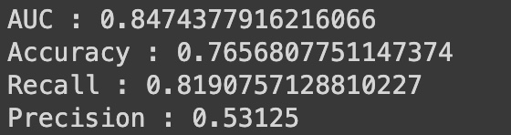
Confusion Matrix
Accuracy vs Epochs
Performance metrics
The model demonstrates good discrimination, overall correctness, and proficiency in identifying positive instances, but with room for improvement in positive prediction accuracy.

Slide 16
MODEL COMPARISON: ACCURACY METRICS
MODEL | ACCURACY | RECALL
Logistic Regression | 0.6440591534931157 | 0.8348082595870207
Logistic Regression with L2 Regularization | 0.6695563488016318 | 0.8112094395280236
Naïve Bayes | 0.7946952308084673 | 0.7479423868312757
Neural Networks | 0.7656807751147374 | 0.8190757128810227
Naïve Bayes outperforms other models with the highest accuracy (79%), while Neural Networks exhibit a strong balance between overall accuracy (77%) and positive instance recall (82%).

Slide 17
THANK YOU

