Slide 1
Advanced Behavioural Biometrics for Fraud
Detection
Presented By: Mr. Akhilan Anbu, Mr. Charan Ragavendra P, Mr. Rovin Samuel Daniel

Slide 2
List of Content
Abstract
Introduction
Literature Survey
Problem Statement
Proposed work
Methodology
Results and Discussions
Conclusion
References

Slide 3
Abstract
As digital transactions grow exponentially and cyber threats evolve, there is a need for strong fraud detection systems. Traditional methods like passwords and PINs are vulnerable. Behavioral biometrics, especially keystroke dynamics, enable non-intrusive and continuous authentication. This paper proposes a system using keystroke dynamics combined with LLMs for real-time fraud detection. The model captures typing behavior and uses LLMs trained on legitimate and fraudulent data for user verification. The study explains data acquisition, feature extraction, and model training, and evaluates the LLM's effectiveness in fraud prevention.

Slide 4
Introduction
AIM:
Improve fraud detection using keystroke dynamics and Large Language Models (LLMs).
Provide continuous, non-intrusive authentication based on behavioral biometrics.
Reduce false positives and improve real-time fraud detection accuracy.

Slide 5
Introduction
Data Collection & Data Preprocessing
Collected typing patterns, including keystroke duration, latency, and errors
Cleaned the collected data.
Extracted key features like key press time, typing speed, and typing rhythm.
Machine Learning
Used Mistral-7B-Instruct LLM (via CTransformers) for analyzing keystroke behavior.
Assigned risk scores anomalies.
Fraud Detection Algorithm
Verified user IP, generated CAPTCHA, analyzed typing data, and sent it to LLM.
LLM assessed if the typing pattern was legitimate or fraudulent.

Slide 6
Literature Survey
Rule-based systems generate too many false positives.
ML models improve adaptability but require high computation and labeled data.
Keystroke-based systems face challenges like imitation, environmental variation, and device inconsistency.
Future trends include multimodal biometrics (e.g., mouse, touch), explainable AI, and federated learning.
Scalability, transparency, and bias mitigation are still open challenges.

Slide 7
Problem Statement
Static and 2FA-based systems are intrusive and still vulnerable to social engineering/phishing.
There’s a need for continuous, real-time anomaly detection that doesn’t affect user experience.
The goal is to provide security without degrading usability.

Slide 8
Proposed Work
Introduces a system that integrates keystroke biometrics with the Mistral-7B-Instruct LLM.
Uses LangChain to turn keystroke data into prompts for contextual analysis.
Combines traditional authentication with real-time behavior monitoring.
Adds security layers like IP filtering (via ipify API) and dynamic CAPTCHAs.

Slide 9
Methodology
Data Collection: Records user typing metrics (duration, latency, input text).
Preprocessing: Extracts key features from typing data.
Machine Learning: Trains models on past data to detect anomalies.
Real-Time Analysis: Compares new inputs to learned behavior and generates risk scores.
Decision Engine: Flags suspicious behavior and logs decisions.
Feedback Loop: Continuously updates models to adapt to new patterns.
Uses a Streamlit UI and LLM prompt formatting for anomaly detection.

Slide 10
Results and Discussions
Achieved 92.5% accuracy, 4.2% false positives, and 3.3% false negatives.
Table I shows sample users classified as legitimate or fraudulent based on metrics.
User ID | Input Text | Duration (ms) | Latency (ms) | Errors | Classification
1 | ”Hello World!” | 25 | 250 | 0 | Legitimate
2 | ”aaaaaa” | 10 | 400 | 3 | Fraudulent
3 | ”This is a test.” | 35 | 290 | 1 | Legitimate
4 | ”Copy and paste here” | 20 | 500 | 5 | Fraudulent

Slide 11
Results and Discussions
User Case Studies:
🔹 User 1 (ID: 1)
Text: "Hello World!"
Duration: 25 ms, Latency: 250 ms, Errors: 0
Classified as Legitimate — smooth, natural typing pattern
🔹 User 3 (ID: 3)
Text: "This is a test."
Duration: 35 ms, Latency: 290 ms, Errors: 1
Classified as Legitimate — slightly slower, but within expected norms
🔹 User 2 (ID: 2)
Text: "aaaaaaa"
Duration: 10 ms, Latency: 400 ms, Errors: 3
Classified as Fraudulent — very fast, repetitive input with high delay and errors
🔹 User 4 (ID: 4)
Text: "Copy and paste here"
Duration: 20 ms, Latency: 500 ms, Errors: 5
Classified as Fraudulent — unnaturally high latency and error rate
suggest automation or manipulation

Slide 12
Results and Discussions
Legitimate Users:
Show consistent rhythm
Low to moderate latency
Minimal to no errors
Reasonable typing speed
Fraudulent Users:
Irregular timing
High latency and/or burst typing
Increased errors or repetitive patterns

Slide 13
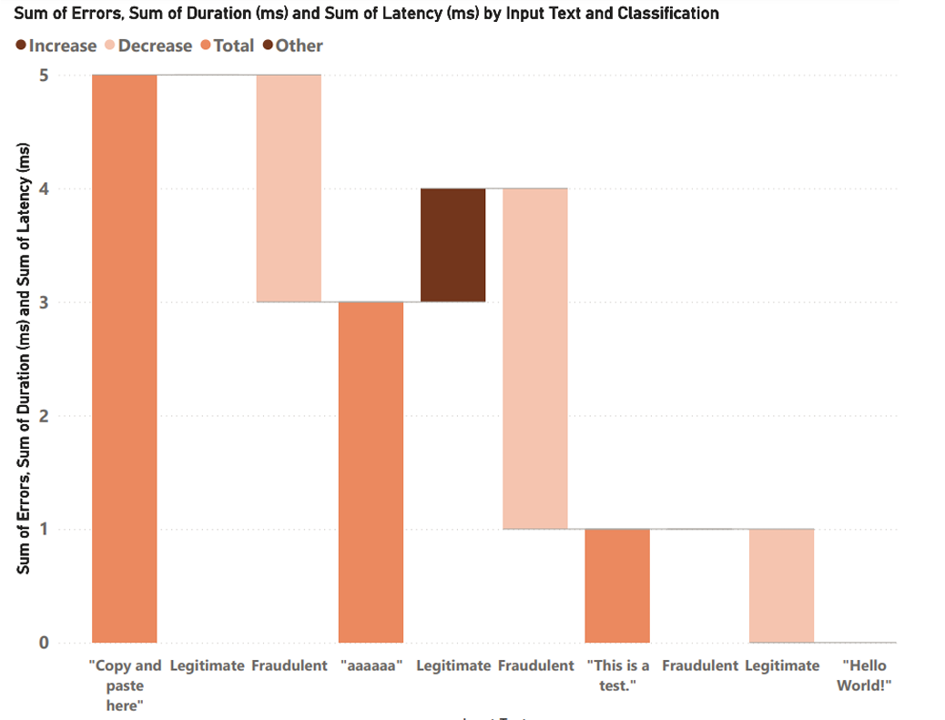
Graphic Displays of Outcome
.

Slide 14
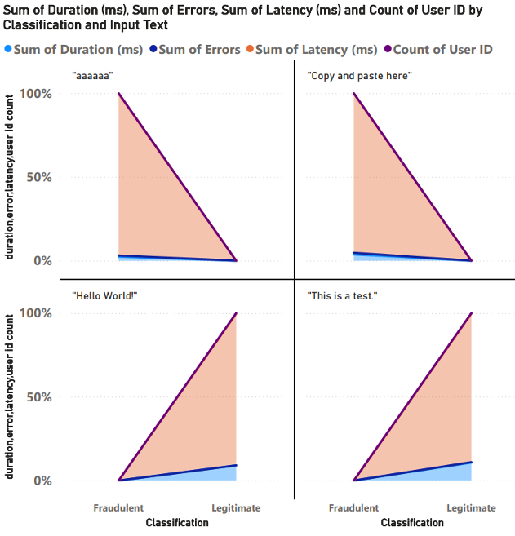
Aggregated Behavioral Metrics and User ID Counts by Classification and Input Text

Slide 15
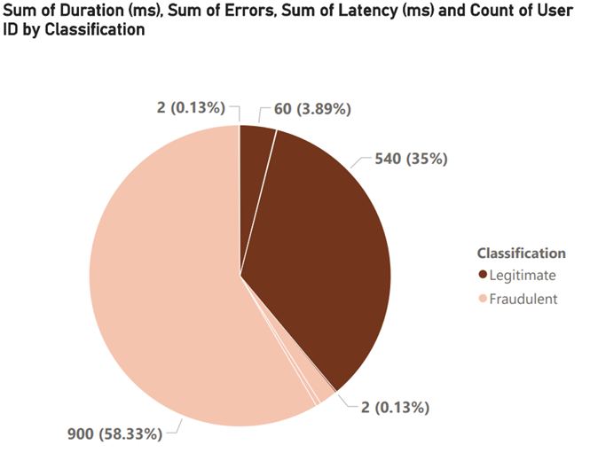
Typing Behavior Metrics: Fraudulent vs. Legitimate

Slide 16
Results and Discussions
Table II defines thresholds (e.g., latency > 300ms = suspicious).
Parameter | Threshold Value | Description
Input Length | < 5 characters | May indicate copying and pasting
Unique Char- acter Ratio | < 1/3 | Excessive repetition detected
Average Typing Duration | < 30 ms | Suggests unusually fast typing
Average Latency | > 300 ms | Indicates potential delay in response
Error Rate | > 10% | High error rate may indicate potential fraud
Fraudulent users often had high latency, short input length, and high error rates.
Legitimate users showed consistent and moderate typing behavior.

Slide 17
Results and Discussions
Key Detection Parameters:
Input Length
Flag if: Less than 5 characters
Why: May indicate copy-paste behavior instead of typing
Unique Character Ratio
Flag if: Below 1/3
Why: Suggests repetition (e.g., "aaaaaaa"), common in automated input
Average Typing Time
Flag if: Below 30 ms
Why: Too fast to be human — indicates possible automation

Slide 18
Results and Discussions
Average Latency
Flag if: Over 300 ms between keystrokes
Why: Inconsistent typing suggests unnatural or unfamiliar behavior
Error Rate
Flag if: Above 10%
Why: High errors may indicate bot usage or fraud attempts

Slide 19
Conclusion
LLMs provide context-aware analysis of behavioral patterns.
Keystroke analysis effectively differentiates between legitimate and fraudulent users.
Future work includes adding mouse/touch gestures and using federated learning for privacy-preserving model training.
The system balances security with usability and is suitable for real-world fraud prevention applications.

Slide 20
References
Simon Eberz, Kasper B Rasmussen, Vincent Lenders, and Ivan Marti novic. Evaluating behavioral biometrics for continuous authentication: Challenges and metrics. In Proceedings of the 2017 ACM on Asia conference on computer and communications security, pages 386–399, 2017.
Ingo Deutschmann, Peder Nordstr¨ om, and Linus Nilsson. Continuous authentication using behavioral biometrics. IT professional, 15(4):12 15, 2013.
Fouad Cherifi, Baptiste Hemery, Romain Giot, Marc Pasquet, and Christophe Rosenberger. Performance evaluation of behavioral biometric systems. In Behavioral biometrics for human identification: Intelligent applications, pages 57–74. IGI Global, 2010.
Abdulaziz Alzubaidi and Jugal Kalita. Authentication of smartphone users using behavioral biometrics. IEEE Communications Surveys & Tutorials, 18(3):1998–2026, 2016.

Slide 21
References
Robert Moskovitch, Clint Feher, Arik Messerman, Niklas Kirschnick, Tarik Mustafic, Ahmet Camtepe, Bernhard Lohlein, Ulrich Heister, Sebastian Moller, Lior Rokach, et al. Identity theft, computers and behavioral biometrics. In 2009 IEEE International Conference on Intelligence and Security Informatics, pages 155–160. IEEE, 2009.
Roman V Yampolskiy and Venu Govindaraju. Use of behavioral biometrics in intrusion detection and online gaming. In Biometric Technology for Human Identification III, volume 6202, pages 249–258. SPIE, 2006.
Hang Yin, Zitao Zhang, Zhurong Wang, Yilmazcan Ozyurt, Weiming Liang, Wenyu Dong, Yang Zhao, and Yinan Shan. Behavioral graph fraud detection in e-commerce, 2022.
Simon Hanisch, Patricia Arias-Cabarcos, Javier Parra-Arnau, and Thorsten Strufe. Privacy-protecting techniques for behavioral biometric data: A survey, 2023.

