Slide 1
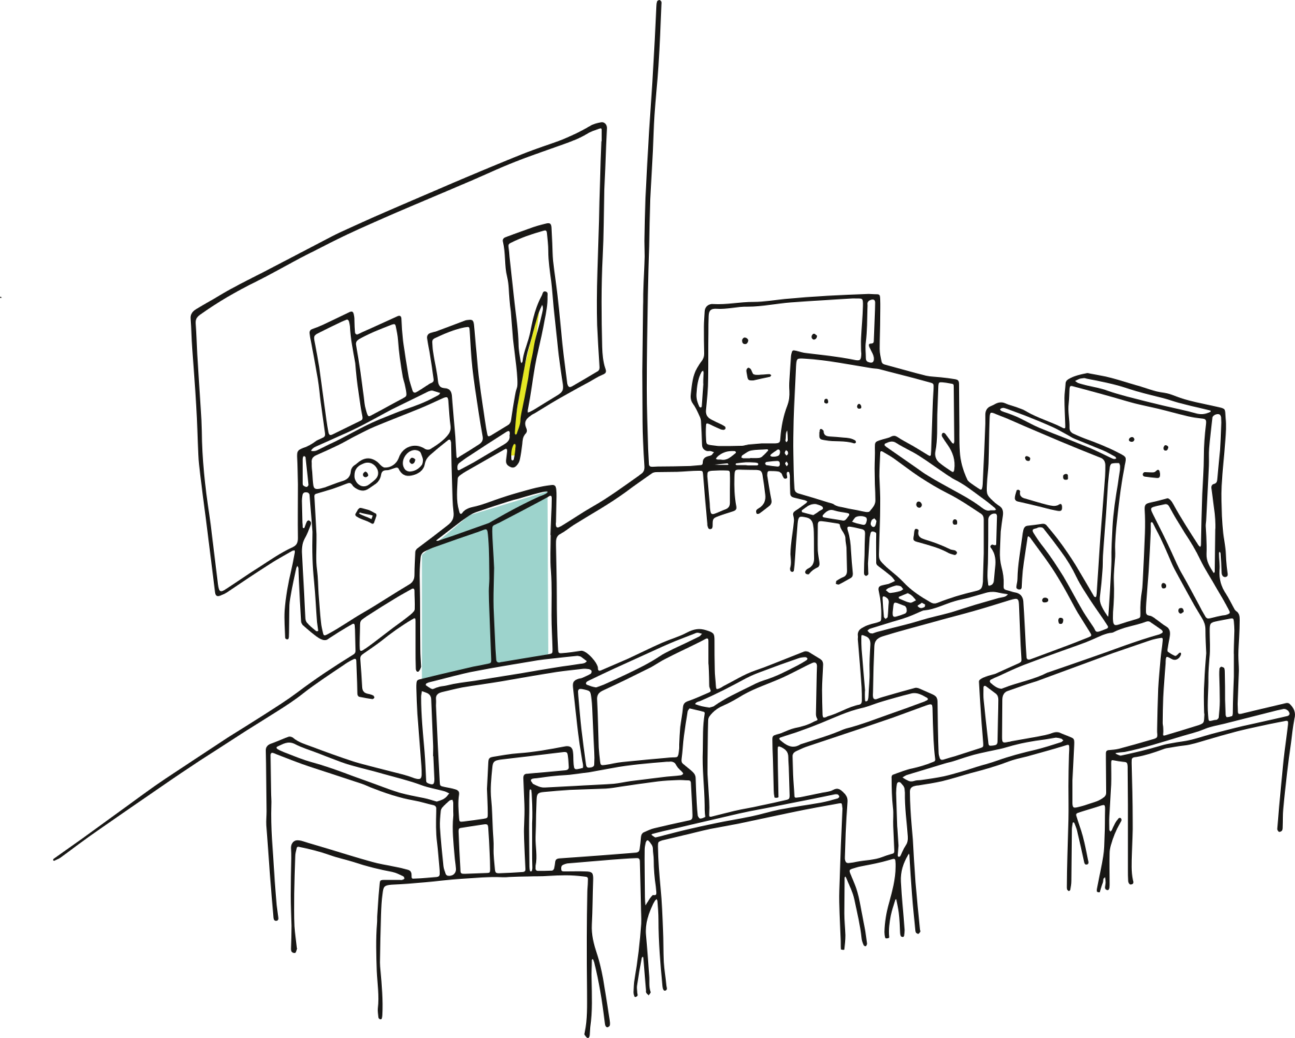

Add to the
Study Hall

Slide 2

Guidelines
Type only in the boxes where ‘write’ is mentioned.
Check for grammatical correctness before submitting.
Do not change anything on these slides including:
Text Font
Text Colour
Image
Background
Border etc.

Slide 3

What’s the case?
Write the details of the case here.

Slide 4

What is unique about this case?
Write the reason for choosing this case here.

Slide 5

Is there something else you want to add?
Write the details of any additional information here. It may include:
Links relevant to the case
Additional facts/information relevant to the case
Links to relevant documents of this case

Slide 6

Help Us Know You!
Paste Your Picture Here
Write Your Name Here
Write Your Process & Manager’s Name Here

Slide 7

Thank you for Adding to the Study Hall

