Slide 1
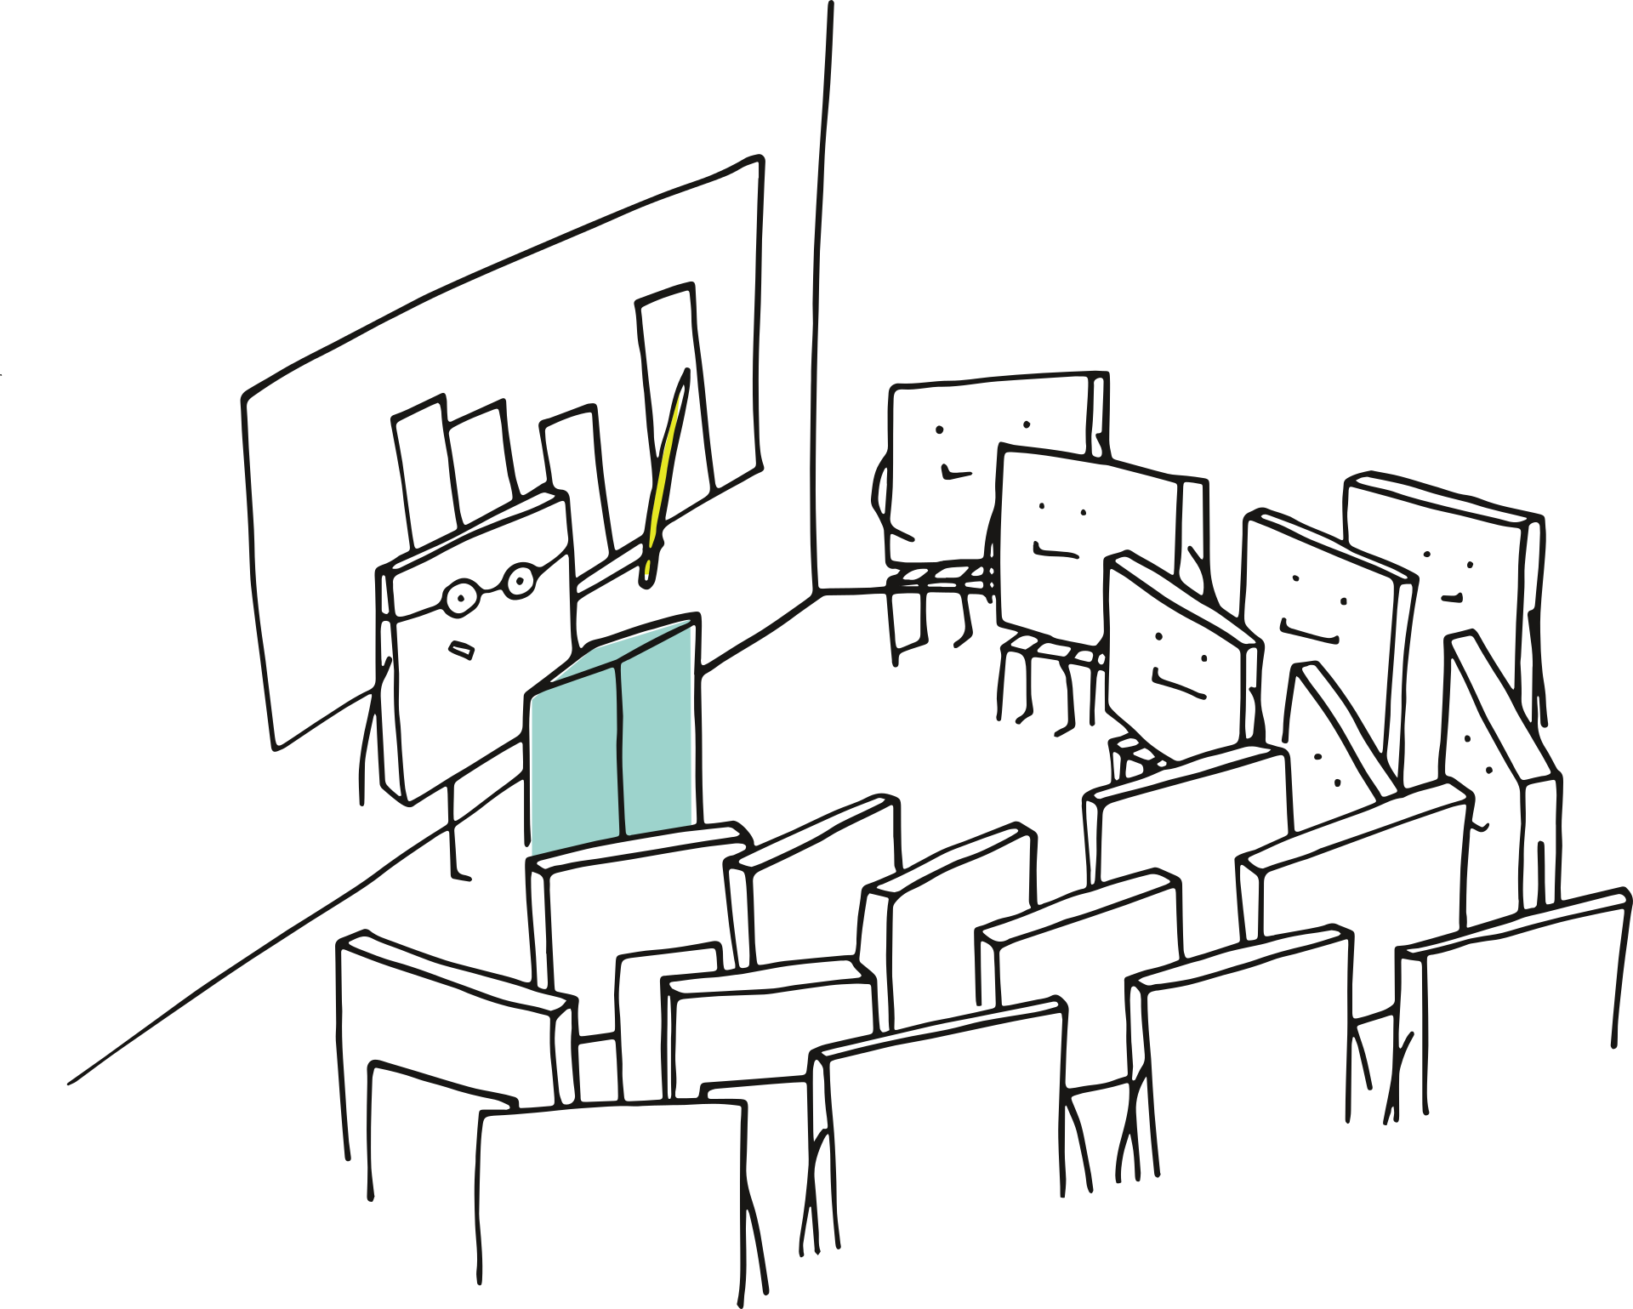

Add to the
Study Hall

Slide 2

Guidelines
Type only in the boxes where ‘write’ is mentioned.
Check for grammatical correctness before submitting.
Do not change anything on these slides including:
Text Font
Text Colour
Image
Background
Border etc.

Slide 3

What’s the information?
Write the details of the information that you wish to share along with the part of your job or process that this information is relevant to.

Slide 4

How is this information relevant?
Write the reason for including this information in training.

Slide 5

Is there something else you want to add?
Write the details of any additional details here. It may include:
Links relevant to the case
Additional facts/information
Links to relevant documents

Slide 6

Example(s)
Write relevant case examples for the information that you have shared.

Slide 7

Help Us Know You!
Paste Your Picture Here
Write Your Name Here
Write Your Process & Manager’s Name Here

Slide 8

Thank you for Adding to the Study Hall

